Slide 1
Year 3 Home School Provision Daily Pack
The following slides will be split into 4 separate activities.
They will consist of Maths, English, Reading and one other subject.
Each slide will be daily activities for you and your child to do at home.
We as a Year 3 team, will update these slides daily to the website – please keep an eye out!
Please email NJS.Year3@taw.org.uk with any queries to share any work and one of the Year 3 teachers will get back to you as soon as possible!
Thank you for your understanding and on going support during these times.

Slide 2
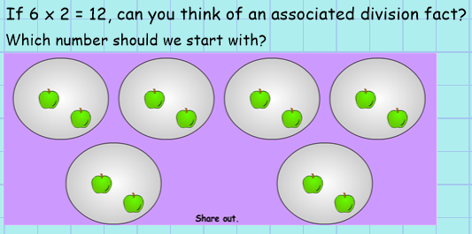
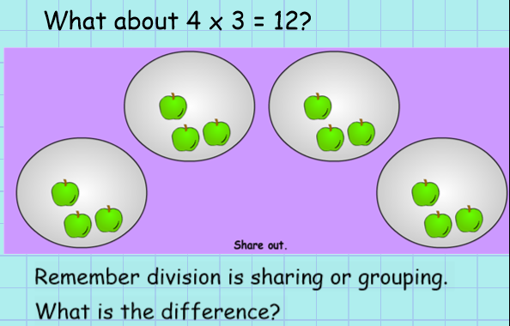
Maths To divide 2-digit numbers by 1- digit numbers (TU / U) using sharing or grouping Introduction

Slide 3
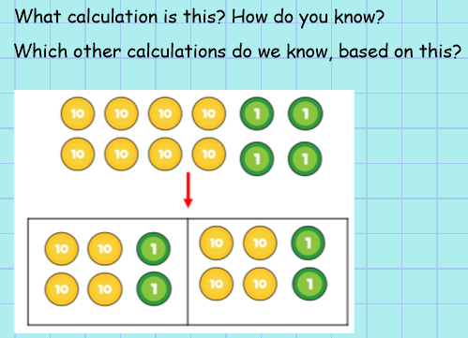
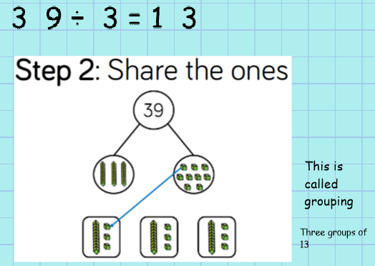
Grouping
Sharing

Slide 4
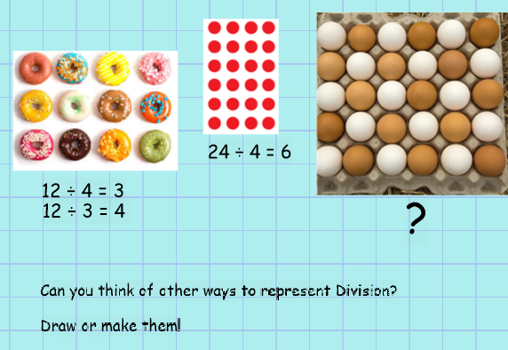
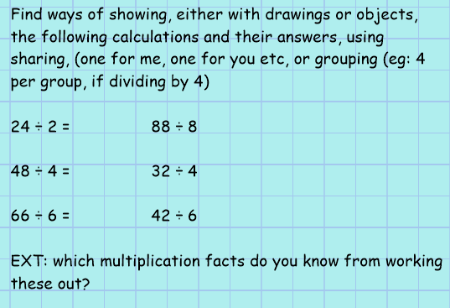
Activity all
An example of how you could represent the division facts in your book.

Slide 5
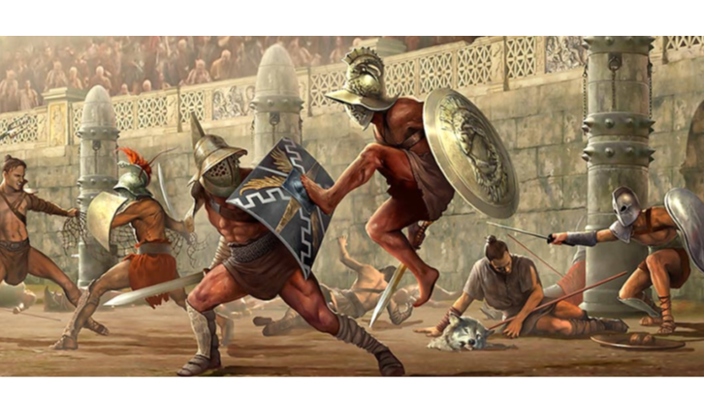
English

Slide 6
Today, you are going to be doing research about the Gladiators!

Slide 7
Once you have found and gathered enough research, to create a poster about 1 type of Gladiator and facts about them.
Your task:
1*
2+3*

Slide 8
Reading – Courageous Advocate: Martin Luthor King Jr
The following slides are about Martin Luthor King Jr – a courageous man and an advocate (supporter/believer) in equal rights for black and white people.
Whilst this work is for everyone, he is Class 3B’s Courageous Advocate for this half term.
Please select your level of challenge by choosing 1*/2**/3*** for the comprehension activity. YOU DO NOT NEED TO DO ALL THREE LEVELS OF CHALLENGE!
Read your chosen passage carefully, out loud, to an adult listener if possible. Then try to answer the questions fully. Remember that the answers are in the text, so go back and re-read to find them. Adults may need to support with this, and even can do this as a verbal activity instead with their child, to assist understanding.
Answer sheets are provided towards the end of the powerpoint. Check your answers and self mark. Remember, you can do this as a written or verbal task.

Slide 9
1*

Slide 10
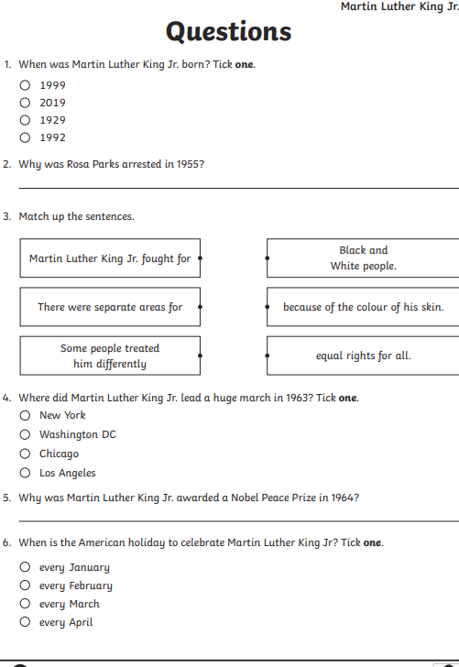
1*

Slide 11
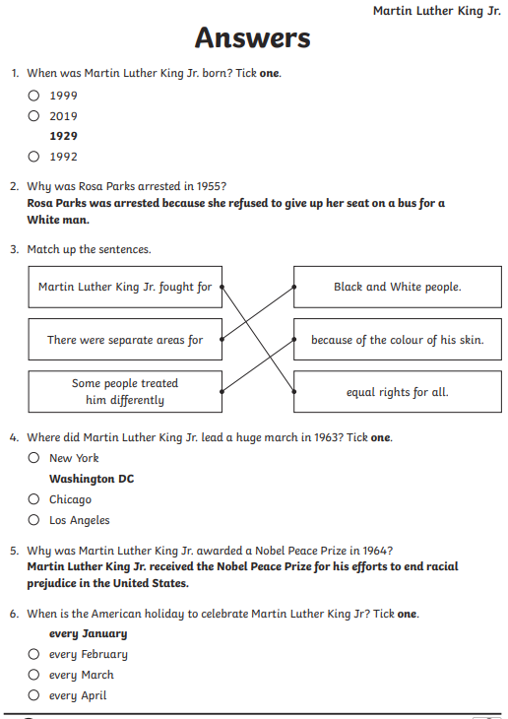
1*

Slide 12
2**

Slide 13
2**

Slide 14
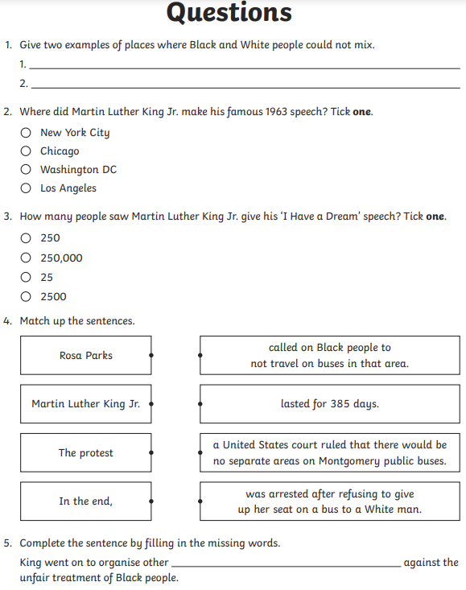
2**

Slide 15
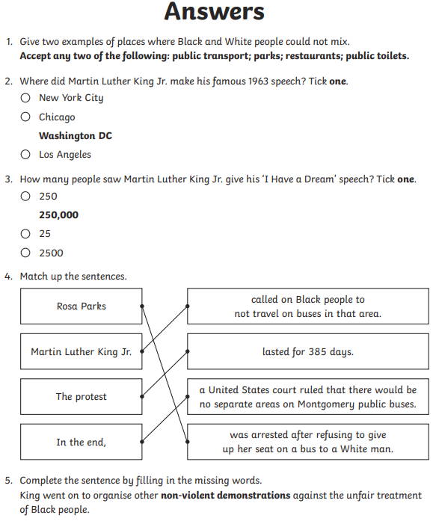
2**

Slide 16
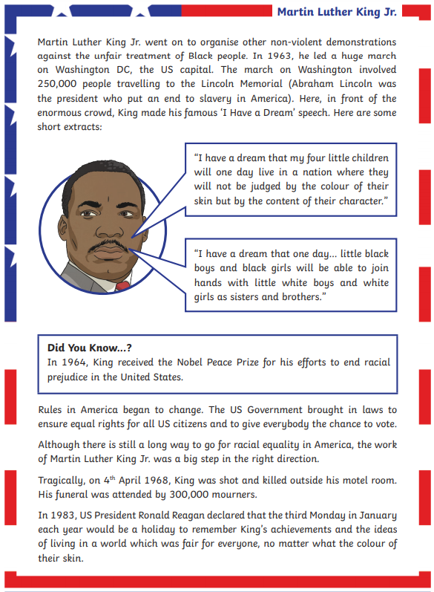
3***

Slide 17
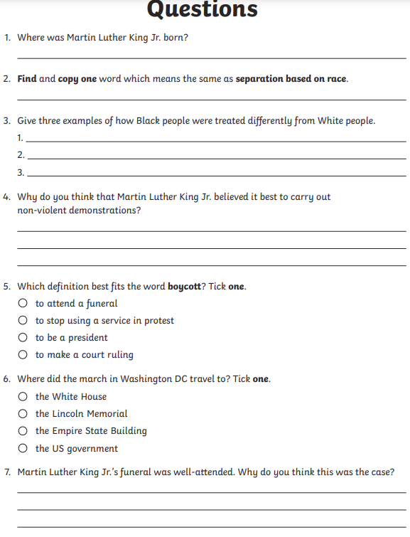
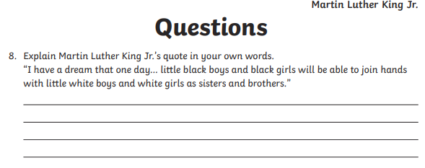
3***

Slide 18
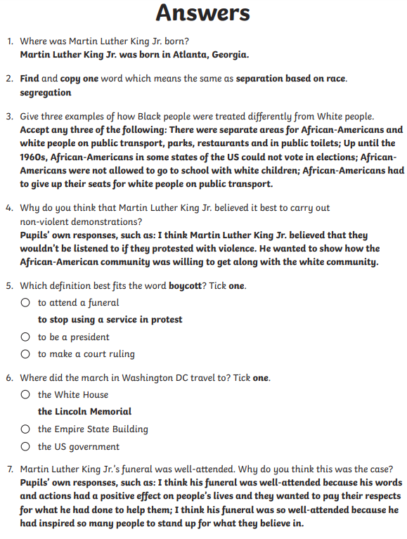
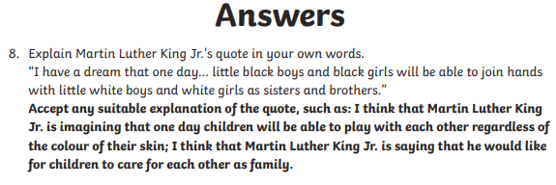
3***

Slide 19
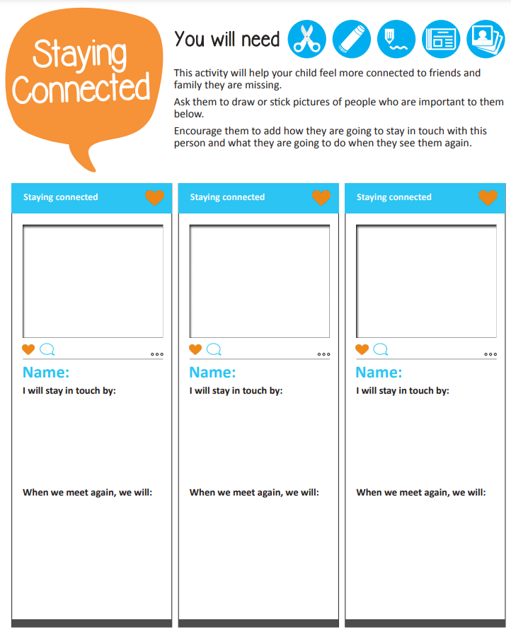
PSHE
We are all missing different people. Today, we are going to write/draw people that we miss and decide what we will do together when we can see each other. Don’t worry if you can’t print the sheet you can draw it in your book!
It might be that you would like to go to the park with your cousins, or have a sleepover with your BFF, or even see your friends at an afterschool club! It could be anything! Anything that you are missing and who you are missing doing it with.
But remember the positives! How can you stay in touch now, you might walk past your neighbours house and wave to them on your daily exercise, you might wave over the fence if you live next to your friend, you might write a letter and post on your daily exercise, you might Facetime or you might phone them.
Remember if you would like to share your work please email; NJS.Year3@taw.org.uk

