Slide 1
Year 3 Home School Provision Daily Pack
The following slides will be split into 4 separate activities.
They will consist of Maths, English, Reading and one other subject.
Each slide will be daily activities for you and your child to do at home.
We as a Year 3 team, will update these slides daily to the website – please keep an eye out!
Please email NJS.Year3@taw.org.uk with any queries to share any work and one of the Year 3 teachers will get back to you as soon as possible!
Thank you for your understanding and on going support during these times.

Slide 2
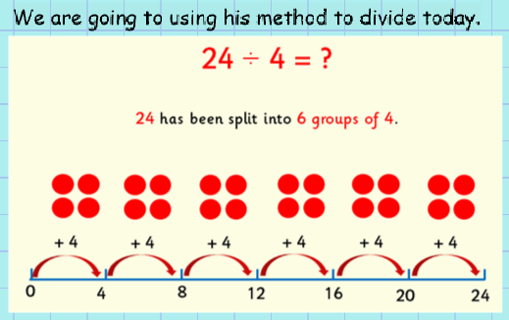
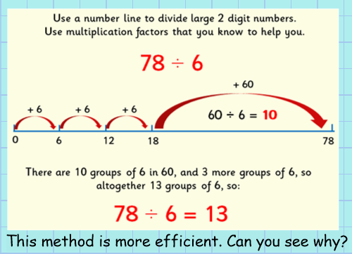
Maths
To use number line for division, without remainders
Introduction

Slide 3
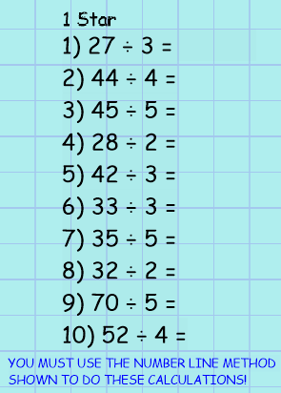
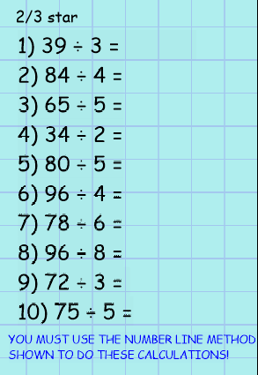

Slide 4
EXT:
Show at least 6 different ways to prove always, sometimes or never.

Slide 5
English
LO: To understand what pronouns are and how to use them in your writing.

Slide 6
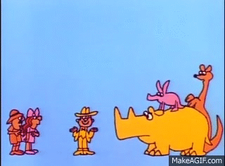
What are pronouns?
Pronouns replace nouns.
They are short words like:
It
She
He
You
We
They
Us
them.
If we didn't have pronouns, we'd have to keep repeating our nouns and that would make our sentences awkward and repetitive.

Slide 7
Watch the video clip from bitesize
Click the picture or the link below to see the video.
https://www.bbc.co.uk/bitesize/articles/zjsnm39

Slide 8
Look at my example:
Remember, we use pronouns to avoid using the same word OVER and OVER.
Tom went upstairs to the bedroom. Tom opened the door and Tom sat on the bed.
We have to keep the first 'Tom' so that the reader knows who we are talking about, but we can replace the second two with pronouns. Like this:
Tom went upstairs to the bedroom. He opened the door and he sat on the bed.

Slide 9
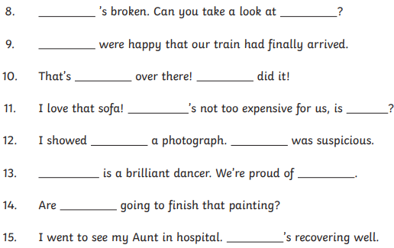
Practice:
1*
2/3*
You must use the word bank to fill the gaps shown above. (You can use the words as many times as you like just make sure you proof read it so that it makes sense!)

Slide 10
Plenary: Pronoun quiz (click the image or the link to play)
https://www.bbc.co.uk/bitesize/articles/zjsnm39

Slide 11
READING
The following pages contain two texts, each of which should contain a level of challenge for the reader, with questions on each one.
Record your answers in your book, using complete sentences, with the correct punctuation.
One word answers are not allowed, unless specifically asked for!

Slide 12
Monday 11th January
To find and record information and summarise a text.

Slide 13
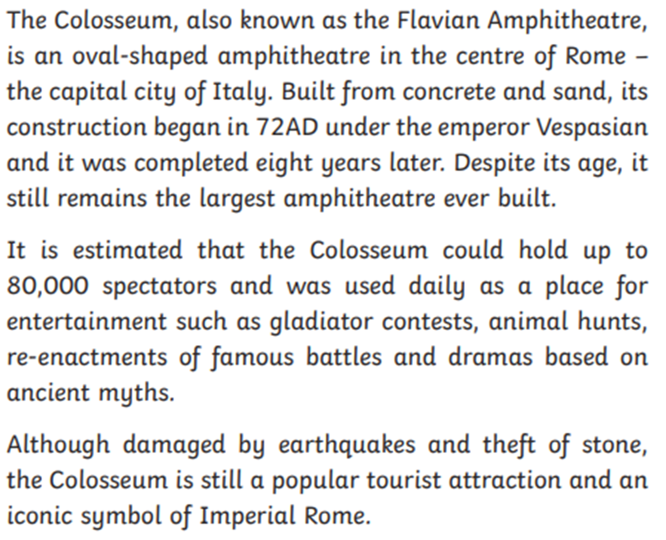
Text 1:
Read the passage with an adult to help you.

Slide 14
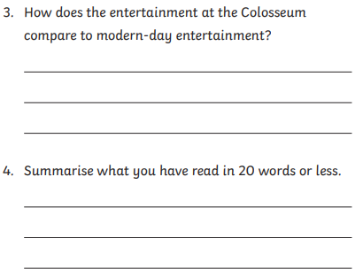
Text 1 questions:
Hint: ‘Summarise’ means find the key or main ideas in a text or paragraph, and write them as simply as you can, so you just keep the main ideas.

Slide 15
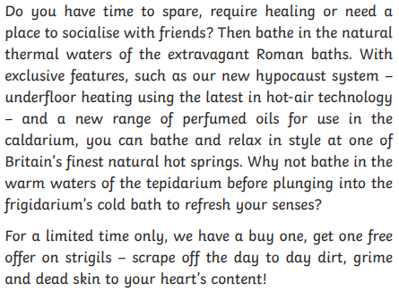
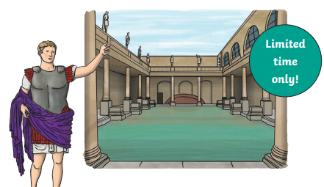
Text 2: To find, record and explain my ideas.

Slide 16
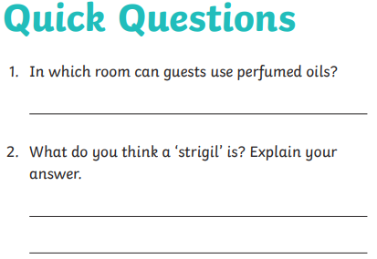
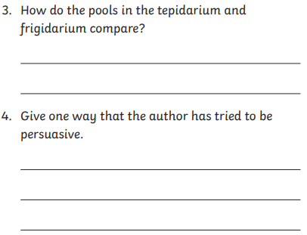
Text 2: Questions

Slide 17
Topic work: The Romans
The year 3 topic this term is, yes, you’ve guessed it, the Romans! Copy the objective and the chart. Then try to fill it up. Take at least ½ a page to complete it.
1* - find at least 5 facts that you already know about the Romans and 5 things you would like to know about them.
2** - find at least 7 facts you know already and 7 things you’d like to know.
3*** - record 10 things you already know and 10 things you would like to know about the Romans.
You need to think about Roman baths, the Colosseum, Roman armies, Roman food and drink, Roman Schools, Women in Roman society, What the Romans did for us, how they lived, Rich and poor Romans etc.
To record what I know and what I would like to find out about the Romans
What I already know about the Romans: | What I want to find out about the Romans:
They fought in organised armies. The Colosseum is an amphitheatre, used for…? | How did they keep clean? Did all children go to school?

