Slide 1
Year 3 Home School Provision Daily Pack
The following slides will be split into 4 separate activities.
They will consist of Maths, English, Reading and one other subject.
Each slide will be daily activities for you and your child to do at home.
We as a Year 3 team, will update these slides daily to the website – please keep an eye out!
Please email NJS.Year3@taw.org.uk with any queries to share any work and one of the Year 3 teachers will get back to you as soon as possible!
Thank you for your understanding and on going support during these times.

Slide 2
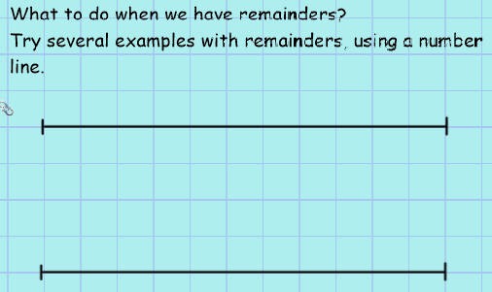
Maths
To use a number line for division (with remainders)
Introduction:

Slide 3
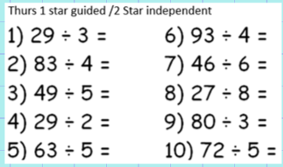
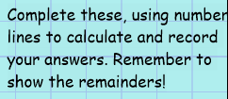

Slide 4
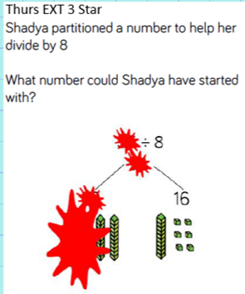
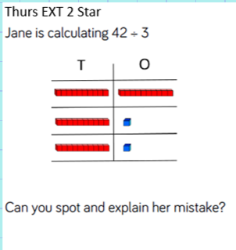

Slide 5
English
Online teaching lesson
with Mr Parker
LO: To identify and distinguish a range of common homophones and use them correctly when writing.

Slide 6
What are Homophones?
Homophones are words that sound the same but have different meanings. They also have different spellings.

Slide 7
Let’s watch the video. Click the link or the picture to watch.
https://www.bbc.co.uk/bitesize/articles/z7g8jhv

Slide 8
Listen to the song and if you are at home join in singing!
https://www.youtube.com/watch?v=-A5uKR2KJv0

Slide 9
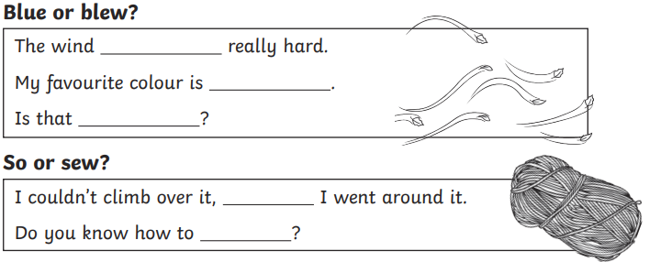
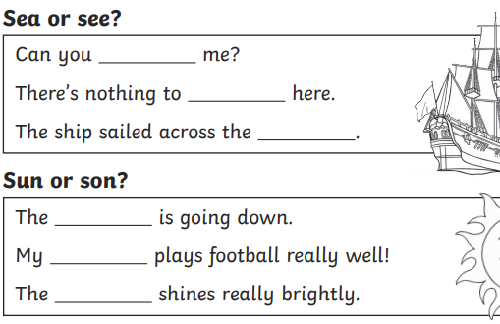
Activity sorting: -Step 1- choose the correct homophone -Step 2- try to write the sentences out again in best handwriting

Slide 10
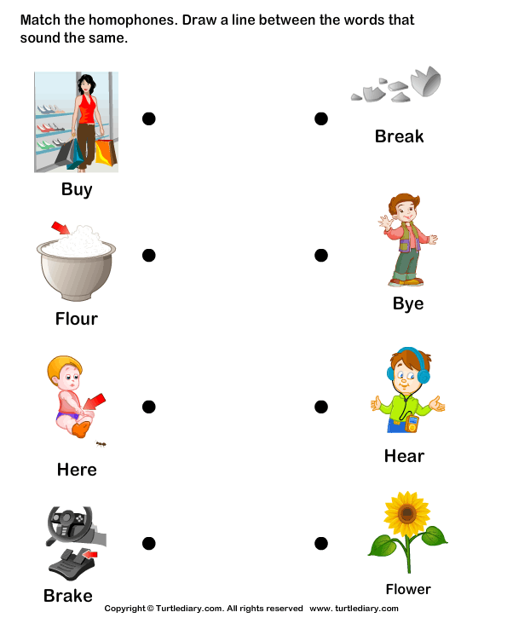
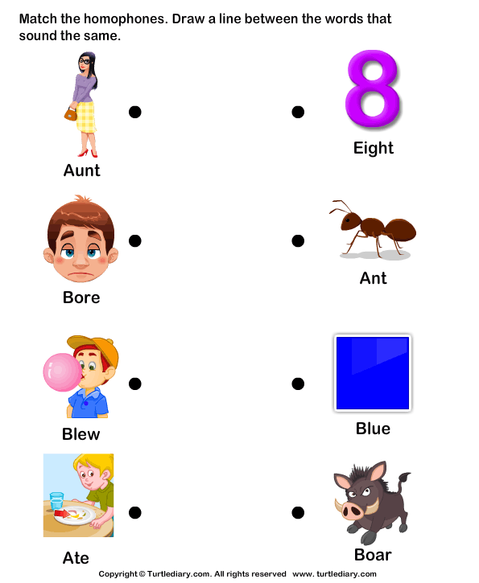
Plenary: Matching game

Slide 11
Reading Tuesday 12th January To read for meaning and retrieve, explain and infer answers.

Slide 12
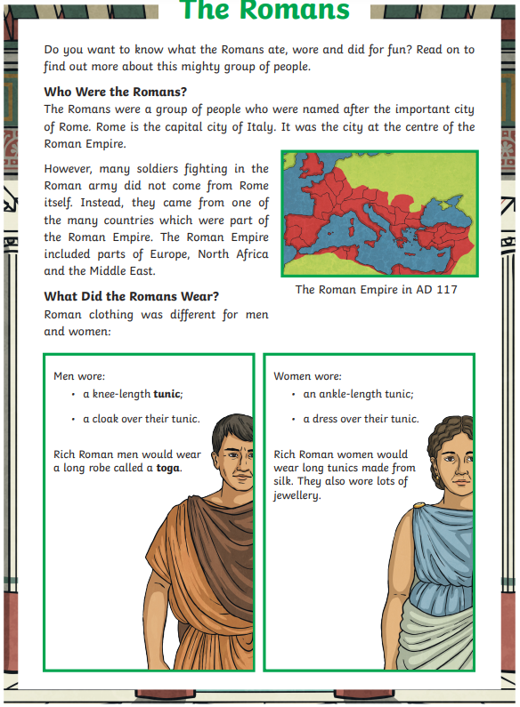
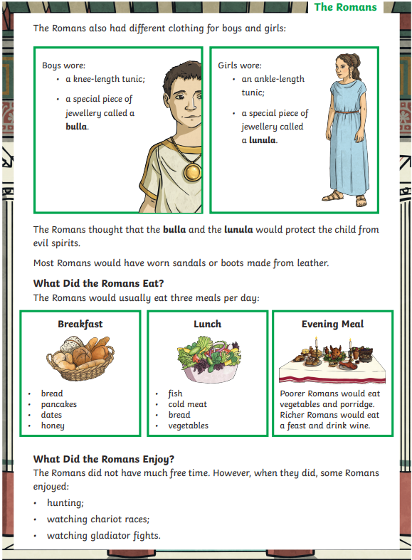
1*

Slide 13
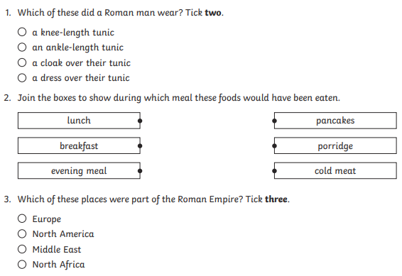
1*

Slide 14
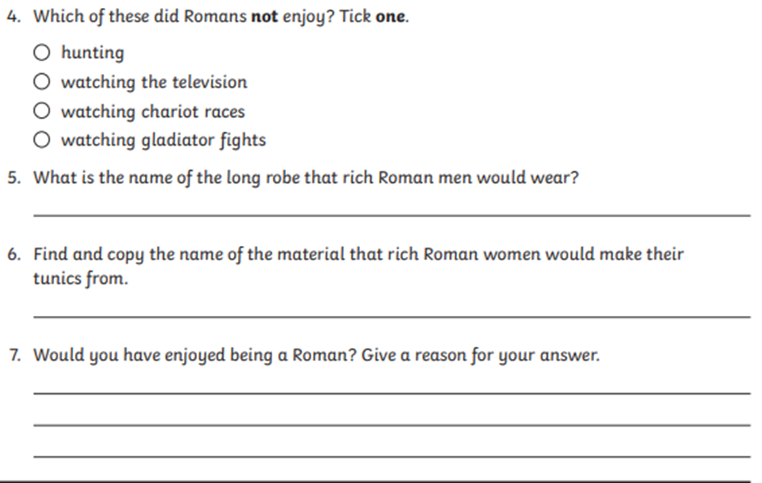
1*

Slide 15
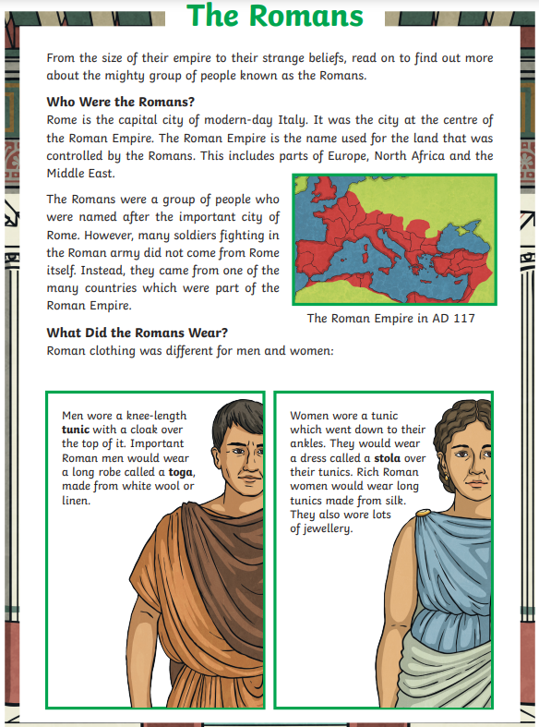
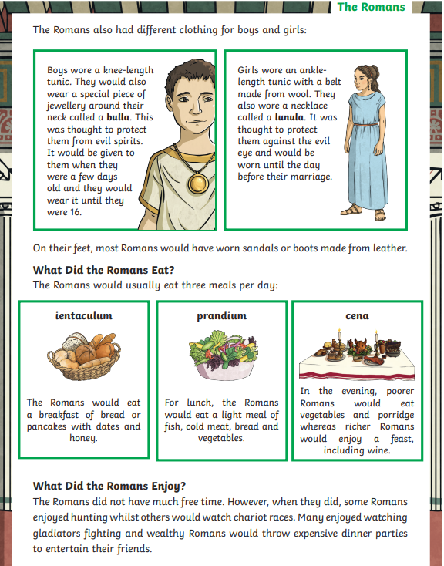
2**

Slide 16
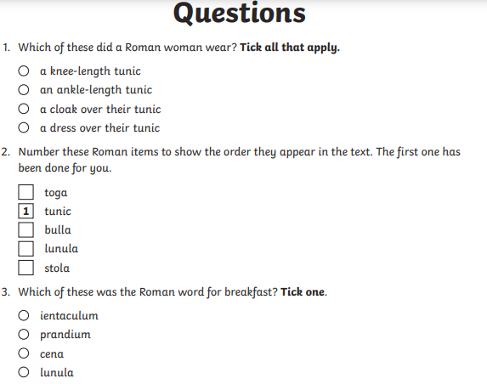
2**

Slide 17
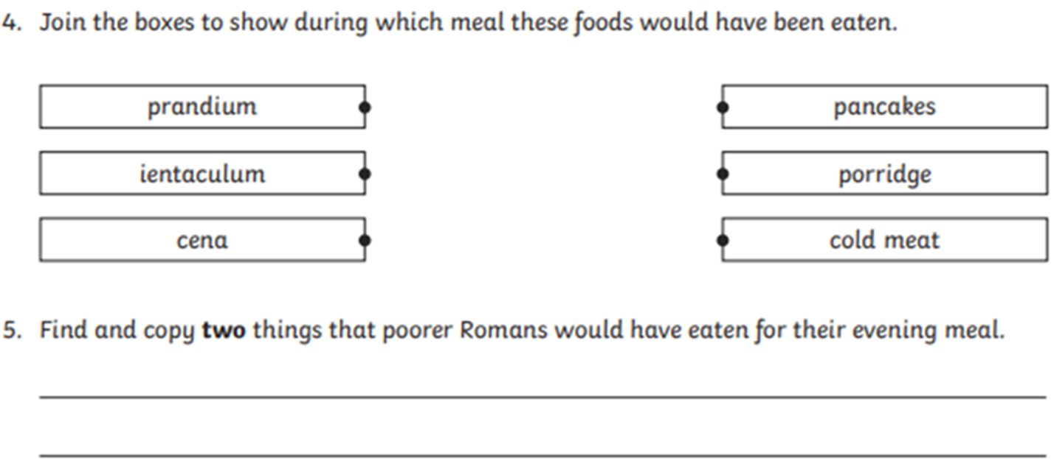
2**

Slide 18
2**

Slide 19
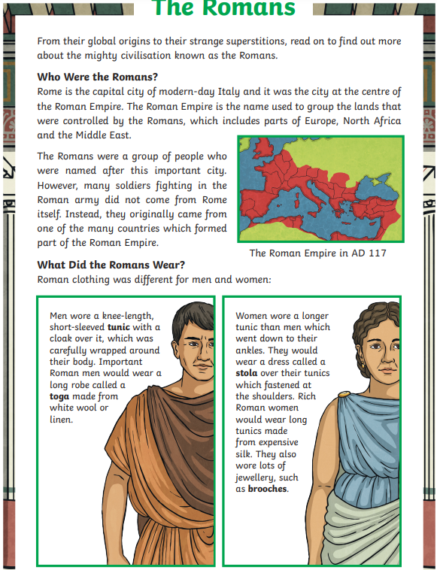
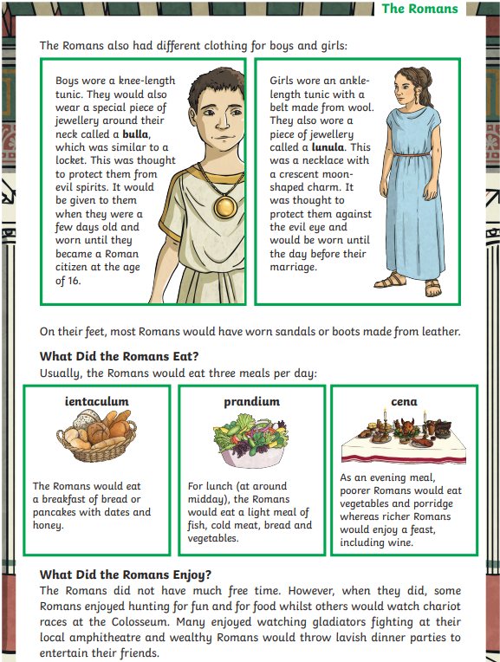
3***

Slide 20
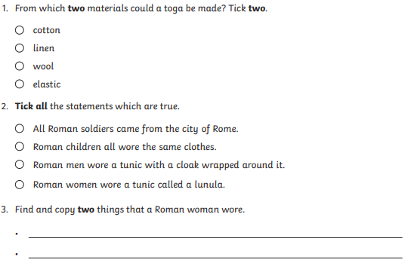
3***

Slide 21
3***

Slide 22
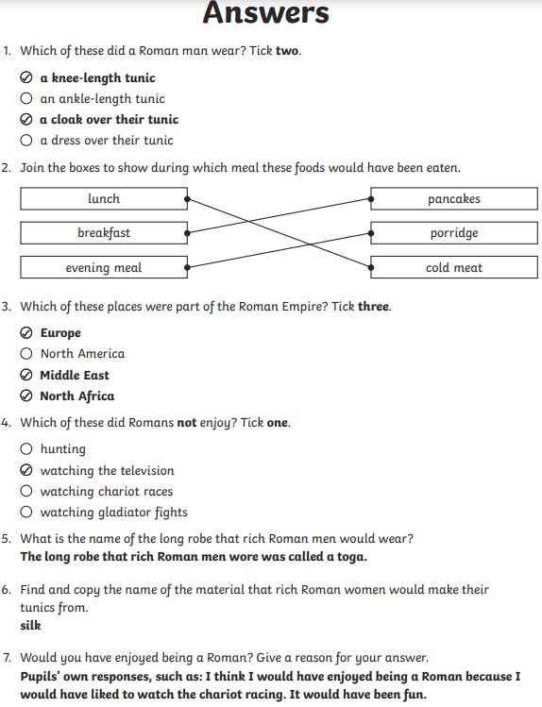
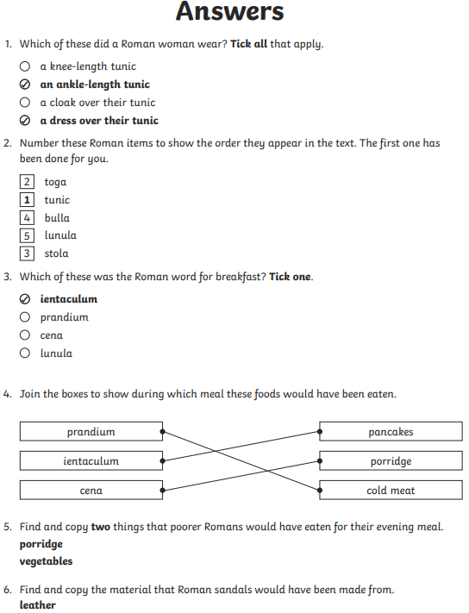
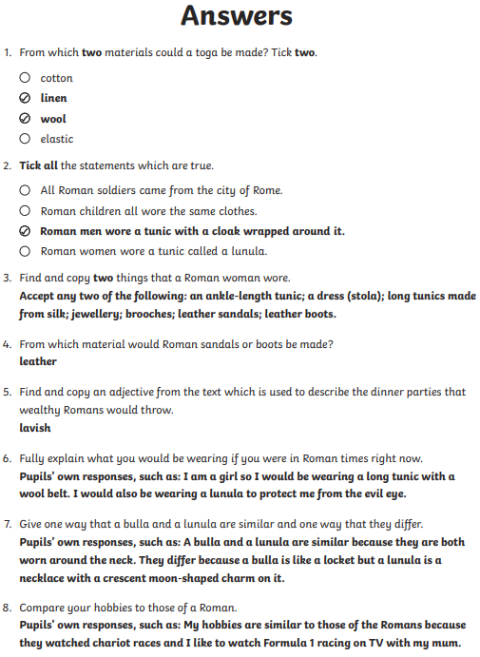
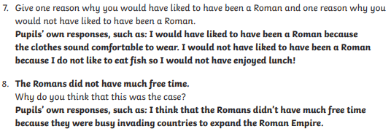
1*
2**
3***

Slide 23
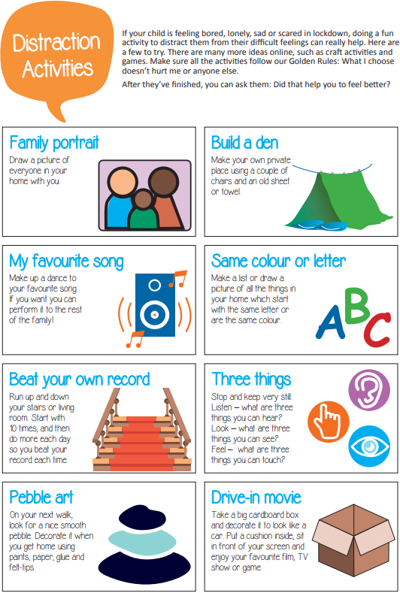
PSHE
Do as many of the activities as you like. You might want to do them together or let your children do them by themselves.
Have some fun! Lockdown is hard for everyone so give yourselves some time to have fun and make positive memories.

