Slide 1
Year 3 Home School Provision Daily Pack
The following slides will be split into 4 separate activities.
They will consist of Maths, English, Reading and one other subject.
Each slide will be daily activities for you and your child to do at home.
We as a Year 3 team, will update these slides daily to the website – please keep an eye out!
Please email NJS.Year3@taw.org.uk with any queries to share any work and one of the Year 3 teachers will get back to you as soon as possible!
Thank you for your understanding and on going support during these times.

Slide 2
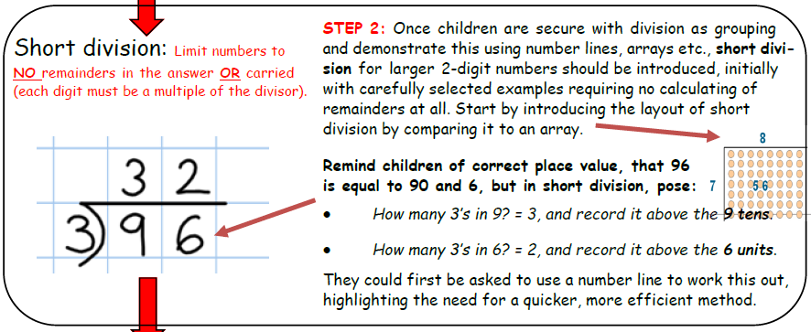
Maths
No starter for this lesson as short division (sometimes referred to as bus stop method) will be new learning and children will need more time to consolidate new learning.
To divide 2 digit numbers by 1 digit numbers, using formal written methods.
Parent support (From NJS Calculation Policy)

Slide 3
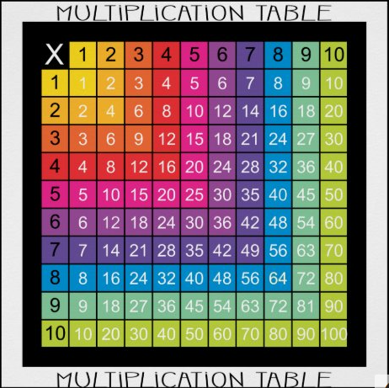
1* - Questions 1 - 10
2* - Questions 1 – 20
3* - Questions 1 - 30
Use the multiplication grid to help you if you are stuck with your division facts. We use these in school (on the front of our maths books) in case we need support with our times tables facts.

Slide 4
Plenary:
Complete your Note 2 Teacher and answer the following questions

Slide 5
English
Objective: To match synonyms and use them in a sentence (SPAG).
Follow the link to play the matching adjectives game. Which words mean the same? What is a synonym?

Slide 6
https://www.englishclub.com/esl-games/grammar/adjectives-synonyms-1.htm
English continued
1 Star
2 Star
3 Star
Loud Loud Loud Loud
1)
On bonfire night, there
1)
On bonfire night, (the 5th November)
Noisy Noisy Noisy Noisy
was a loud bang!
there was a loud bang!
2)
The neighbours were
2)
The neighbours (who were in the
being very noisy outside.
garden) were being very noisy.
Complete the word matching game. Synonyms are words that mean the same for example; loud and noisy. They both mean the same. Use the link above to play the game. Play one or more rounds – it’s up to you! Once you have finished, write the words out to practise your handwriting. Remember ascenders are tall and descenders are low but all the other letters are the same height!
Complete the word matching game. Synonyms are words that mean the same for example; loud and noisy. They both mean the same. Use the link above to play the game. Play two or more rounds – it’s up to you! Once you have finished, write the words out in sentences to practise your handwriting. Remember ascenders are tall and descenders are low but all the other letters are the same height!
Complete the word matching game. Synonyms are words that mean the same for example; loud and noisy. They both mean the same. Use the link above to play the game. Play three or more rounds – it’s up to you! Once you have finished, write the words out in sentences to practise your handwriting. Your sentences must use brackets (they add information in) as well as having beautiful handwriting. Remember ascenders are tall and descenders are low but all the other letters are the same height!

Slide 7
Wednesday 13th January To use inference to improve my understanding of a picture or text.
READING –online with Mr Butler
Today we are going to be a bit like detectives. Sometimes, the answers to questions aren’t always obvious, so we have to look for clues.
However, rather than reading a text, lets start with some pictures. Look at the next slides and then answer the questions that follow, either verbally or in writing…

Slide 8
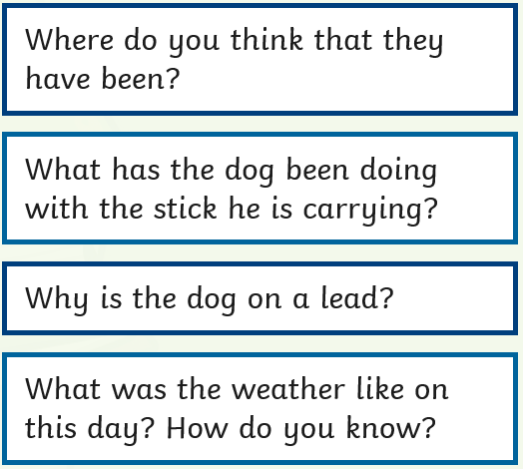
Intro example – read and understand what to do:
Do we know what the actual answers are to these questions? Or do we have to INFER what the answers MIGHT be?
What is inference?

Slide 9
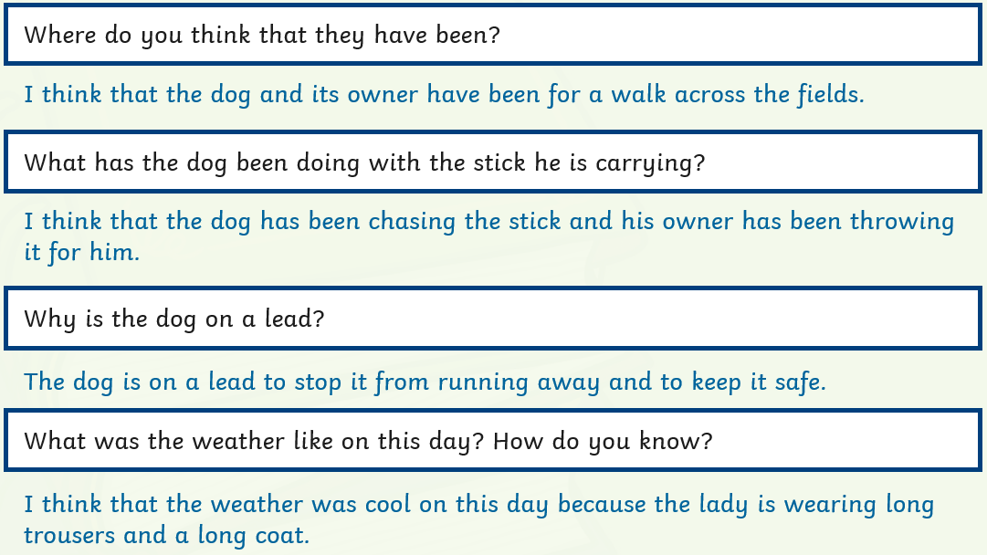
Intro
‘Model
Answers’
In future, when you answer the questions yourself, use complete sentences, like the ones above.

Slide 10
Try this:
Start your answers with words
from the questions: e.g: This photograph was taken…
Some people are standing up because…

Slide 11
Try this:
The Chat’

Slide 12
What have we learned so far about inference?
An inference is:
working something out that wasn’t completely explained by the writer;
reading between the lines and using clues to make a good guess.
Moving on, we are now going to use our detective skills on several short pieces of text.
Read the text aloud.
2. Write the title of the piece of writing in your book.
3. Answer the questions, using complete sentences.

Slide 13
Read the text aloud.
2. Write the title of the piece of writing in your book.
3. Answer the questions, using complete sentences.
What else can we infer about Chelsea?
What can’t we infer?

Slide 14
Read the text aloud.
2. Write the title of the piece of writing in your book.
3. Answer the questions, using complete sentences.
What else can we infer about these people?
How do you know?

Slide 15
Read the text aloud.
2. Write the title of the piece of writing in your book.
3. Answer the questions, using complete sentences.
What sort of person is this child?
What do they want to do when they grow up?

Slide 16
Read the text aloud.
2. Write the title of the piece of writing in your book.
3. Answer the questions, using complete sentences.
Is this a running race? How do you know?

Slide 17
Ext:
Try these if you want an extra challenge to complete!
What else could you infer about the people in these extracts?

Slide 18
So remember:
Inference comes from you, not the writer.
It is about reading ‘between the lines’ and working out what the writer doesn’t tell you.
It is about looking for clues from the writer.
Good readers often change their inferences.

Slide 19
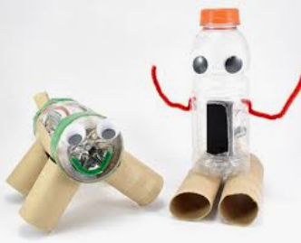
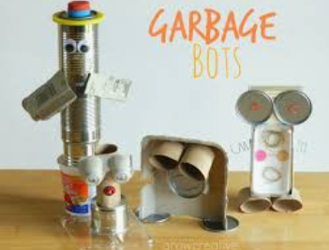
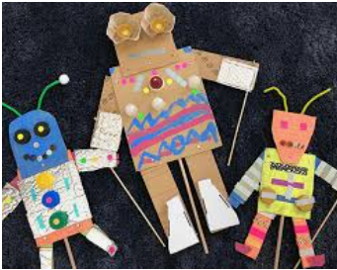
Design & Technology
We are setting you a challenge!
Using items for your recycling bin, we want you to design and then make a robot!
Try to decide what you want your robot to do. What tasks will it complete for you?
Then draw a picture of your robot, labelling it first, before colouring in, if you can.
Your robot can be any design you can think of. You can use glue, cellotape or string etc to hold it together. You can decorate in any way you like!
There are some examples of other robots that might give you some inspiration.
Please have fun, be creative and share any pictures with us on
NJS.Year3@taw.org.uk

