Slide 1
Year 3 Home School Provision Daily Pack
The following slides will be split into 4 separate activities.
They will consist of Maths, English, Reading and one other subject.
Each slide will be daily activities for you and your child to do at home.
We as a Year 3 team, will update these slides daily to the website – please keep an eye out!
Please email NJS.Year3@taw.org.uk with any queries to share any work and one of the Year 3 teachers will get back to you as soon as possible!
Thank you for your understanding and on going support during these times.

Slide 2
Maths
To divide TU / U, using formal written methods.
Introduction:

Slide 3
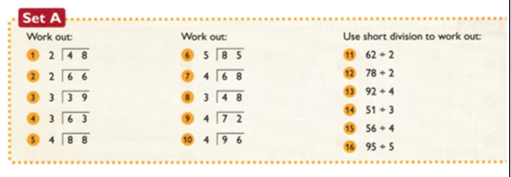
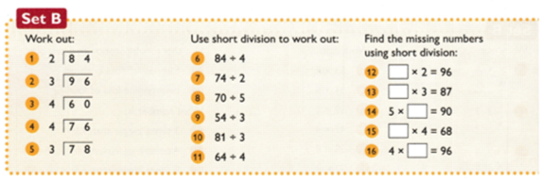
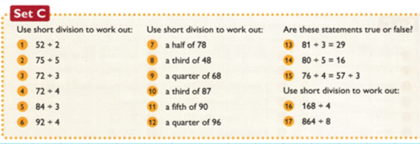
1* - Set A
2* - Set B
3* - Set C
EXTs on following slides

Slide 4
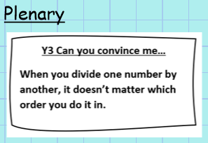
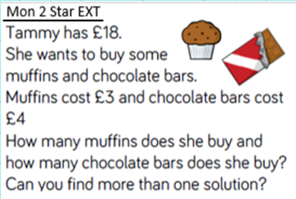

Slide 5
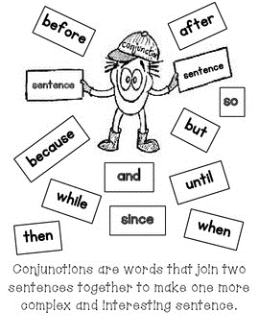
English
Thursday 14th January
Learning Objective:
To learn what conjunctions are and write sentences including the word because.

Slide 6
Conjunctions are joining words that link two parts of a sentence together.
For example combine these to make them fit best:
Lewis smiled,
The park was fun,
Harry Potter was elated,
because he returned to Hogwarts.
because I got to ride on the slides.
because he got some chocolate.

Slide 7
Conjunctions are joining words that link two parts of a sentence together.
Your task now is to try and complete these sentences
Lewis smiled,
The park was fun,
Harry Potter was elated,

Slide 8
Why is because important?
The word because is a very important conjunction and it is used to explain why something has happened.
For example:
Bill wore a scarf because it was cold outside.
By using the conjunction because, we know the reason for Jayati’s actions.

Slide 9
Your turn:
Copy out these sentences and finish them by completing what comes after 'because’.
Amy laughed loudly because …
Charlotte put on her shiny shoes because …
Jack rubbed his eyes because …
The lion lay down low in the tall grass because …
Mr Parker screamed because …
I sat on the floor because…
He sprinted towards the castle because...
I like school because…
Tom is my friend because…
I was scared because…

Slide 10
Plenary: Look at the sentence.
Harry Potter was very brave because he fought Voldemort many times.
It can be flipped so it looks like this:
Because he fought Voldemort many times, Harry Potter was very brave.
Can you rearrange the order so that the sentence begins with the word ‘because’ from any of your sentences today?

Slide 11
Reading – To use evidence to make estimations and draw conclusions about a picture.
Work through the next few slides and try to answer the questions, using complete sentences.
For extra challenge, try to give two different possible inferences if you can.

Slide 12
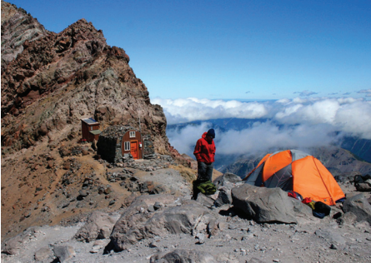
EXT: - what else can you infer from this picture?

Slide 13
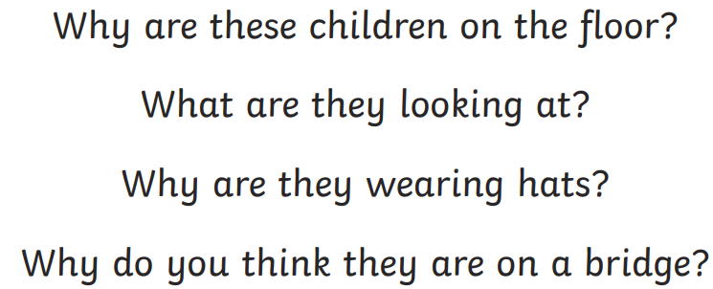
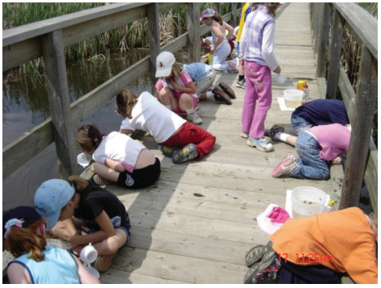

Slide 14
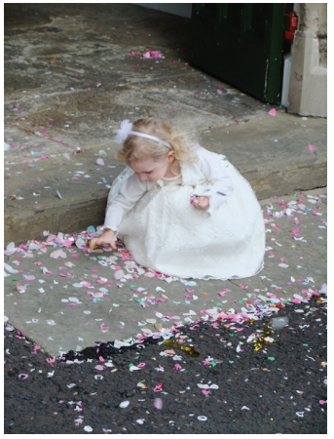
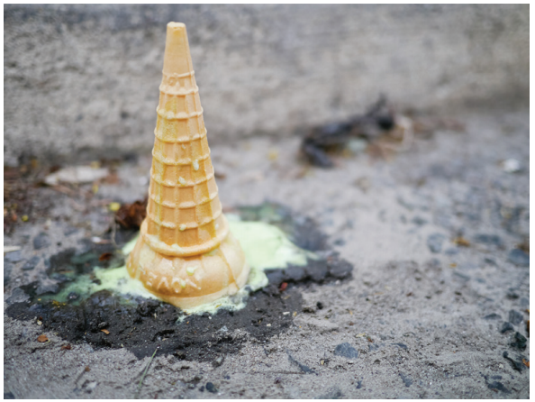
EXTENSION: For each of these, write two different inferences that could be true.

Slide 15
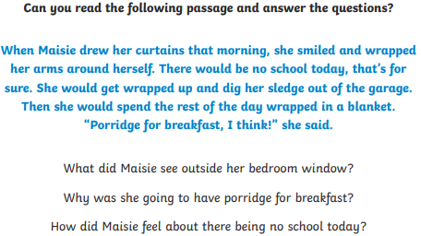

Slide 16
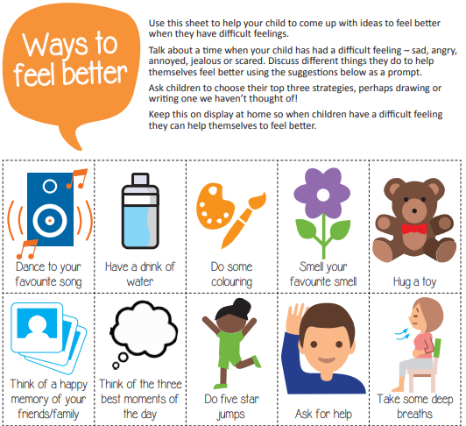
PSHE – To better understand my emotions and make myself feel better

