Slide 1
Year 3 Home School Provision Daily Pack
The following slides will be split into 4 separate activities.
They will consist of Maths, English, Reading and one other subject.
Each slide will be daily activities for you and your child to do at home.
We as a Year 3 team, will update these slides daily to the website – please keep an eye out!
Please email NJS.Year3@taw.org.uk with any queries to share any work and one of the Year 3 teachers will get back to you as soon as possible!
Thank you for your understanding and on going support during these times.

Slide 2
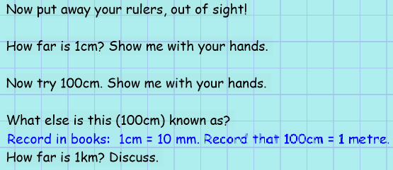
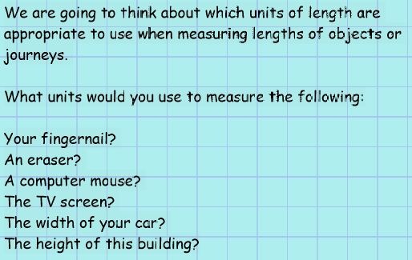
Maths
To know the relationship between kilometres, meters centimetre and millimetres and select appropriate units to measure lengths.
Introduction

Slide 3
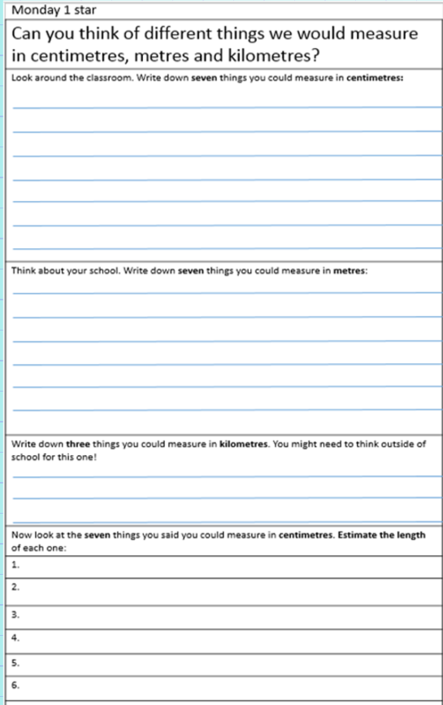
If you haven’t got a printer then you can write the headings into your book and answer the questions in there.
Where the sheet uses the word school, replace it with home. Think about all the different things you could measure around the home. Maybe you could measure in the kitchen, the lounge, you bedroom, the garden, the street – you can measure anywhere!

Slide 4
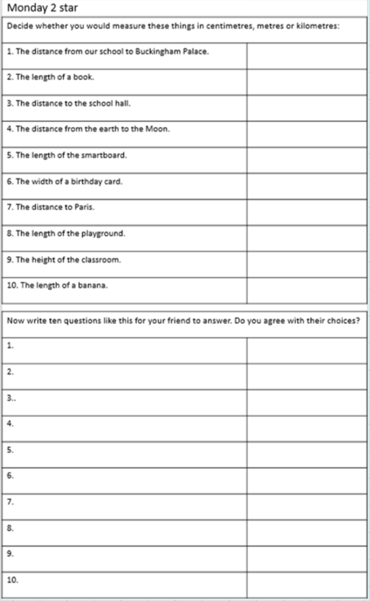
If you haven’t got a printer then you can write the headings into your book and answer the questions in there.
Where the sheet uses the word school, replace it with home. Think about all the different things you could measure around the home. Maybe you could measure in the kitchen, the lounge, you bedroom, the garden, the street – you can measure anywhere!

Slide 5
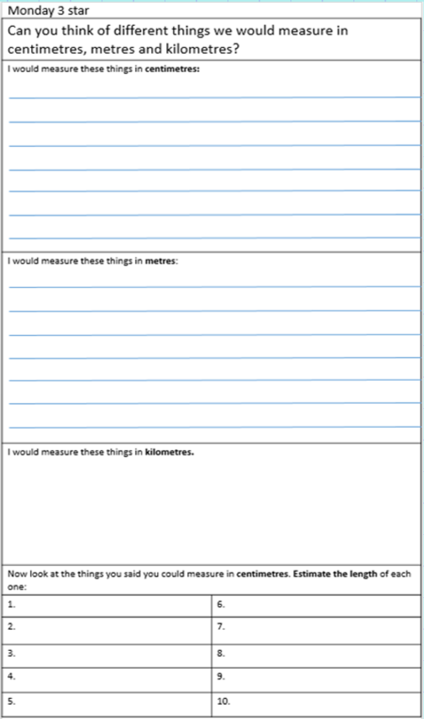
If you haven’t got a printer then you can write the headings into your book and answer the questions in there.
Where the sheet uses the word school, replace it with home. Think about all the different things you could measure around the home. Maybe you could measure in the kitchen, the lounge, you bedroom, the garden, the street – you can measure anywhere!

Slide 6
Plenary

Slide 7
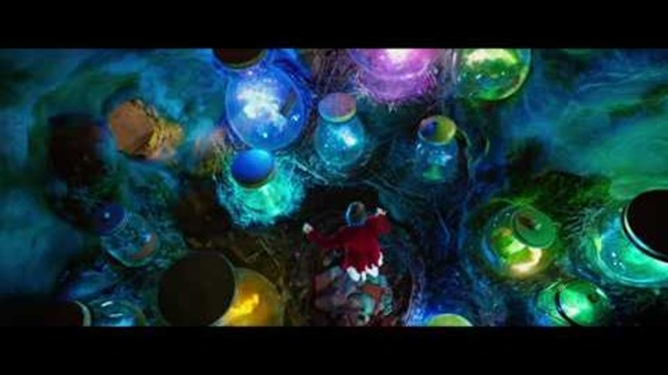
English- Monday 18th January Objective: to create a Recipe for Dreams.
This is a lesson inspired by Roald Dahl’s- The BFG.
Today, you are going to be creating a recipe for a dream!
You need to make a recipe for the perfect dream. Set it out like a cooking recipe with ingredients and a short description of the dream. Give a fun name! “The Golden Phizzwizard!”

Slide 8
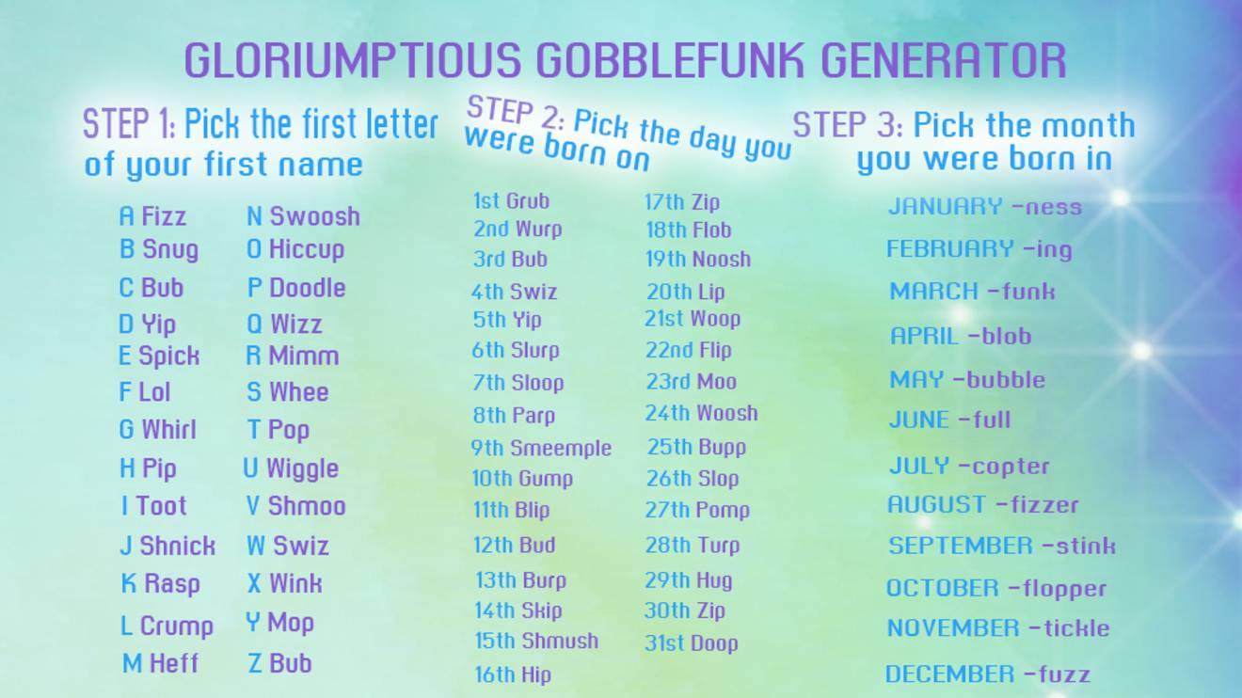
English lesson support:
You can use the picture if you are struggling to think of a weird and wonderful name for your dream recipe!
When all of your recipes have been created please draw fun pictures of your ingredients and the final product of your dream in a jar. It can be completed with crayons/paint/computer too.
I wish to create a small ‘cook book’ using all of your dream recipes. This will then be shared on our school website page AND printed out to present in our school library.
Language to use:
A pinch of…
A drop of…
A teaspoon of…
A sprinkle of…
A tablespoon of…
A cup of…
A spoonful of…

Slide 9
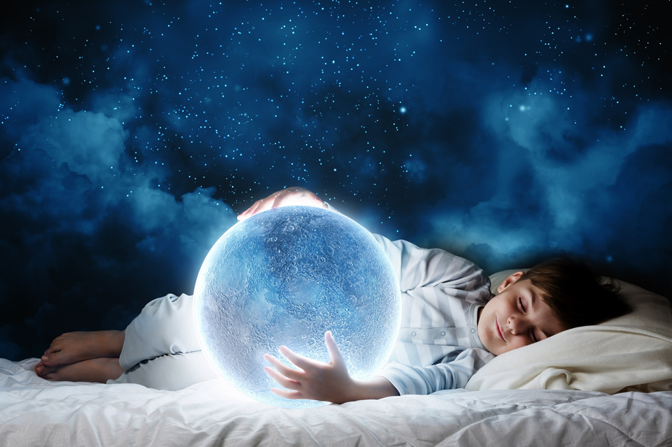
Mr Parker’s dream recipe for a:
To make the perfect Sweet Popfizzer you must add:
A handful of lemon sherbets.
A spoonful of happiness.
A drop of tickles.
Half a cup of smiles.
A dash of laughter.
A sprinkle of jolliness.
A crack of pepper.
A spray of Paco Rabanne One Million.
3 Tablespoons of Nutella.
Sweet Popfizzer !

Slide 10
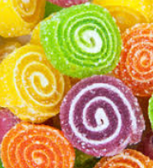
Mr B’s dream recipe for: Tootdoodle Slurpfizzers!
To make the perfect Tootdoodle Slurpfizzers, mix the following ingredients together in bowl, then cook with dragon fire:
A cupful of strawberries.
A bucketful of sugar.
An umbrella of raindrops.
Half a glass of unicorn tears.
A bottle of laughter.
A sprinkle of smiles.
Two shakes of sherbet.
Ride it around on your bike for 1 hour.
Mix well and pour in a circular motion
Set with Dragon Fire for 15 minutes – et voilà! Your slurpfizzers are ready to enjoy!

Slide 11
Reading 18.1.21 – Fiction Express new book – The Source
From this week, and for the next few weeks, we will be using Fiction Express to do our reading work, so children will need their logins to participate in the live voting. Logins were issued last term and can be found on the inside front cover of their Homelink books.
If you have lost your details, please email the Year 3 email for assistance.
TASK 1
Look at the cover before you log in. What do you think the story will be about? Why? (use your inference skills!) Now read the chapter on the following slides. Remember that if you log in, there is a text speak function on the page, which you can use to listen to the author read the story to you.

Slide 12
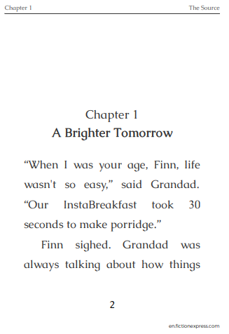
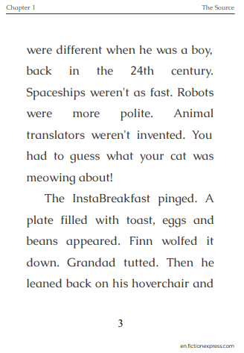

Slide 13
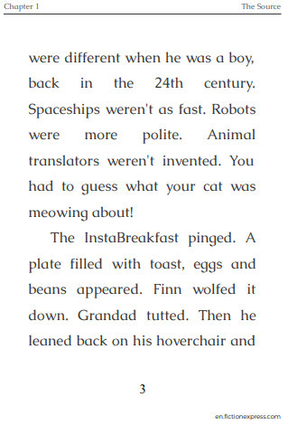
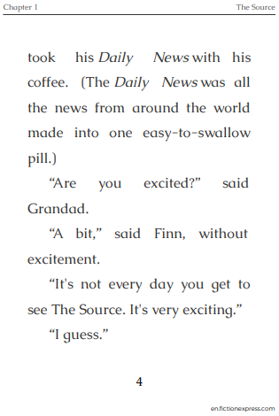

Slide 14
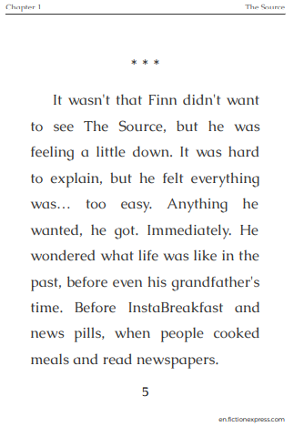
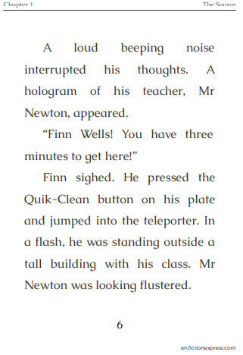

Slide 15
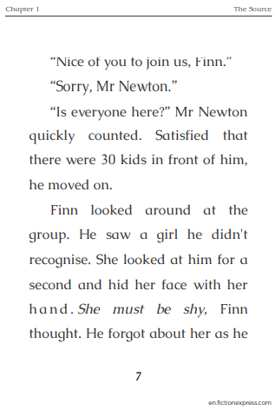
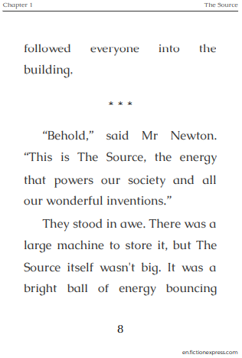

Slide 16
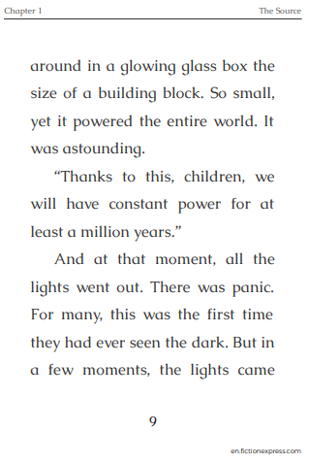
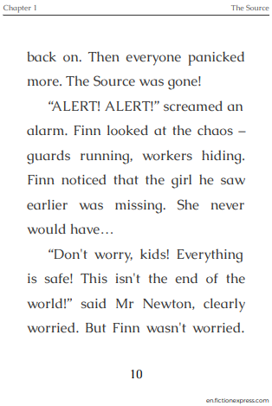

Slide 17
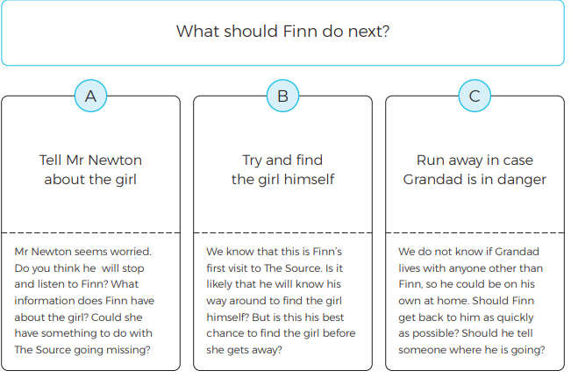
TASK 2:
Now you have read the chapter, before you vote online, write a prediction about what you think will happen next. Answer the questions for the option you choose above, and record your answers in your book.

Slide 18
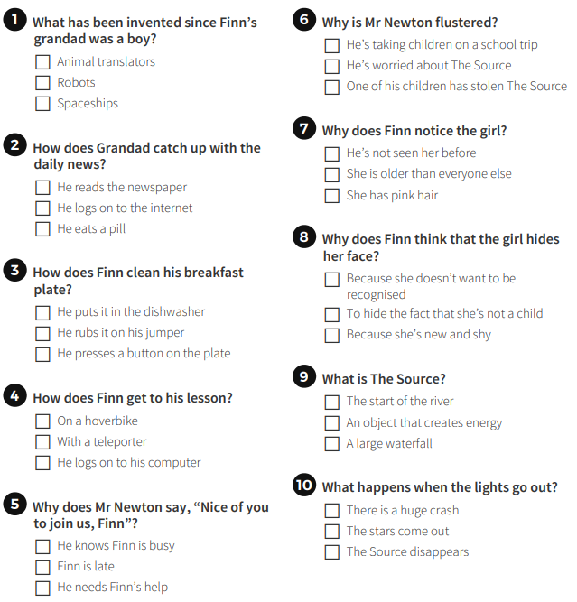
TASK 3:
Complete the online quiz about the chapter and record your score in your book.

Slide 19
Beliefs and Values What makes a valuable Disciple (follower)?
A disciple is someone who is loyal and follows someone else, because they believe in the same ides. Jesus had 12 disciples, the most well-known being Matthew, Mark, Luke and John.
We are going to look more closely at Jesus’ first meeting with Matthew, a tax-collector.

Slide 20
What was Matthew’s job? He was a tax collector.
In those days, people hated tax collectors. The tax collectors’ job was to take some of your money and give it to the king. But the tax collectors would always charge you too much money, more than the king said you had to give him, and then, they would keep the extras for themselves. So, most people probably didn’t like Matthew because he stole from them and wasn’t a very good person.
But then, Jesus asked Matthew to follow Him and to believe in Him. Why do you think Jesus asked Matthew to follow Him when He knew that Matthew was stealing from people?

Slide 21
The Calling of Matthew
9 As Jesus went on from there, he saw a man named Matthew sitting at the tax collector’s booth. “Follow me,” he told him, and Matthew got up and followed him.
10 While Jesus was having dinner at Matthew’s house, many tax collectors and sinners came and ate with him and his disciples.
11 When the Pharisees saw this, they asked his disciples, “Why does your teacher eat with tax collectors and sinners?”
12 On hearing this, Jesus said, “It is not the healthy who need a doctor, but the sick.
13 But go and learn what this means: ‘I desire mercy, not sacrifice.’[a] For I have not come to call the righteous, but sinners.”
Read this extract from the Bible. What is it trying to tell us?
Why did Jesus choose to sit and eat with sinners?

Slide 22
By sitting with Matthew (a person who was stealing from others), and other wrong-doers (sinners), Jesus showed that he believed in people’s ability to change, even when they did very bad things and were bad people.
Jesus knew that we can always do more than we think we can, and we can always do more than other people think we can.
People didn’t think that Matthew could change and be better, but Jesus did. Matthew believed in Jesus and stopped stealing and became one of Jesus’s twelve disciples.

Slide 23
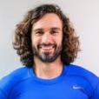
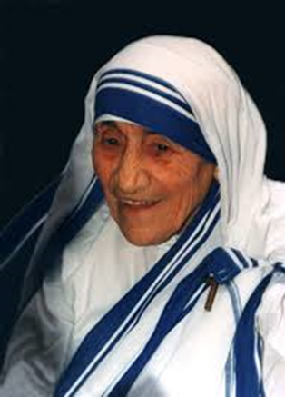
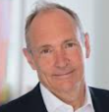
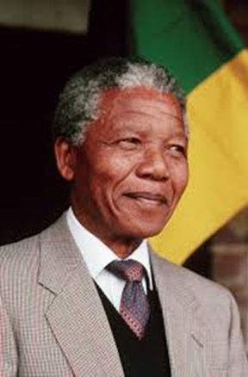
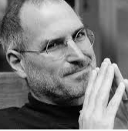
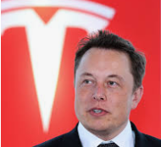
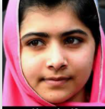
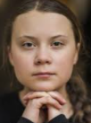
Jesus chose his 12 disciples because he wanted their help to change the world we live in.
Joe Wicks –Online fitness
Mother Teresa (helping the sick/ poor)
There are many influential people in the world (people who create good changes).
TASK:
Choose up to 12 people who you would select to be YOUR disciples (followers). Remember to say WHY you chose them.
1* - choose 6 disciples and explain why.
2** - Choose 9 disciples and explain why.
3*** - Choose 12 disciples and explain why.
Example:
I would choose:
Rosa Parks, because she is good at standing up for herself and what she believes in.
Tim Berners-Lee because he invented the Internet and this helps everyone to communicate more easily.
Nelson Mandela, because ….
Tim Berners-Lee
Inventor of the Internet
Nelson Mandela – equal rights (apartheid)
Steve Jobs – Apple iPhone and iPad
Elon Musk- (Tesla –electric cars)
Malala Yousafzai – human rights activist
Greta Thunberg – Climate change activist
Or, why not choose your own disciples: https://www.activityvillage.co.uk/famous-people-az

Slide 24
Extension task:
What does ‘sinner’ mean?
What does ‘mercy’ mean?
What does ‘sacrifice’ mean?
What does ‘righteous’ mean?
Explain the meanings of these key vocabulary words in your books.
Plenary:
Do you think someone would choose you to be a disciple?
What qualities do you have that would make you desirable to be someone's friend? Discuss this with your partner / adult helper.

