Slide 1
Year 3 Home School Provision Daily Pack
The following slides will be split into 4 separate activities.
They will consist of Maths, English, Reading and one other subject.
Each slide will be daily activities for you and your child to do at home.
We as a Year 3 team, will update these slides daily to the website – please keep an eye out!
Please email NJS.Year3@taw.org.uk with any queries to share any work and one of the Year 3 teachers will get back to you as soon as possible!
Thank you for your understanding and on going support during these times.

Slide 2
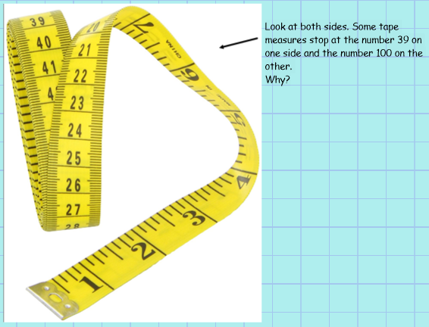
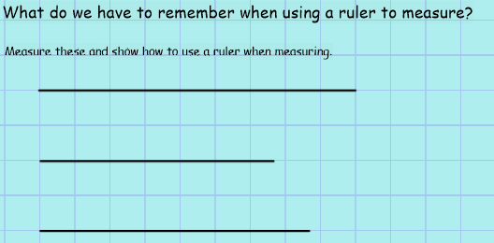
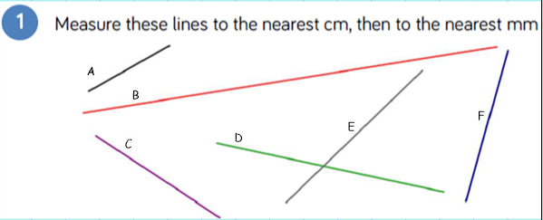
Maths
Equipment needed IF AVAILABLE:
Ruler
Tape measure
To measure lengths using a ruler
Introduction

Slide 3
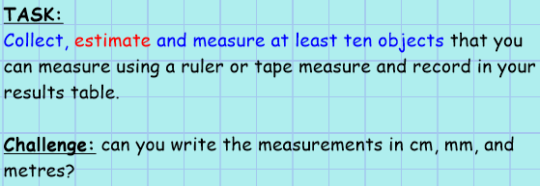
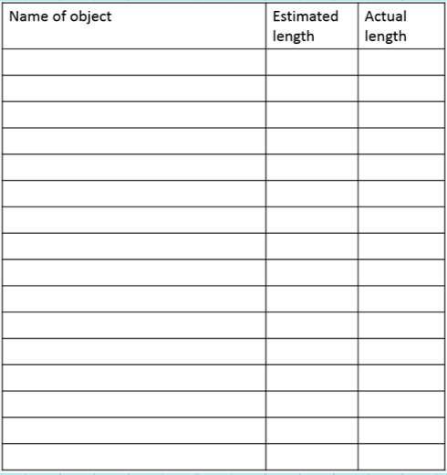
Activity for all:
Table can be draw into books if not able to print

Slide 4
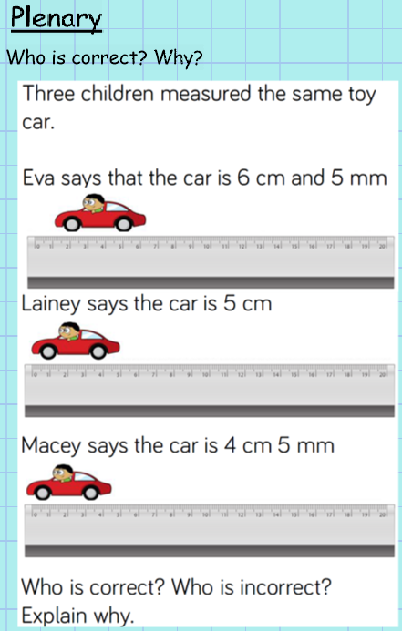

Slide 5
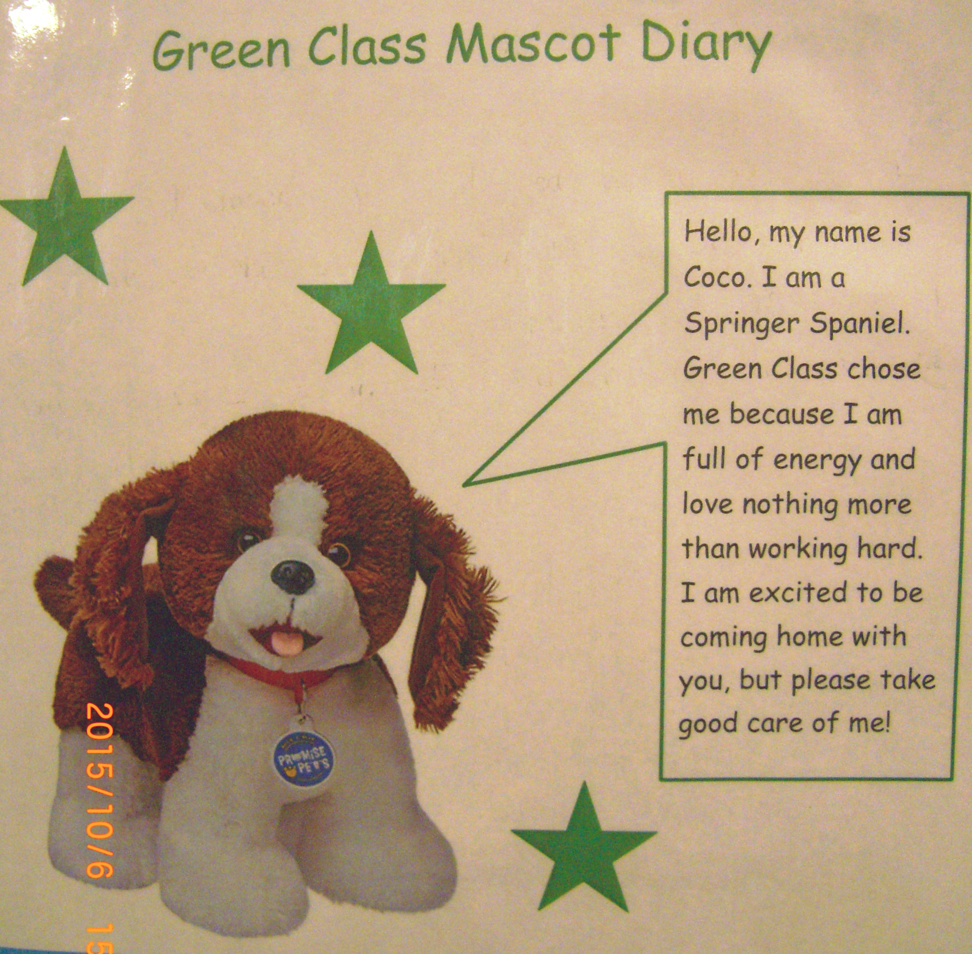
English Objective: to write persuasively.
Today, you are writing to persuade. Your class teacher is considering having a class mascot to represent their classroom.
You must find a suitable toy at home that you think is suitable to do the job.
You should:
Give it a suitable name (a teacher’s name perhaps! E.g. Mr Hedgehog)
Try to discuss its background (where it comes from, its friends, its likes and dislikes, favourite lessons, etc)
Why your teacher should choose it over everyone else’s!
Is there a specific purpose or job it is for or that it is good at doing?
Can it help the class with anything in particular?

Slide 7
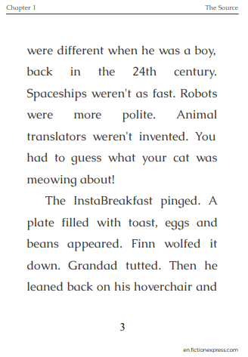
Reading - Tuesday 19th January
To retrieve, infer and explain information about a text.
Re-read the chapter before you attempt the work. Practice reading aloud with an adult listening, if possible, recording it in your reading diary.
Remember that if you need to listen to it being read, usually the

Slide 8
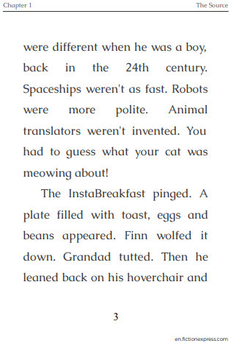
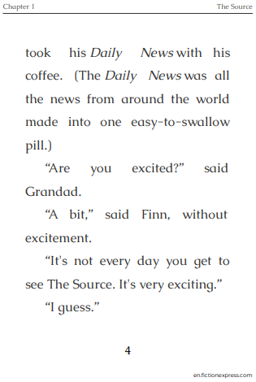

Slide 9
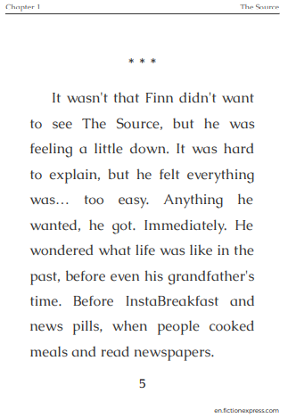
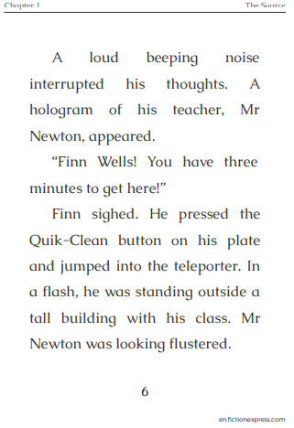

Slide 10
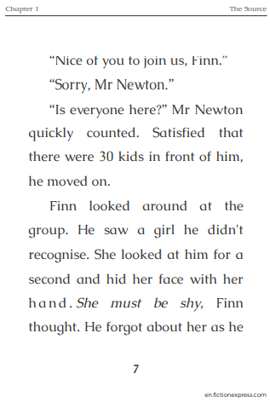
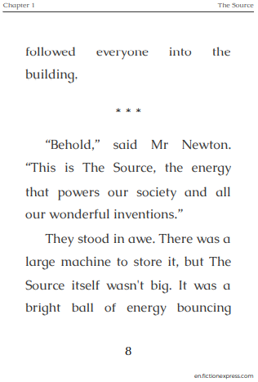

Slide 11
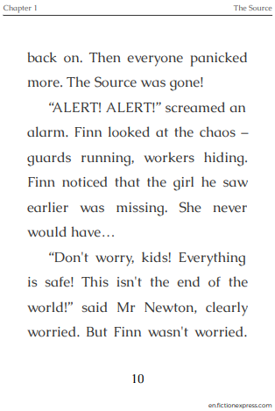

Slide 12
TASK (all)
Now you have read the chapter again, have a go at answering the comprehension questions on the following page. If you don’t have a print out, copy out the questions and then write your answer, using complete sentences.

Slide 13
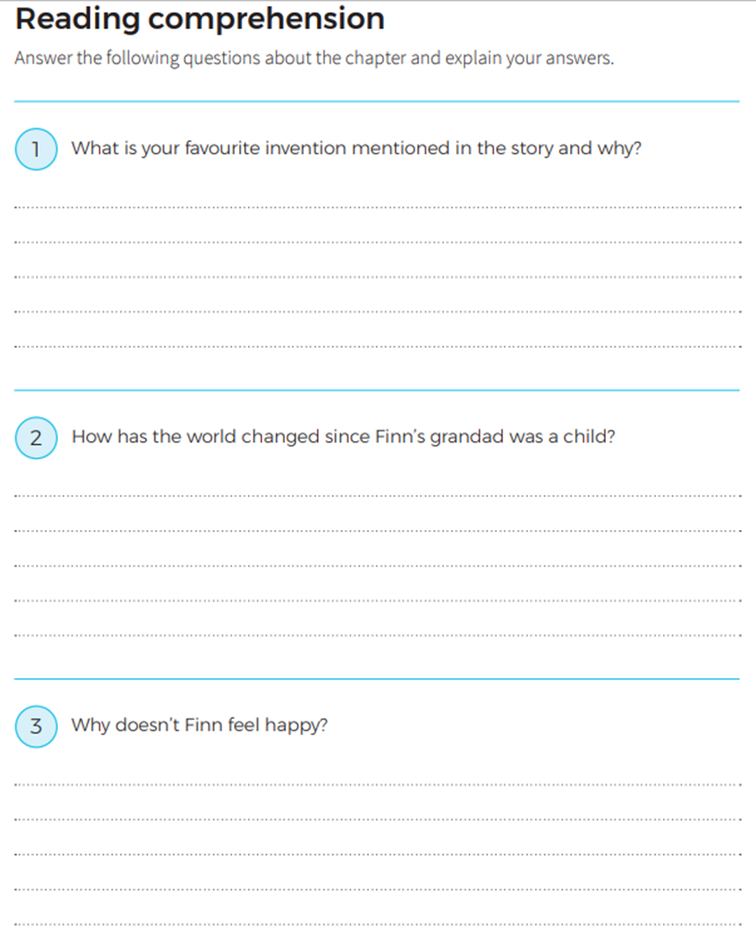
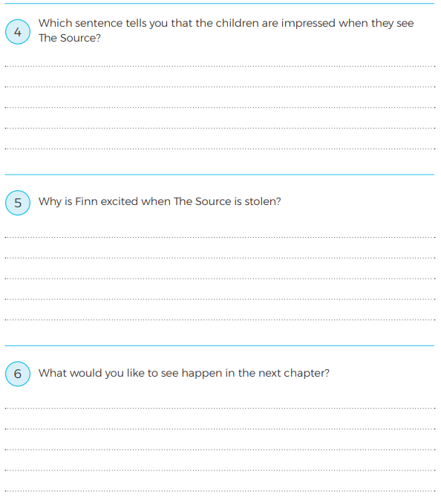

Slide 14
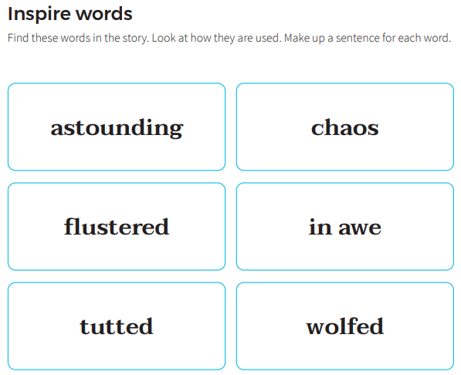
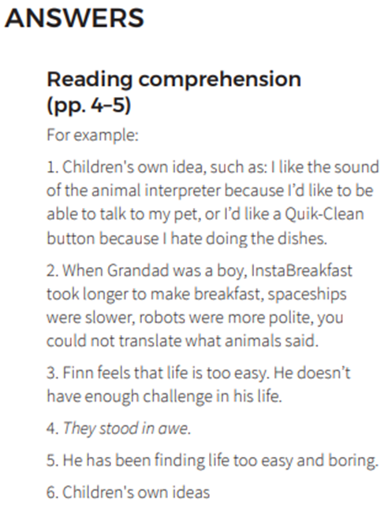
EXTension: - once you have completed the comprehension, try this task below.

Slide 15
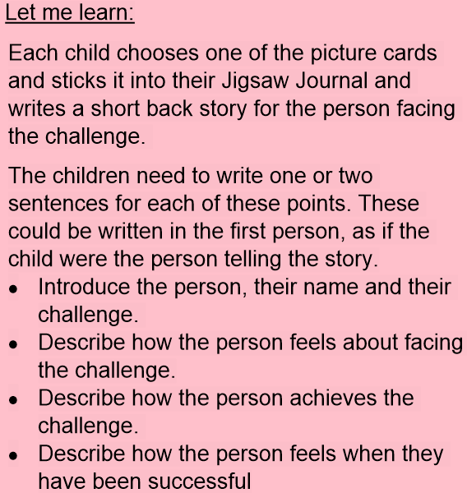
PSHE Please teach me to… Tell you about a person who has faced difficult challenges and achieved success. Respect and admire people who overcome obstacles and achieve their dreams and goals
PE:
Using Youtube search ‘Just Dance’.
Pick a song and have a dance! Get everyone involved and have a good time! Throw some shapes!

