Slide 1
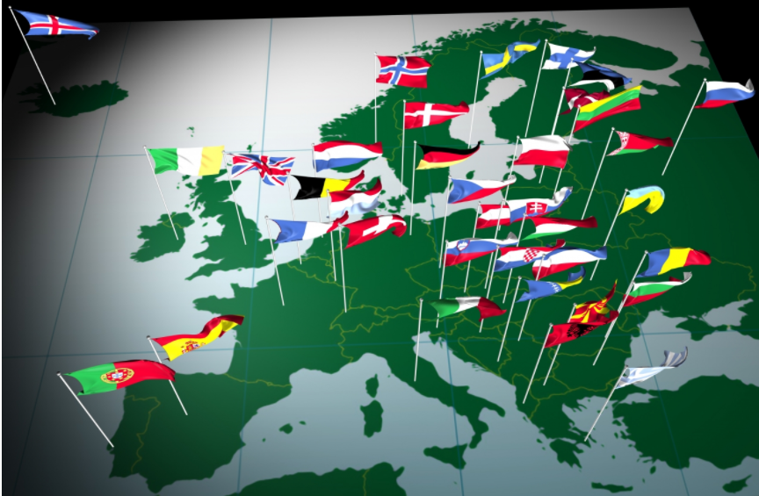
Year 3 Home School Provision Daily Pack Wednesday 20th January NJS’s European Day of Languages
Welcome to today’s home learning pack – today we will be celebrating different languages spoken across Europe, with several activities linked to languages, including French.
Although officially, European Day of Languages was in September last year, we thought it would be nice to raise its profile today.
In this pack, are some Language, Art, Design & Technology and Geography activities, mostly linked to language learning.
We have also included several, simple maths activities linked to language, but also included the usual Maths lesson work linked to this week’s focus of study - measurement. You can choose which activities you would like to do for Maths.
Please email NJS.Year3@taw.org.uk with any queries to share any work and one of the Year 3 teachers will get back to you as soon as possible!

Slide 2
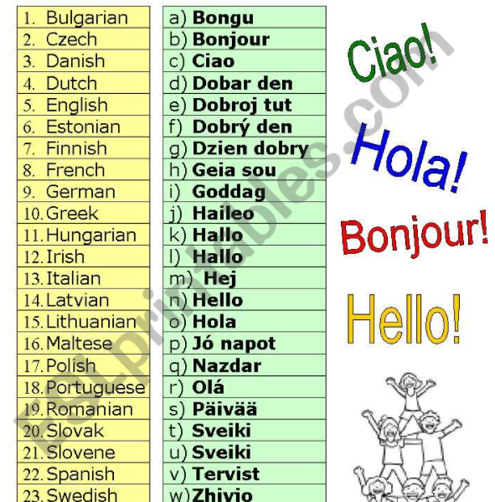
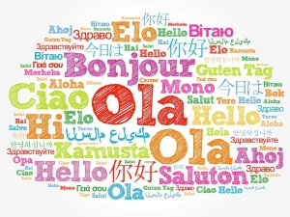
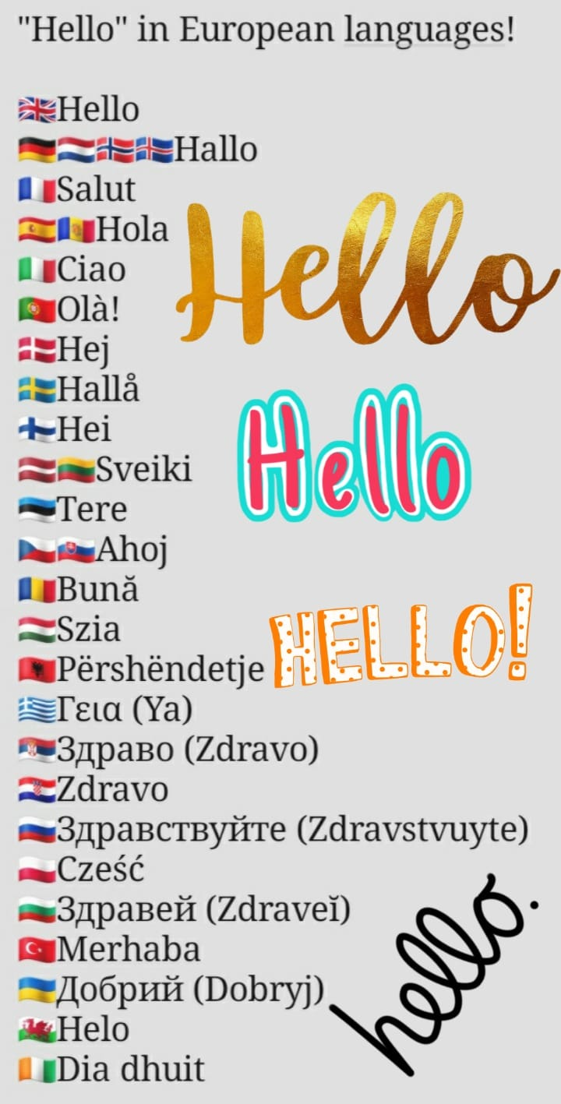
SALUT! How many different ways can you find to say hello?
In this activity, you will need to research as many different ways to say hello from the languages spoken in Europe as you can.

Slide 3
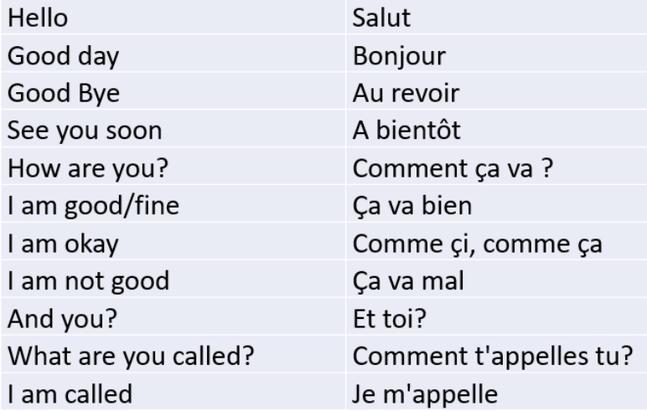
Revise your French greetings with me!
Remember these? Find a partner to practice with in class or at home, and have a short conversation, taking it in turns to speak each part. Can you do it from memory?
Using the French words opposite, try to have this conversation:
A: Hello!
B: Good day!
A: What are you called?
B: I am called (your name here!)
A: How are you?
B: I’m fine, and you?
A: I am okay.
B: See you soon.
A: Goodbye!
A: Salut!
B: Bonjour!
A: Comment t’appelles-tu?
B: Je m’appelle..(your name here!)
A: Comment ca va?
B: Ca va bien. Et toi?
A: Comme-ci, comme-ca.
B: A bientot!
A: Au revoir!

Slide 4
Sign Language Naming Game.
Do you know the European country names in international sign language? Learn by selecting and clicking on a country on the map and then test yourself to see how many you can get right!
Weblink to game: Country Game (ecml.at)

Slide 5
Maths –Numbers 1-10 wordsearch
If you are unable to print these, try creating your own version of a French word search, using the words above, or have a go at playing ‘Onze’ (see rules below)
Rules:
Starting on zero, each person takes turns to say up to three numbers in French. You can stop after saying one, two or three numbers.
Whoever says ‘onze’ is out!
Eg:
A: Un, deux, trois..
B: Quatre..
A: Cinq, six
B: Sept, huit, neuf…
A: Dix,…Onze! (A loses, because they landed on ‘Onze’)

Slide 6
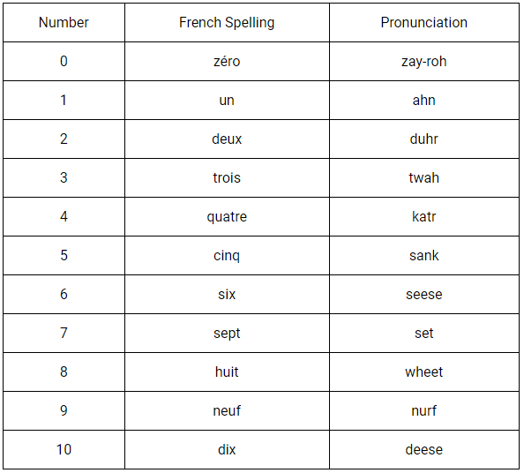
Subtract / minus = ‘moins’ (mwan)
Add = plus (ploo)
equals = Égal (aygal)
How to play LOTO (Bingo):
Pick 5 numbers between 0-10. Write them down.
Listen to my voice as I read out a calculation in French, eg: six moins deux (6-2).
If you have the answer number, cross it off your list.
When you have crossed off all your numbers, shout, “LOTO!”

Slide 7
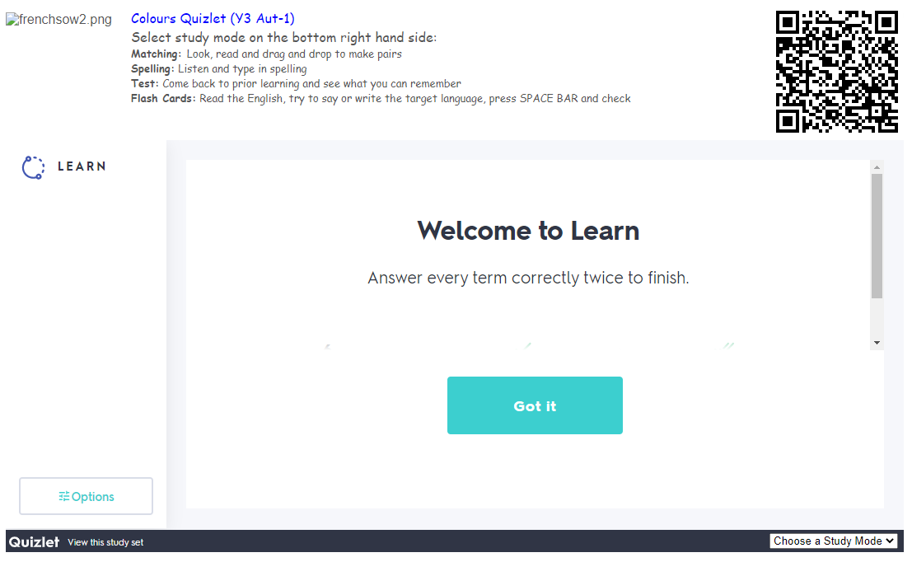
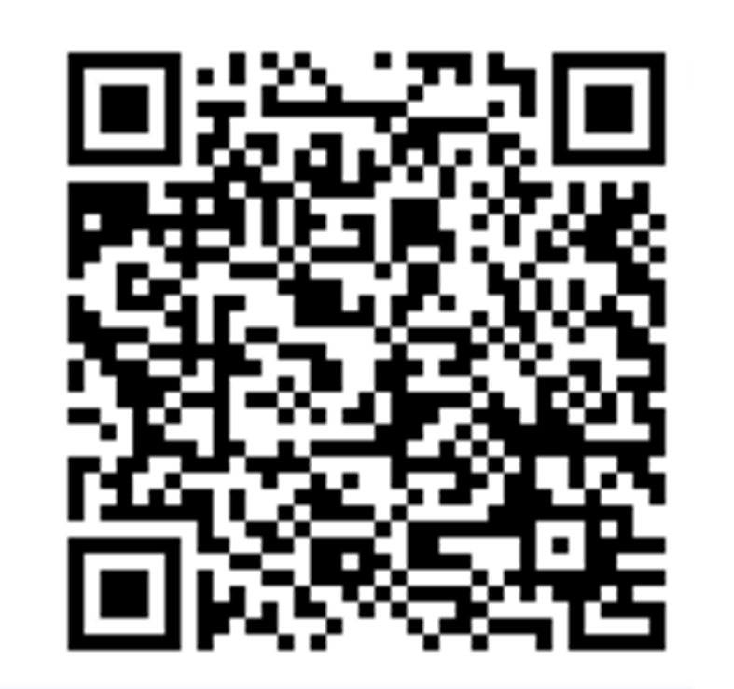
Let’s review our memory of French colours. On this page is a QR code (the black dotty square.) Point a smart phone or device camera at these, and they should link to a website that allows you to play some self assessment games on French colours.
QR code
Click here to chose four types of game to practice your colours. Then try the test!

Slide 8
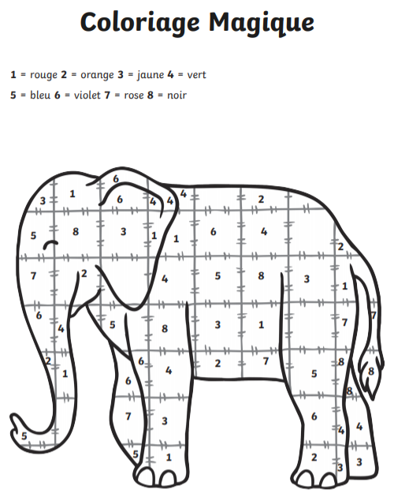
Maths –colour by number

Slide 9
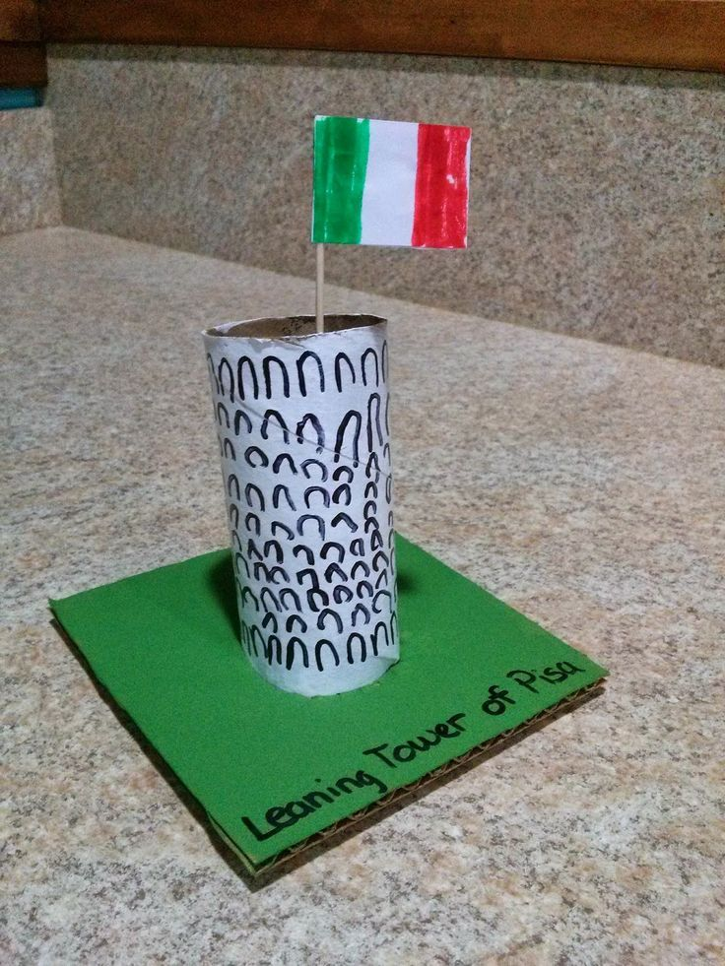
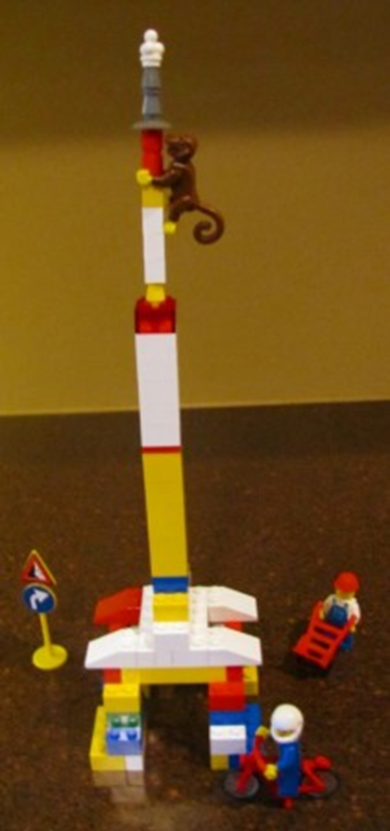
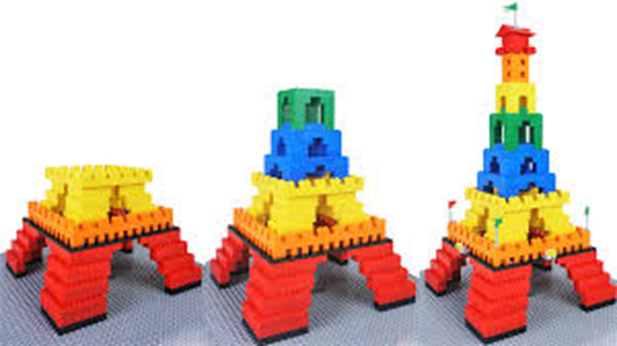
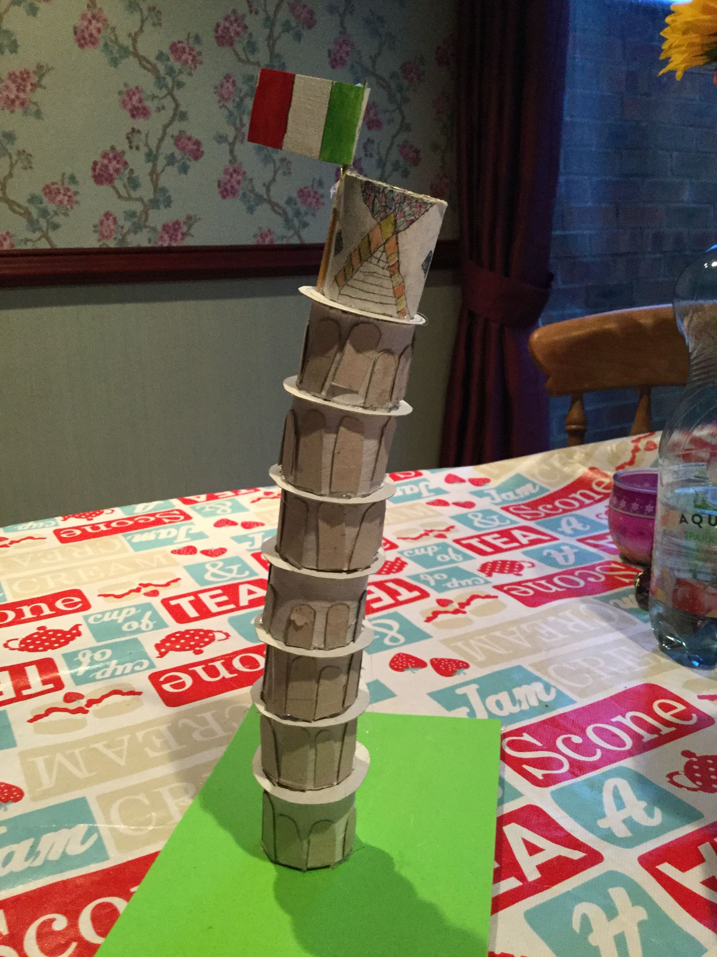
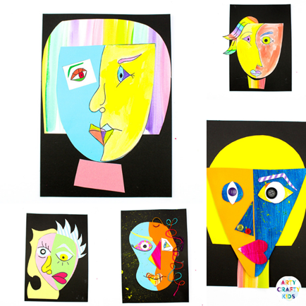
ART / DESIGN & TECHNOLOGY
Research famous European Paintings or Sculptures and recreate them to make your own masterpieces! Photos to the Year 3 email please!
Lego
Eiffel Tower
Leaning tower of Pisa
Picasso

Slide 10
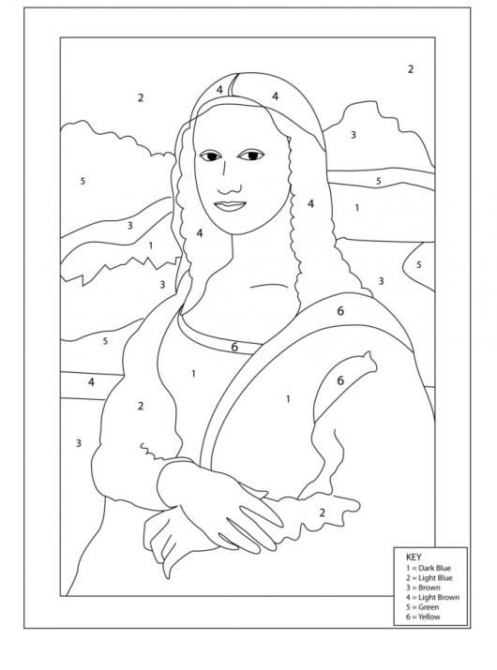
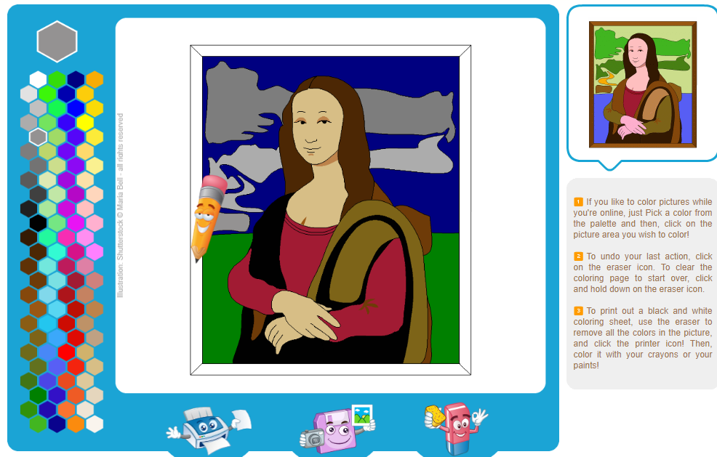
The Mona Lisa
Which famous artist drew and painted this painting?
Where is it kept?
Who was she?
Which other famous paintings did he do?
Create your own Masterpiece!
Try the painting by numbers activity opposite, if you can print out the picture, or have a go online, using the following website below:
https://www.online-coloring.com/coloring-page/mona-lisa-leonardo-da-vinci-103.html

Slide 11
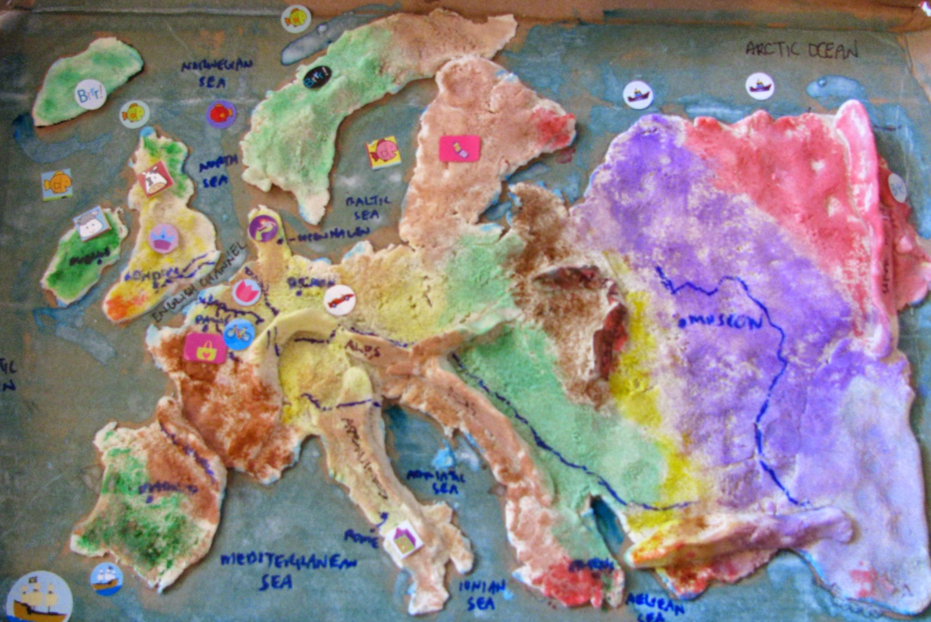
Salt Dough recipe (from BBC Good Food website)
Makes 1 ball
Prep 10 minutes
Cook 3 hours
1 cupful of plain flour (about 250g)
half a cupful of table salt (about 125g)
half a cupful of water (about 125ml)
Method
1. Preheat the oven to its lowest setting and line a baking sheet with baking parchment.
2. Mix the flour and salt in a large bowl. Add the water and stir until it comes together into a ball.
3. Transfer the dough to a floured work surface and shape into your chosen model. You can roll it out and cut out shapes, numbers or letters using biscuit cutters, or make any kind of model you can think of. We made some fruit and veg shapes plus cupcakes for a teddy bear’s picnic.
4. Put your finished items on the lined baking sheet and bake for 3 hrs or until solid.
5. Leave to cool and then paint.
Make a salt dough map of Europe (or anything else you fancy!

Slide 12
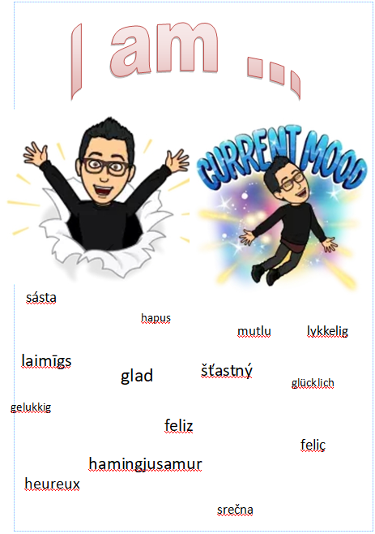
Mindfulness – Can you create a poster about you, using one adjective? In French, the adjective ‘heureux’ means ‘happy’. The different ways of saying this in other languages are shown here.
Write a positive poster about you using one adjective “I am …”
happy

Slide 13
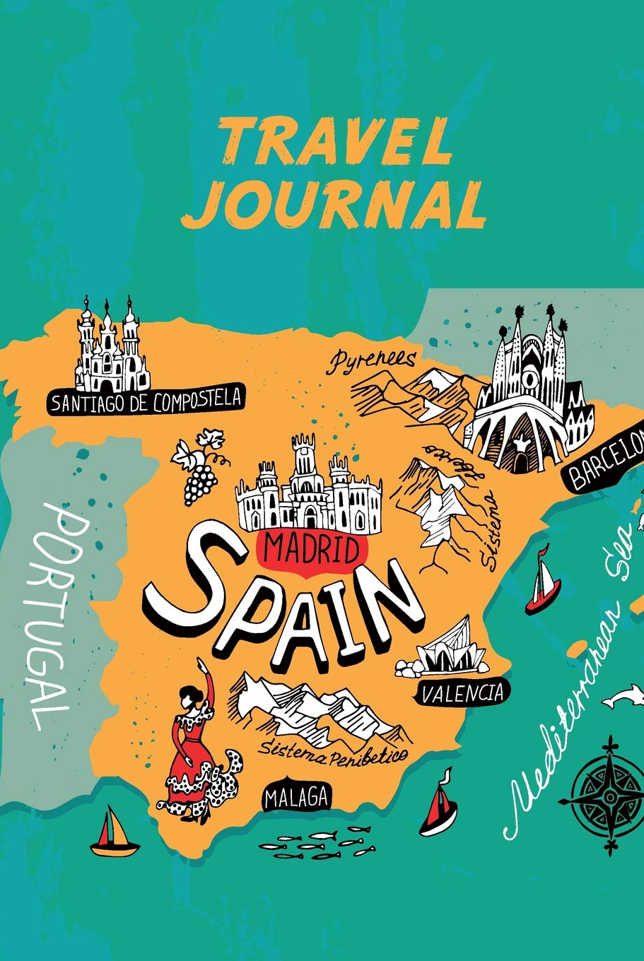
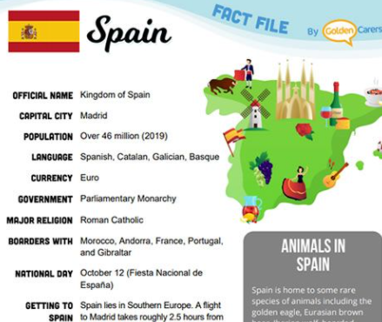
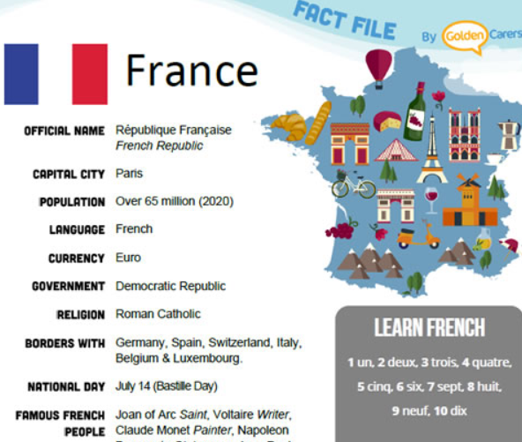
Geography/English- European Country fact finding poster
Your task is to create a fact file about a European country of your choice. Include pictures, traditions, flags, capital city.

Slide 14
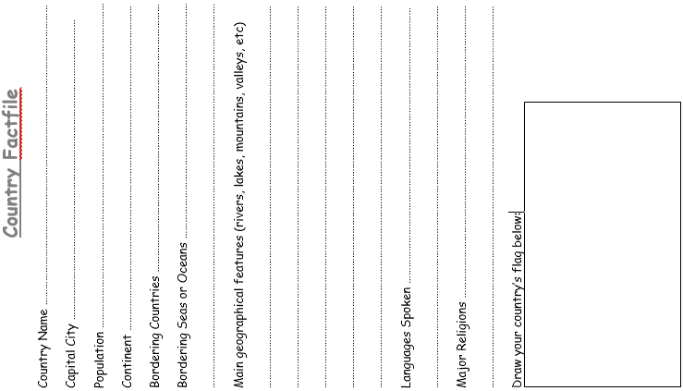
Either print out and use, create your own, or copy and complete!

Slide 15
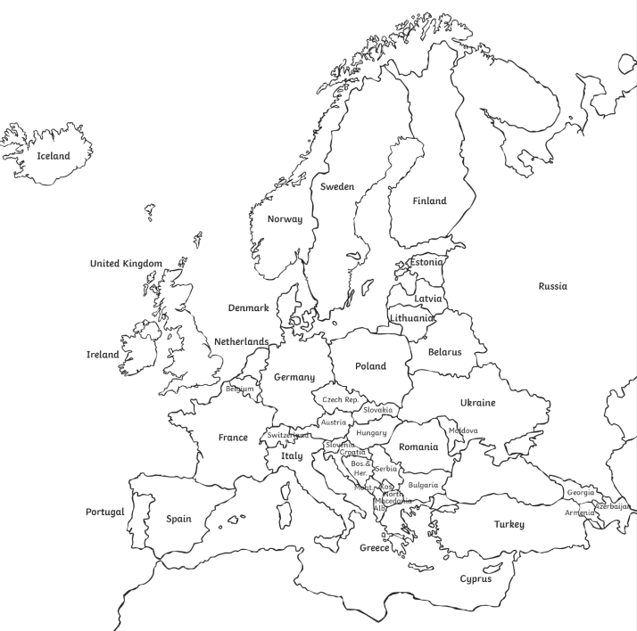
Colour your chosen country in, for your fact file.

Slide 16
TONGUE TWISTERS!
Like English, most other languages have tongue twisters. From, ‘Around the rugged rock, the ragged rascal ran’, to ‘red leather, yellow leather’, one aspect of mastering a language is being able to master its tongue twisters. They are always decidedly odd sentences:

Slide 17
Let’s warm up in our own language first…
Some short words or phrases ‘become’ tongue-twisters when repeated, a number of times fast (try it!):
Thin Thing
French Friend
Red Leather, Yellow Leather
Unique New York
Sometimes Sunshine
Irish Wristwatch
Big Whip

Slide 18
Now for some more testing tongue-twisters…
How much wood would a woodchuck chuck if a woodchuck could chuck wood? A woodchuck would chuck all the wood that he could if a woodchuck could chuck wood!
Sister Sue sells sea shells. She sells sea shells on the seashore. The shells she sells are sea shells she sees. Sure, she sees shells she sells.
You've known me to light a night light on a light night like tonight. There's no need to light a night light on a light night like tonight, for a night light's a slight light on tonight's light night!

Slide 19
Now try this!
Combien de sous sont ces saucissons-ci? Ces saucissons-ci sont six sous (French):
“How much are these sausages here? These sausages here are six cents”.

Slide 20
And these two gems!
Als vliegen achter vliegen vliegen, vliegen vliegen vliegensvlug.
(Dutch): ”If flies fly behind flies, flies will fly like lightning”.
Zwei schwarze schleimige Schlangen sitzen zwischen zwei spitzen Steinen und zischen.
(German): “Two black slimy snakes sit between two pointed stones and hiss”.

Slide 21
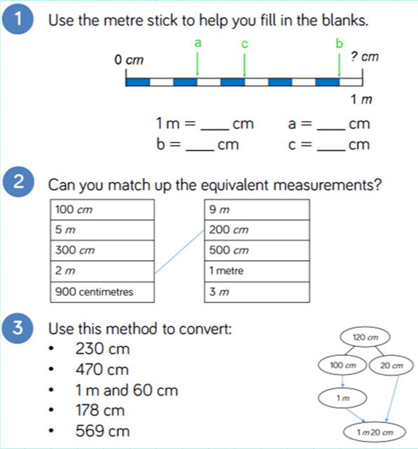
Maths
To compare and order lengths using the same units or different units.
Introduction

Slide 22
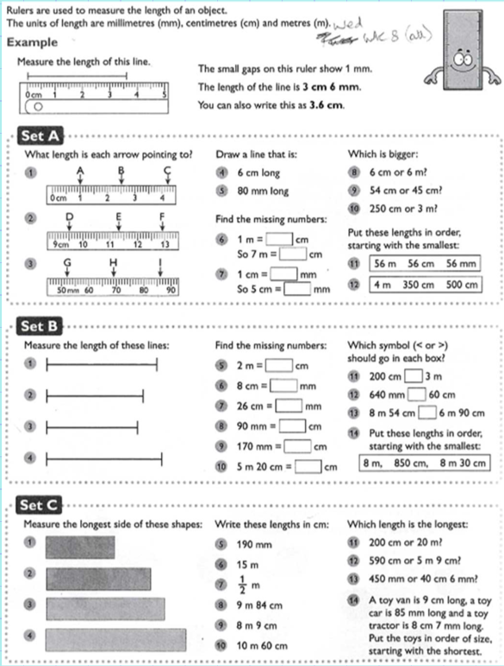
Activity for all:
Set A – 1*
Set B – 2*
Set C – 3*

Slide 23
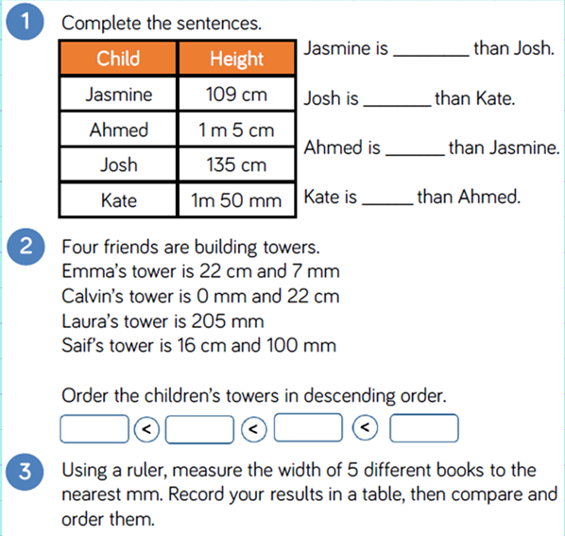
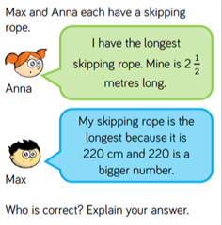
EXT
Plenary

