Slide 1
Year 3 Home School Provision Daily Pack
The following slides will be split into 4 separate activities.
They will consist of Maths, English, Reading and one other subject.
Each slide will be daily activities for you and your child to do at home.
We as a Year 3 team, will update these slides daily to the website – please keep an eye out!
Please email NJS.Year3@taw.org.uk with any queries to share any work and one of the Year 3 teachers will get back to you as soon as possible!
Thank you for your understanding and on going support during these times.

Slide 2
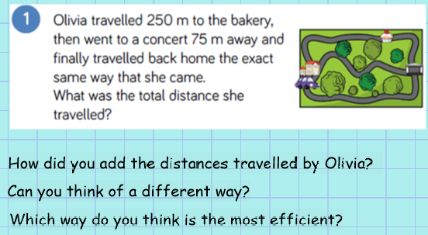
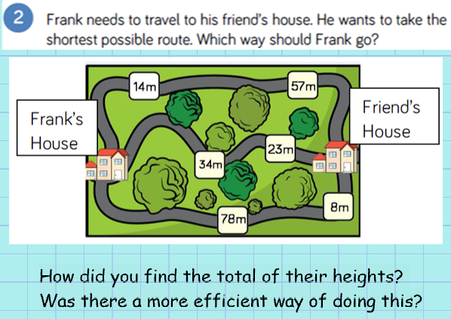
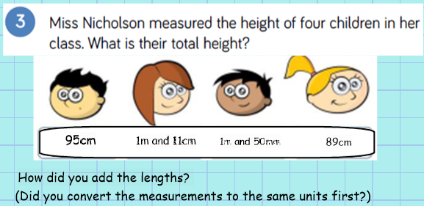
Maths
To add and subtract lengths using reasoning to solve problems.
Introduction

Slide 3
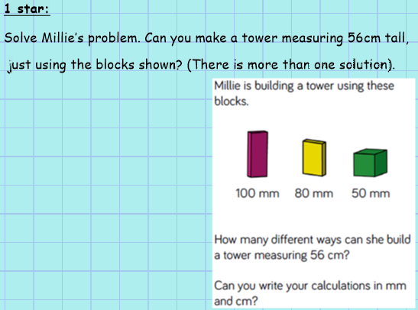
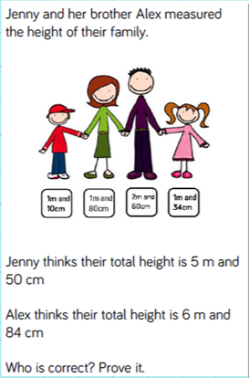
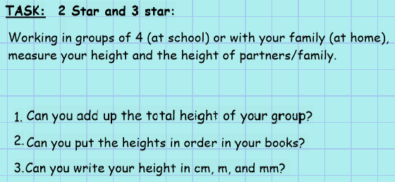
Plenary

Slide 4
English: Objective: To write imaginatively and creatively for an explanation text.
Thursday 21st January
Today, any idea you write is great!
There are no wrong or silly ideas. Be as fun and creative as you can be!
You need to think of an imaginative explanation as to how animals got their specific and recognisable traits!
You could write about and explain:
How did an elephant get its trunk?
How did a giraffe get its long neck?
How did a leopard get its spots?
How did the salt get into the sea?
How did the rabbit get long ears?
How did a zebra get its stripes?

Slide 5
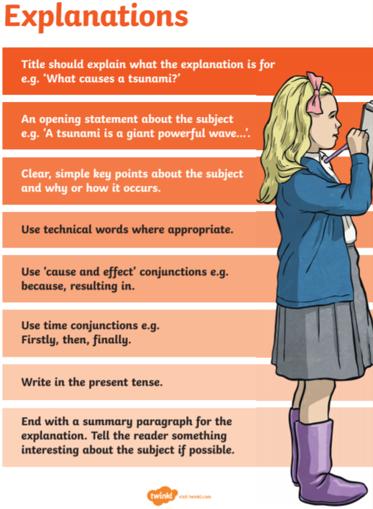
English support resources:

Slide 6
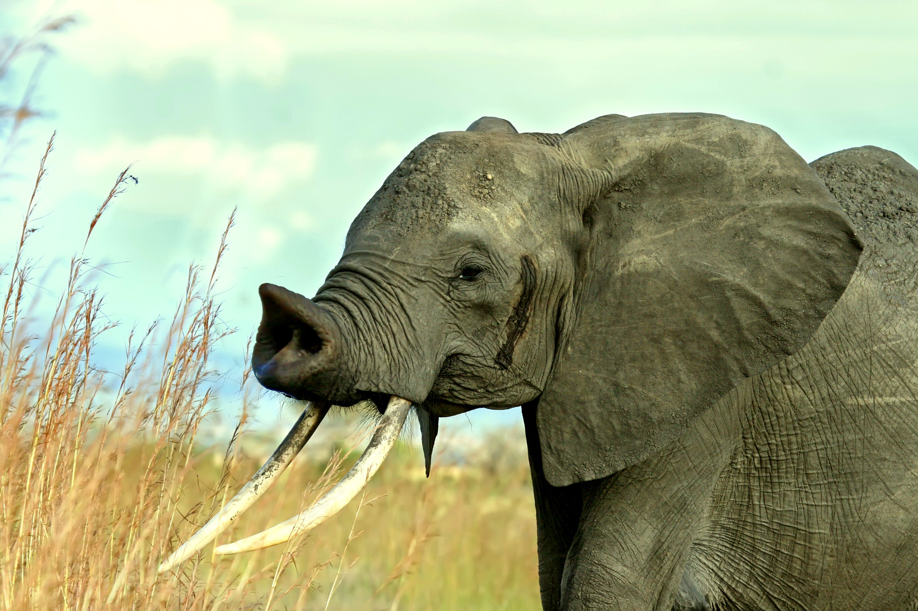
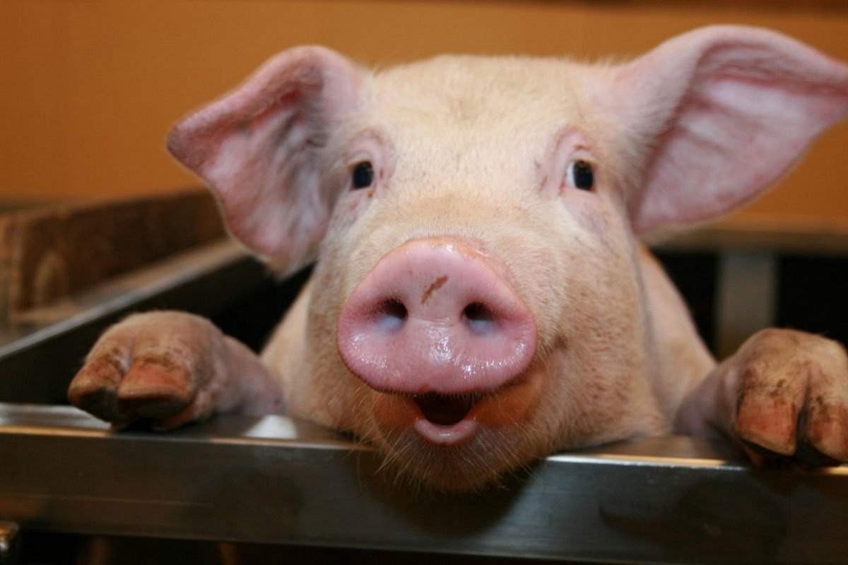
Mr Parker’s English example.
How did an elephant get its trunk?
This explanation text will explain to you how an elephant got its trunk.
There are many different rumours and many scientists have tried to find the answer to this long pondered question. Today, you will discover the truth.
Elephants are part of the same family that pigs belong to. Just like pigs, they used to have short noses and these noses are used to smell.
However, as elephants grow, they use their noses for more and more jobs to help them get food or to aid in doing other jobs.

Slide 7
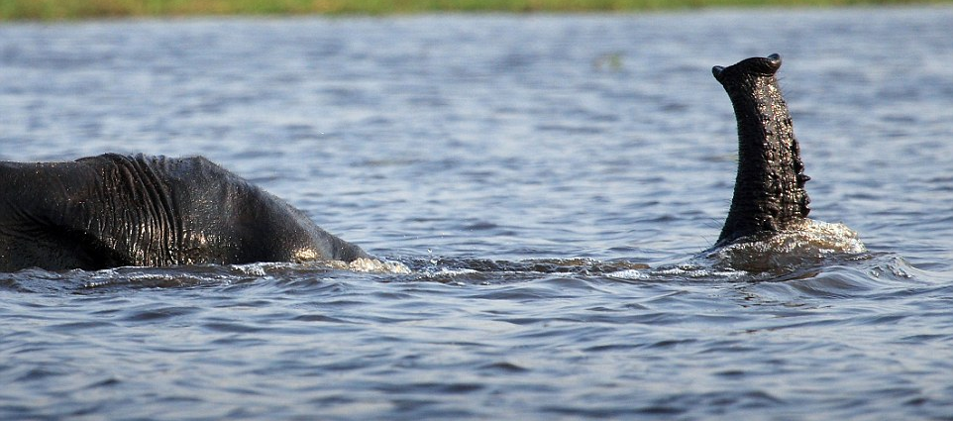
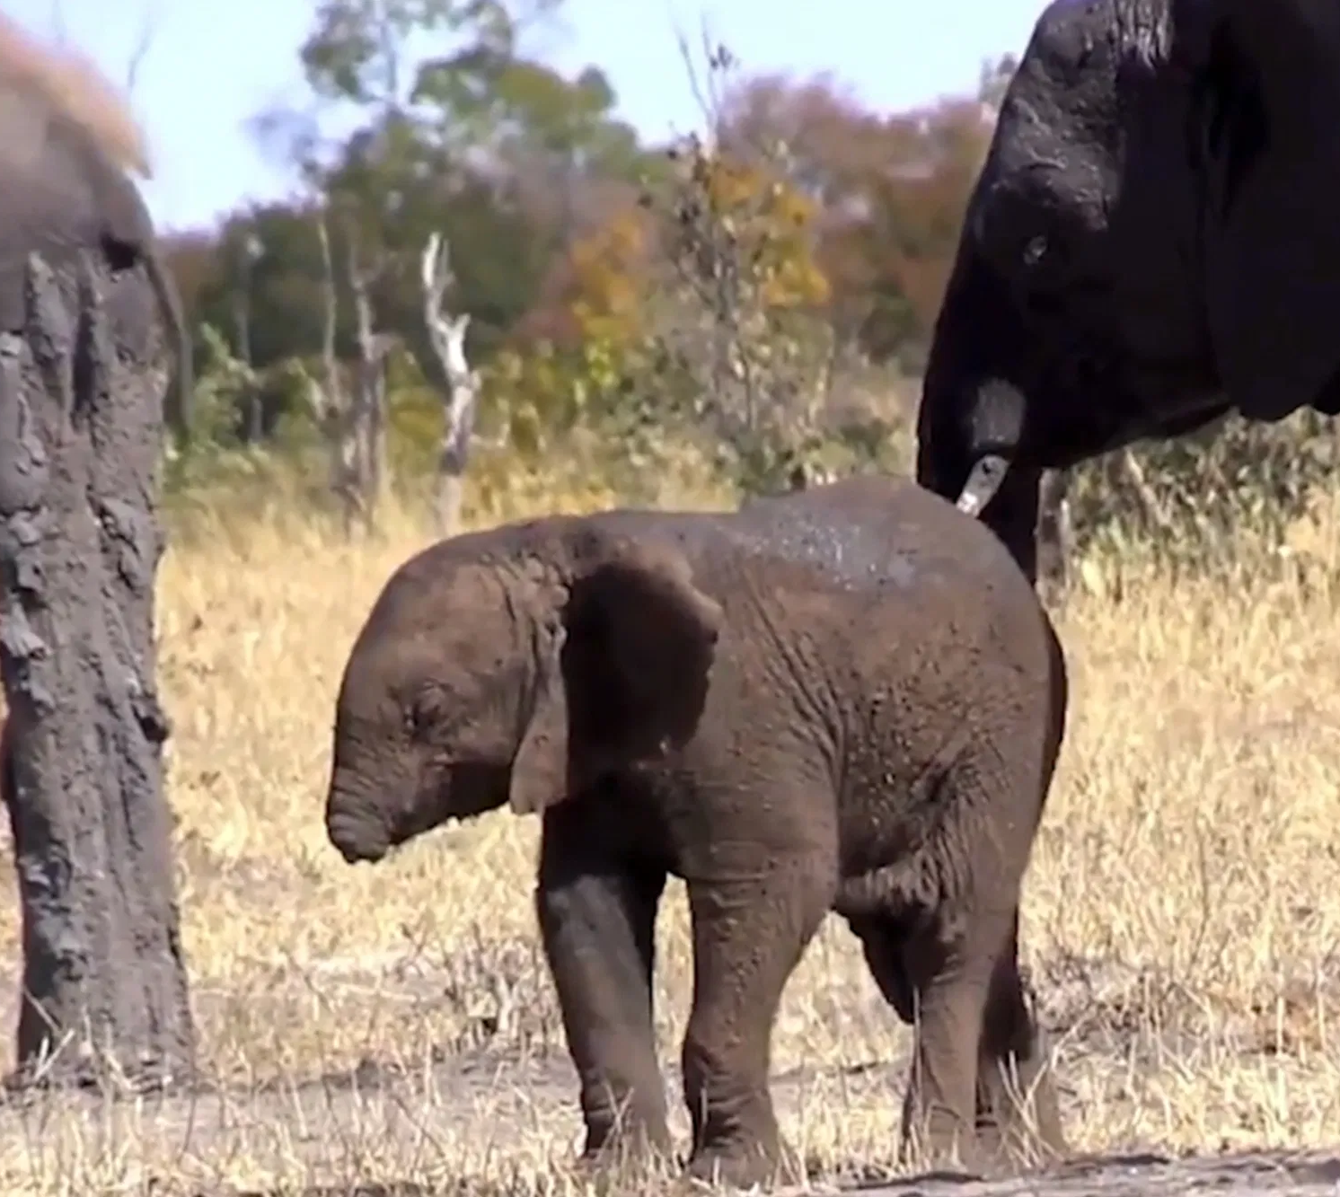
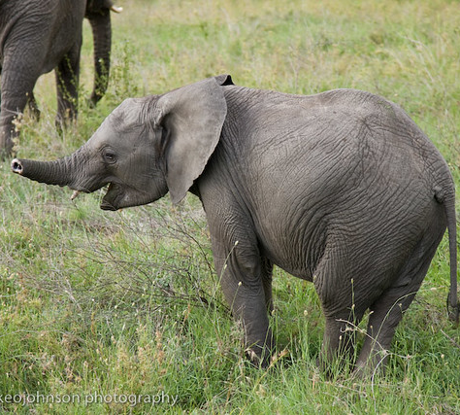
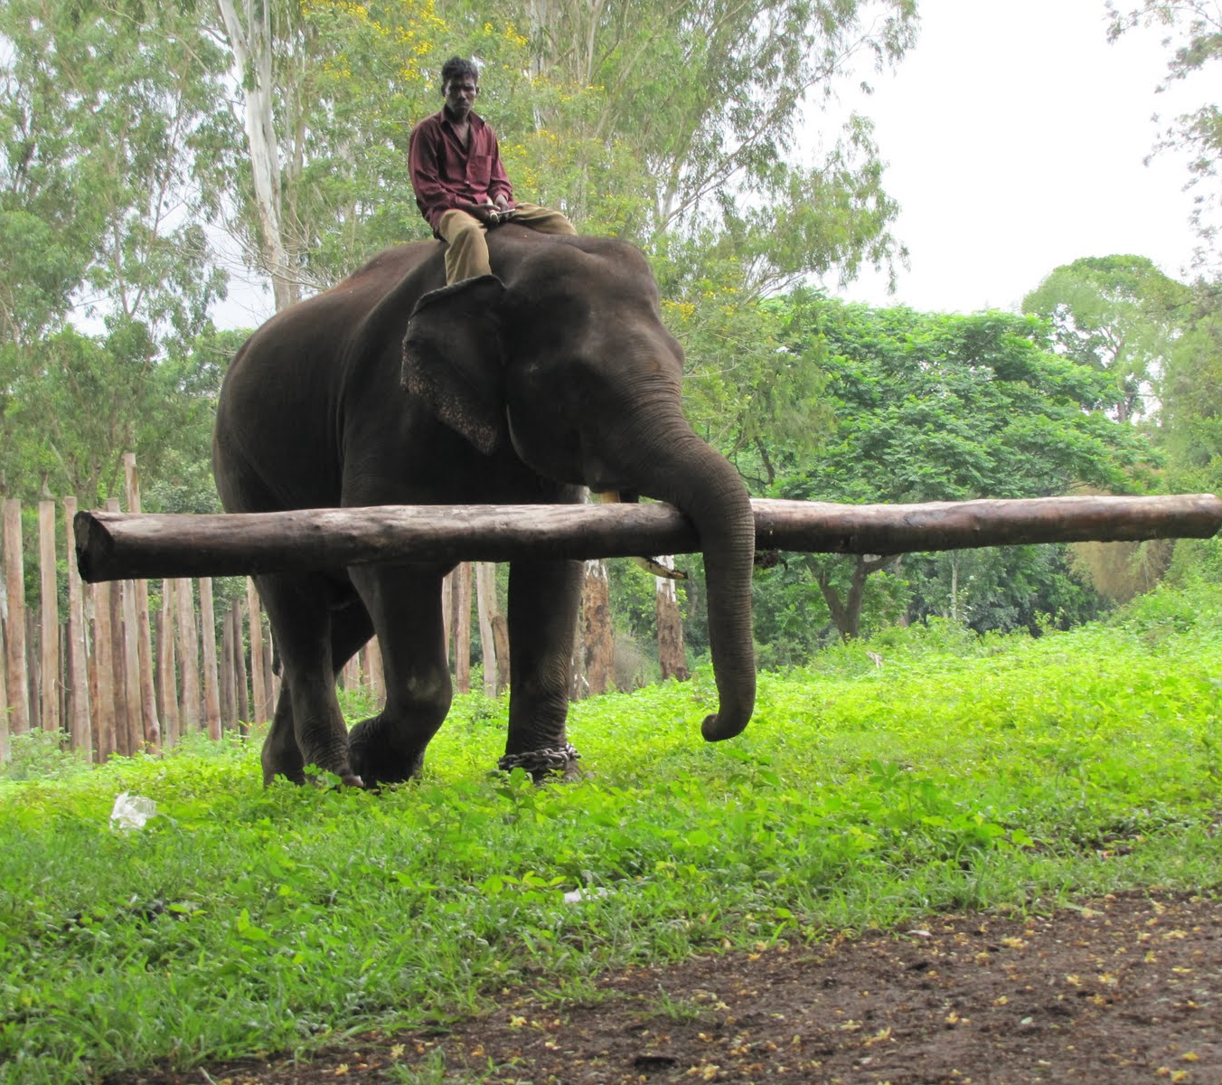
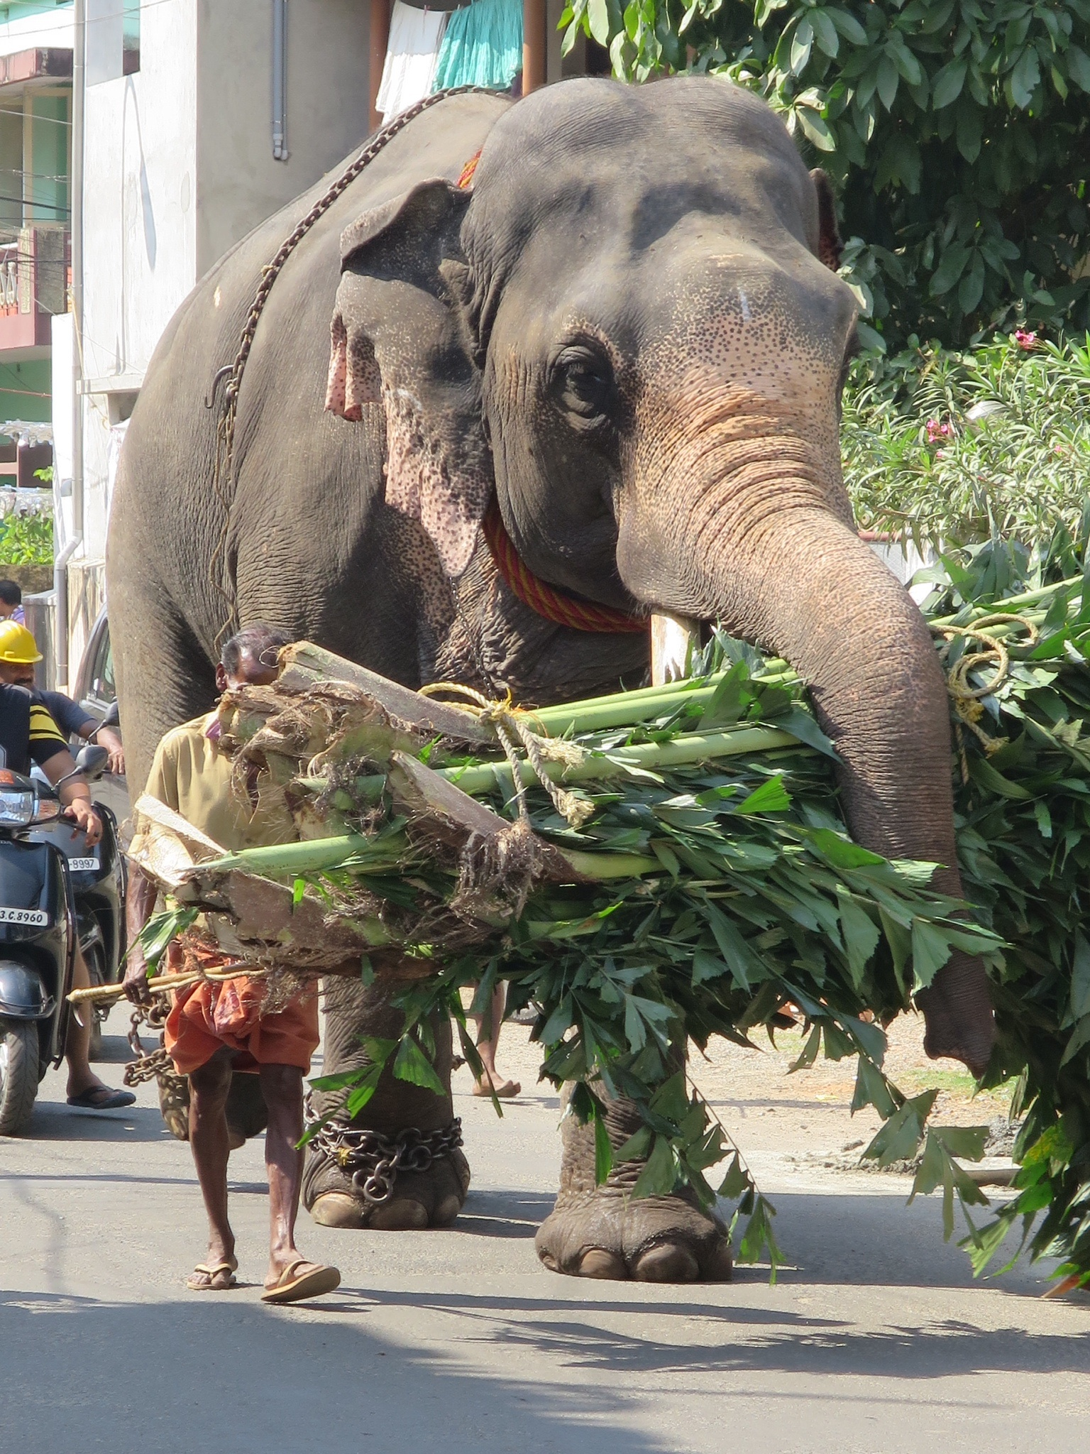
Did you know?
Did you know that an elephant’s trunk is able walk under water? They use their trunks by holding them in the air and use it to breathe whilst walking along the riverbed!
When elephants are 10 months old, they begin to use their noses for these jobs as they learn. However, if they lift too much their noses eventually start to become longer and longer. Eventually, having used their noses for so much and lifting heavy objects they begin to get longer and not shrink back to its original size. The nose is now up to 15x larger now and is called a trunk.
In conclusion, if the elephant never lifted anything with its nose then they would still be short- just like when they are young!

Slide 8
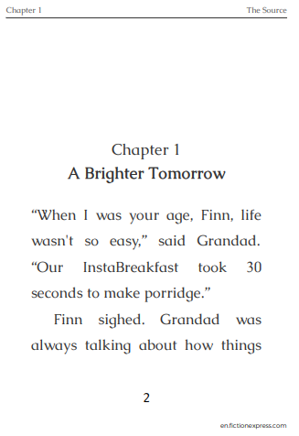
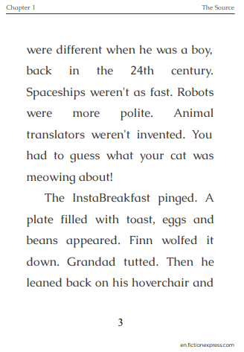
Reading - Thursday 21st January
To identify new vocabulary and understand its meaning
Re-read the chapter before you attempt the work. Practice reading aloud with an adult listening, if possible, recording it in your reading diary.

Slide 9
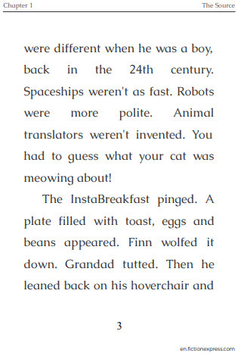
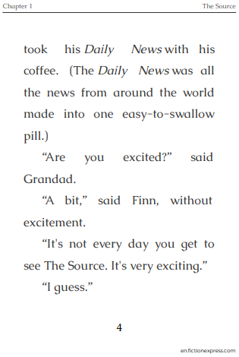

Slide 10
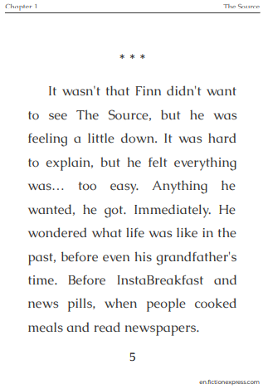
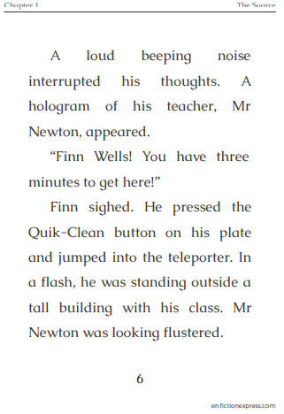

Slide 11
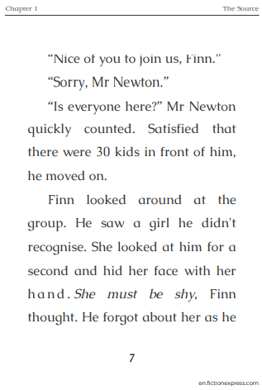
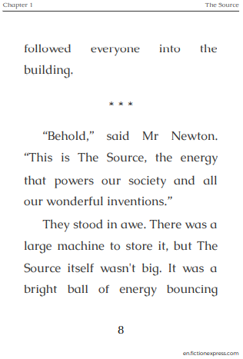

Slide 12
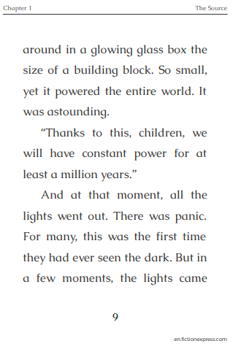
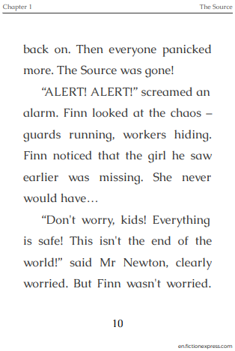

Slide 13
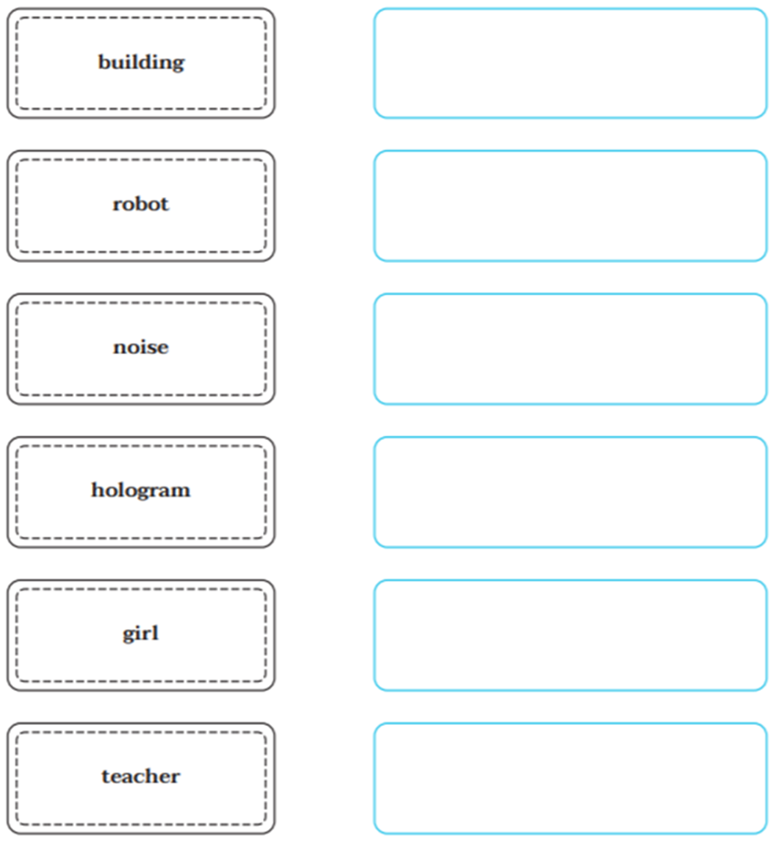
TASK (all)
Complete the task opposite. How could you describe the words in sentences which explain a few more details about them? E.g.:
It was a tall, grey building, with lots of small, square windows.
EXT: Find other words in the chapter which you do not know. Find out what they mean and write them in a sentence.
Remember – log in to Fiction Express and click on the underlined words to find out what they mean.

Slide 14
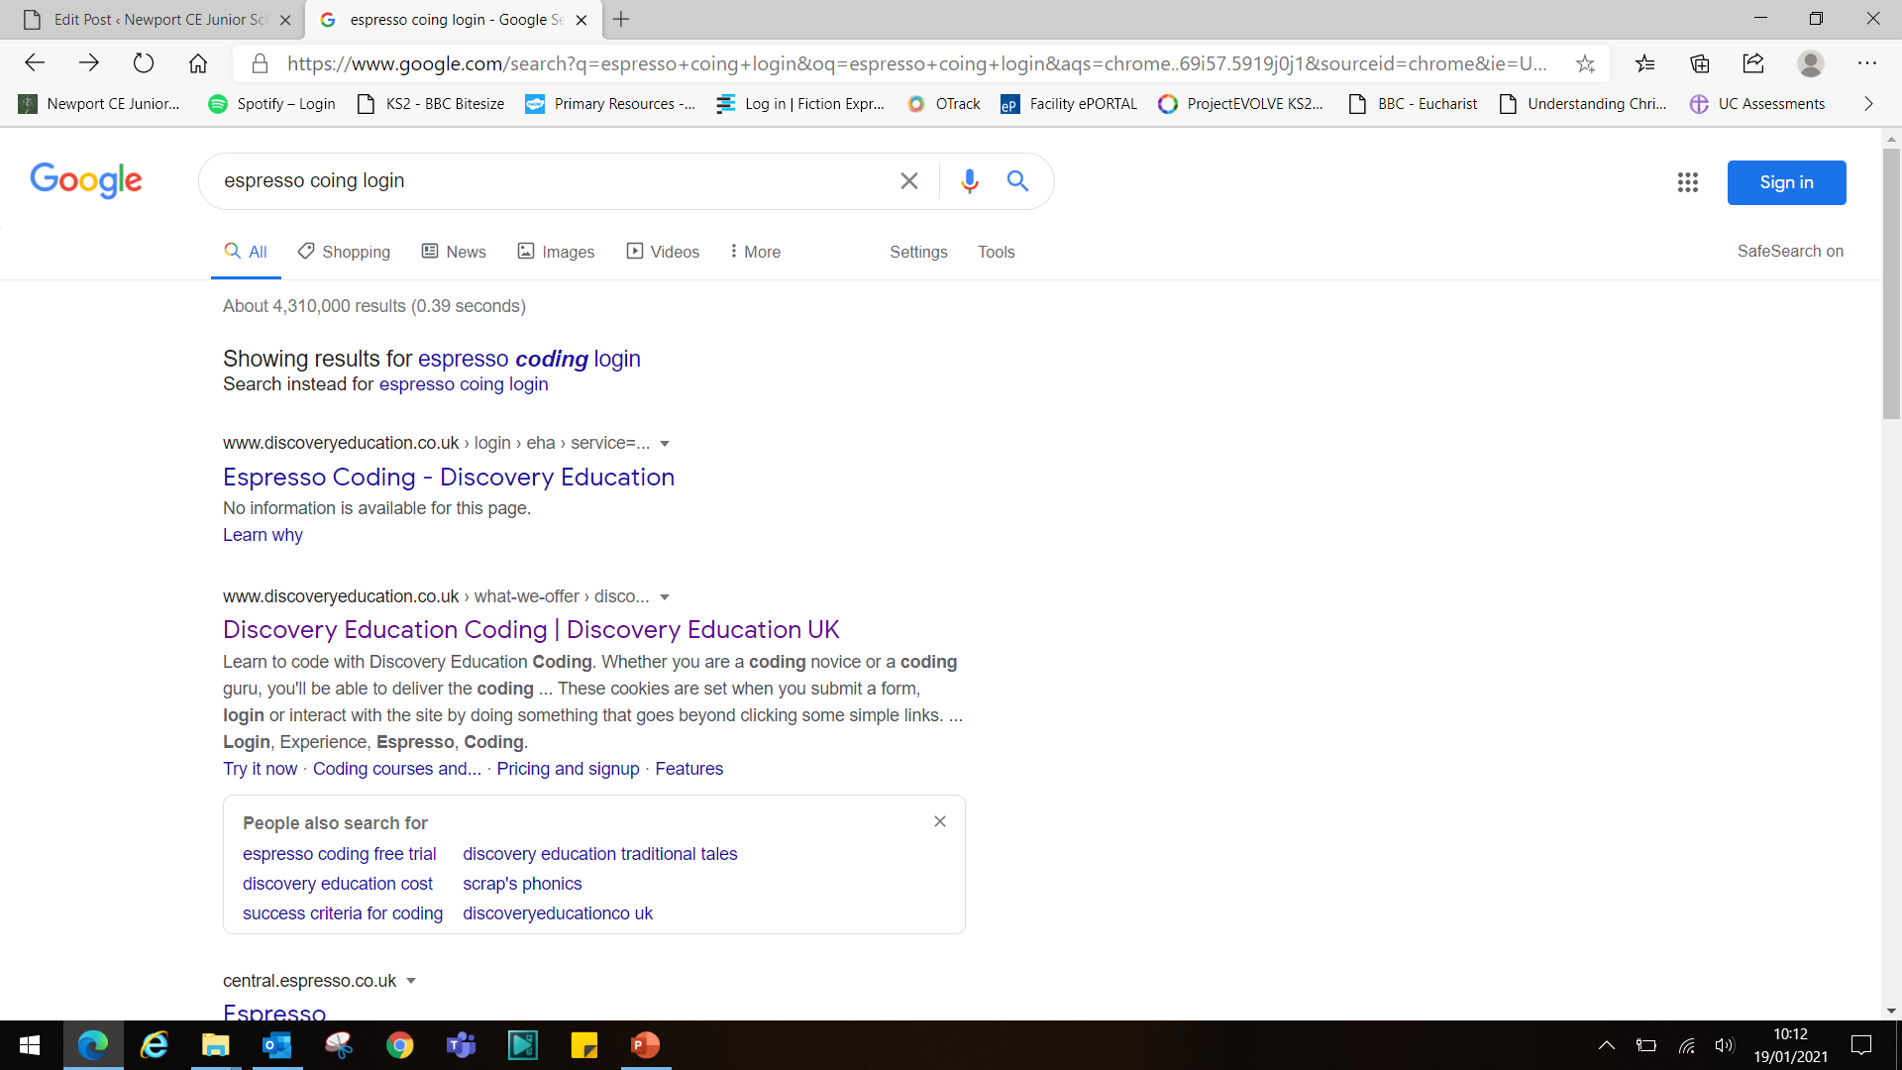
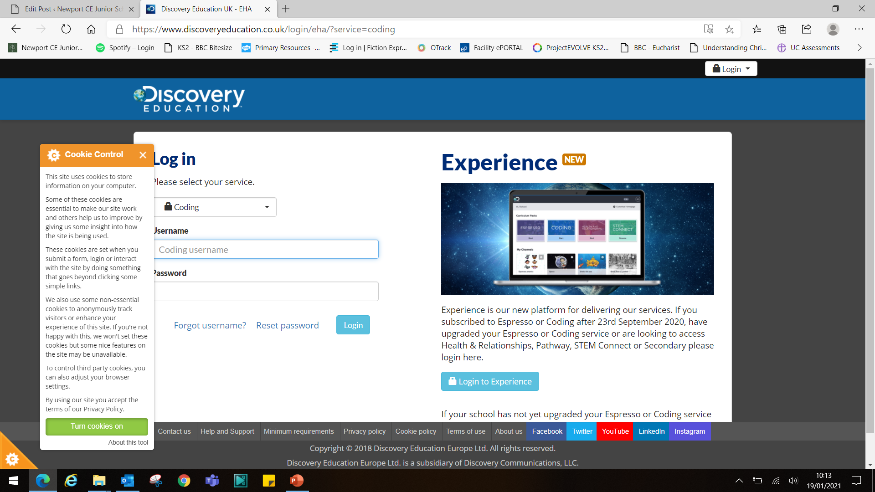
Computing – Conditional programming using Espresso Coding. To use ‘if’ statements when programming.
Children have already accessed Espresso Coding in school, so should be familiar with this software program.
Open up google and type in ‘Espresso Coding Login’ and it should take you to…
…this page. Click the first link down, shown above and it should open…
…this page. Turn cookies ‘ON’.

Slide 15
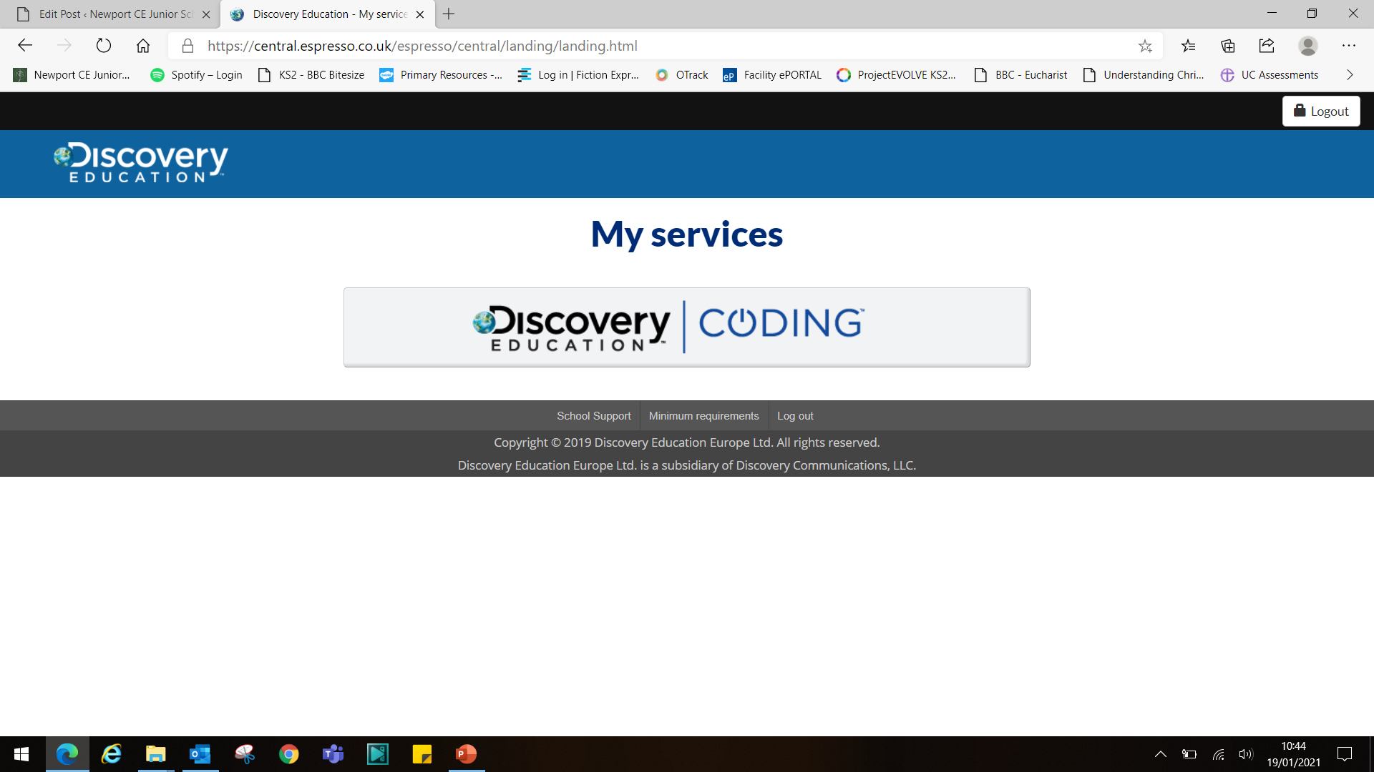
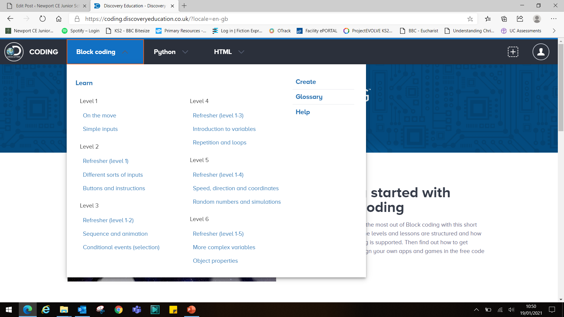
Log in to the website using the username below. The password is
newport (all lower case).
Click on the Coding link…
Once you land on this page, click the ‘Block Coding’ drop down arrow, and the options shown here will be presented to you.
Click the ‘Level 3 – Conditional events (selection) link.

Slide 16
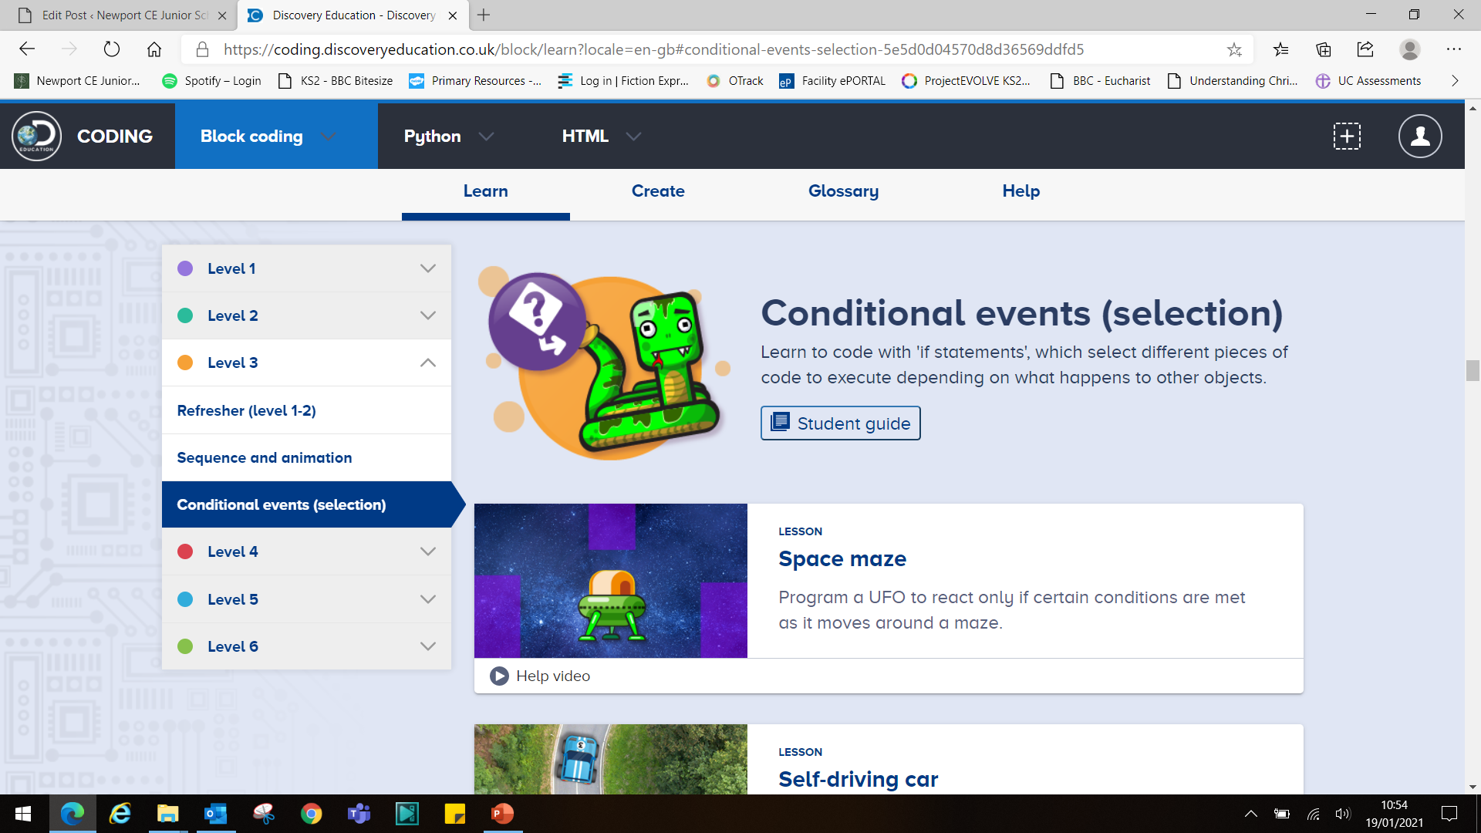
Finally, you should arrive at the main page for level 3 (Y3) lessons.
Have a go at the first lesson, ‘Space Maze’
Before you start, read the ‘Student guide’, so you know what the lesson should be about. The following slides show the student guide for this lesson. Enjoy!

Slide 17
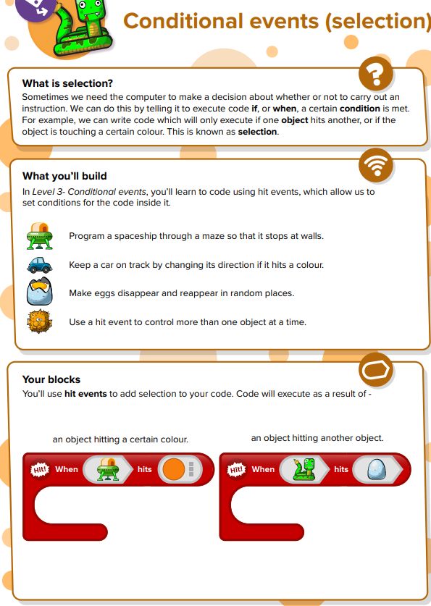
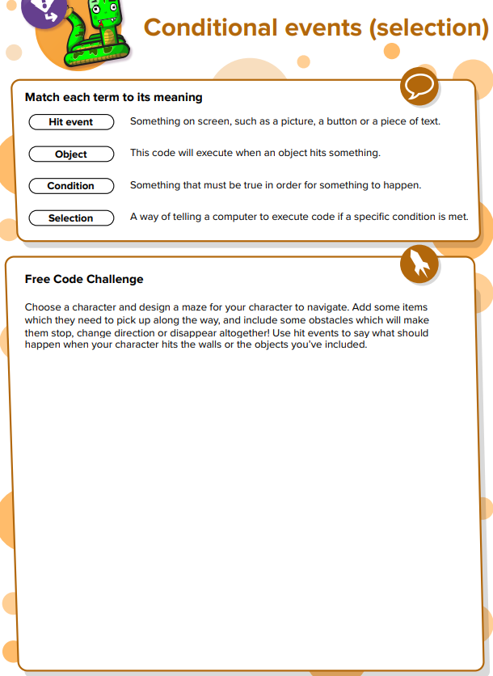

Slide 18
