Slide 1
Year 3 Home School Provision Daily Pack
The following slides will be split into 4 separate activities.
They will consist of Maths, English, Reading and one other subject.
Each slide will be daily activities for you and your child to do at home.
We as a Year 3 team, will update these slides daily to the website – please keep an eye out!
Please email NJS.Year3@taw.org.uk with any queries to share any work and one of the Year 3 teachers will get back to you as soon as possible!
Thank you for your understanding and on going support during these times.

Slide 2
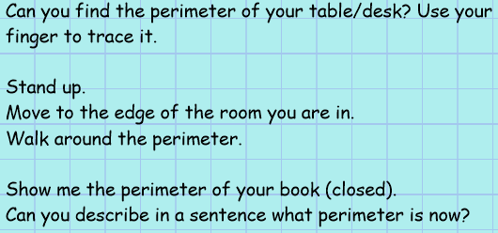
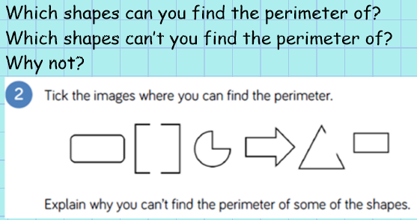
Maths
To understand and measure perimeter.
Introduction

Slide 3
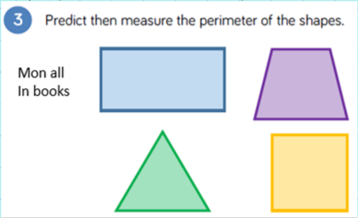
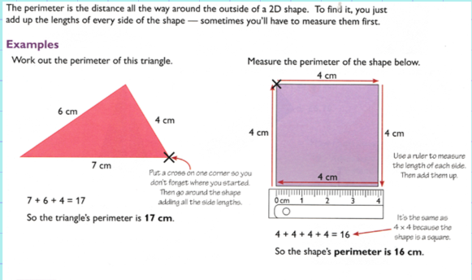
Support/method:

Slide 4
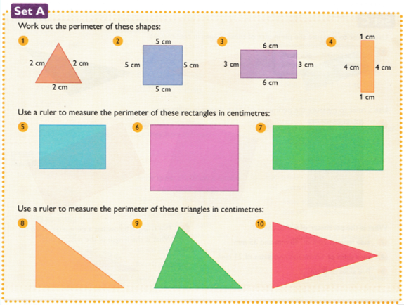
Set A – 1 *

Slide 5
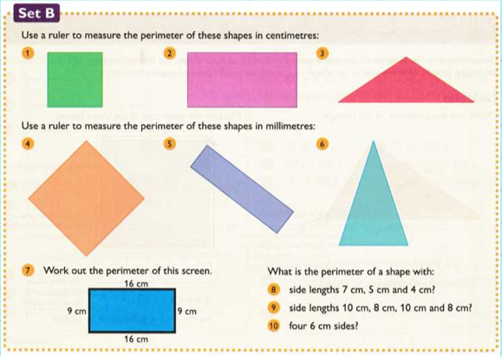
Set B – 2 *

Slide 6
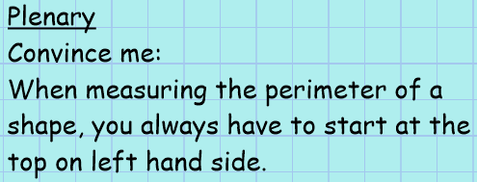
Set C – 3 *

Slide 7
English- Objective: To participate in discussion about both books that are read to them and those they can read for themselves.
Friday 22nd January
On Thursday 14th January, Mr Parker read chapter 2 of Harry Potter and the Chamber of Secrets- Dobby’s Warning. (if you haven’t seen it yet, it is on the Newport CE Junior School Facebook page).
Today, you will be completing various activities related to that chapter. Please see on the slides below your English activities.
If you would prefer, you can also read chapter 2 yourself or with a grown up.
Also, yesterday, Mr Parker read Chapter 4 of Harry Potter and the Chamber of Secrets – At Flourish and Blotts.

Slide 8
Activities
Dobby the house-elf appears in Harry’s bedroom in Privet Drive in Chapter 2, ‘Dobby’s Warning’, and tries to stop him returning to Hogwarts. Why? What is Dobby’s role in this story? Discuss the humorous aspects of his nature too.
Take part in the online quiz about Chapter 2 https://www.sparknotes.com/lit/potter2/section2/?quickquiz_id=5932

Slide 9
Reading – Friday 22nd January
To discuss and write words and phrases that capture the reader’s imagination.
TASK – ALL
Using the chapter text that I have highlighted on the next few slides, find words, phrases and sentences to describe the setting in the story.

Slide 10
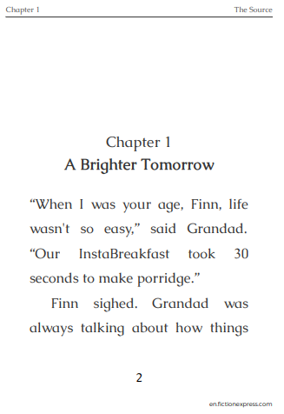
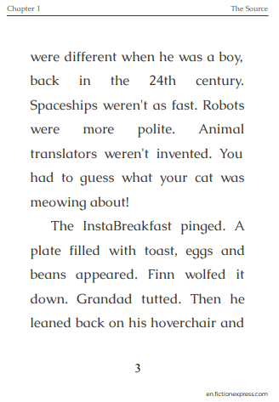
Reading - Tuesday 19th January
To retrieve, infer and explain information about a text.
Re-read the chapter before you attempt the work. Practice reading aloud with an adult listening, if possible, recording it in your reading diary.
Remember that if you need to listen to it being read, usually the

Slide 11
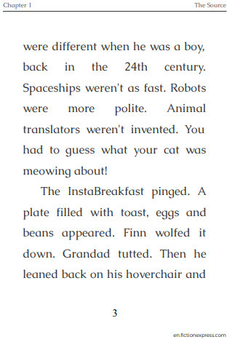
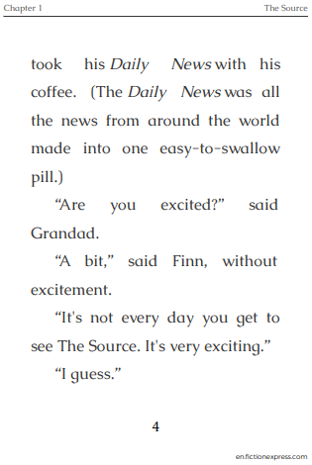

Slide 12
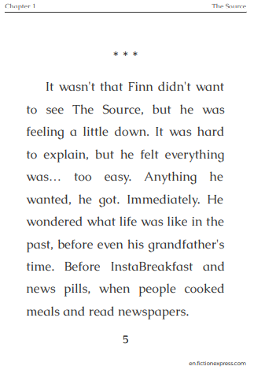
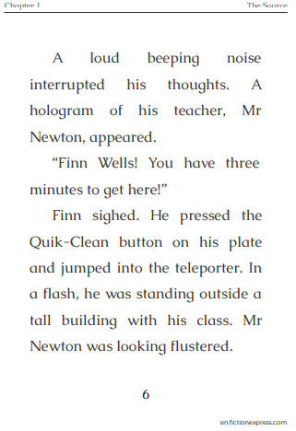

Slide 13
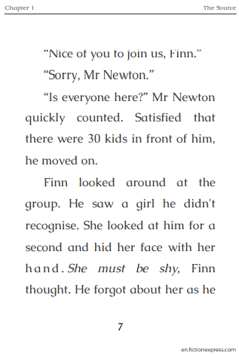
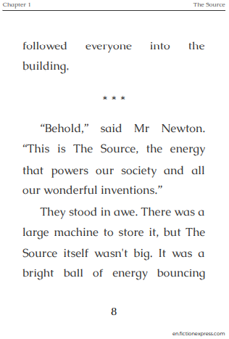

Slide 14
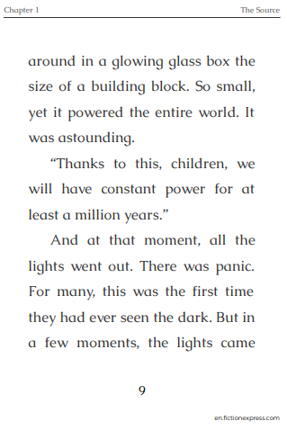
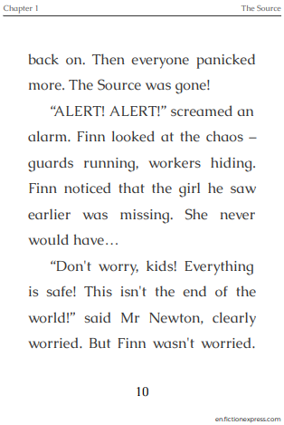

Slide 15
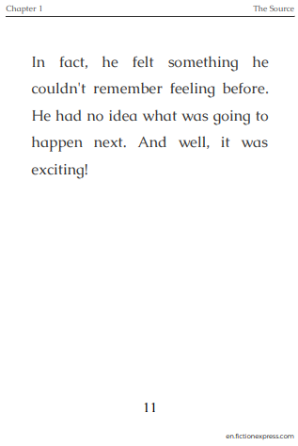
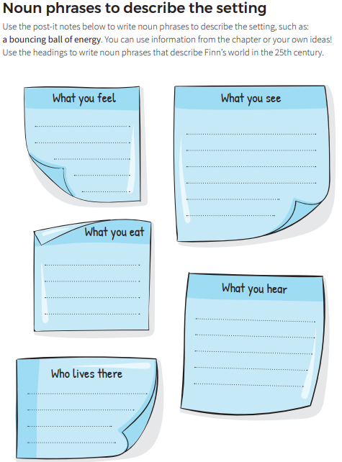
Several examples have been done for you.
Everything is too easy.
Spaceships, robots

Slide 16
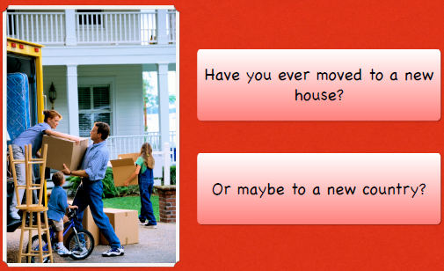
Topic
To understand the terms ‘invade’ and ‘settle’ and to place the Romans on a timeline.

Slide 17
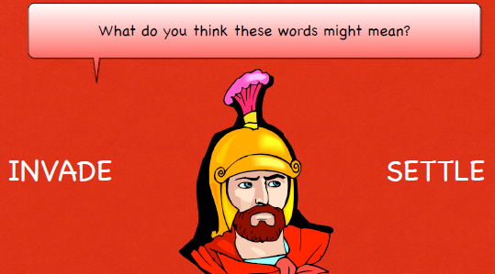

Slide 18
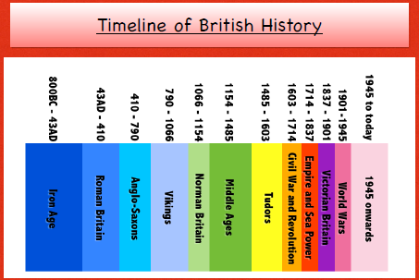

Slide 19
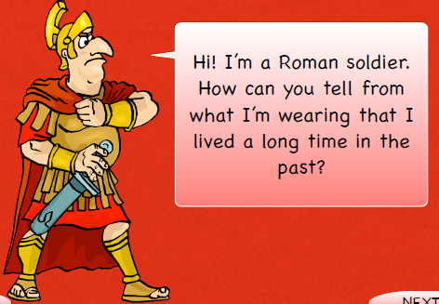
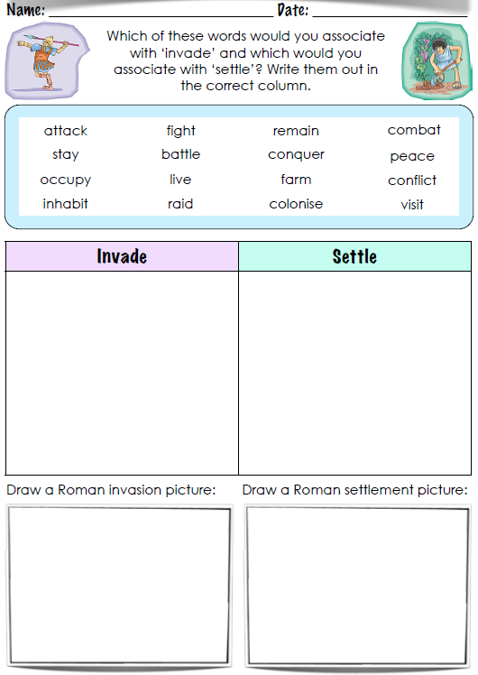
Activity:

