Slide 1
Year 3 Home School Provision Daily Pack
The following slides will be split into 4 separate activities.
They will consist of Maths, English, Reading and one other subject.
Each slide will be daily activities for you and your child to do at home.
We as a Year 3 team, will update these slides daily to the website – please keep an eye out!
Please email NJS.Year3@taw.org.uk with any queries to share any work and one of the Year 3 teachers will get back to you as soon as possible!
Thank you for your understanding and on going support during these times.

Slide 2
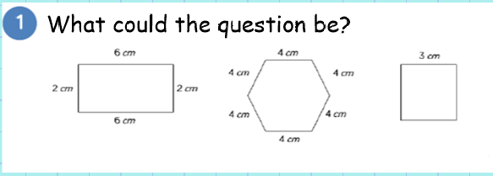
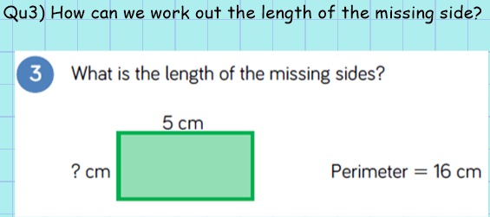
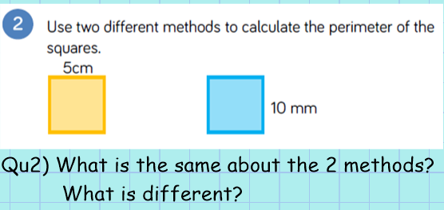
Maths
To measure perimeter and solve problems involving perimeter.
Introduction

Slide 3
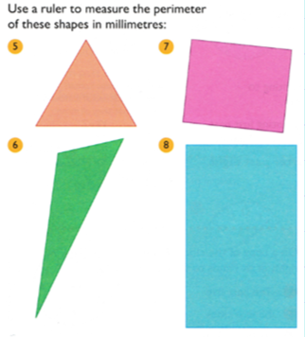
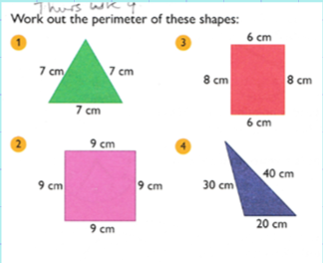
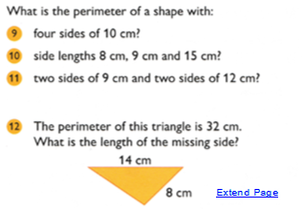
Task - all

Slide 4
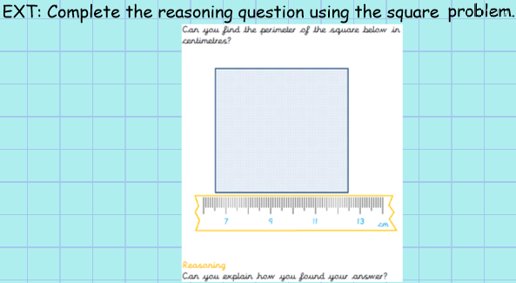
Plenary: Can you explain your reasoning for the question above? Explain why. Explain how you know.

Slide 5
English- Today we are going to start our unit on Recounts and Diary Writing’!
Who uses a diary?
Why is it important for some people to write in diaries?
How are diaries set out?
What information goes in a diary?

Slide 6
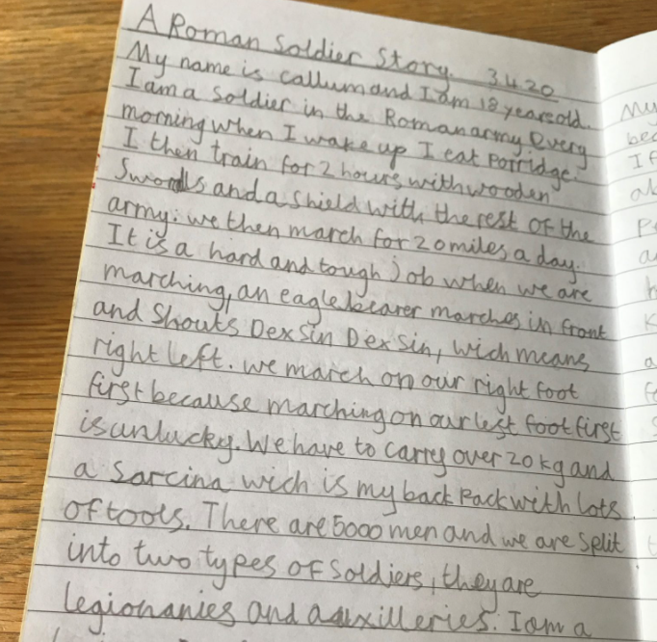
An extract from a diary:

Slide 7
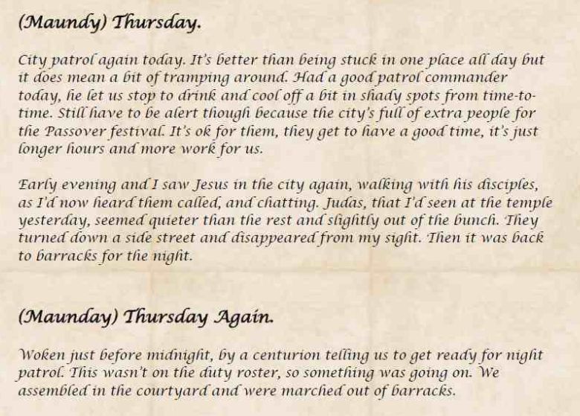
How might diaries be useful?

Slide 8
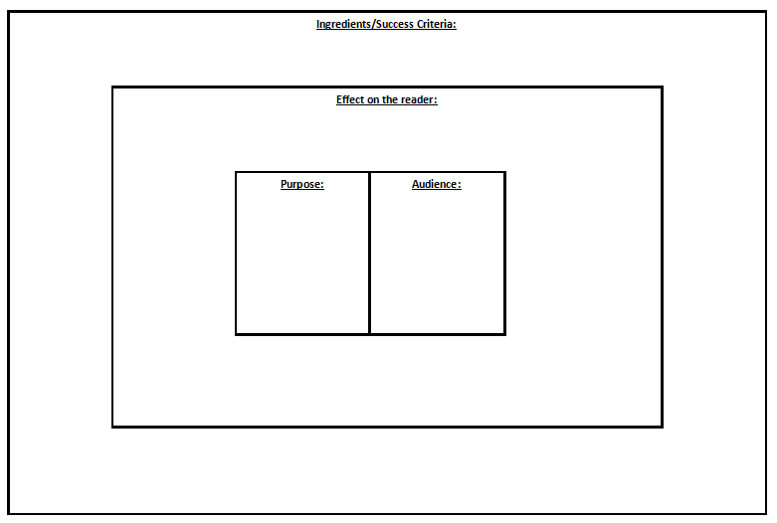
We have seen this ‘Big Picture’ before in English. We use it at the start of a new unit
Spend some time looking at the ‘Big Picture’ and decide what you need to write in the boxes.
What things can you add in?
Have a try at coming up with your own ideas before clicking on to the next page!

Slide 9
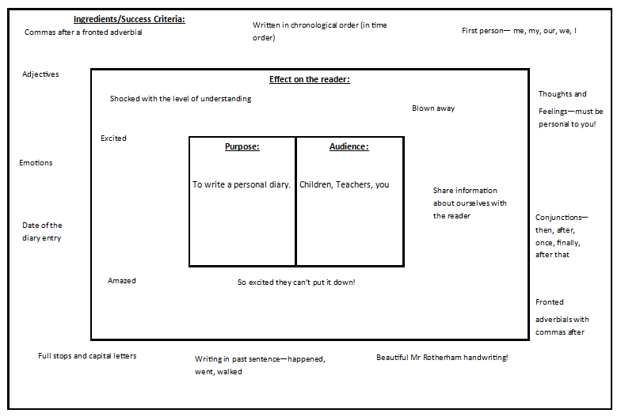
Take a look at this one for some ideas! Feel free to add some more to yours…

Slide 10
READING – New chapter – ‘The Source’ (Fiction Express)
To justify predictions with evidence from the text. To retrieve information, and justify inferences made, with evidence from the text.
Log in to Fiction Express and open up Chapter 2 of ‘The Source’ – Level 1. Remember you can read Level 1 Lite, if he words are too tricky, or you can listen to the author read the story back, by pressing the icon which look like this:
Click to listen.
Well done if you voted for option ‘B’ last time – it won! Now read on…

Slide 11
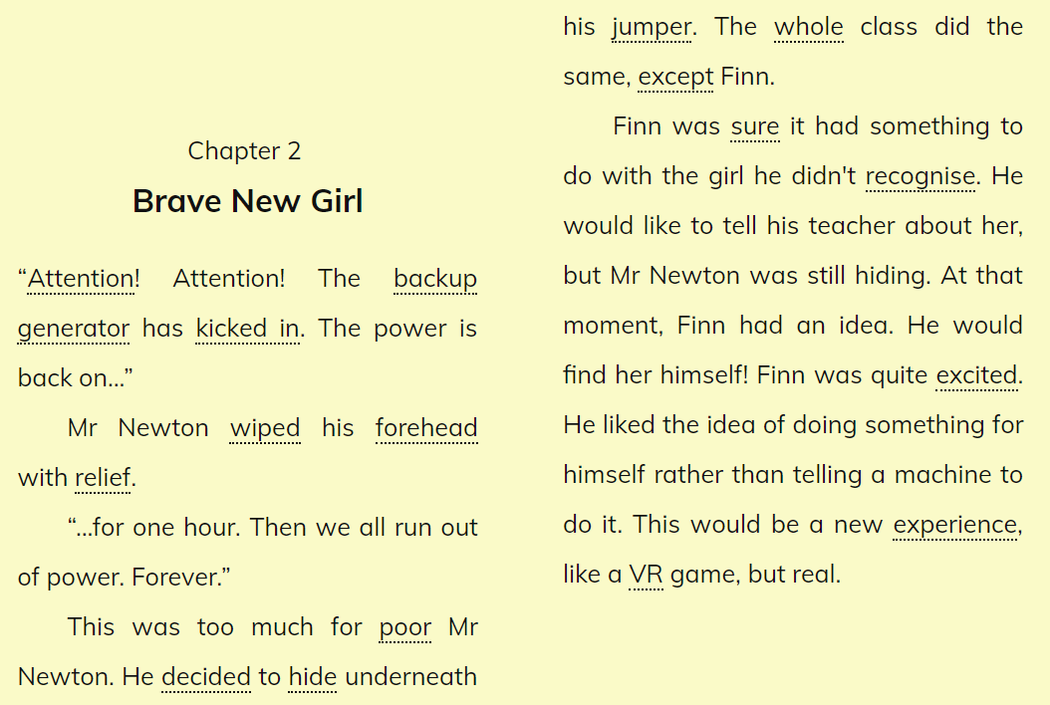

Slide 15
Before you vote, make your predictions!

Slide 16
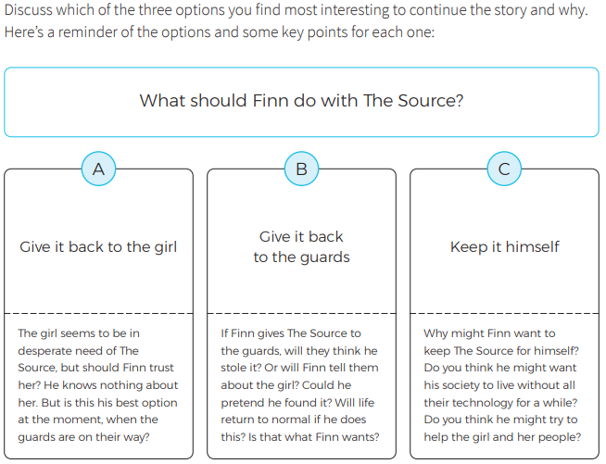
Now make a written prediction about what you think will happen. Try to answer the questions posed here.

Slide 17
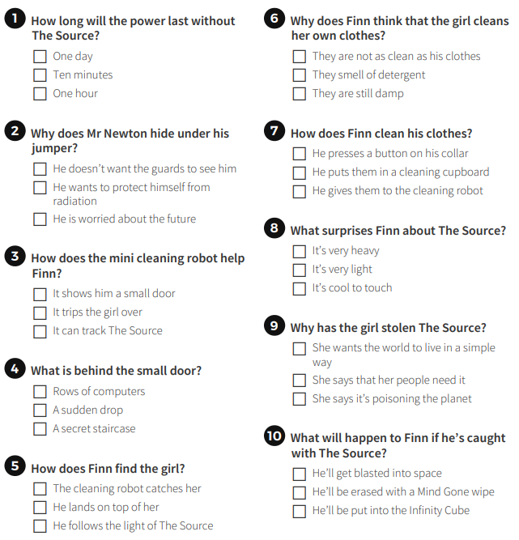
Try the quiz online!

Slide 18
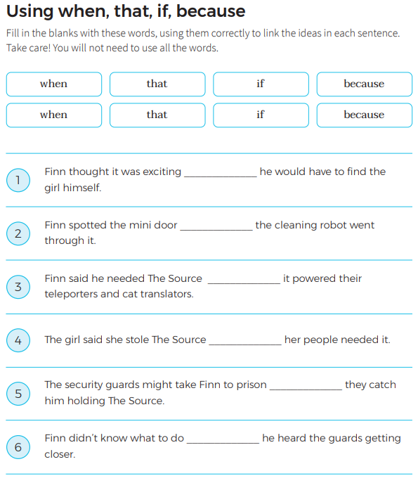
Copy and complete the questions, filling in the blanks appropriately.

Slide 19
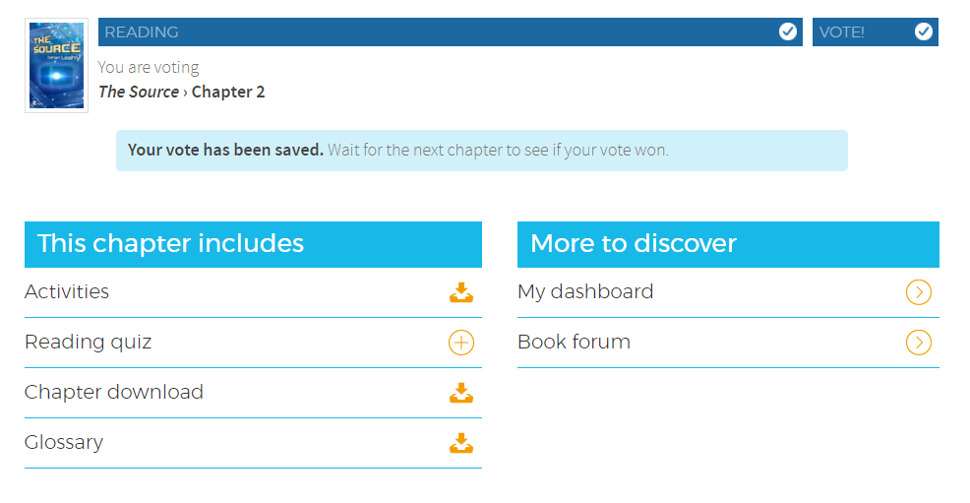
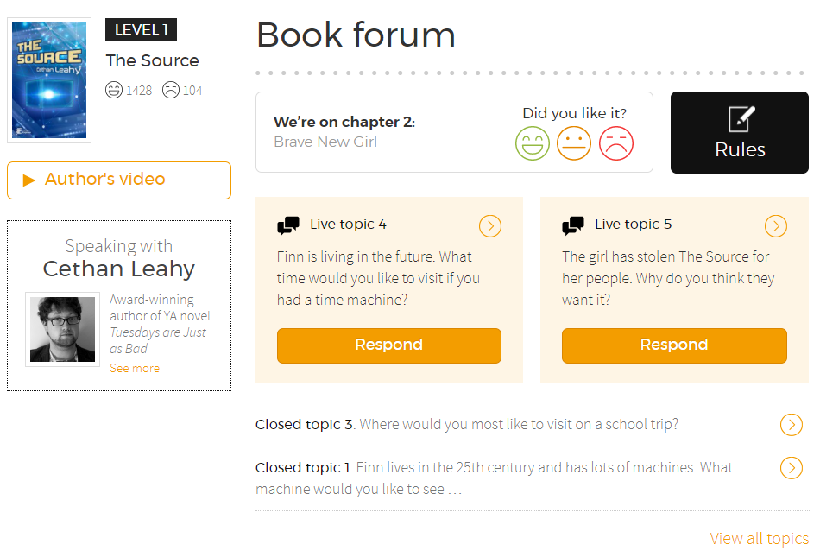
The Book Forum is a communication blog, which allows you to talk to the author about the questions he has set. Remember to read the Rules of the forum BEFORE you post anything. The responses you give should be about the questions below. Click the small orange ‘arrowheads’ to respond to the questions asked. The forum page will not allow posts of less than 100 characters, so think hard! If you impress the author with you ideas, he may respond personally, or award you a certificate!
Once you have voted, this page will appear. Click on the reading quiz to try to online version.
You could also look up the Book Forum.

Slide 20
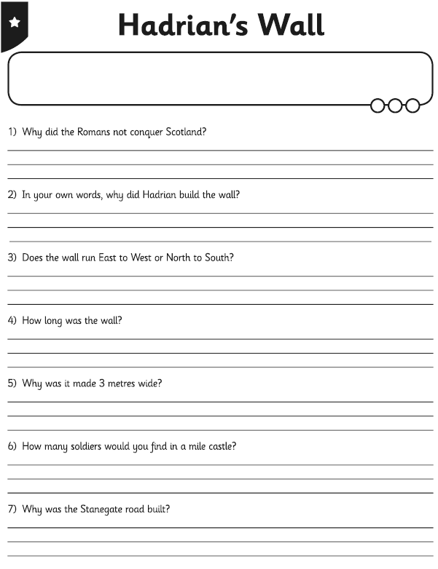
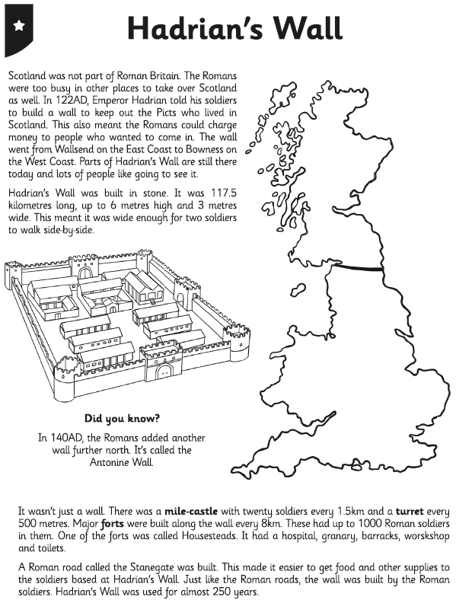
Topic:
Pick 1/2/3* activity and complete the reading comprehension.

Slide 21
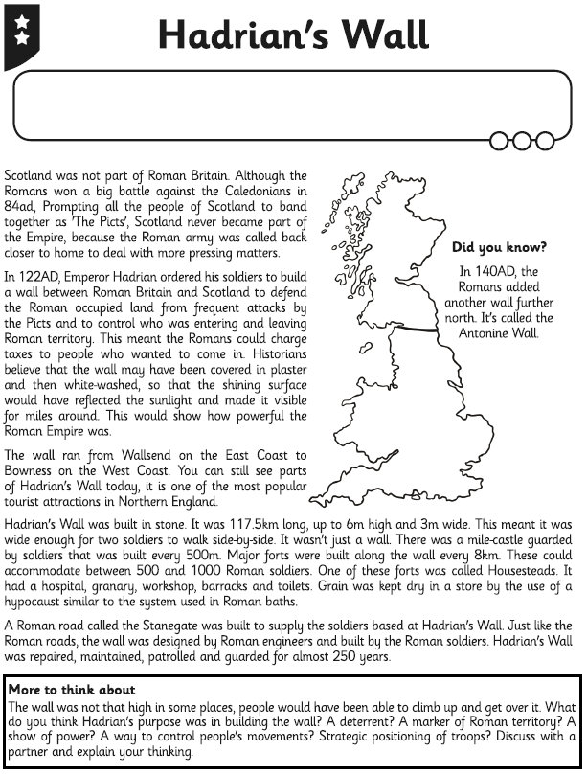
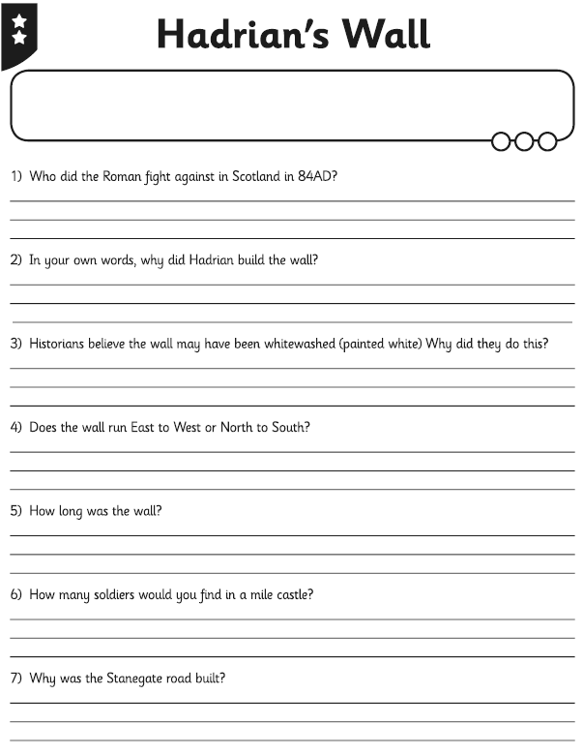

Slide 22
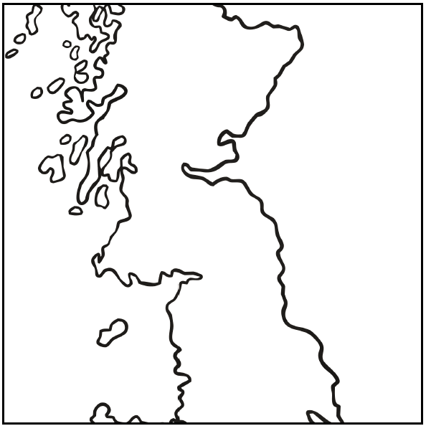
Topic EXT:
Plot Hadrian’s Wall on the map and label towns/cities it passes through or it is near.

