Slide 1
Year 3 Home School Provision Daily Pack
The following slides will be split into 4 separate activities.
They will consist of Maths, English, Reading and one other subject.
Each slide will be daily activities for you and your child to do at home.
We as a Year 3 team, will update these slides daily to the website – please keep an eye out!
Please email NJS.Year3@taw.org.uk with any queries to share any work and one of the Year 3 teachers will get back to you as soon as possible!
Thank you for your understanding and on going support during these times.

Slide 2
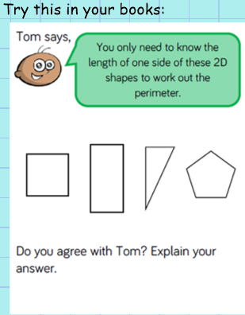
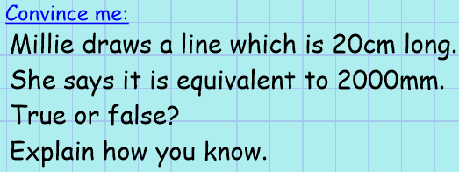
Maths
To solve problems involving perimeter
Introduction

Slide 4
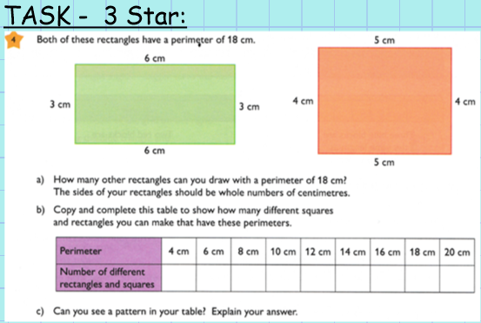

Slide 5
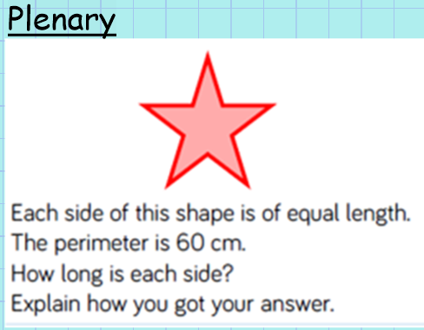

Slide 6
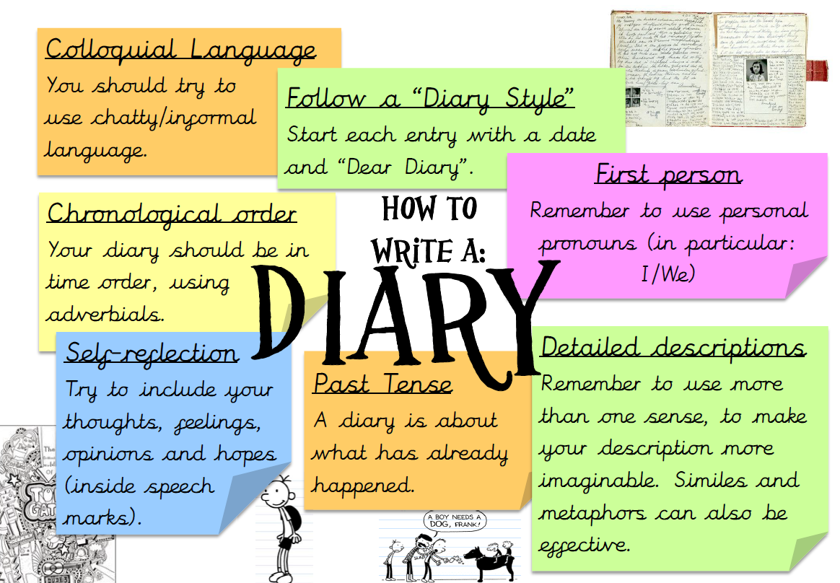
English: - To look at features of a diary entry. - To look at a ‘WAGOLL’ (What A Good One Looks Like)

Slide 7
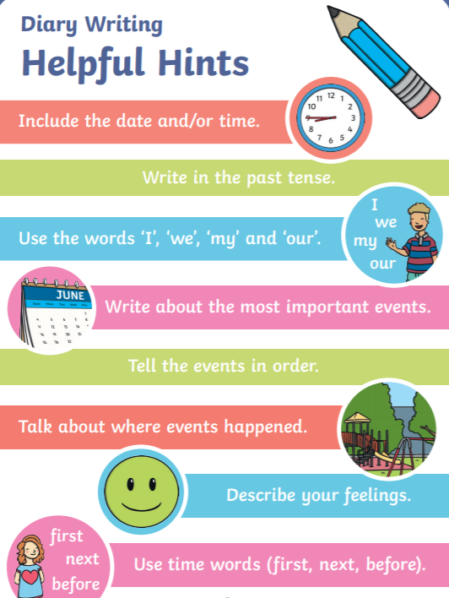
These things are really important when writing a diary entry…

Slide 8
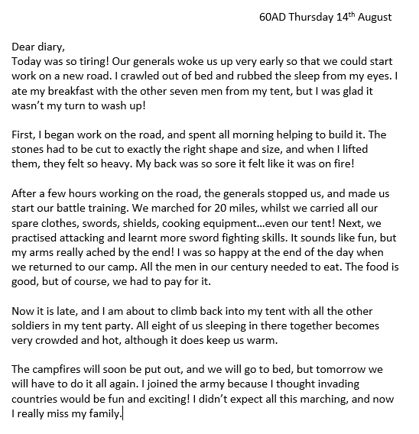
Now let's take a look at this ‘WAGOLL’:

Slide 9
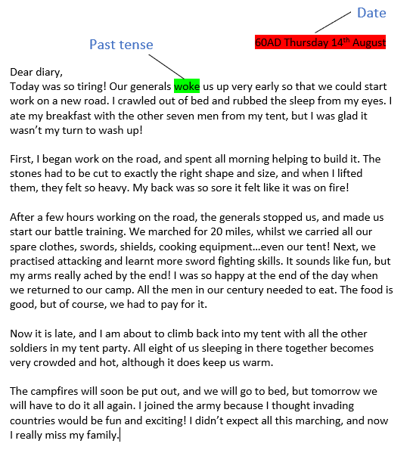
Task: Using different coloured pens or crayons, highlight features of a diary entry in our ‘WAGOLL’.

Slide 10
Reading – To relate parts of a story to the world today, and understand what the writer might be thinking. To discover words and phrases that capture the reader’s imagination.

Slide 11
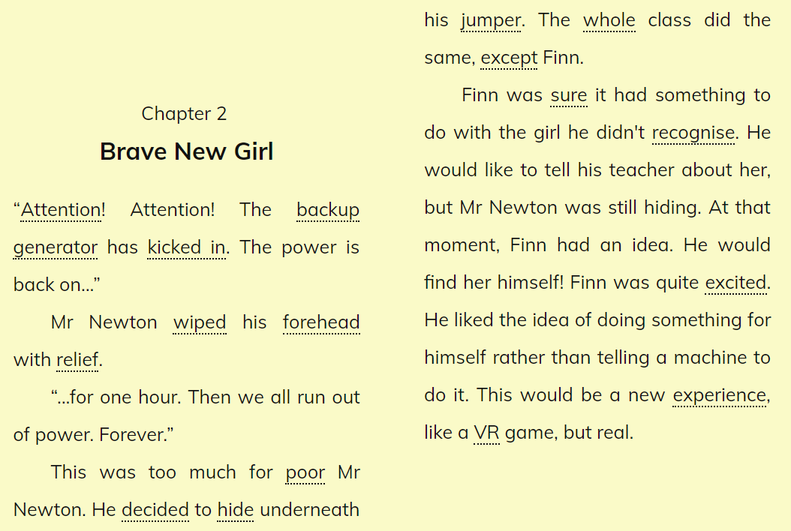

Slide 15
Before you vote, make your predictions!

Slide 16
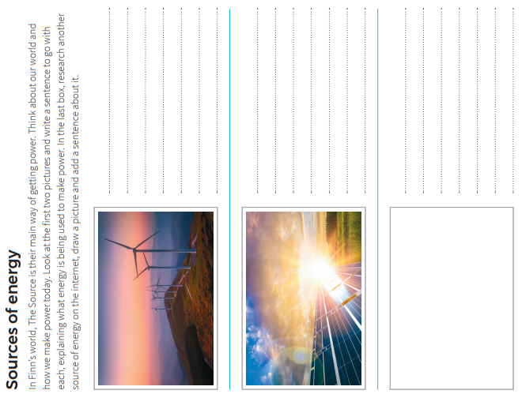
To relate parts of a story to the world today, and understand what the writer might be thinking.
Read and complete the boxes.

Slide 17
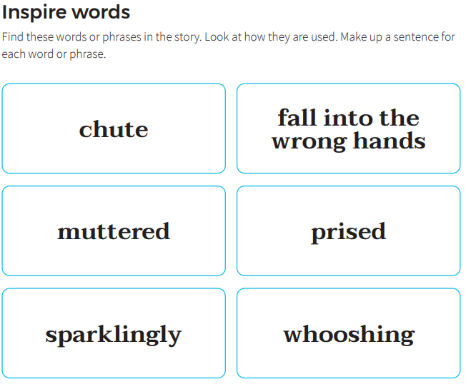
To discover words and phrases that capture the reader’s imagination.
EXT: Find some other words that inspire you. Write them down, in a sentence, to show you understand how to use them correctly.
From tomorrow, I will be starting a new Fiction Express book, during the Reading Online Lesson, which is not ‘Live’, and has already been published in full.
I recommend that children continue to read ‘The Source’ in their own personal time, to it’s conclusion, taking part in the voting and online quizzes.
This can form part of their Reading Record, or additional reading, with the added bonus that it can be done independently, by using the built-in voice recordings of the story, to read it out loud.
Regards, Mr Butler

Slide 18
French - To learn different ways of saying ‘a’ in French.
Run this powerpoint in presentation mode to enable the video below. Then press play at the bottom of the video.

Slide 19
French – To learn the names of some common animals.
Again, run the slides in presentation mode to access the slideshow to the left.
When in presentation mode, click the speaker icon to hear the words spoken. Repeat the words yourself, to practice and learn them.

Slide 20
French - To learn days of the week.

Slide 21
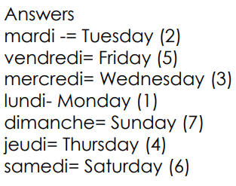
Answers

