Slide 1
Year 3 Home School Provision Daily Pack
The following slides will be split into 4 separate activities.
They will consist of Maths, English, Reading and one other subject.
Each slide will be daily activities for you and your child to do at home.
We as a Year 3 team, will update these slides daily to the website – please keep an eye out!
Please email NJS.Year3@taw.org.uk with any queries to share any work and one of the Year 3 teachers will get back to you as soon as possible!
Thank you for your understanding and on going support during these times.

Slide 2
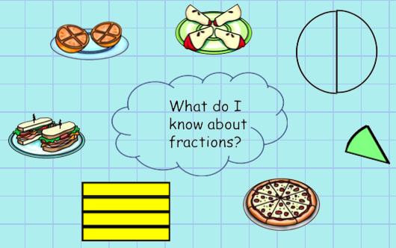
Maths
To recognise and use unit and non-unit fractions
Introduction
Support:
https://www.youtube.com/watch?v=hzfjlv6mE-s
Watch video if needed.

Slide 3
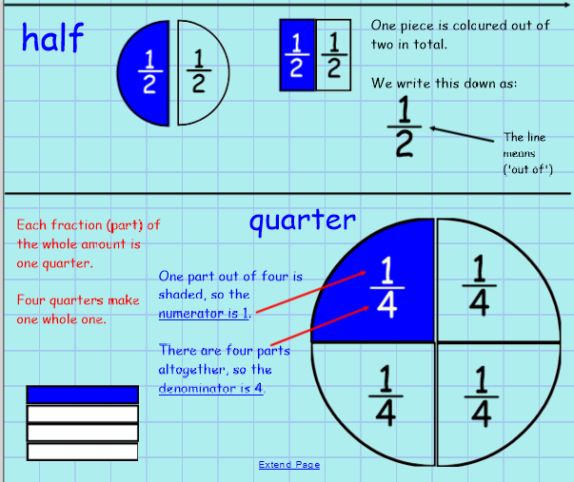
Explanation:

Slide 4
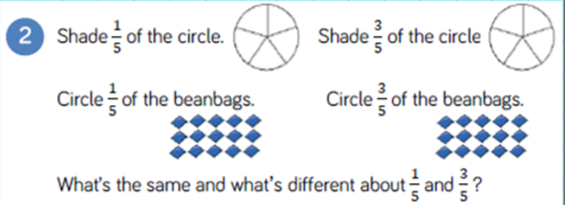
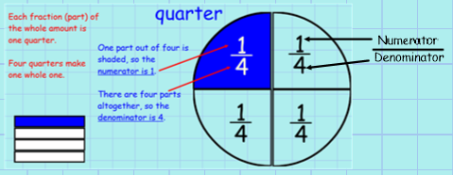

Slide 5
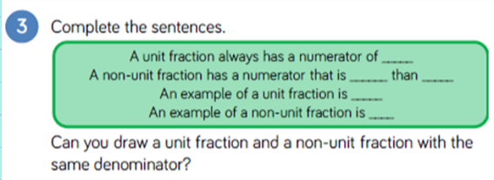
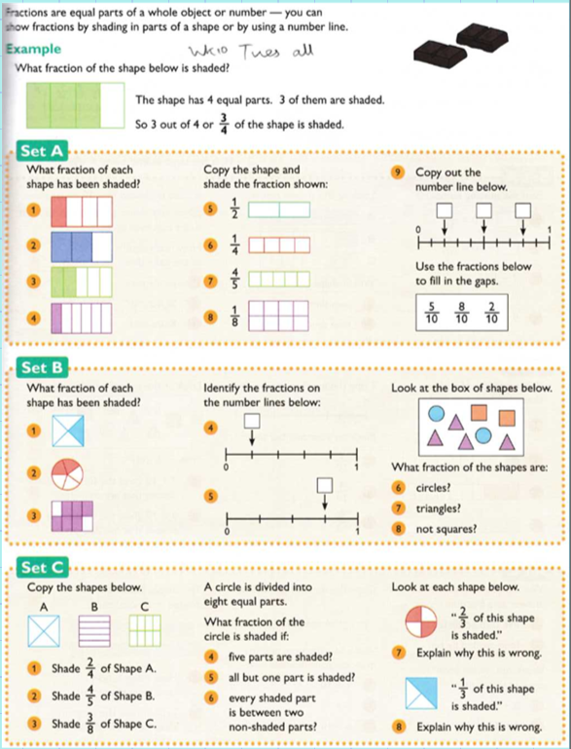
Set A – 1*
Set B – 2*
Set C – 3*

Slide 6
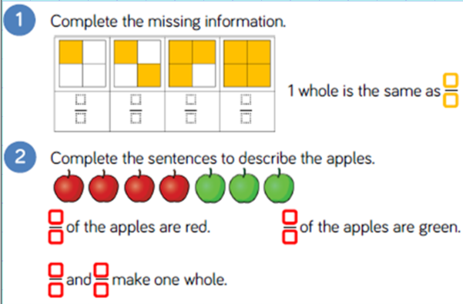
EXT:
Plenary:
Using items in your house represent 5 fractions of your choice.
Miss W’s example: I have chosen to colour 3 fifths of my kites yellow.
Please send any pictures to NJS.Year3@taw.org.uk

Slide 7
English- Research -To use a search engine to retrieve information about Roman soldiers, in Britain.
Use a children’s search engine, such as ‘KidRex’ or ‘Kiddle’ to research Roman soldiers, whilst they were in Britain.

Slide 8
Have a think about some of these points when researching:
When were Roman soldiers in Britain?
How long were Roman soldiers in Britain?
What was life like for Roman soldiers in Britain?
What work did Roman soldiers do in Britain?
What food did Roman soldiers eat in Britain?
Where did Roman soldiers sleep?
What did Roman soldiers wear in Britain?
When researching, remember to jot your findings in note form and feel free to include any drawings.

Slide 9
Reading – Online lesson with Mr Butler
To make a prediction, retrieve information, infer conclusions and explain my ideas.
Today we are going to begin reading a new book from Fiction Express, which I hope none of you have read before! The previous book we started, The Source, is still live – I encourage you all to continue reading this one in your own time, and vote for each chapter.
If you have read this new book, Takeover, before, please be patient with the rest of us, and remember not to reveal what happens – no spoilers!
This is a book which is not ‘Live’ anymore, so we cannot vote for the next chapter - all 5 chapters are already published. Please resist the temptation to log in and read ahead, as this will make some of the prediction activities difficult / pointless, because you will know the story.
First activity – Look at the front cover of the book. What do you think it will be about? Why?
What does ‘Takeover’ mean? How do you think Mr Simpkin got superglue on his hand?

Slide 10
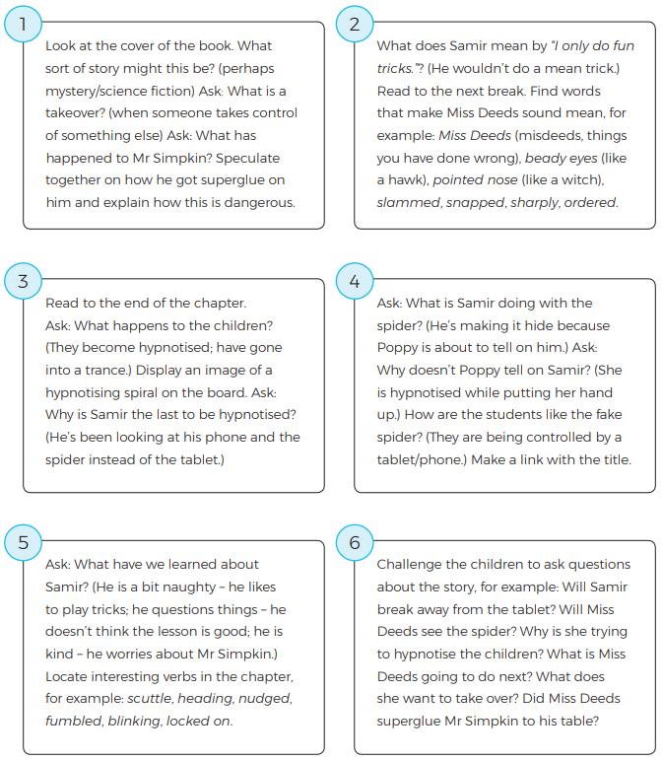
Parent / teacher Guided reading notes.
Use this selection of ideas as a reading prompt when reading the chapter with your child / class.
You don't have to ask every question, or get an answer – adjust as necessary.

Slide 11
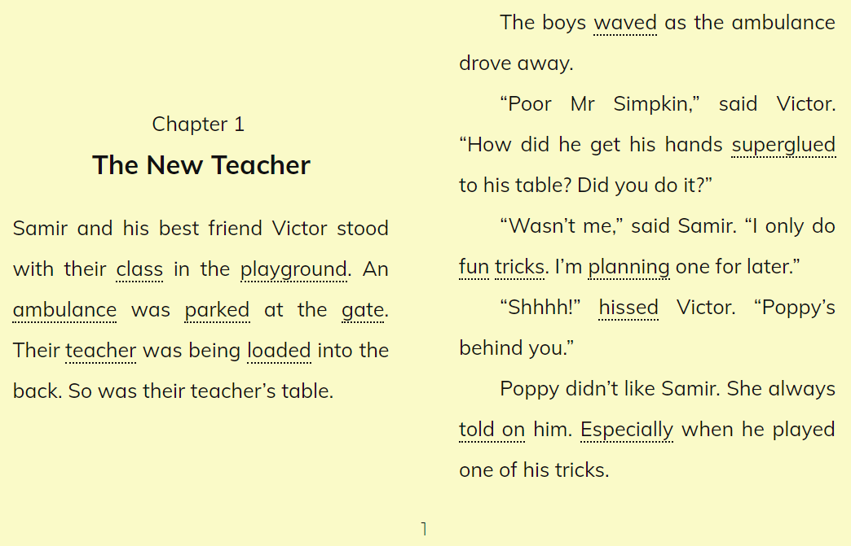

Slide 13
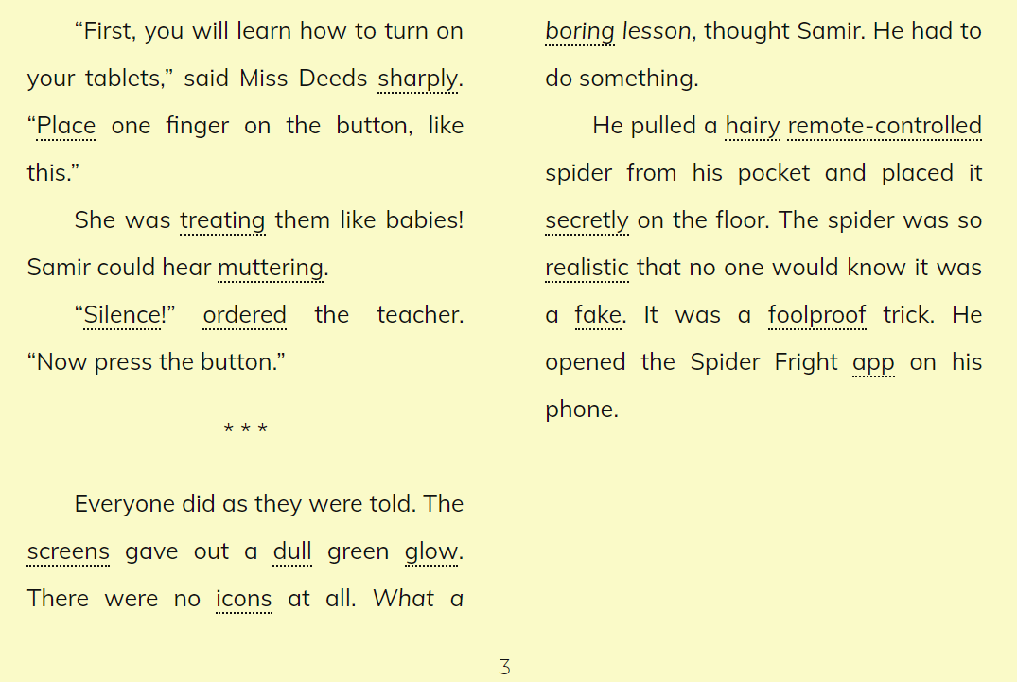

Slide 15
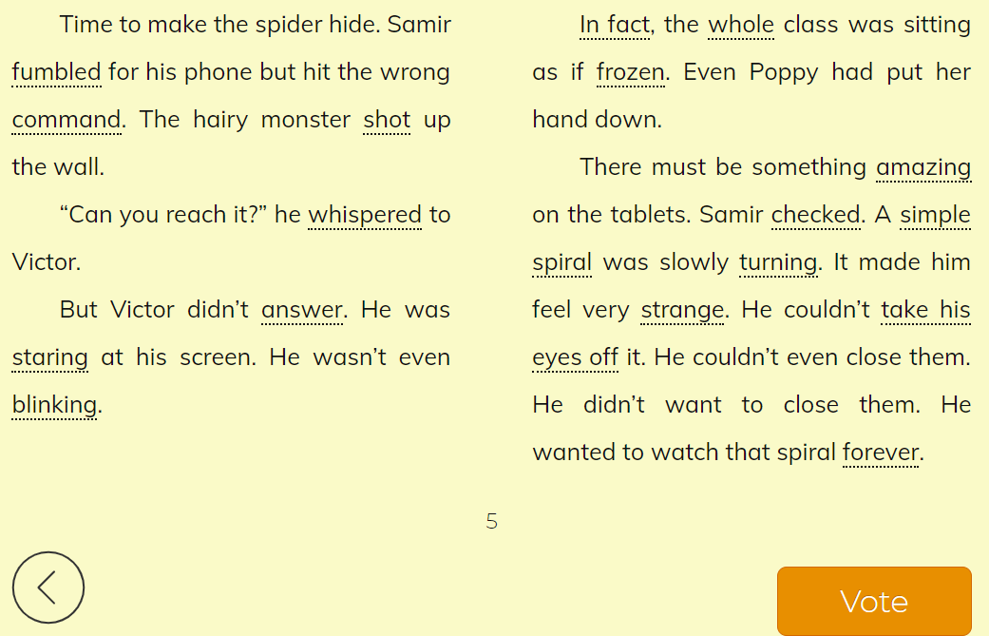

Slide 16
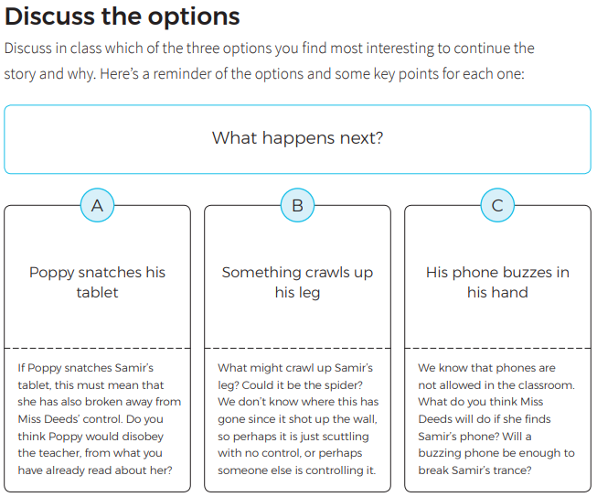
To make a prediction
First, discuss the questions presented here for each option. Then write a response to the question, ‘What happens next?’
E.g.:
I predict that Poppy will snatch Samir’s tablet, because she was distracted away from the tablet, so she didn’t get hypnotised.
She is quite a goody-goody, so I think she wouldn’t disobey the teacher, as she was putting up her hand to tell on Samir.

Slide 17
To retrieve and infer answers and draw conclusions.

Slide 18
Extension task:
Write a short summary of five key points, explaining what has happened so far.
E.g.:
The children arrived at school and Mr Simpkin was taken away in an ambulance.
A new teacher called Miss Deeds took over, giving everyone a new tablet.
…

Slide 19
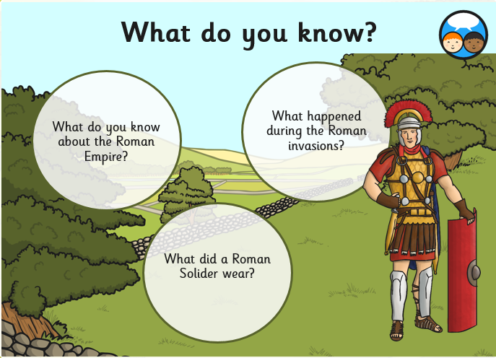
D&T (sequence of lessons): To understand what a Roman soldier wore
http://www.nms.ac.uk/explore/games/discover-the-romans/discover-the-romans/dress-a-roman-soldier/ Use the link to explore what a Roman Solider would have worn

Slide 20
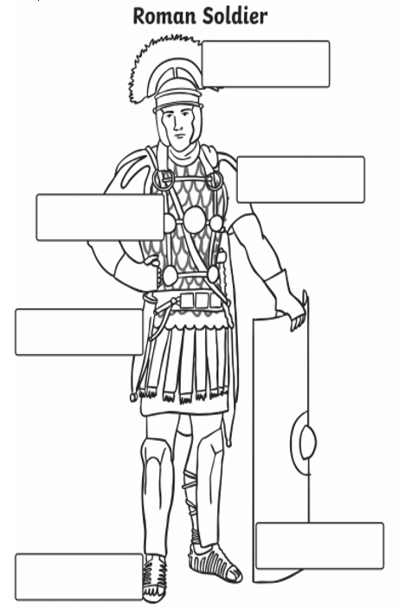
Label the Roman soldiers uniform using the words in the word bank below.

