Slide 1
Year 3 Home School Provision Daily Pack
The following slides will be split into 4 separate activities.
They will consist of Maths, English, Reading and one other subject.
Each slide will be daily activities for you and your child to do at home.
We as a Year 3 team, will update these slides daily to the website – please keep an eye out!
Please email NJS.Year3@taw.org.uk with any queries to share any work and one of the Year 3 teachers will get back to you as soon as possible!
Thank you for your understanding and on going support during these times.

Slide 2
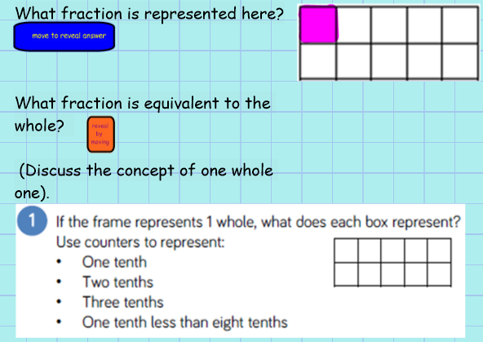
Maths
To recognise tenths and count up and down in tenths.
Introduction
Discuss

Slide 3
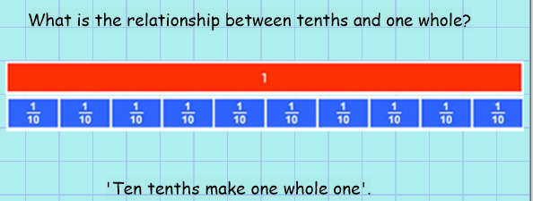
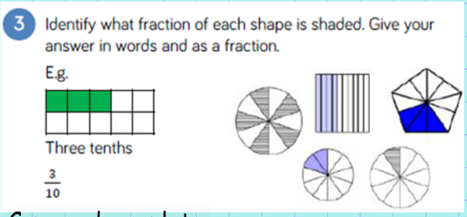
Copy and complete:
When I am writing tenths, the _____________ is always ten.

Slide 4
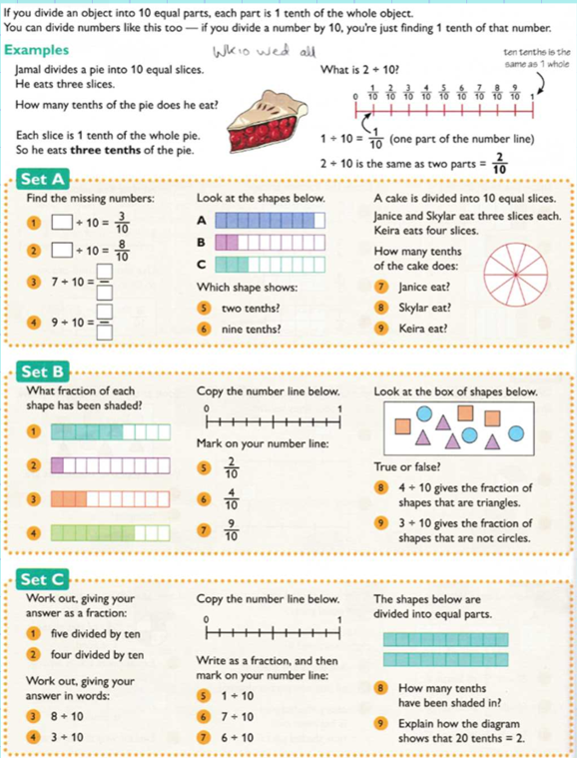
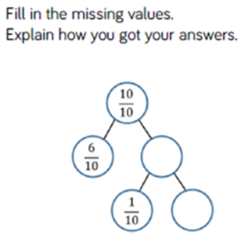
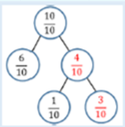
Set A – 1*
Set B – 2*
Set C – 3*
EXT
Answer

Slide 5
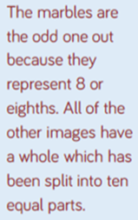
Plenary
Answer

Slide 6
English- SPaG -To use inverted commas for direct speech.

Slide 7
Have a go at inserting inverted commas into the sentences.

Slide 8
When writing a diary entry, we might decide to include some direct speech. What things might Roman soldiers be saying to each other? Chat to a grown up or a friend…
How might they be feeling?
What might they be doing?
Use your research from yesterday to think of ideas.
Who might they be talking to?

Slide 9
Look through some of these rules…

Slide 10
Task: Using direct speech, write sentences from the point of view of a Roman soldier.
For example:
The General screamed, “ Defeat our enemies, for the glory of Rome!”
My friend enquired, “How are you feeling today?”
“When do you think we will be going home?” whispered the scared soldier.
(Remember to try and use synonyms for the word “said”.)

Slide 11
Reading –
To retrieve information, infer and explain, using evidence from the text to support my ideas.
Re-read the chapter out loud, to your adult helper or carer.

Slide 12
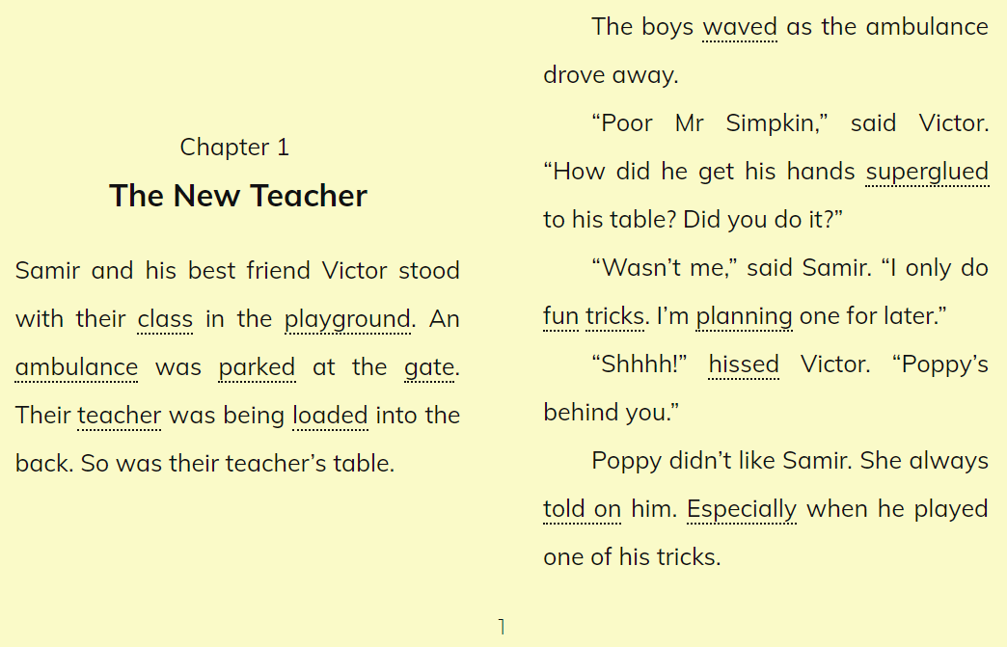

Slide 14
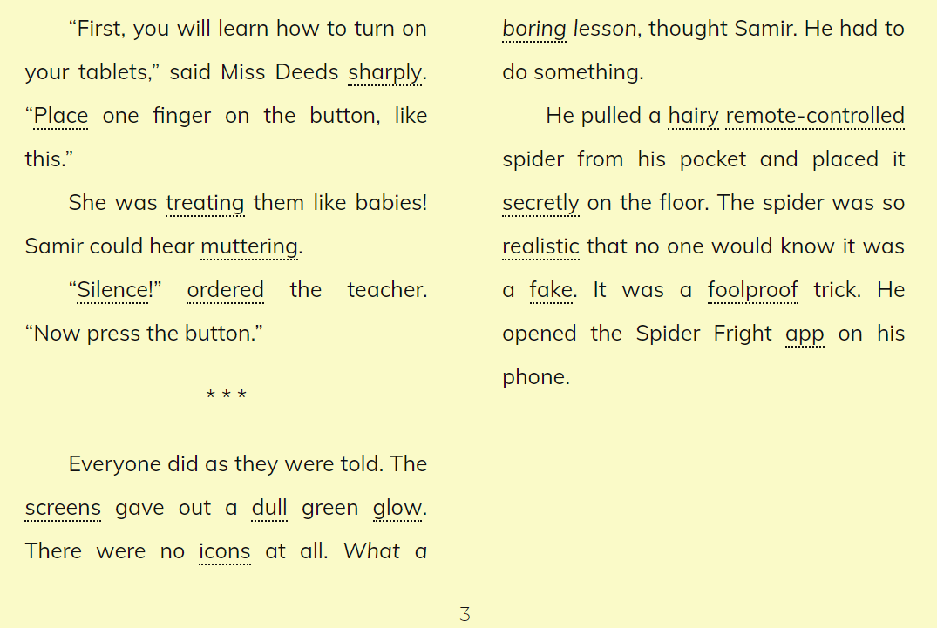

Slide 16
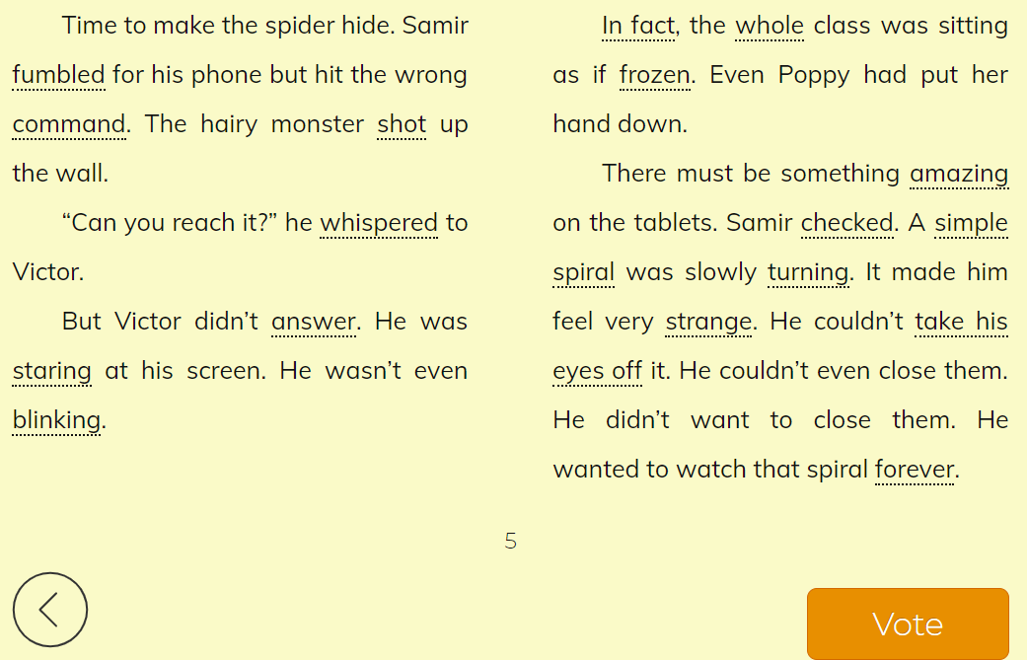

Slide 17
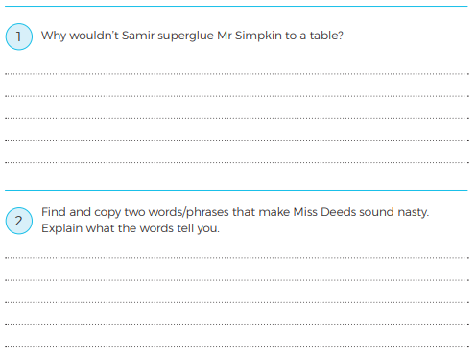
Answer the questions, using complete sentences (2**/3***) or verbally (1*).

Slide 18
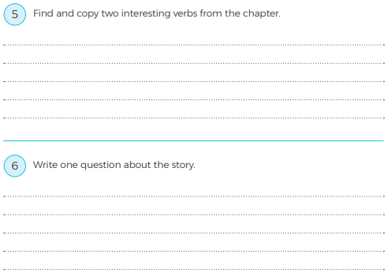
(verb = ‘doing’ word / action)
Can you explain what they mean, by using them in a sentence?
Write three questions about the story that you would like to know the answers to:

Slide 19
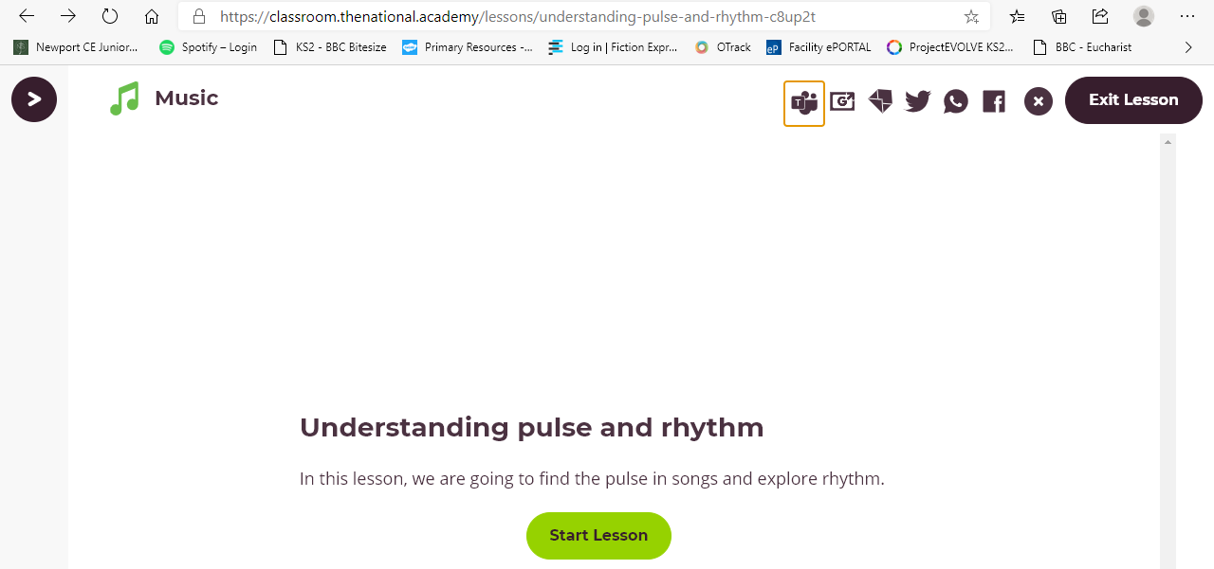
Music – To understand Pulse and Rhythm. Today’s lesson is expertly covered by the Oak National academy video, linked below, and is aligned with our planning in school. Please click to access it. If you can’t get the link to open, Google ‘Oak National Academy Year 3’, and search for Music, Pulse and Metre 1, and Lesson 1 – Understanding pulse and Rhythm. I had fun trying to copy these rhythms! Enjoy! Mr B.
Lesson 1 Link – Understanding Pulse and Rhythm (CTRL+click these words or the picture below to open the link..

