Slide 1
Year 3 Home School Provision Daily Pack-29/01/21
The following slides will be split into 4 separate activities.
They will consist of Maths, English, Reading and one other subject.
Each slide will be daily activities for you and your child to do at home.
We as a Year 3 team, will update these slides daily to the website – please keep an eye out!
Please email NJS.Year3@taw.org.uk with any queries to share any work and one of the Year 3 teachers will get back to you as soon as possible!
Thank you for your understanding and on going support during these times.

Slide 2
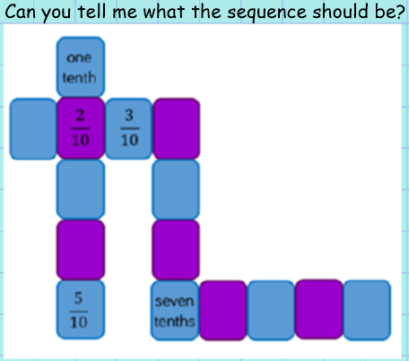
Maths
To recognise tenths and count in tenths, using my knowledge to solve problems involving tenths.
Introduction

Slide 3
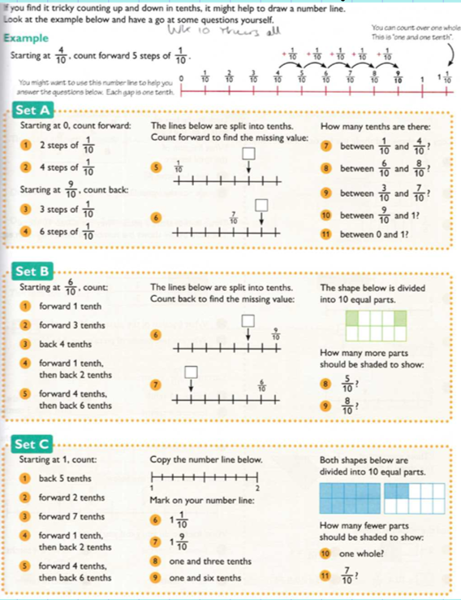
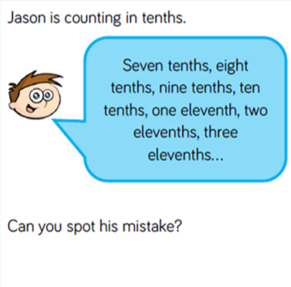
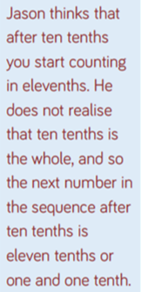
Set A – 1*
Set B – 2*
Set C – 3*
EXT
Answer

Slide 4
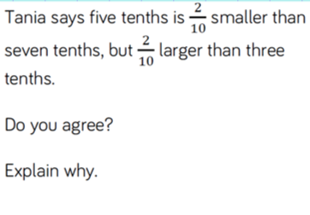
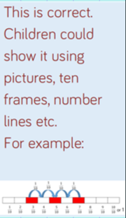
Plenary
Answer

Slide 5
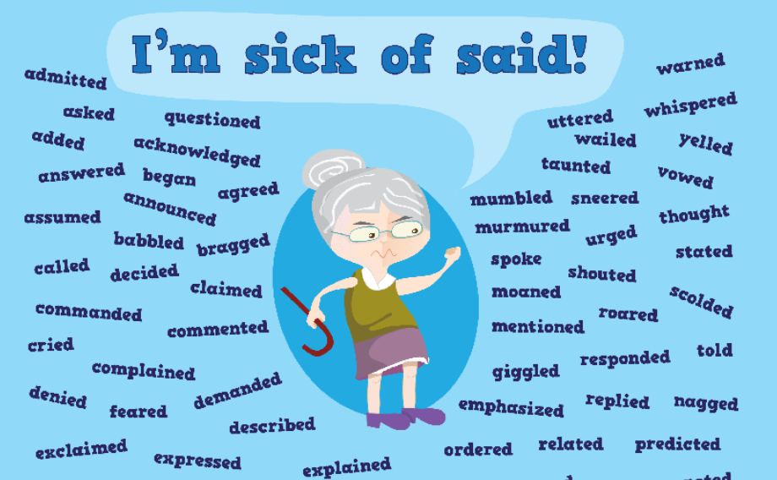
English - To write a plan for a diary extract, from the point of view of a Roman soldier.
Did anyone use any of these words instead of ‘said’ yesterday?

Slide 6
Next week we will be writing a diary extract, pretending to be a Roman soldier in Britain.
We are going to need all the skills we have learnt this week.
We will need to remember to include:
Features of a diary
Research of a Roman soldier in Britain
Direct speech
To help us to remember all these things, today we are going to plan what we will include in our diary extract.

Slide 7
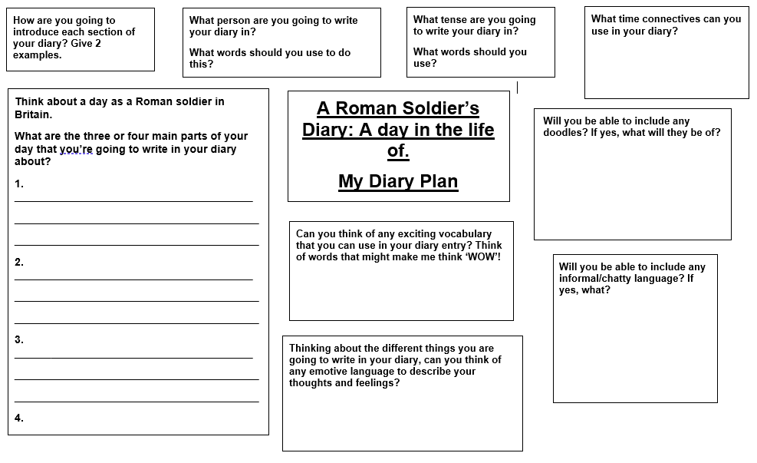
Task: Using your research from yesterday, complete this plan for your diary extract.
Remember that YOU are the Roman soldier!

Slide 8
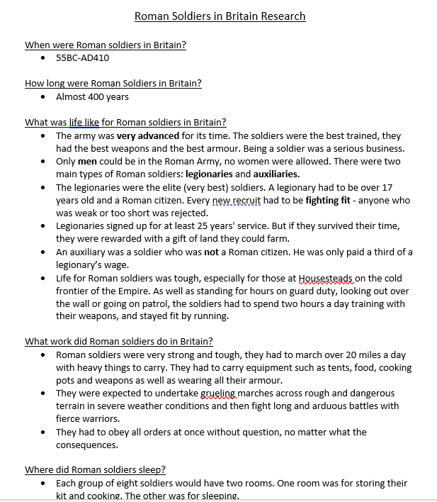
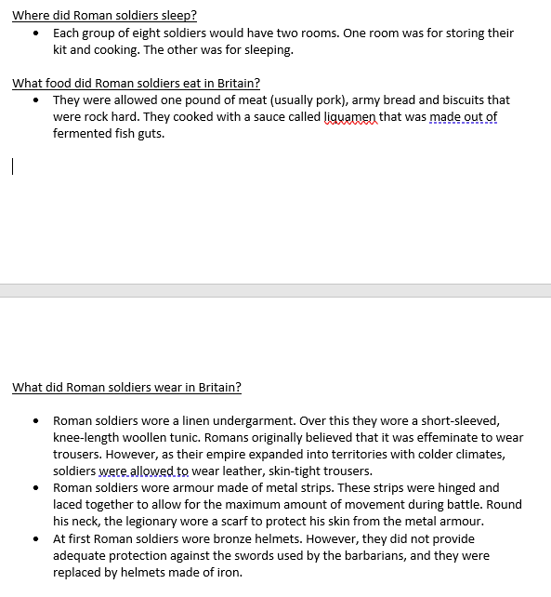
Here is some research that I did!

Slide 9
Reading -
I can use context to read unfamiliar words and discuss words that capture the reader’s imagination.
Re-read the chapter to yourself.
Pay attention to the highlighted parts.

Slide 10
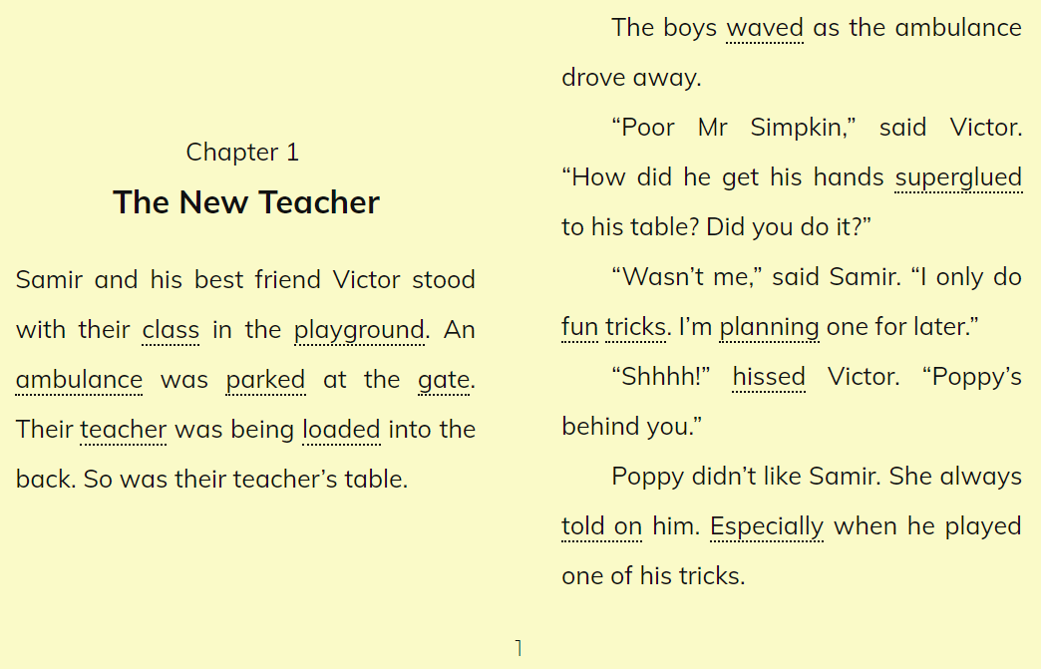

Slide 12
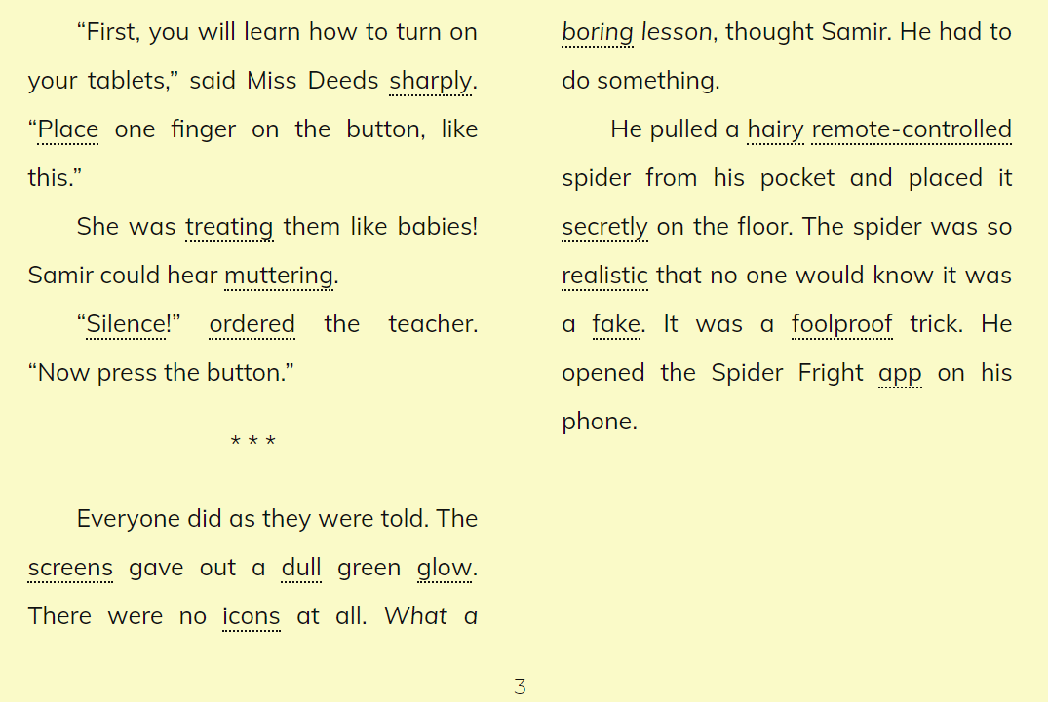

Slide 14
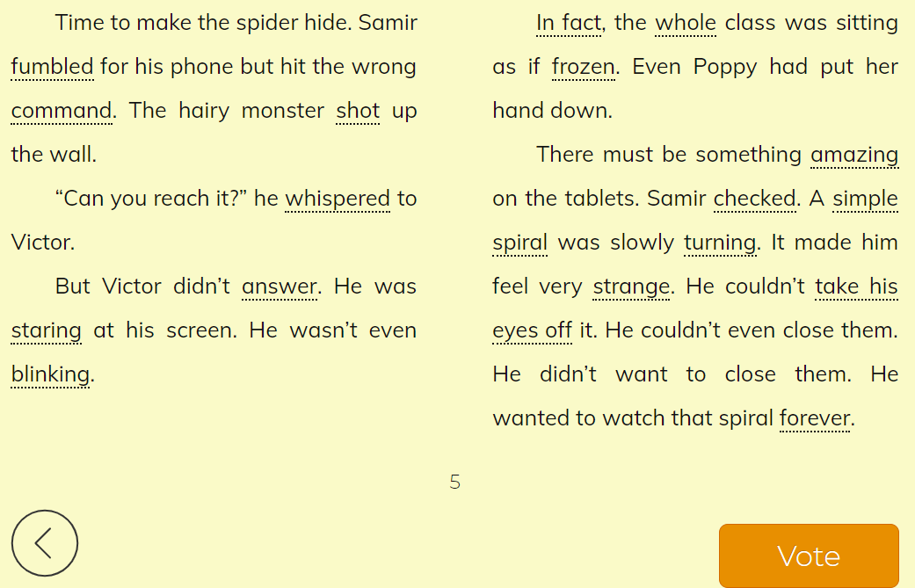

Slide 15
You are going to create and write a character description of Miss Deeds and draw a detailed picture of her, to colour in. The next slide has a template on it for you to either print out, or copy. Use a new page, landscape orientation.
Character description:
Using the highlighted text, think about what it is saying about her personality. If she ‘barks’ at pupils, what does this tell you about her? Is she kind or mean because of this?
What about the way she acts? On the first page of the chapter, she ‘slammed’ new tablet computers down on the desk. What does this tell you about her? Is she patient? Read through the description or listen to the story read by the author online, to find out more about the sort of person she is.
Physical description:
Not much is given away. Read for clues (bony fingers, pointed nose). Can you find any more ideas?

Slide 16
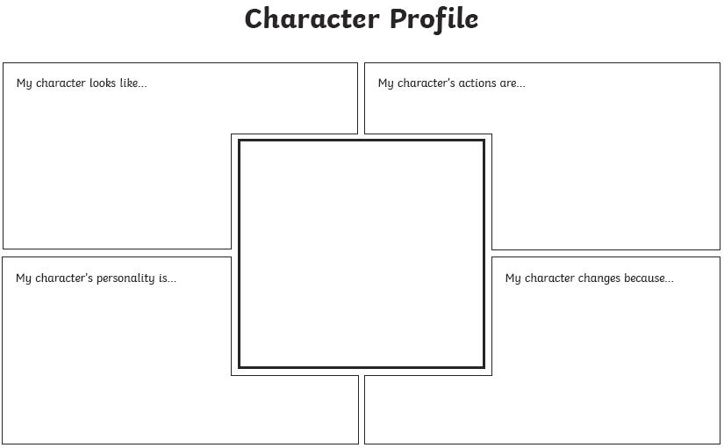
Miss Deeds
1.
2.
3.
4.
1.
2.
3.
4.
What do you think Miss Deeds wants to do in the end? Why is she trying to hypnotise the children?
1.
2.
3.
4.
Draw your picture of Miss Deeds in this box.

Slide 17
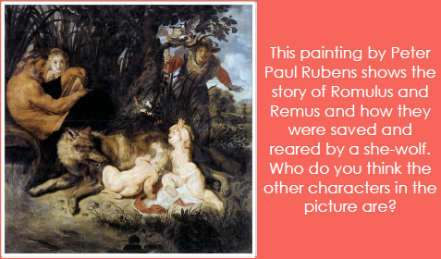
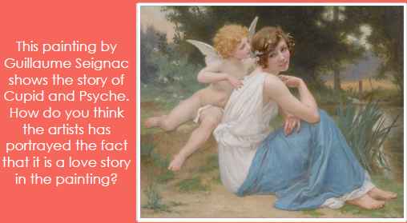
Art: To be able to paint a scene from a Roman myth

Slide 18
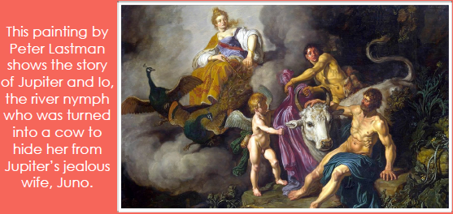
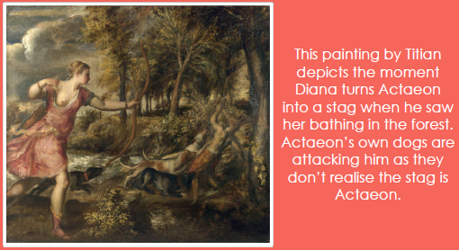
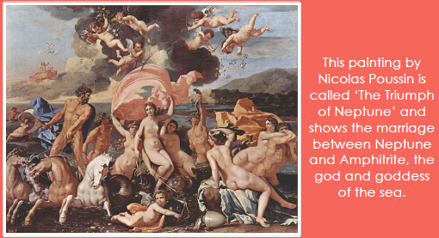

Slide 19
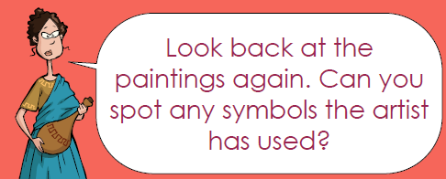

Slide 20
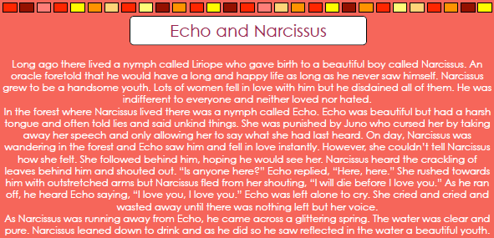
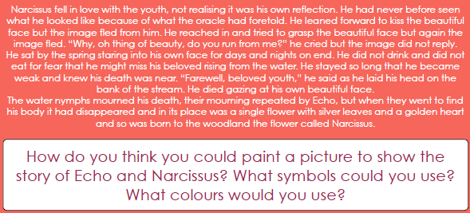
If you don’t have paints you could you pens or colouring pencils. Anything you have at home!

