Slide 1
Year 3 Home School Provision Daily Pack
The following slides will be split into 4 separate activities.
They will consist of Maths, English, Reading and one other subject.
Each slide will be daily activities for you and your child to do at home.
We as a Year 3 team, will update these slides daily to the website – please keep an eye out!
Please email NJS.Year3@taw.org.uk with any queries to share any work and one of the Year 3 teachers will get back to you as soon as possible!
Thank you for your understanding and on going support during these times.

Slide 2
Maths:
To use formal written methods to multiply TU x U and solve word problems
1/2/3* - your children know what star they were working on in school. However, use whichever star you feel your child is comfortable with! Level of challenge increases from 1* - 3*.

Slide 3
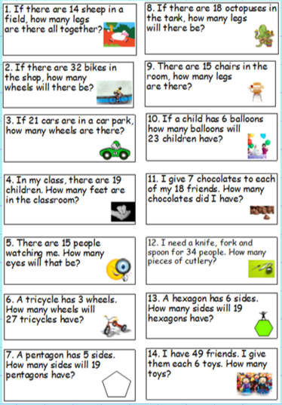
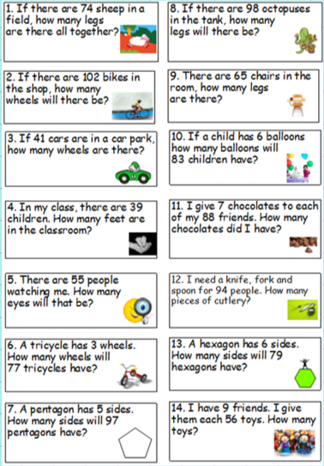
1*/2*
2*/3*

Slide 4
English

Slide 5
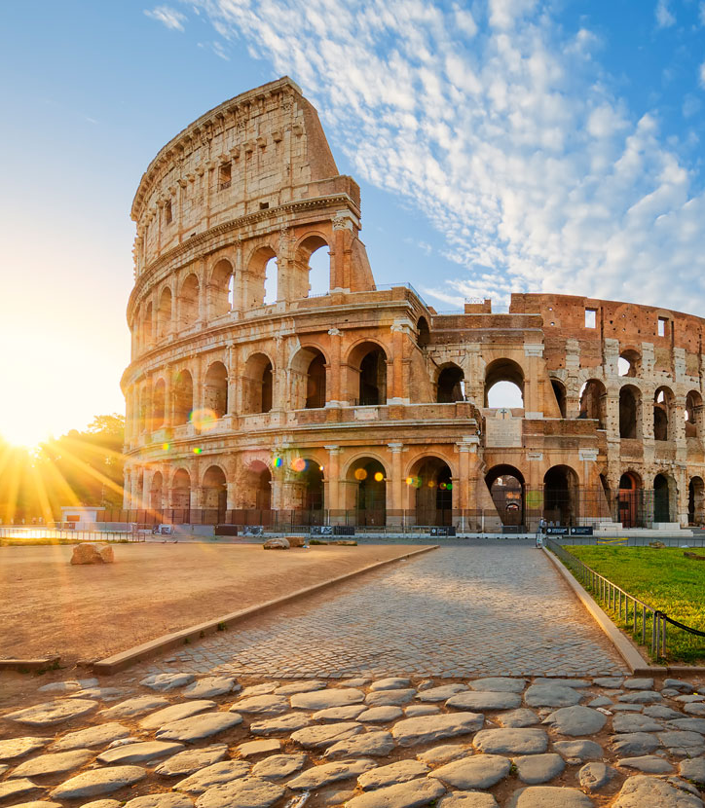
For the next two days, you are going to find as many facts as you can about… the Colosseum!

Slide 7
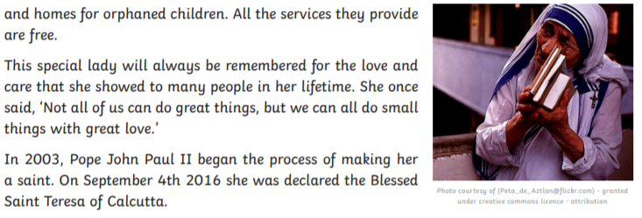
Reading for today:

Slide 8
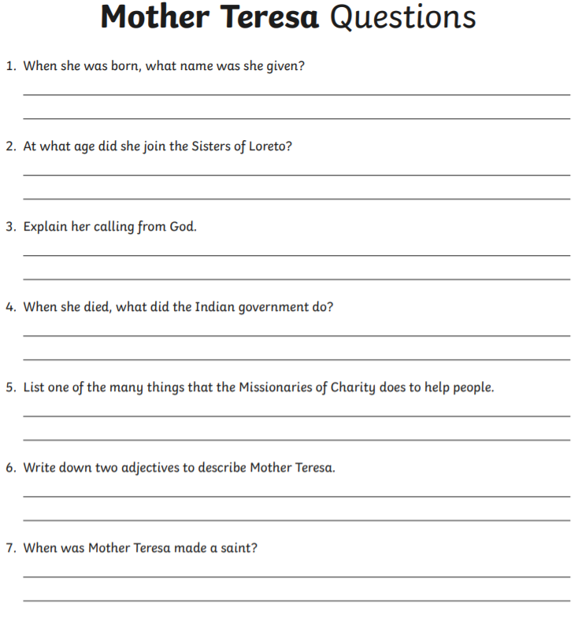
Read the Text about Mother Teresa and try to answer the questions. Class 3W, Mother Teresa is your Courageous Advocate for this term.

Slide 9
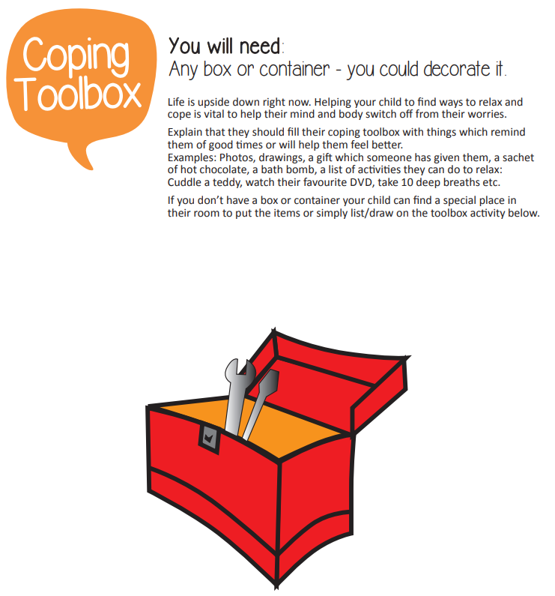
PSHE
We know school is very different at the minute, some of us are there and some of us are not. It’s okay to be worried, sad or happy about school but you need to talk about your feelings.
We are going to make a toolbox to help you get through this change. Your toolbox will be different to everyone else’s and that’s okay! It will be as unique as you are!
Your toolbox can be a decorated cardboard box from the recycling or it could be your lunchbox or even put it in an empty pillowcase! Your toolbox needs to be filled with things to help you.
Your class teacher will talk you through this activity and might even share their toolbox with you!
You will need:
Something that reminds you of a good time
Something that will make you feel better
Photo of someone you miss/can’t wait to see
A drawing of you being happy
Something/list of activities that makes you relax
A favourite toy/teddy
Your favourite DVD
If you haven’t got the object at home you can write a note to go in your toolbox or draw a picture of it!

