Slide 1
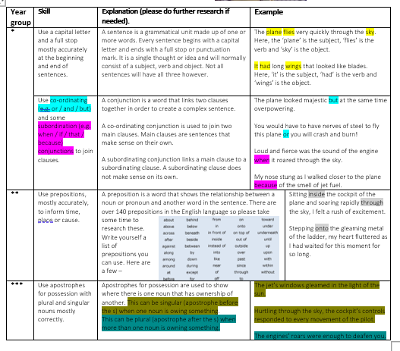
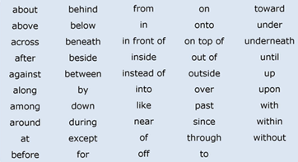
Skills required for lesson 2 week 1
*** expected to show all skills

