Slide 1
Remote Learning Plan!
Hello Year 4!
During the next few weeks, we will be providing the children with remote learning on a daily basis. The work will be available on the website the day before e.g. Monday’s work will be online Sunday.
Everyday the remote learning will consist of:
English Lesson
Maths Lesson
Reading Lesson
One other curriculum lesson (PSHE, Art etc)
We will be available during the hours of 9am-4pm so please feel free to contact us on our new e-mail njs.year4@taw.org.uk
Some of the work provided will be split into the star levels that the children use everyday in class (1,2 3).
Stay safe everyone!
Miss Jones, Mrs Jukes, Mrs Kuczynska and Mrs Sisson.

Slide 2
English:
Objective: To write creatively using an idea or stimulus.
FREE WRITE FRIDAY!
Use the image to create your own piece of writing. You could:
Write down where the key came from? Why does the bird have it?
Why do you think the crow has taken the key?
Write a story about how the key, clock and crow all fit together.
Write down the thoughts of the Crow.
Imagine the object that the key fits into (a door or treasure chest for example). Draw the object and describe it.
Tell the story of the key from the point of view of the Crow.
Be as creative as you can!

Slide 3
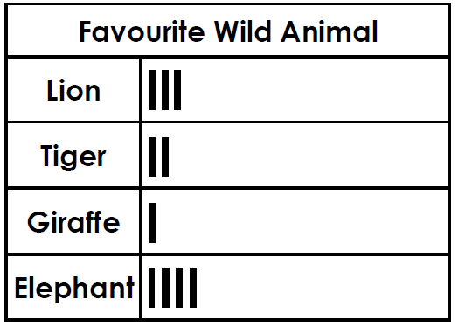
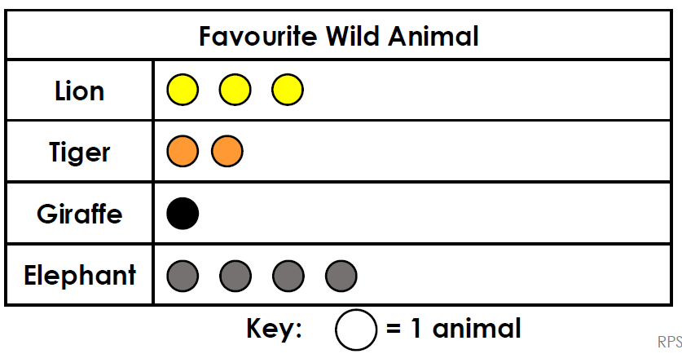
Maths: We will be focusing on Statistics.
Objective: To solve problems focusing on statistics.
Do you think the Pictogram is the best
way to present this information?
Explain why …
Please choose a video from the link below and focus on the teaching strategies used to help you interpret Tables and retrieve data from them.
Interpreting Data, Graphs and Tables
https://newportjuniorschool.org.uk/wp-content/uploads/2019/10/Calculation-Policy.pdf
As we are beginning a new topic, please read the calculation policy which will offer guidance on how to set calculations out.
1* - Today you will be focusing on the tally chart and you will need solve the problem. Would a Pictogram be the best way to present the data from the Tally Chart?
2*/3* - Today you will be focusing on the various graphs shown and solve the problems and answer the questions. Remember to use the RUCSAC method to help you. READ, UNDERSTAND, CHOOSE, SOLVE, ANSWER and CHECK!
Extension: Is the statement true or false?

Slide 4
1 STAR TASK!

Slide 5
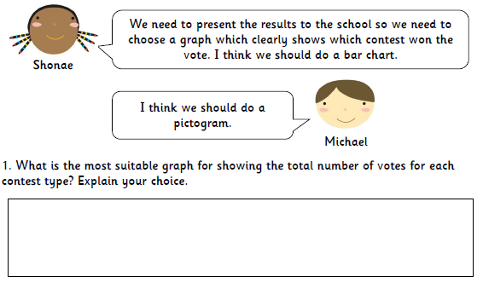

Slide 6
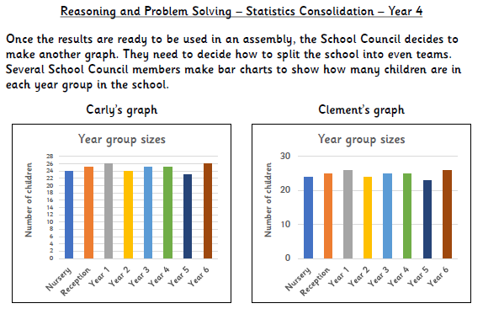
2/3 STAR TASK!

Slide 7
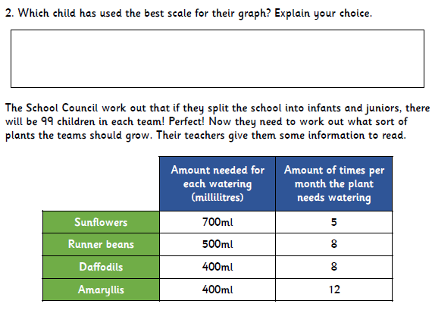
2/3 STAR TASK!

Slide 8
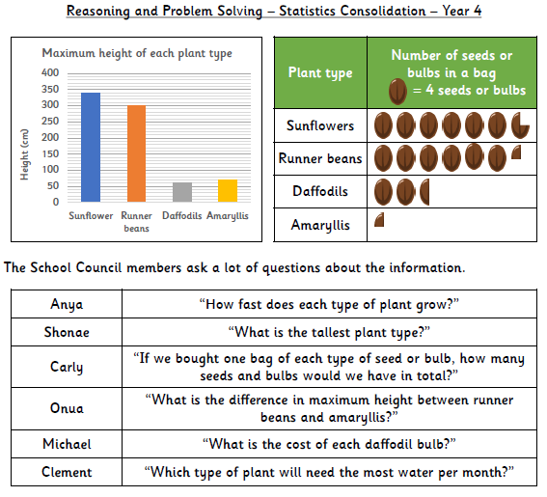
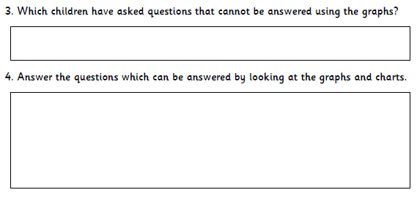

Slide 9
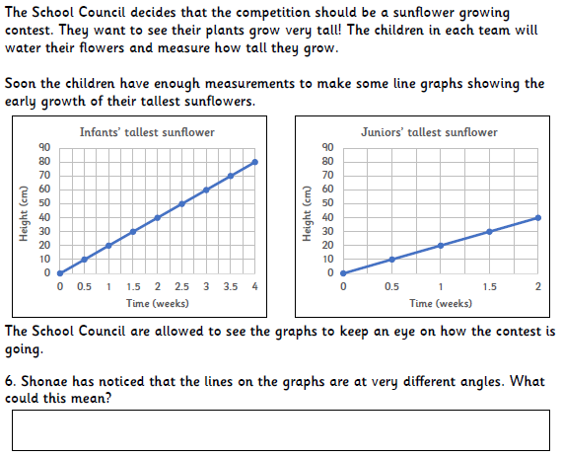

Slide 10
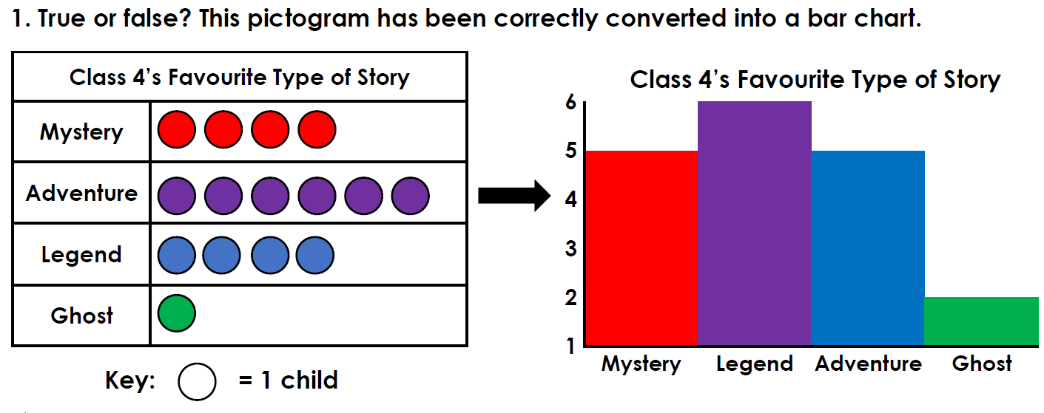
Extension Task!
Please explore this statement by focusing on the Pictogram.
Is the statement true or false?

Slide 11
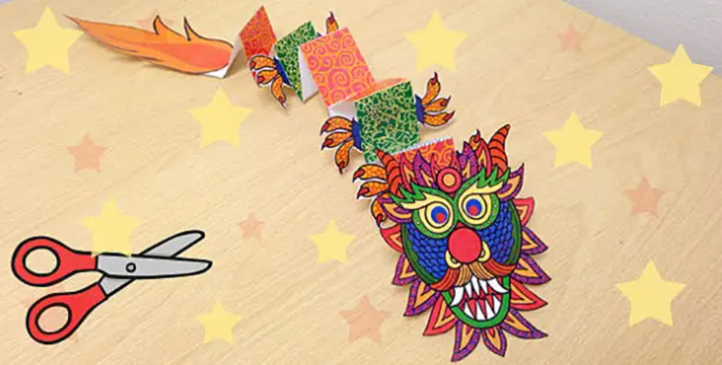
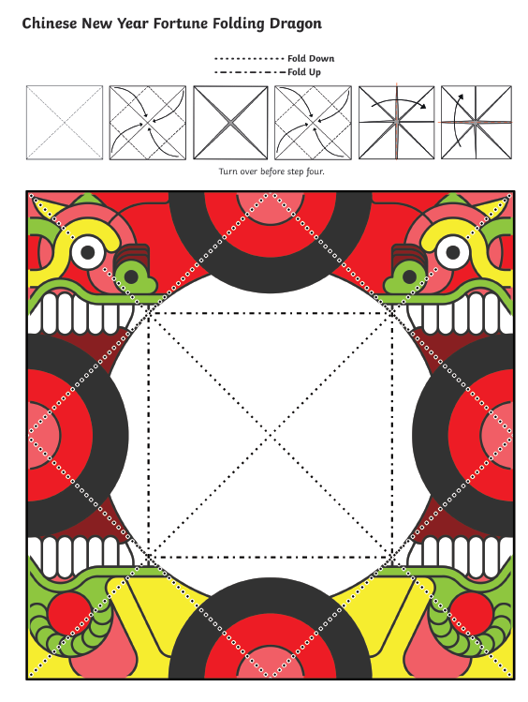
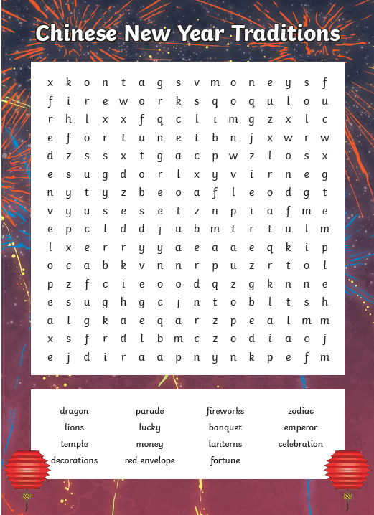
Other: Topic – Chinese New Year
Objective: To create something that is associated
with Chinese New Year.
Reading:
Objective: To create a poster about Chinese News Year.
Read through the information about Chinese New Year on the next few slides!
Task… Create a poster to explain to someone all about Chinese New Year.
Think about Why it is celebrated?
How it is celebrated?
Make your poster bright and colourful!
On the website, choose one of the Chinese New Year activities! You can complete more than one – it is entirely up to you!
Hope you have enjoyed the activities – please email pictures of what you have done.
Kung Hei Fat Choy
(Happy New Year)

