Slide 1
Remote Learning Plan!
Hello Year 4!
During the next few weeks, we will be providing the children with remote learning on a daily basis. The work will be available on the website the day before e.g. Monday’s work will be online Sunday.
Everyday the remote learning will consist of:
English Lesson
Maths Lesson
Reading Lesson
One other curriculum lesson (PSHE, Art etc)
We will be available during the hours of 9am-4pm so please feel free to contact us on our new e-mail njs.year4@taw.org.uk
Some of the work provided will be split into the star levels that the children use everyday in class (1,2 3).
Stay safe everyone!
Miss Jones, Mrs Jukes, Mrs Kuczynska and Mrs Sisson.

Slide 2
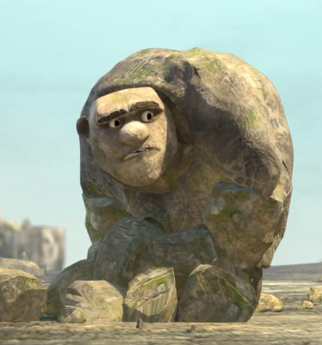
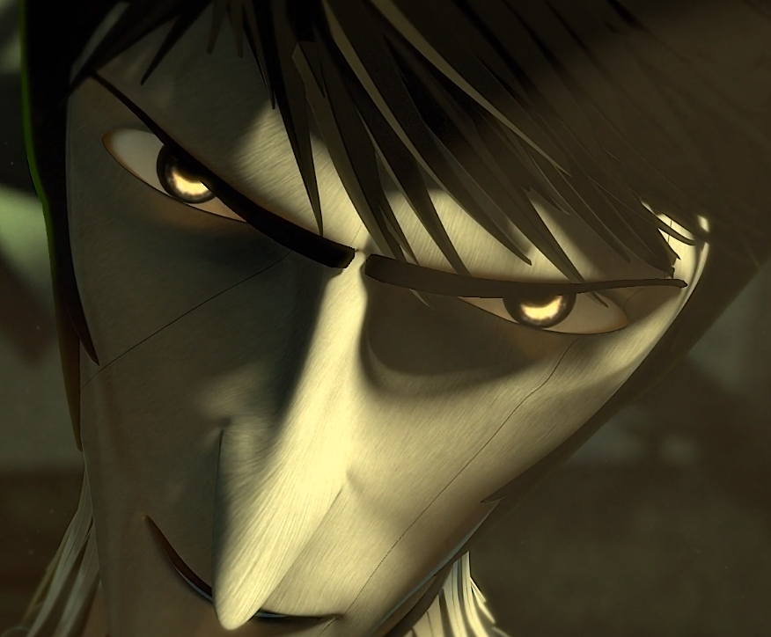
English:
Objective: To write the second half of my story.
Yesterday, you had the opportunity to write the first half of your own story using the characters of Rock, Paper and Scissors.
Today…
1* - Write the final half of your story and try to use full sentences.
Focus on using different sentence openers.
2* - Write the final half of your story and use full sentences.
Focus on using fronted adverbials.
3* - Write the final half of your story and use full sentences.
Focus on using various conjunctions and speech.
See the next few slides for some useful word banks!

Slide 4
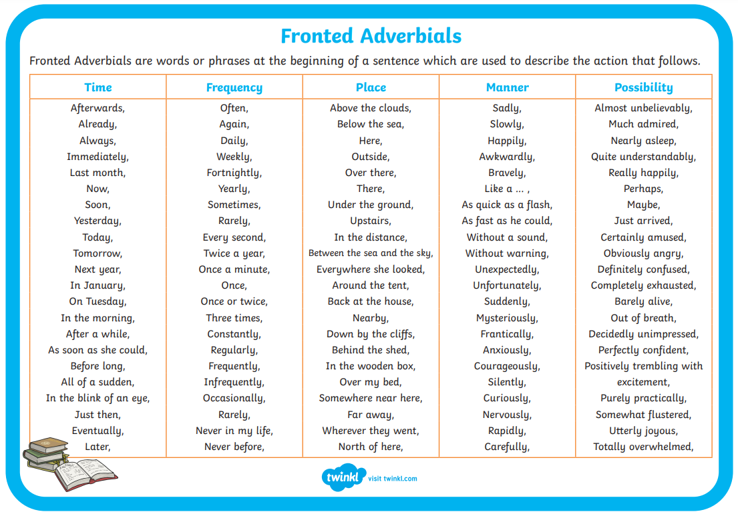

Slide 5
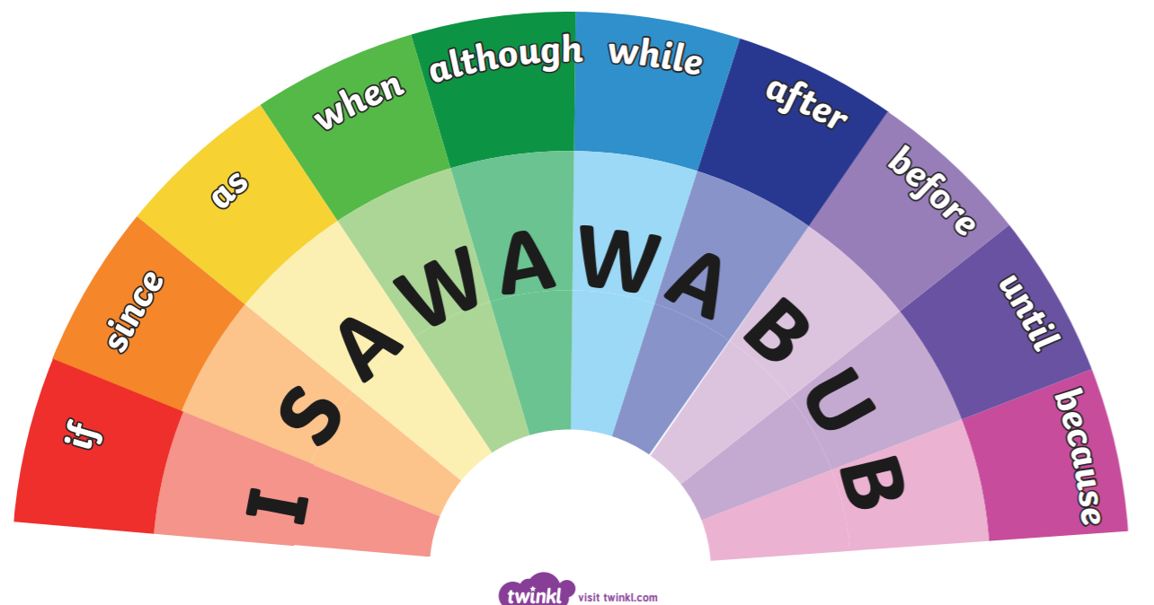

Slide 6
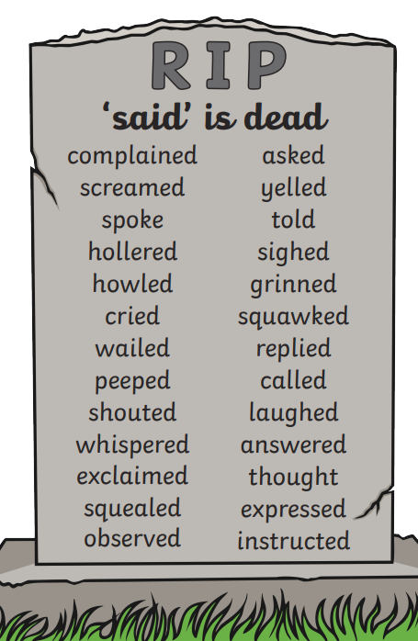

Slide 7
Maths: We will be focusing on Telling the Time.
Objective: I can tell the time to the nearest minute.
Please choose a video from the link below and focus on the teaching strategies used to help you identify how to tell the time to the nearest minute.
Adding and Subtracting Time
https://newportjuniorschool.org.uk/wp-content/uploads/2019/10/Calculation-Policy.pdf
As we are beginning a new topic, please read the calculation policy which will offer guidance on how to set calculations out.
1* - Today you will be focusing on telling the time to the nearest minute and you will be using your reasoning skills to solve the following problems.
2*/3* - Today you will be focusing on telling the time to the nearest minute and you will be using your reasoning skills to solve the following problems.
Extension: Solve the True or False Statement.
Is the statement true or false?
What is the time on the clock face?

Slide 8
1 STAR TASK!

Slide 9
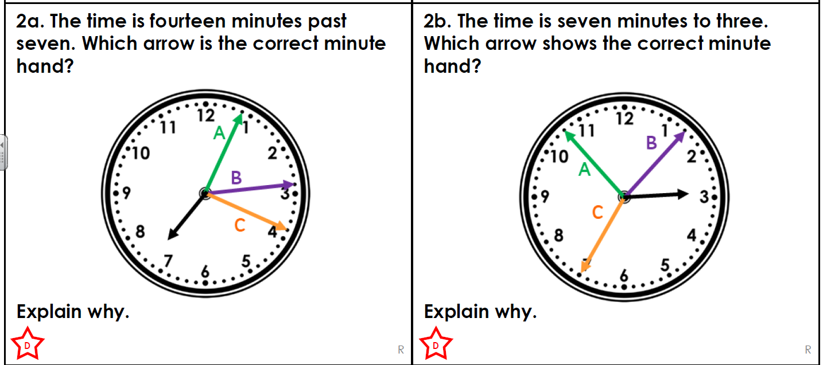
1 STAR TASK!

Slide 10
1 STAR TASK!

Slide 11
2/3 STAR TASK!

Slide 12
2/3 STAR TASK:

Slide 13
Extension Task!
Please explore this statement. Is it correct?
How can we check this time is correct?

Slide 14
Reading: BOOK WEEK CELEBRATIONS!
Objective: To create a front cover of our class story.
Task… We have been reading a class story during our live lessons. Create your own front cover of the book! What would you include?
You can find a full version of the front cover template on the website!
4J – The Creakers by Tom Fletcher
4NJ – Fantastic Mr Fox by Roald Dahl
4S – The Boy, the mole, the fox and the horse by Charlie Mackesy
See the next slide for full versions of the current front covers ☺

Slide 16
Other: Mindfulness
Objective: To decorate a famous quote of my choice by Roald Dahl.
On the website, you will find many famous quotes by Roald Dahl.
Choose your favourite and decorate how you would like.

