Slide 1
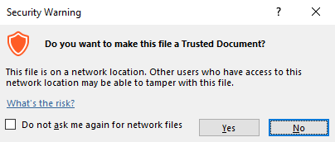
Guidance for Macros in PowerPoints
We use macros within PowerPoints to increase the interactivity of our presentations. Follow this simple process to get the most out of this resource.
What to do:
Open the PowerPoint file and enable editing.
A security warning box may appear. Click yes.
Click enable content.
Enter presentation mode (start the slide show).

Slide 2
Computing
Online Safety
Year One
Computing | Year 5 | Online Safety | False Photography | Lesson 4

Slide 4
Aim
To recognise when, why and how photographs we see online may have been edited.
Success Criteria
I can recognise changes that have been made to an original photograph.
I can digitally alter a photograph.
I understand that not everything I see online is true.
I can explain how false photographs can make people feel bad about themselves.

Slide 5
Interesting Images
Look at these amazing images of things we might not usually see…
This stunning elephant is blue due to the large amount of grapes and figs it eats in Sri Lanka.

Slide 6
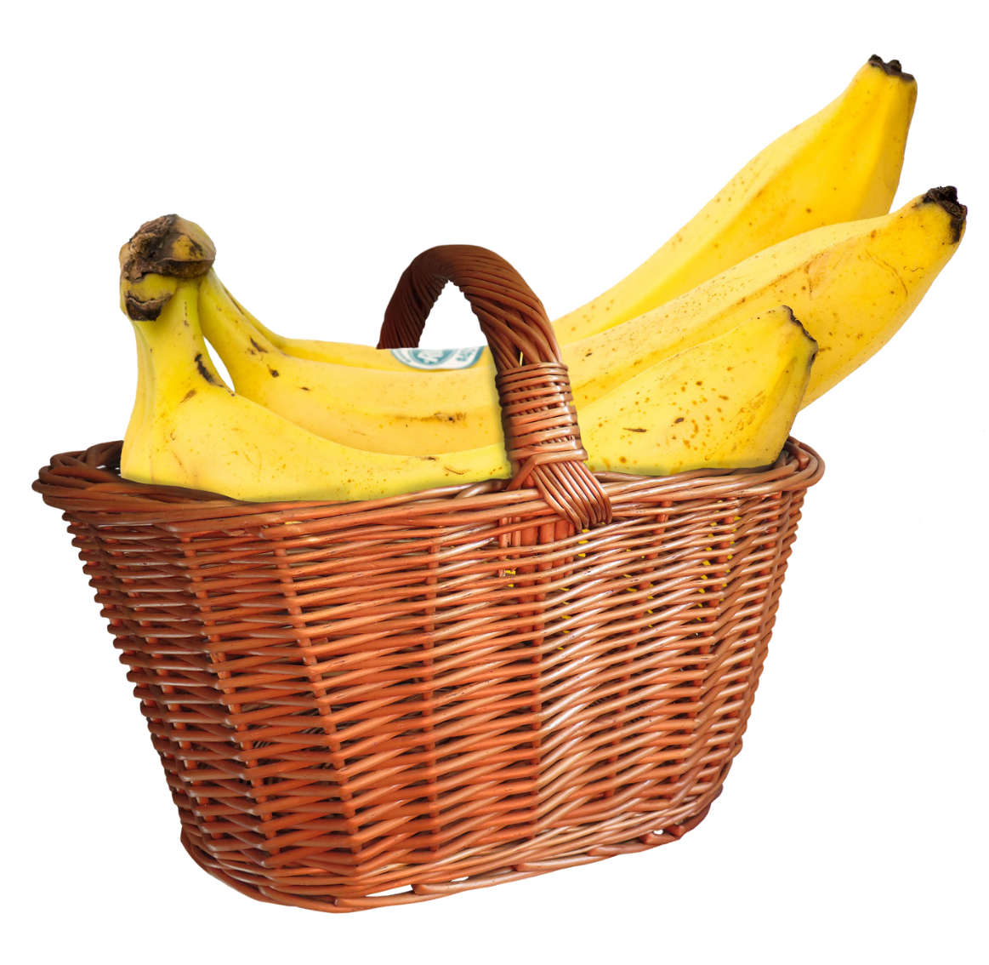
Interesting Images
In South America, farmers are beginning to use a type of fertilizer which is producing these huge bananas!

Slide 7
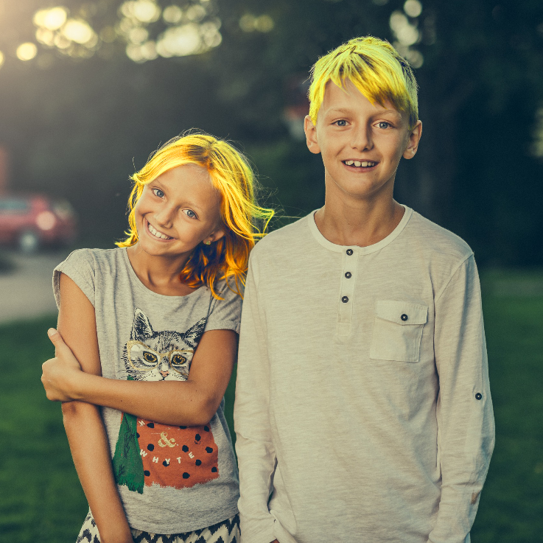
Interesting Images
In some parts of Southern Europe, the water is so polluted that people in small villages along riverbanks are experiencing changes to their hair and nails.

Slide 8
Interesting Images
How does it feel to know that people can be fooled this easily?
All of these pictures are fake. They have been edited with basic software to make them seem more interesting.
How do you feel when you believe something and then find out it’s not true?

Slide 9
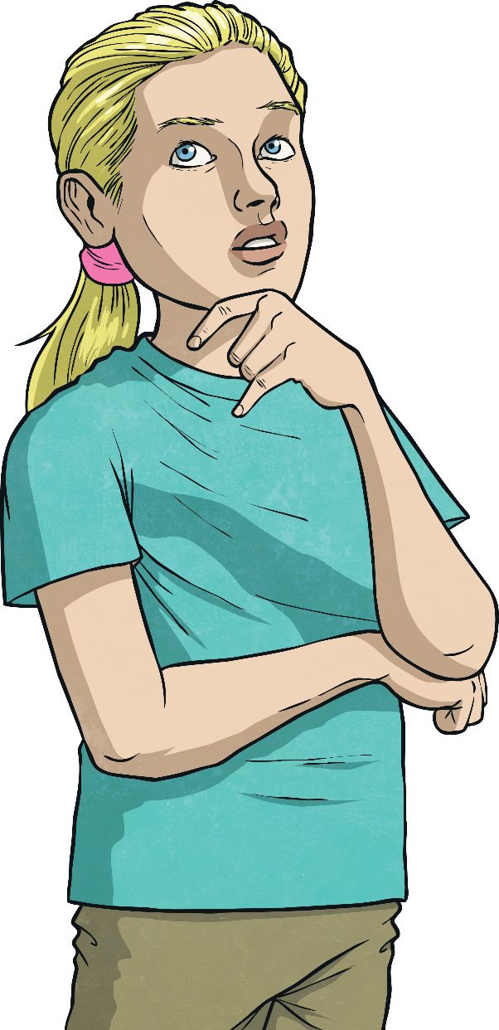
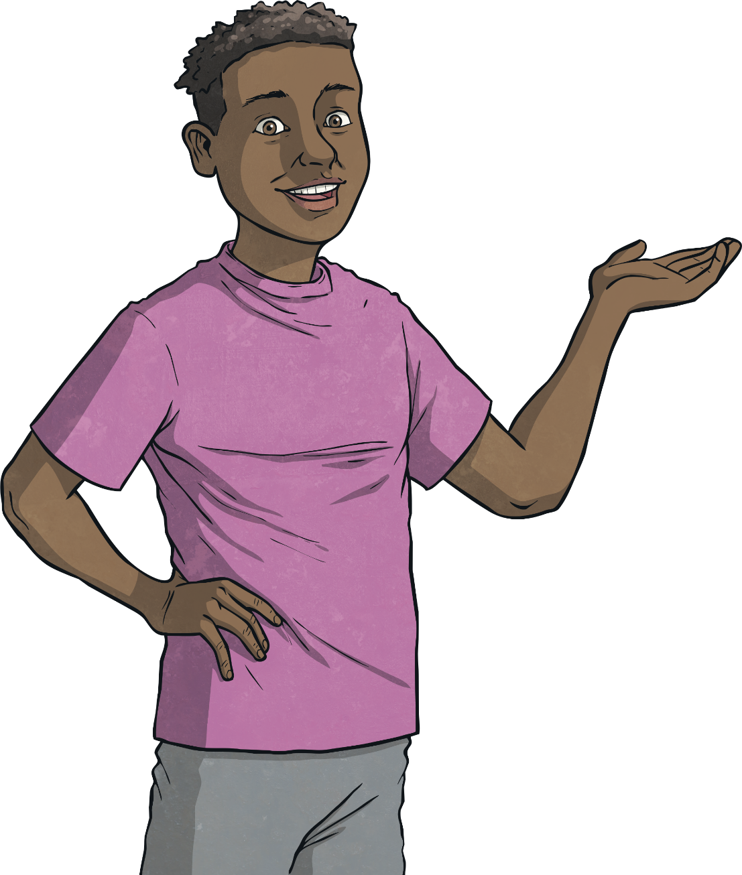
Picture Perfect
Sometimes, however, we might not realise that the photos we are looking at have been edited…
Photo editing software is often used to create fun, interesting pictures that we wouldn’t be able to see without this amazing technology.

Slide 10
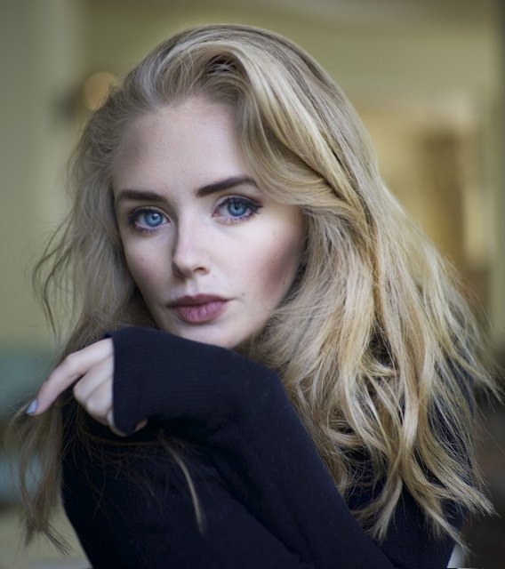
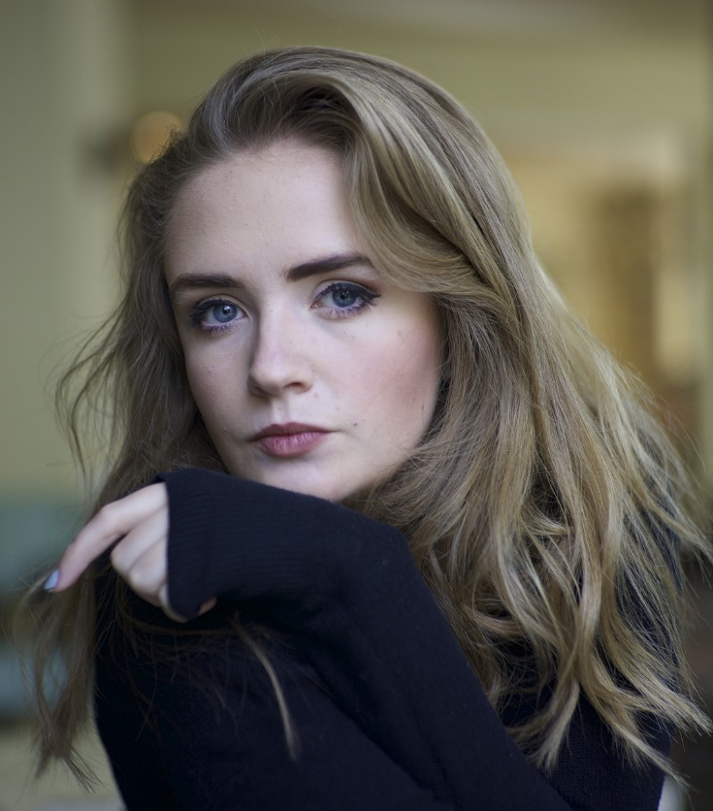
Picture Perfect
If you saw this photo online, you might think it was real.
But this is the original photo. Can you spot what has been changed?
Lips made fuller
Eye colour exaggerated
Hair lightened
Nose made smaller
Face shape changed
Shadows and highlights on face made more dramatic

Slide 11
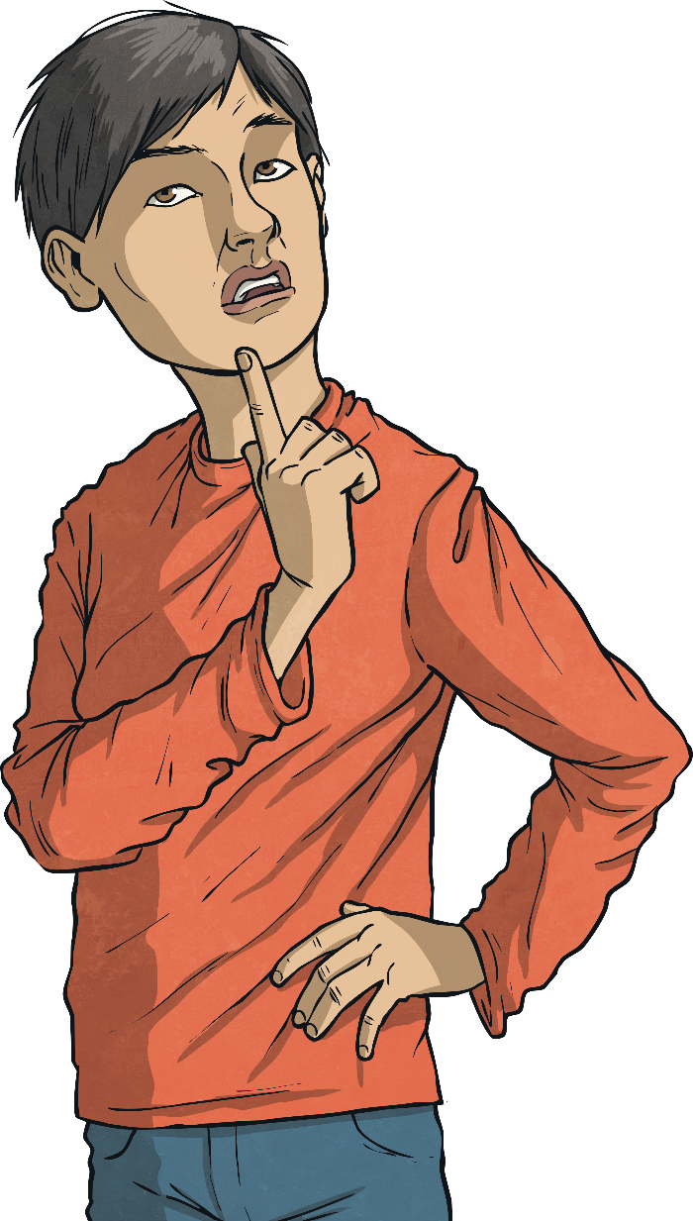
Spot the Edits
Can you spot what has been edited?
With your group, look at the different photos of people you have been given.
Discuss these questions in your group:
How can it feel to see ‘perfect’ people in photographs?
Is it realistic to try and look like those photos? Why?
Why do you think photos are edited by advertisers?
Why do you think people sometimes edit the photos of themselves that they post on social media?

Slide 12
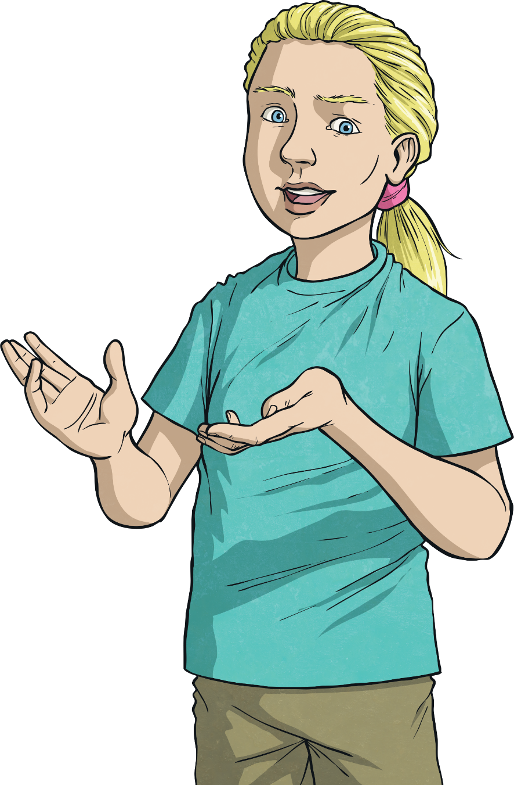
Editors
We can do all of these things on apps or software on our own computers. Lots of social media apps allow you to edit photos before posting them online.
There are lots of ways we can edit photos very easily…
cropping
adding filters
recolouring
changing the shape of a body
adding parts
smoothing out surfaces - including skin

Slide 13
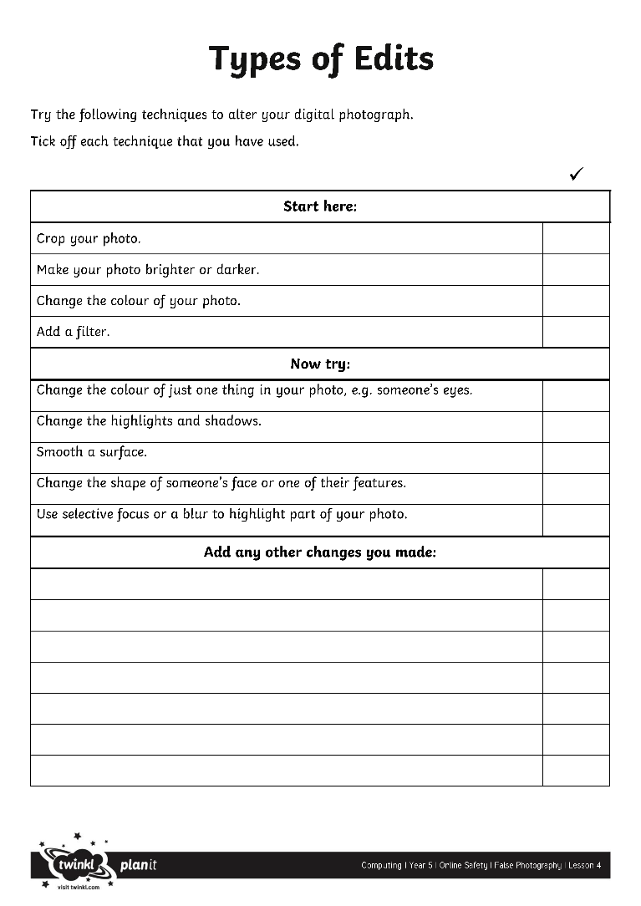
Fakers!
Now, try to edit a digital photo yourself.
Use the Types of Edits Checklist to give you some ideas for how to alter your picture. Tick off the ones you have tried.
Can you digitally alter a photograph?

Slide 14
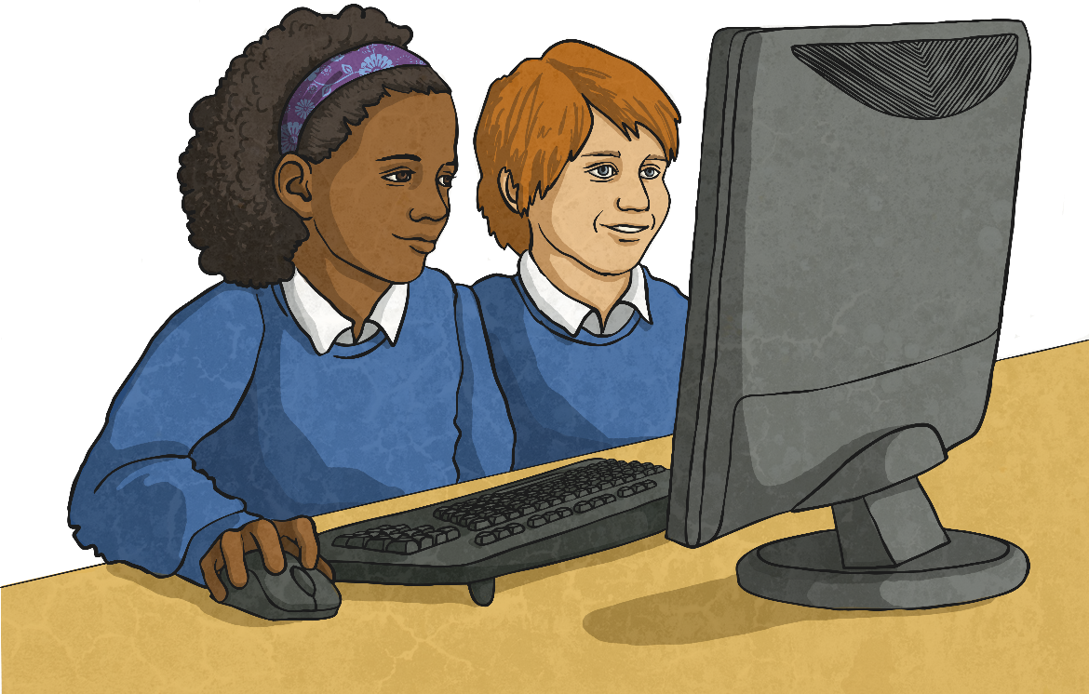
Digital Detectives
Join up with a partner.
Does it worry you how easy it is to change a photo that people could believe was real?
Look at each other’s edited photos.
See if you can spot the edits your partner has made.
Imagine how different we could make a photo look if we had professional equipment!
Then, show your partner your original
image and compare it to your
edited version, explaining the
changes you have made.

Slide 15
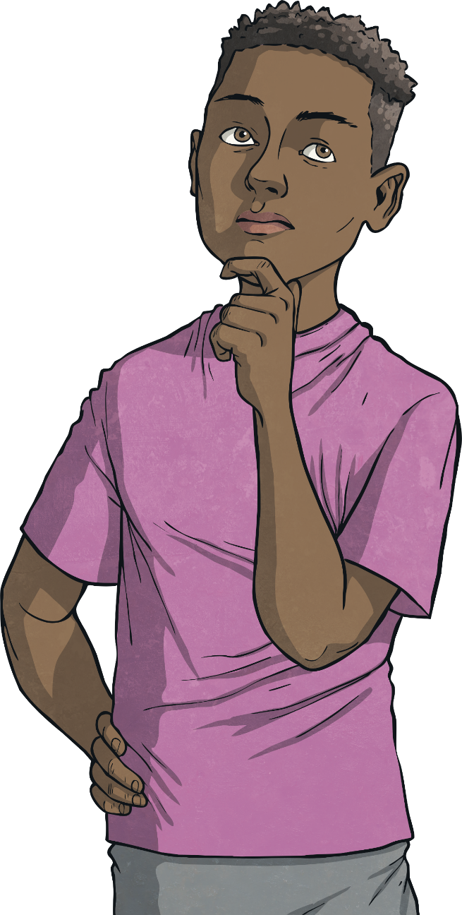
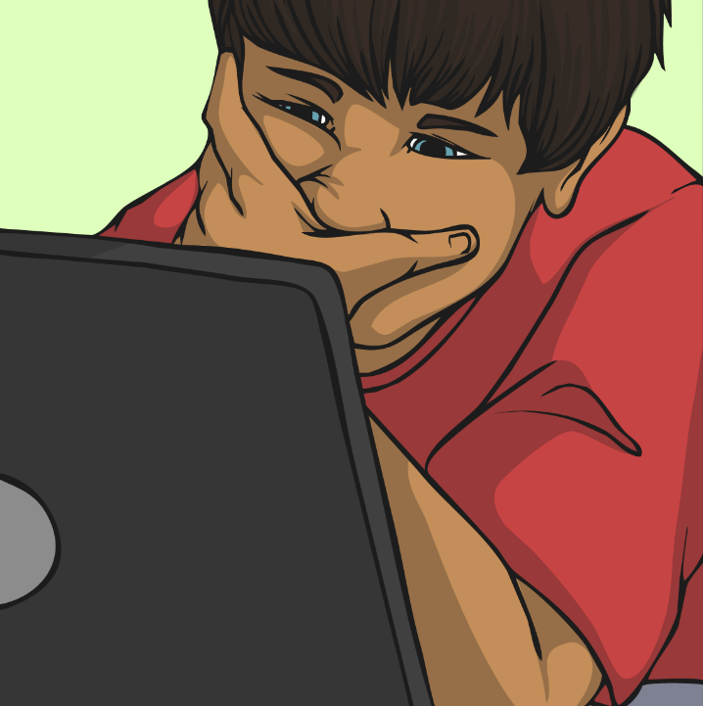
True to You
Don’t try to compare yourself to fake photos; it’s better to be you!
What would you say to Hari?
Hari has been looking at some photos of his favourite film star in an online article.
Don’t believe everything you see online. Photos on the Internet are often edited.
Everyone is different. Why would you want to look like someone else?
I’ll never look as good as Jack Starman. How does he always look so cool?
I wish I didn’t look so terrible.
Don’t spend time worrying about someone else’s photos when you could be busy having fun!
Even the people in the edited photos don’t look ‘perfect’ in real life!

Slide 16
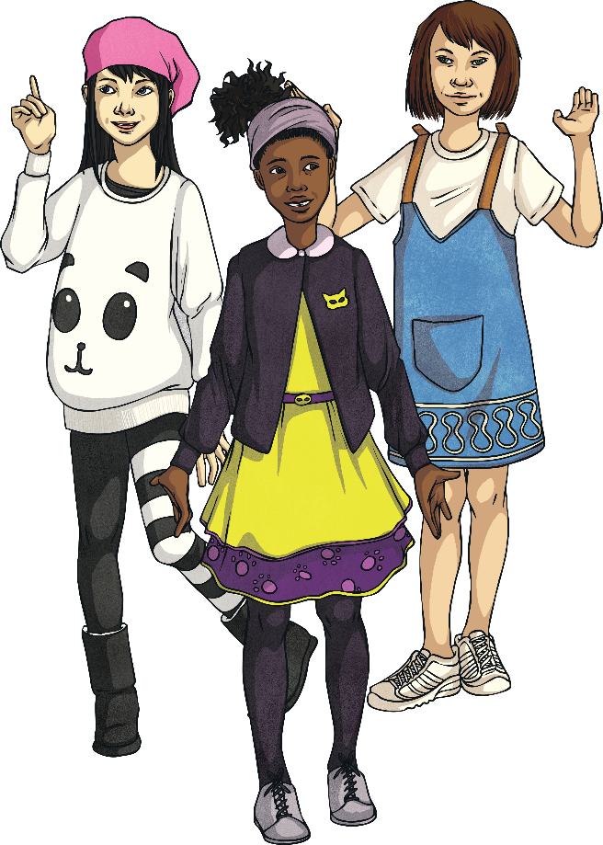
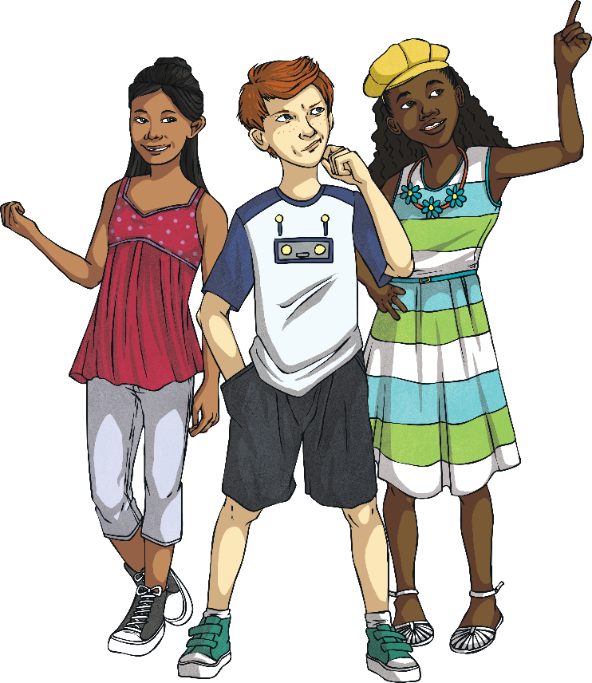
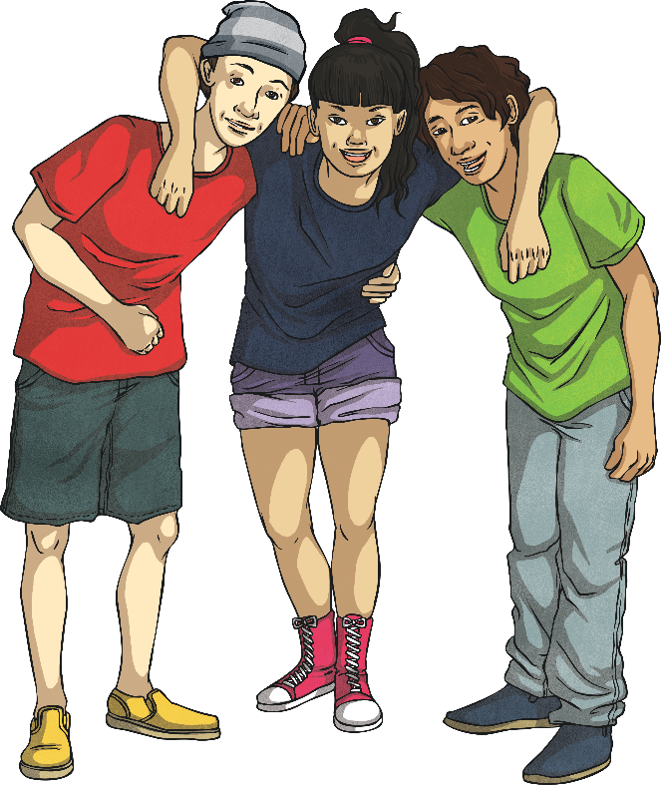
True to You
Love yourself for who you are and be true to you!

Slide 17
Aim
To recognise when, why and how photographs we see online may have been edited.
Success Criteria
I can recognise changes that have been made to an original photograph.
I can digitally alter a photograph.
I understand that not everything I see online is true.
I can explain how false photographs can make people feel bad about themselves.

