Slide 1
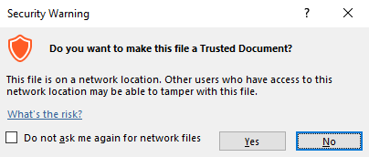
Guidance for Macros in PowerPoints
We use macros within PowerPoints to increase the interactivity of our presentations. Follow this simple process to get the most out of this resource.
What to do:
Open the PowerPoint file and enable editing.
A security warning box may appear. Click yes.
Click enable content.
Enter presentation mode (start the slide show).

Slide 2
Computing
Online Safety
Year One
Computing | Year 5 | Online Safety | Powerful Passwords | Lesson 3

Slide 4
Aim
To create strong passwords.
Success Criteria
I can explain the rules for creating a strong password.
I can create a strong password using a set of rules.
I can explain why having a strong password is important.

Slide 5
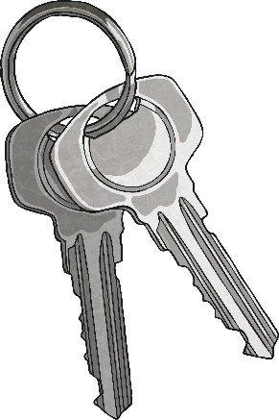
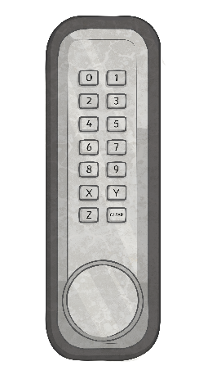
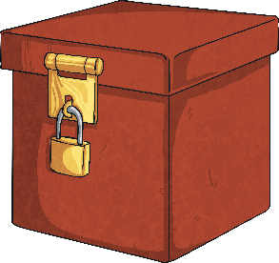
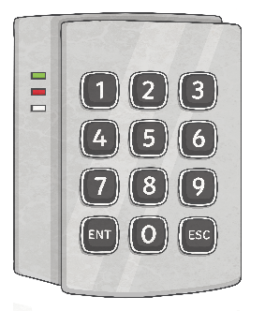
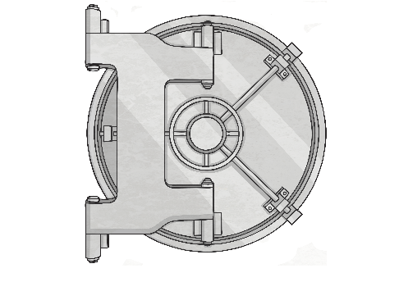
Stay Secure
As a group, think about all the ways you keep your homes and belongings safe.
You wouldn’t give people the key or combination to a lock, would you?

Slide 6
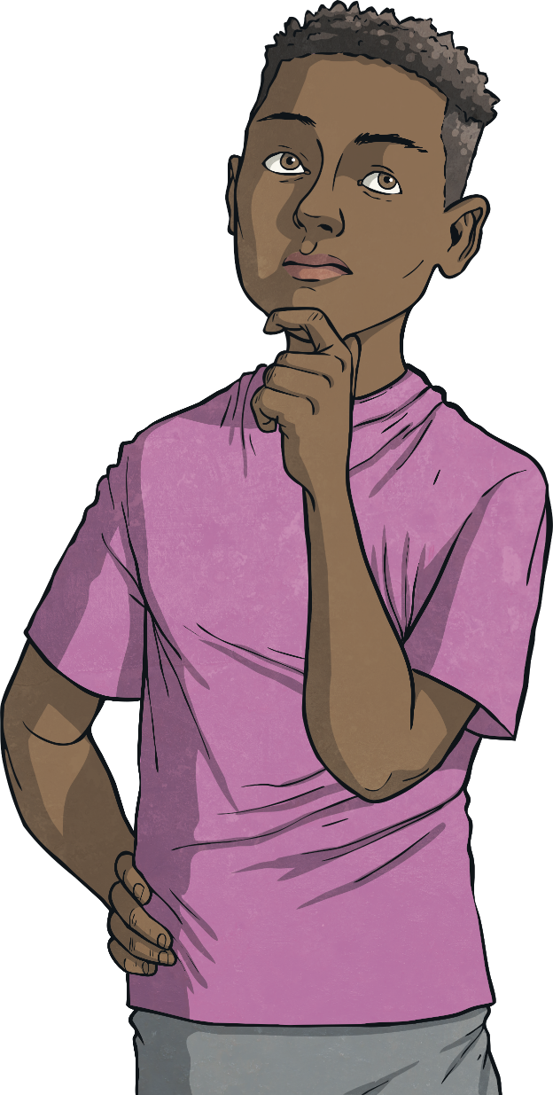
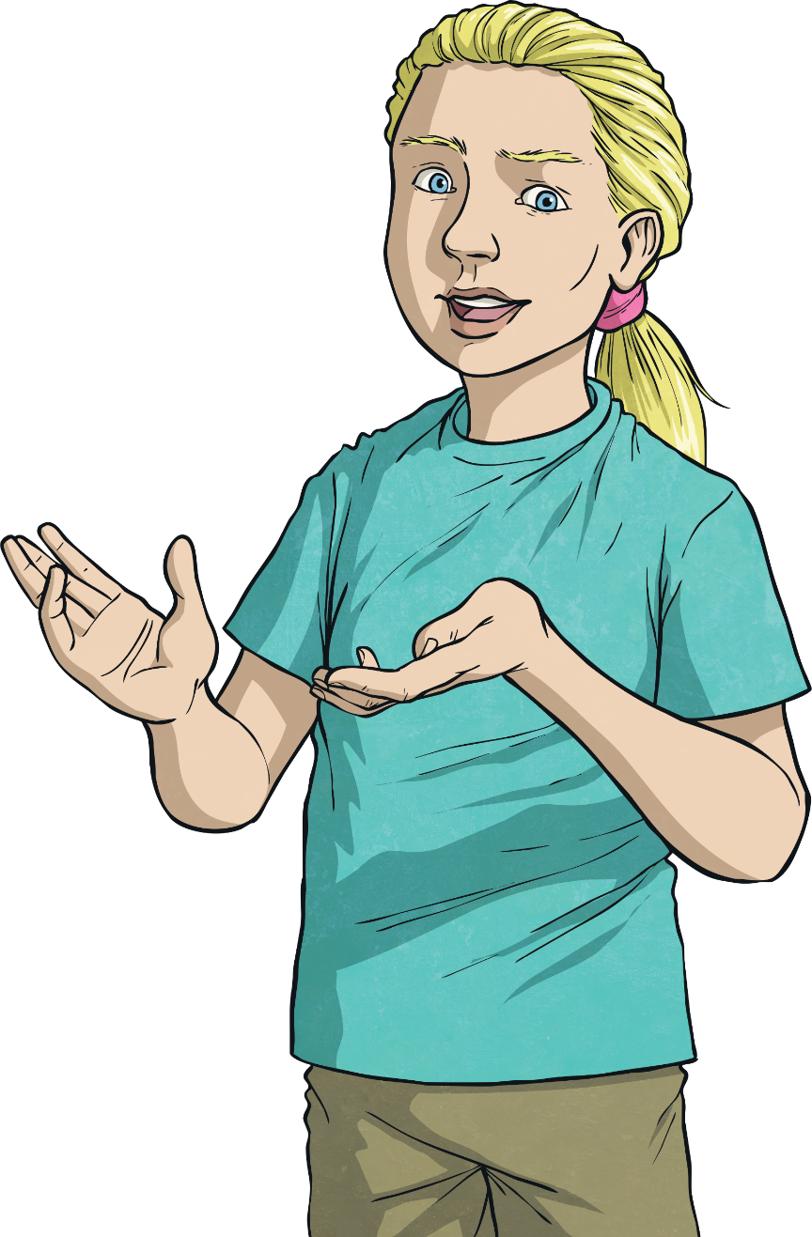
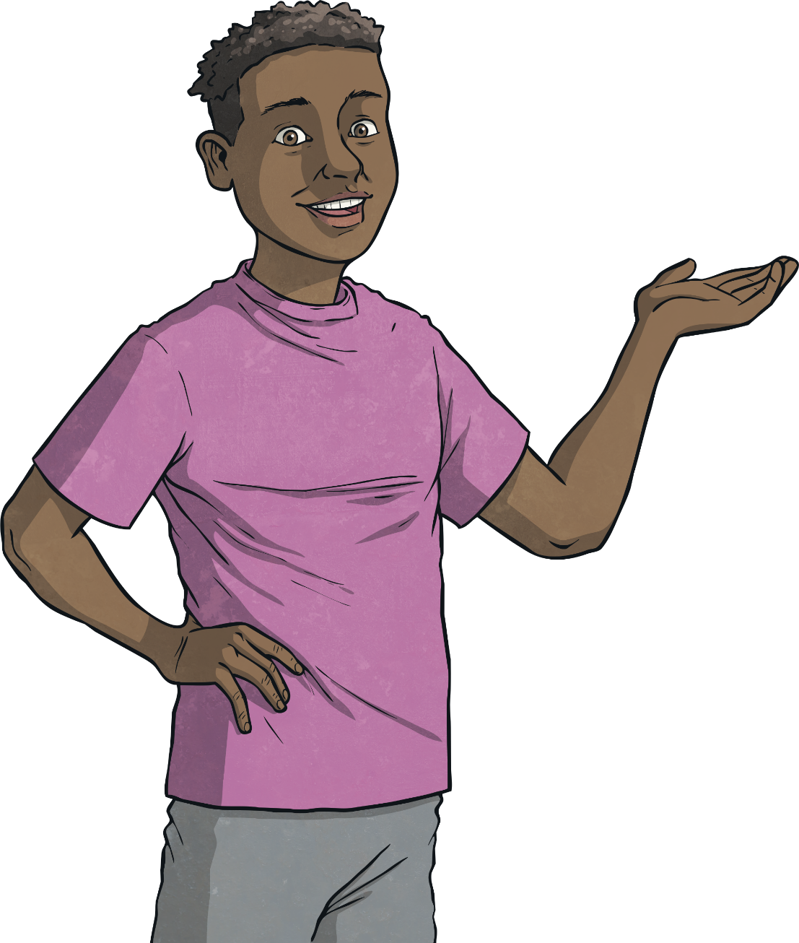
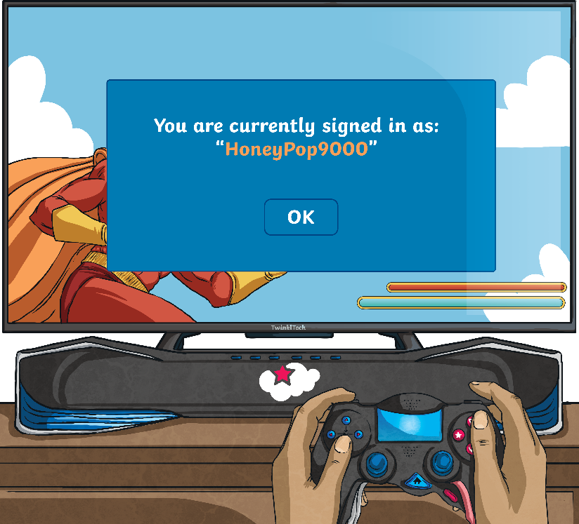
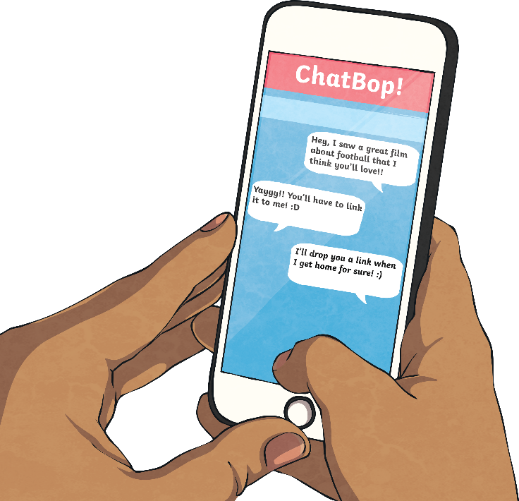
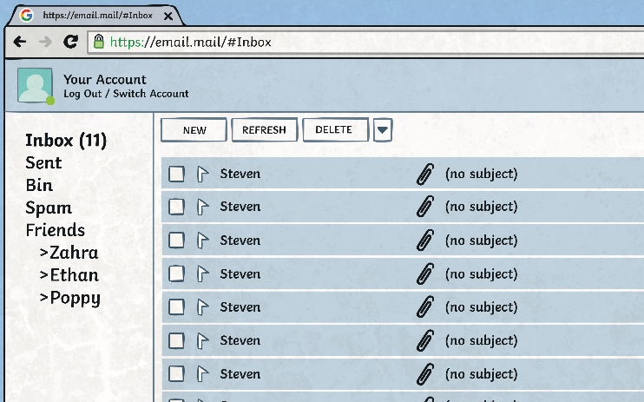
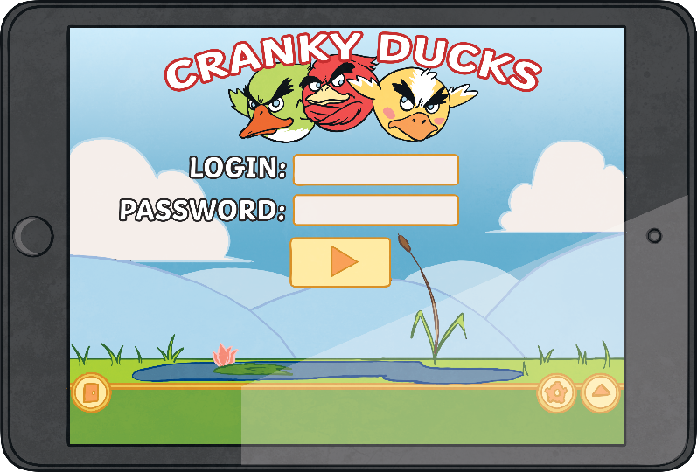
Passwords
We should not tell anyone else our passwords.
Passwords are just another type of lock. We use them to keep information safe.
Think of your password as a key - you wouldn’t leave it out for just anyone to use!
What do you use passwords for?

Slide 7
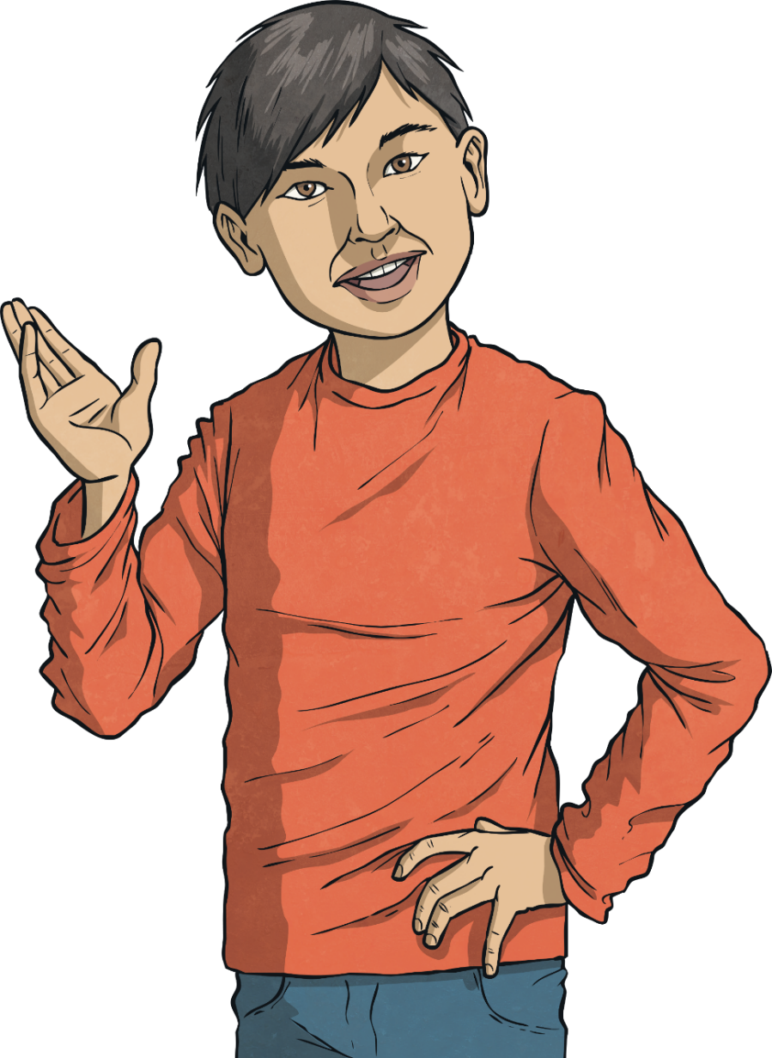
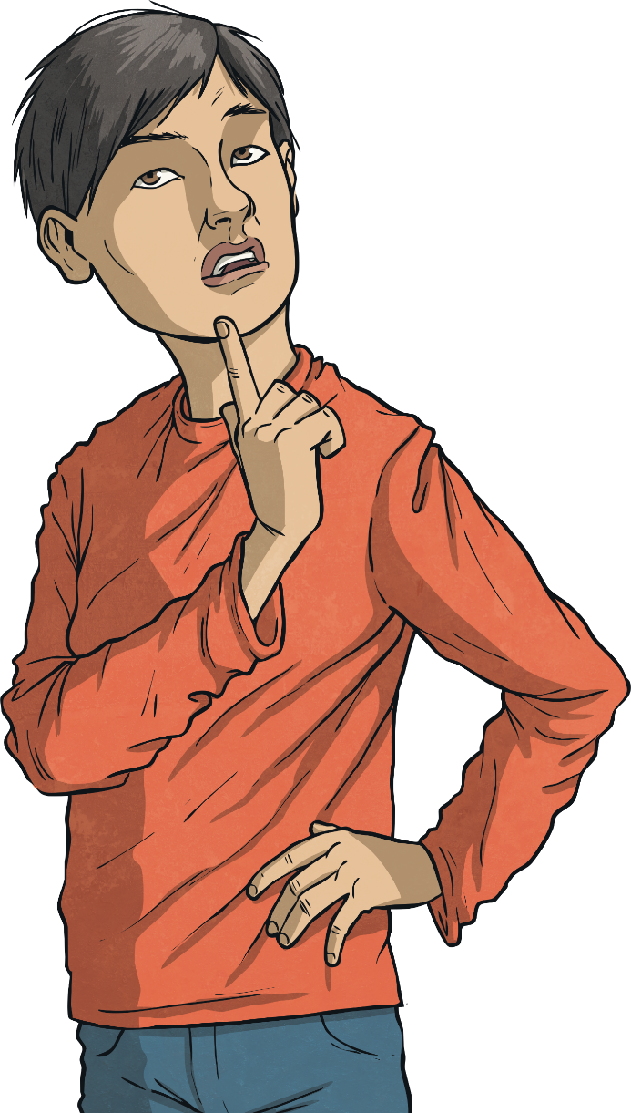
12345
Sometimes, people use passwords that are really common, usually because they’re easy to remember.
Talk to your group.
Why should people not choose these passwords?
abcdefg
123456789
birthdays
Think about what would happen if someone were to guess these passwords. Write down your ideas.
password
qwerty123
names of family members or pets

Slide 8
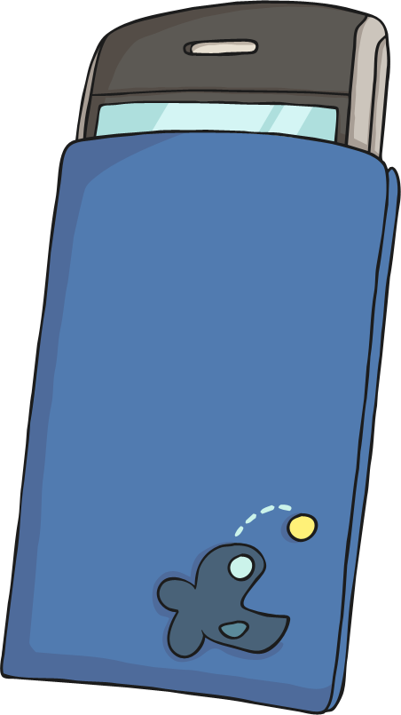
Rules
There are some basic rules you can follow to create a really strong password.
Include both lower-case (abc) and upper-case (ABC) letters.
Include numbers (123).
Include other characters (like punctuation marks and symbols), e.g. ?&#£$!@
Avoid using full words.
Avoid using names or birthdays.

Slide 9
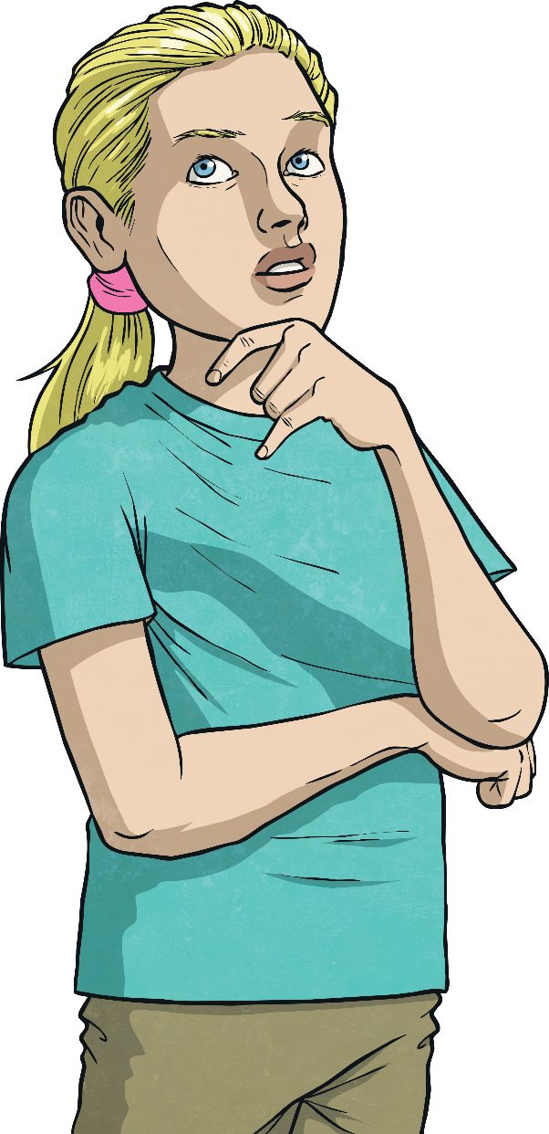
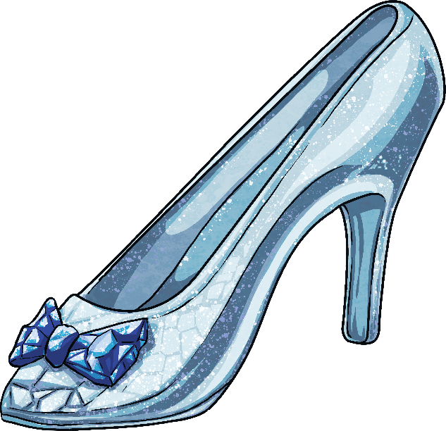
Rules
Of course, remembering Lizzy03 is much easier than remembering g6??b2N8n*n – but you can use sentences or phrases as a clue to help you remember tricky passwords.
To help us remember this password…
Clhs@12@tB
…we could use this sentence:
Cinderella lost her shoe at midnight at the ball.
C
l
h
s
@
12
@
t
B

Slide 10
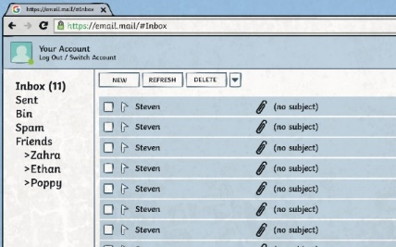
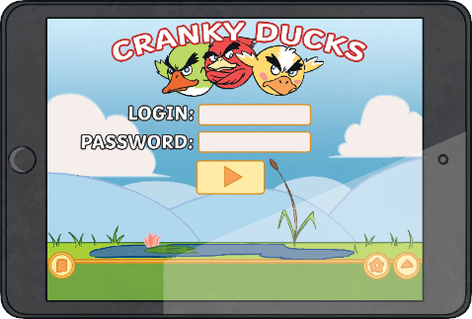
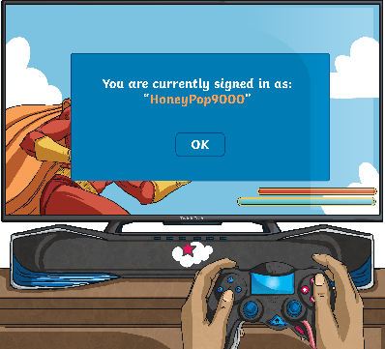
Rules
Now that I have thought of a really strong password, I should make sure I use this for every account.
True or false?
False.
If you use the same password for different logins, someone who guesses your password on one account can log in to all your accounts!
Use a different strong password for each of your accounts.

Slide 11
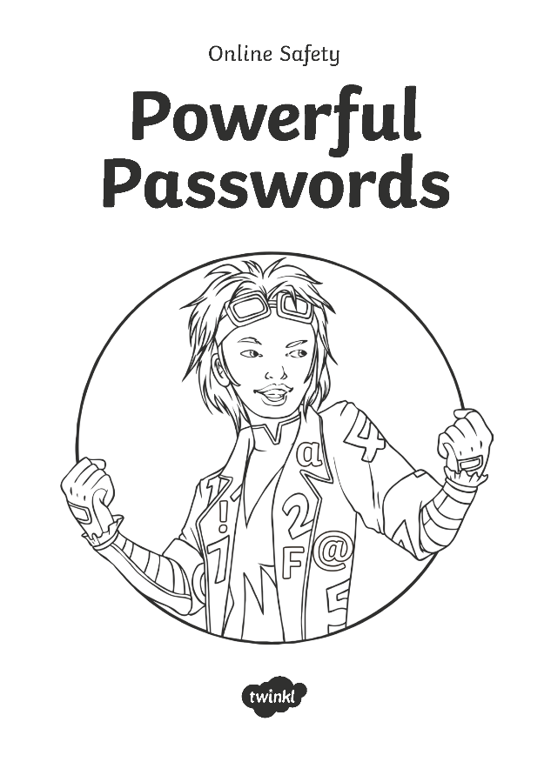
Powerful Passwords
Now it’s your turn to practise thinking of your own powerful passwords that you could use online.
You’ll need to think of three different passwords that you could use for different accounts.
For each password, use a sentence or phrase as a clue to help you remember them.
Then, try memorising them and check to see if you can remember them correctly.

Slide 12
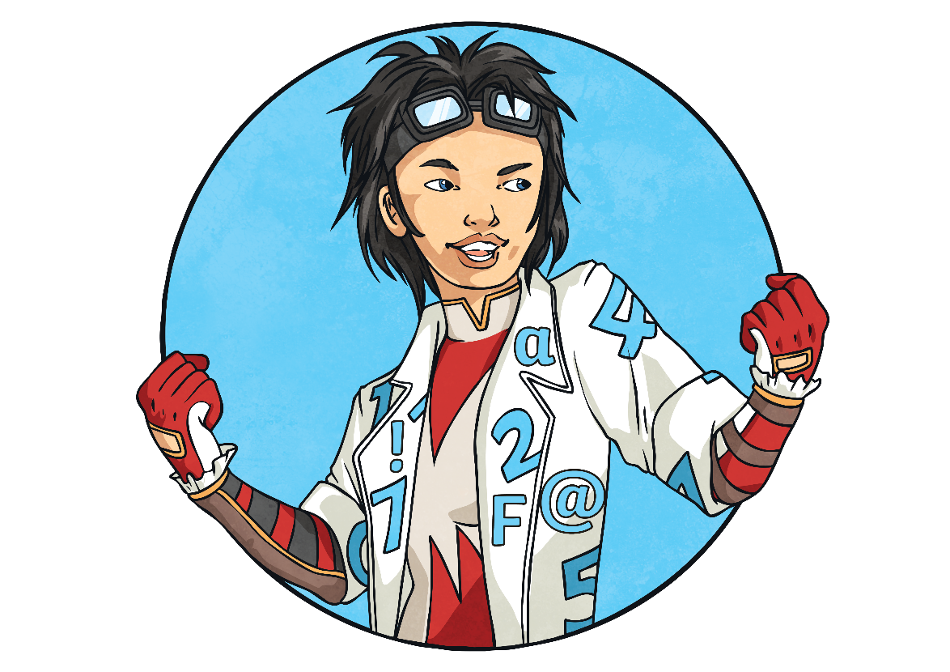
Powerful and Private
Remember - the passwords that we created today were practice passwords.
In real life, you would not write your passwords down. Once you are really good at creating and memorising passwords, the only place you should keep your password is in your brain!
Why do you think you should not write your passwords down? Talk to your partner.

Slide 13
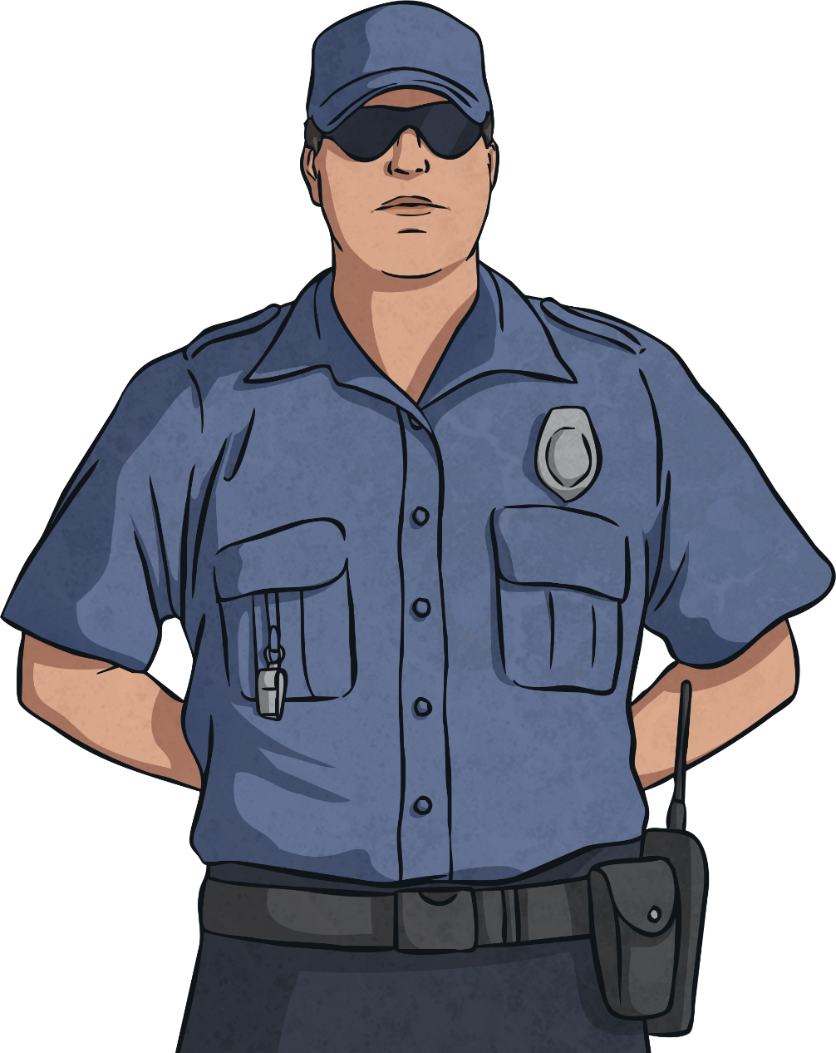
Security Questions
Hi! I’m the cyber security guard. We’re looking for new recruits.
I need you to answer some security questions to see if you’d be up to the job.
Answer correctly to score points.

Slide 14
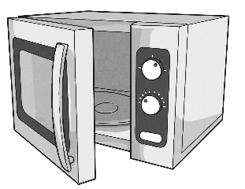
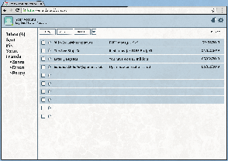
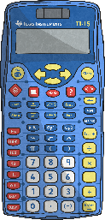
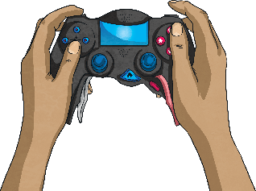
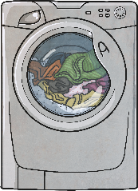
Security Questions
Which of these would you normally use a password for?
microwave
email inbox
0 points
1 point
social media app
calculator
1 point
0 points
online game
washing machine
1 point
0 points

Slide 15
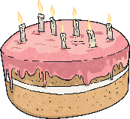
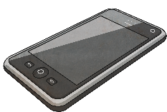
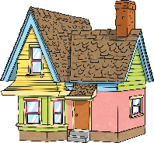
Security Questions
Which of these things should you use in a password? Choose all the answers that are correct.
b
lower-case letters
g
z
1 point
7
numbers
your nan’s name
8
1 point
2
0 points
your birthday
0 points
your phone number
symbols
@
#
1 point
!
?
punctuation marks
0 points
1 point
Y
capital letters
your house number
emojis
Q
A
0 points
1 point
0 points

Slide 16
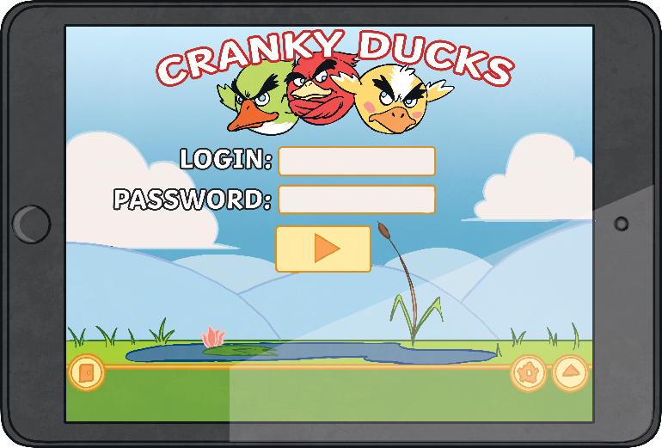
Security Questions
Which of these is the strongest password?
Je$$ie159
0 points
John7
0 points
Im2B@h@2
2 points
Pa$$w0rd
0 points

Slide 17
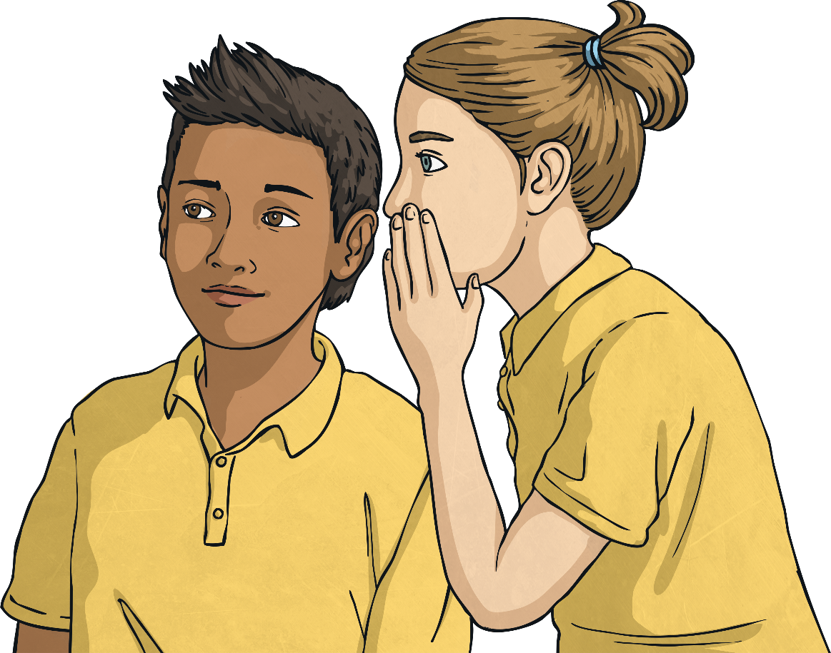
Security Questions
You should tell your password to three friends in case you forget it.
True
0 points
False
1 point

Slide 18
Security Questions
Which of these top tips should you listen to?
Use country names in your password to help you remember it.
0 points
Write your password in your diary in tiny letters in case you forget it.
0 points
Use a different strong password for each of your online accounts.
2 points
Passwords with numbers in are easiest to guess.
0 points

Slide 19
Security Questions
You’re worried that there has been a security breach and someone has found out your password. What should you do?
Call an ambulance.
0 points
Change your password straight away.
1 point
Email everyone you know and ask for advice.
0 points
Ask the person to forget your password.
0 points
Tell a trusted adult.
1 point
Delete all of your accounts.
0 points
Relax and do nothing.
0 points

Slide 20
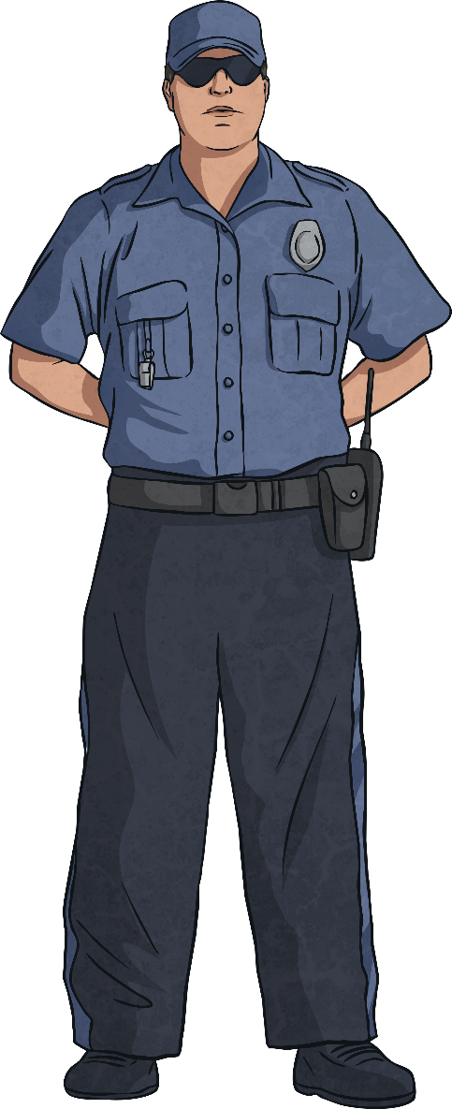
Security Questions
How did you do?
0 - 4 - I can see your potential.
5 - 9 - You’ve got more to learn but you’re on your way to being a great candidate.
10 - 14 - A little training and you could be a real security star.
15 - Outstanding. Have you thought about joining the Cyber Security Service?

Slide 21
Aim
To create strong passwords.
Success Criteria
I can explain the rules for creating a strong password.
I can create a strong password using a set of rules.
I can explain why having a strong password is important.

