Slide 1
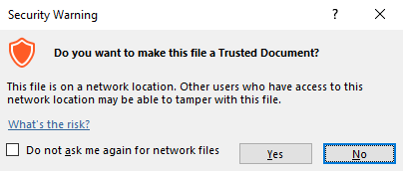
Guidance for Macros in PowerPoints
We use macros within PowerPoints to increase the interactivity of our presentations. Follow this simple process to get the most out of this resource.
What to do:
Open the PowerPoint file and enable editing.
A security warning box may appear. Click yes.
Click enable content.
Enter presentation mode (start the slide show).

Slide 2
Computing
Online Safety
Year One
Computing | Year 5 | Online Safety | Spam! | Lesson 1

Slide 4
Aim
To identify spam emails and what to do with them.
Success Criteria
I can look at the sender and subject to spot a spam email.
I can identify the potential dangers of spam email.
I know what to do with spam email.
I can take steps to avoid receiving spam.

Slide 5
Junk Mail
Do you sometimes get letters or leaflets through your letter box that aren’t really for anyone in your home?
Do you think they are sent especially to your home?
What do the people in your home do with them?
Why are they sent and who by?

Slide 6
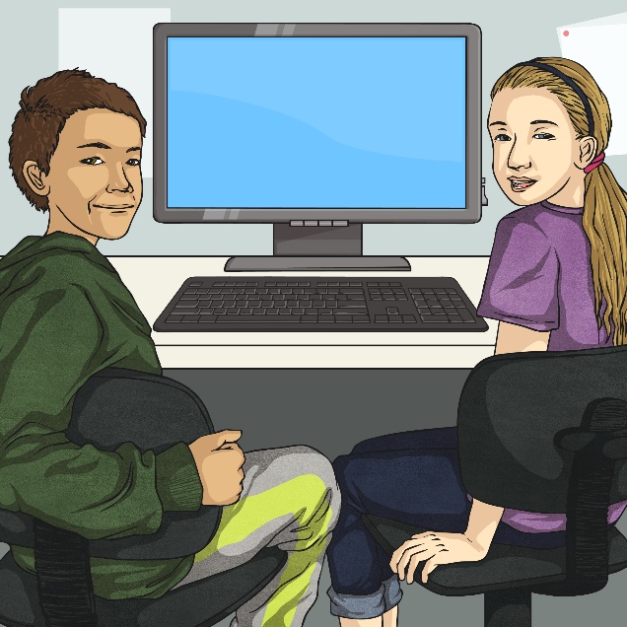
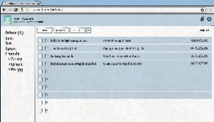
What Is Spam?
They are sent to any email address that the sender has, and are never just for the person that receives it.
We call the unwanted letters and leaflets posted to homes ‘junk mail’.
Spam is the name we give to the email version of junk mail.
^ Inbox
1-4 of 4
Sender
Subject
Date
bill776556@interspam.ds
FREE Money!!! £££
03/01/2019
They are emails someone receives without asking for them.
The Free Stuff Co!
Reply now for FREE Stuff :D
04/02/2019
Lottery Legends
You have won £5 million!
05/02/2019
bananas2345666@spamnet.bot
Open now to read a secret!
06/02/2019

Slide 7
What Is Spam?
On a sticky note, write how having your email inbox filled with this type of message would make you feel.
^ Inbox
1-4 of 4
^ Index
1-4 of 4
Sender
Subject
Date
Sender
Subject
Date
bill776556@interspam.ds
FREE Money!!! £££
03/01/2019
bill776556@interspam.ds
FREE Money!!! £££
03/01/2019
The Free Stuff Co!
Reply now for FREE Stuff :D
04/02/2019
The Free Stuff Co!
Reply now for FREE Stuff :D
04/02/2019
Lottery Legends
You have won £5 million!
05/02/2019
Lottery Legends
You have won £5 million!
05/02/2019
bananas2345666@spamnet.bot
Open now to read a secret!
06/02/2019
bananas2345666@spamnet.bot
Open now to read a secret!
06/02/2019

Slide 8
Annoying but Harmless?
We can agree that spam is very annoying, but is it dangerous?
Look at this email. Could it be unsafe?
Save and Win!!
Inbox X
The Ham Kings
Date: 03/01/2019
Dear customer
Save 50% on tinned ham and you could win £100 in our prize draw!
Click here to enter or click here to download our entry form.
Reply
Reply to all
Forward

Slide 9
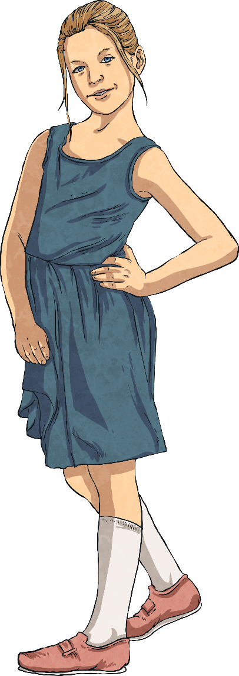
Annoying but Harmless?
The links you can click could take you to a dangerous website.
Filling in details on an online form like this gives your personal information to a stranger. This is called phishing (pretending to be a real company to get your details).
If you click the links or download the file, it could let the sender know that your email address belongs to someone. They could then send you lots more spam.
The links and download could contain a virus.
Save and Win!!
Inbox X
The Ham Kings
Date: 03/01/2019
Dear customer
Save 50% on tinned ham and you could win £100 in our prize draw!
Click here to enter or click here to download our entry form.
Reply
Reply to all
Forward

Slide 10
Protect Your Inbox
It can be quite easy to spot spam…
When using email, it is important to try to protect yourself from spam.
A spam email will often look like it is from a company. Sometimes, it will look like it is from a company you trust.
The emails often come from a strange-looking or unknown email address.
The subject might say that you have won something or that there is an amazing deal for you.
^ Index
1-1 of 1
Sender
Subject
Date
SNAZZY SHOES CO.
fakerboy1331234@spamtown300.pe.it
You’ve WON some FREE shoes!
03/01/2018

Slide 11
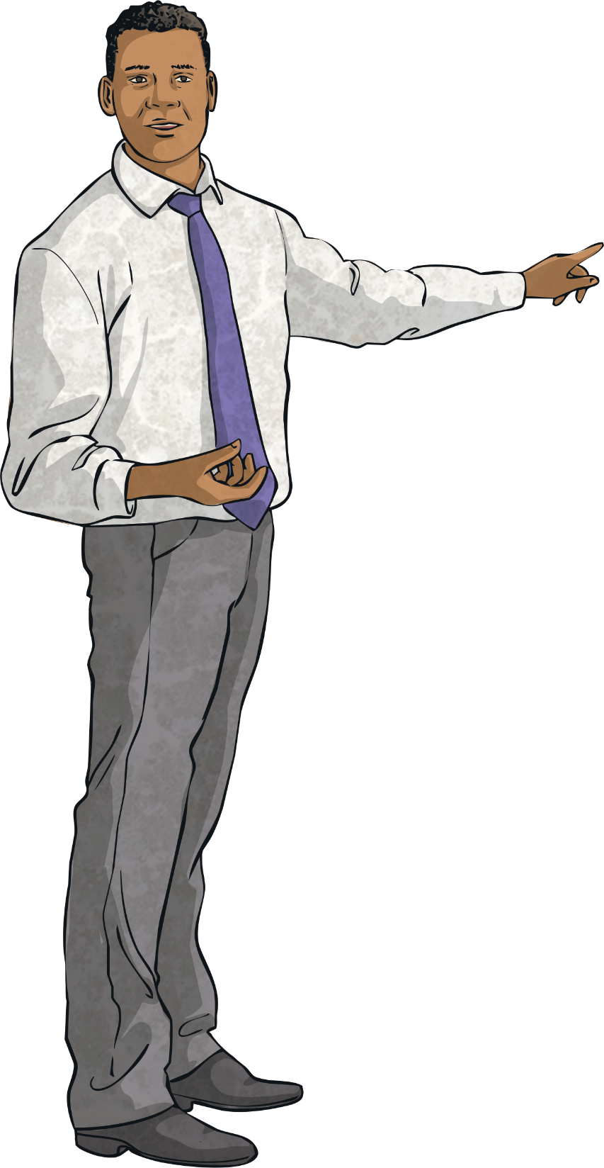
Protect Your Inbox
If you spot spam…
Do not open the email.
Find out how to ‘mark as junk’ so that your email provider knows the email is junk mail. This will move it out of your inbox.
If you think the email might be dangerous, ask a trusted adult to help you report it.
^ Index
1-1 of 1
Sender
Subject
Date
SNAZZY SHOES CO.
fakerboy1331234@spamtown300.pe.it
You’ve WON some FREE shoes!
03/01/2018
Mark as Junk

Slide 12
Protect Your Inbox
If you open an email and then realise it’s spam…
Make sure you do not reply to it or forward it.
Don’t click any links or attachments in it - these could be really harmful!
You can still move the email to your junk folder or report it after you’ve opened it.
Tell a trusted adult that you opened it by accident, just so they can check that nothing harmful has happened.

Slide 13
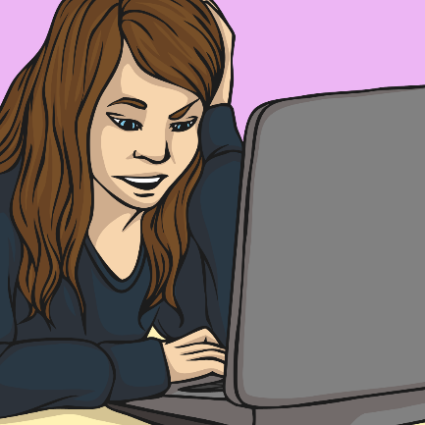
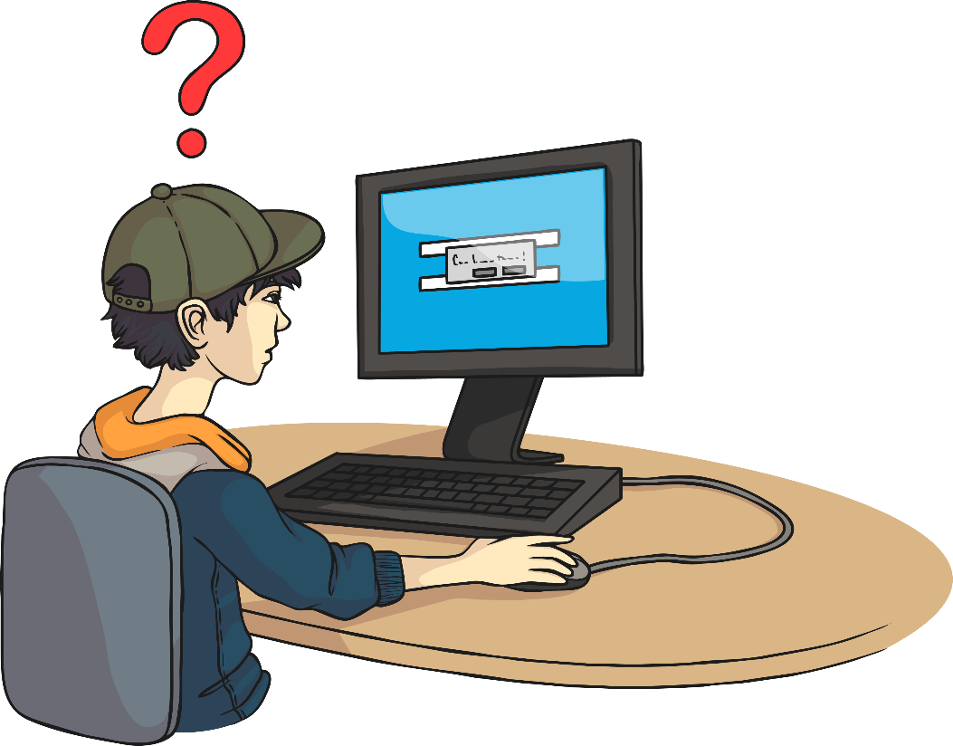
Protect Your Inbox
There are things you can do to prevent more spam emails in the future…
Avoid putting your email address into websites or online forms unless you have to. Try not to sign up to mailing lists.
Send any unwanted spam emails straight to your junk folder.

Slide 14
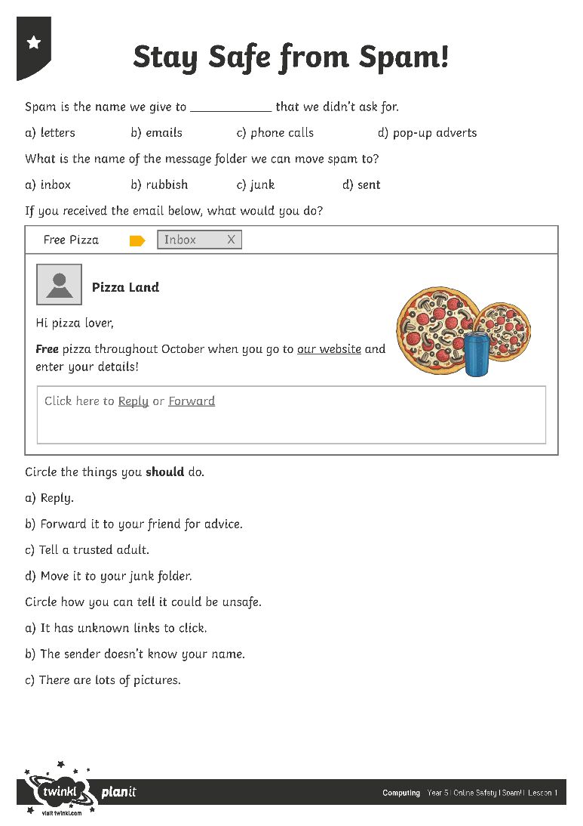
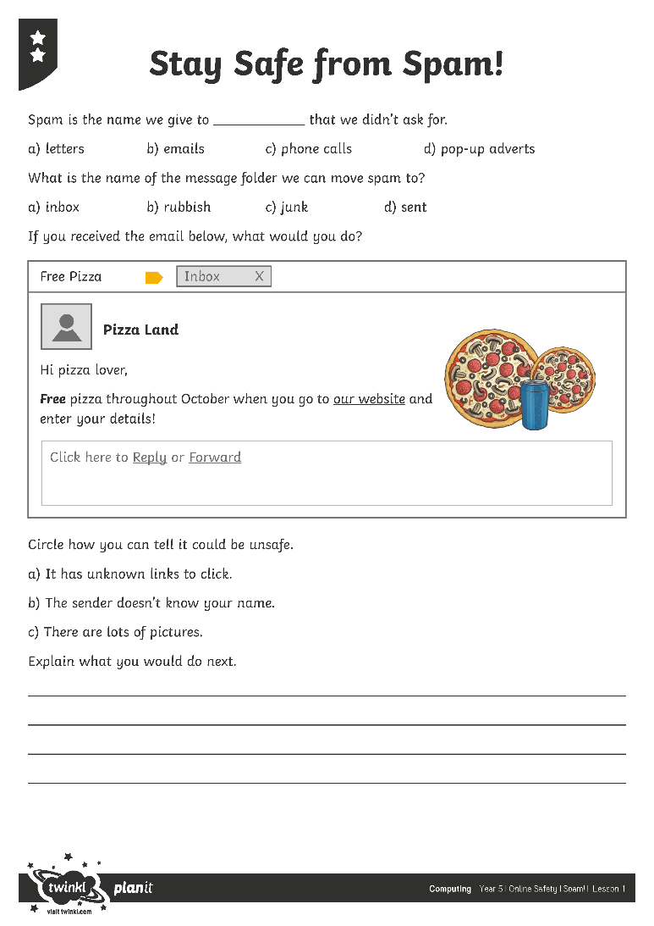
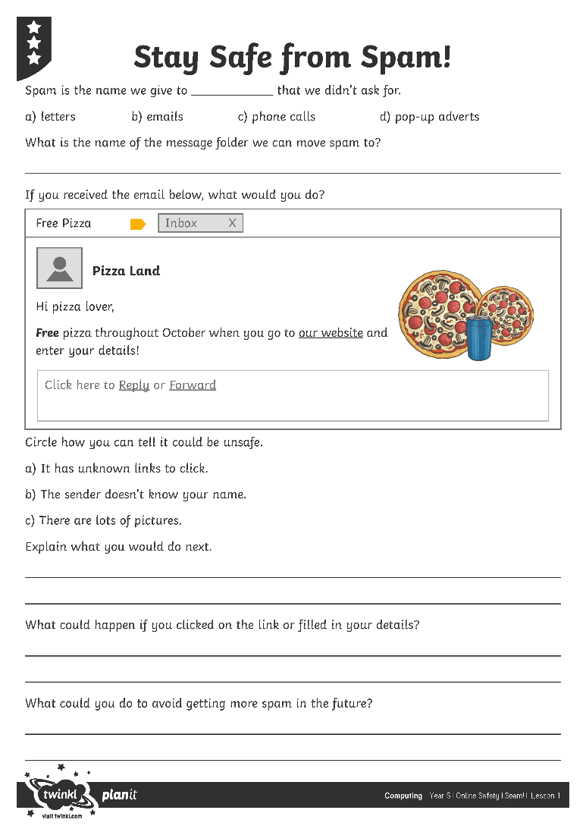
Stay Safe from Spam!
Complete the Stay Safe from Spam! Activity Sheet to show how much you know about avoiding the dangers of spam.

Slide 15
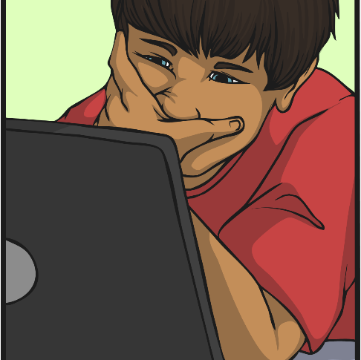
Quick Quiz
Which emails should Kyron choose to open?
Kyron has received these emails.
Discuss the emails with your partner and vote yes or no for each one.
^ Inbox
1-5 of 5
Sender
Subject
Date
Steakhouse
Free Tinned Beef and Shopping Vouchers!!
27/12/2018
Lauren F
The photos you wanted ☺
1/1/2019
Ham.house.uk.pu
###sale###
2/1/2019
Mum
Re: thanks!
3/1/2019
Canned shopping
Register to get super deals
4/1/2019

Slide 16
Aim
To identify spam emails and what to do with them.
Success Criteria
I can look at the sender and subject to spot a spam email.
I can identify the potential dangers of spam email.
I know what to do with spam email.
I can take steps to avoid receiving spam.

