Slide 1
Remote Learning Plan!
Hello Year 4!
During the next few weeks, we will be providing the children with remote learning on a daily basis. The work will be available on the website the day before e.g. Monday’s work will be online Sunday.
Everyday the remote learning will consist of:
English Lesson
Maths Lesson
Reading Lesson
One other curriculum lesson (PSHE, Art etc)
We will be available during the hours of 9am-4pm so please feel free to contact us on our new e-mail njs.year4@taw.org.uk
Some of the work provided will be split into the star levels that the children use everyday in class (1,2 3).
Stay safe everyone!
Miss Jones, Mrs Jukes, Mrs Kuczynska and Mrs Sisson.

Slide 2
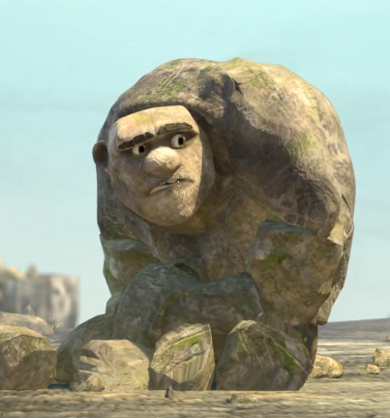
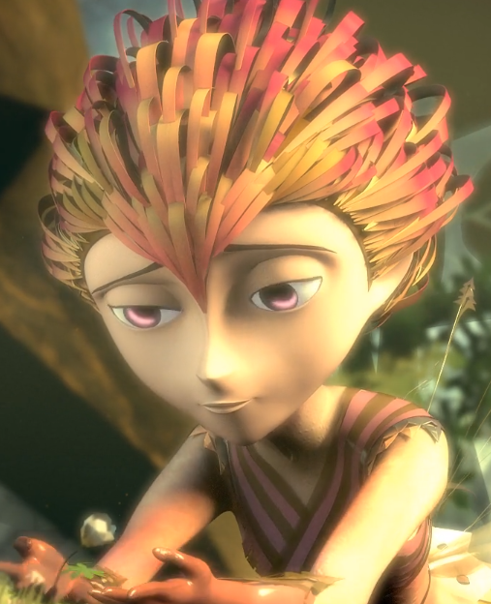
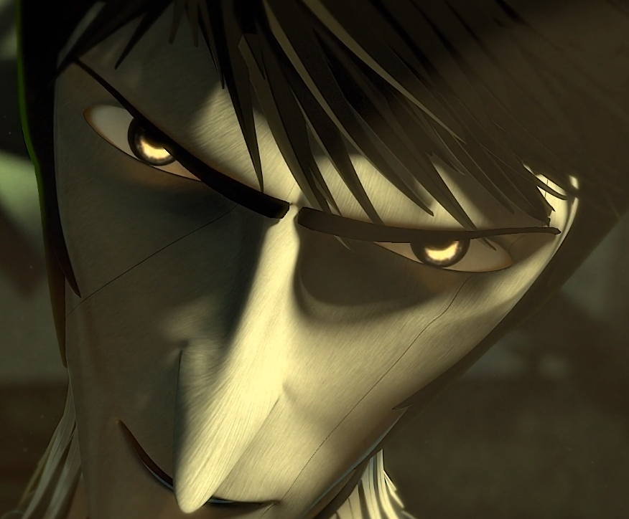
English:
Objective: To answer questions based on a video.
Watch the following video…
https://vimeo.com/91642206
For the next two weeks, we will be completing our English work based on this video. It is based on a very popular game called Rock, Paper, Scissors.
Task…
Choose a set of questions from 1 star or 2/3 star to answer about the video.
Write all answers in FULL sentences and use the video for evidence where possible.
For example: I think that Rock is trying to help paper because in the video you can clearly see he fears for her life.
1 Star – Questions.
What happened in the story?
Give one word to describe the following characters:
Rock = Paper = Scissors =
3. Why do you think Rock is trying to help Paper?
4. How does the character Scissors make you feel?
5. How does Paper feel at the start of the story? How does she feel at the end of the story? Why do you think this?
2/3 Star - Questions
Write a summary for the video.
Give two words to describe the following characters:
Rock= Paper = Scissors =
3. Why do you think Rock is trying to help Paper?
4. What does the video suggest about Scissors? Why?
5. What is the main theme for the video? Why?
6. How does Paper’s feelings change from the start to the end?
7. What happened to Rock in the story?
8. Out of Rock, Paper and Scissors, who is the most powerful and why?

Slide 3
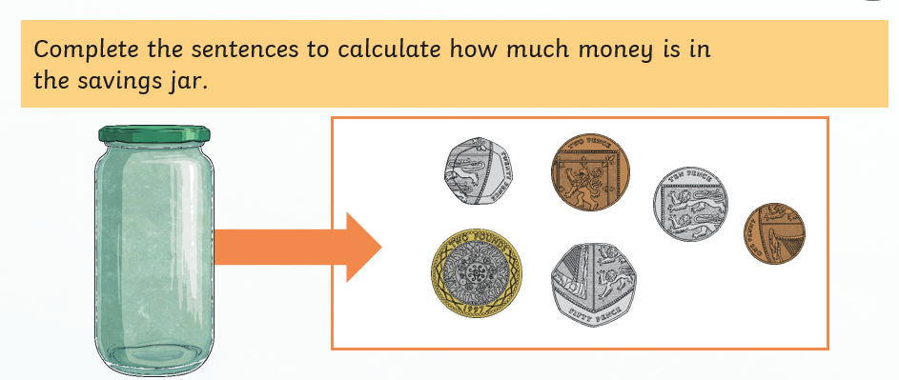
Maths: We will be focusing on Statistics.
Objective: To identify Pounds and Pence (Money).
Please solve the following by looking at
diagram below:
In the savings jar there is …
In the savings jar there is £2 and how
many pennies?
Please choose a video from the link below and focus on the teaching strategies used to help you identify all the various types of money we use.
How many ten pence pieces in a pound?
https://newportjuniorschool.org.uk/wp-content/uploads/2019/10/Calculation-Policy.pdf
As we are beginning a new topic, please read the calculation policy which will offer guidance on how to set calculations out.
1* - Today you will be focusing on pounds and pence. You will need to answer the following questions as to how much money is in the jar. What are the missing amounts on the following page.
2*/3* - Today you will be focusing on money and looking specifically at pounds and pence. Answer the questions on the worksheet.
Extension: Is the statement true or false?
Remember to check how many pennies are in a pound.
Remember there are 100p in every pound £.

Slide 4
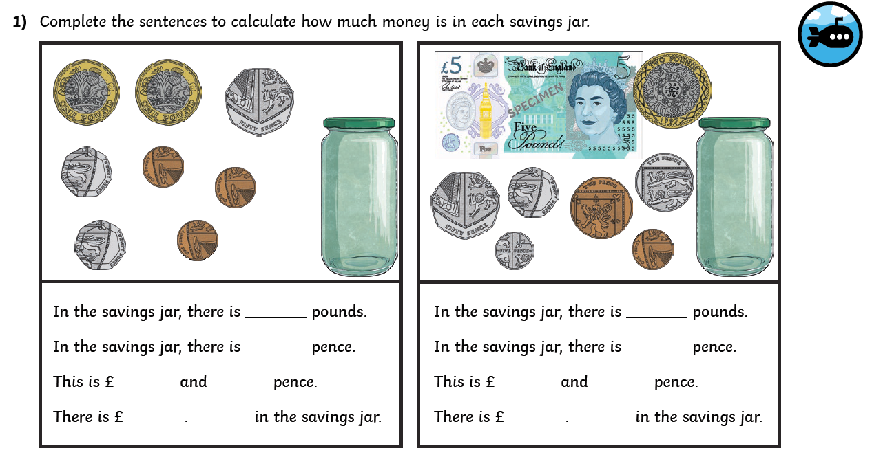
1 STAR TASK!

Slide 5
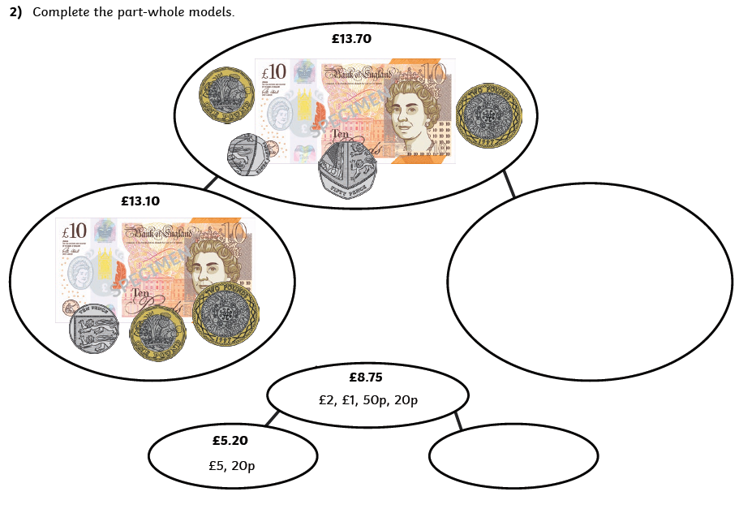
What amount is missing from the total?
Find the amount and place it in the blank circles.

Slide 7
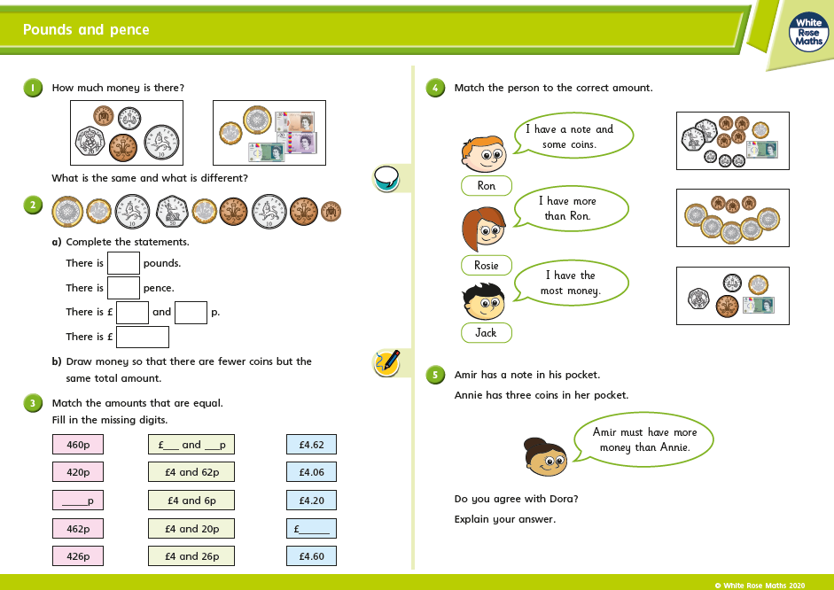
2/3 STAR TASK!

Slide 8
2/3 STAR TASK!

Slide 9
Extension Task!
Please explore this statement by focusing on the pounds and pence.
Is the statement true or false?
Remember how many pennies make four pounds?

Slide 10
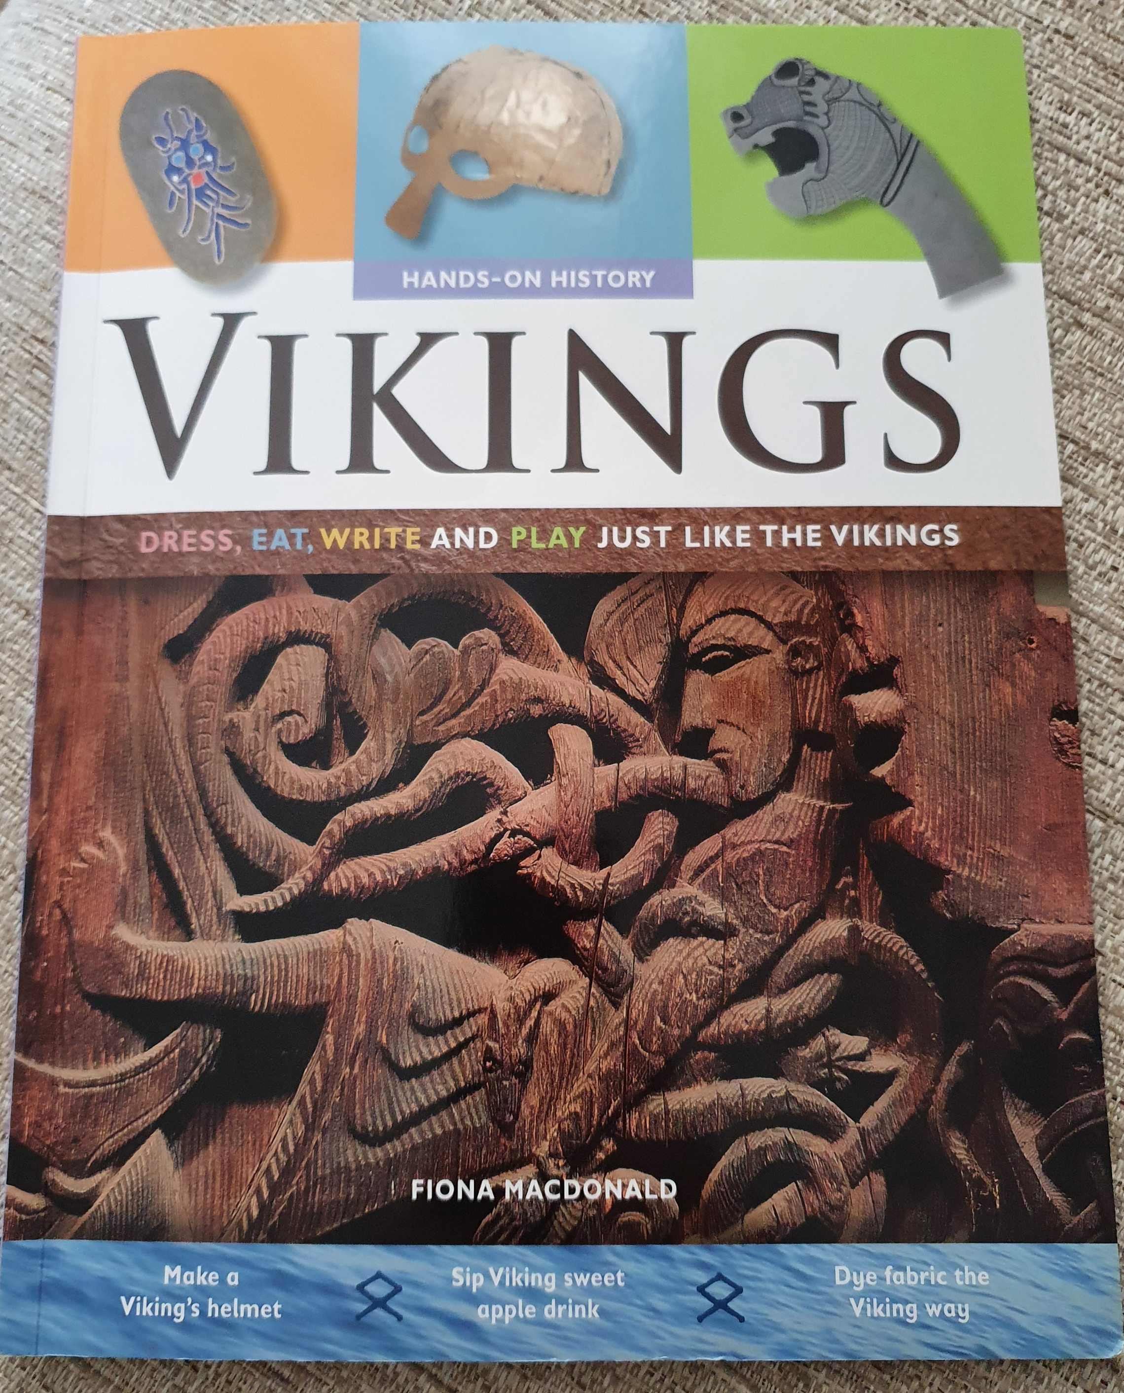
Reading: This week we will be focusing on a Non-fiction book about the Vikings.
Objective: To make a comparison between our live today and Viking life.
Read through the information on the following slides. It explains who the Vikings were and some survival skills they had. Our life today is very different to Viking times. Read the text before attempting the task for today.
1 Star Task…
Write down some bullet points about life as a Viking and life today.
In the middle section, are there any aspects that are the same between Viking and modern life?
On the next slide you will find a template.
2/3 Star…
Write a comparison between Viking life and modern life. What makes them different and what makes them similar? Aim for at least 2 paragraphs.
This is book is Non-Fiction.
This means it is a factual book rather than fictional.
Other Non-fiction examples could be: cook books or autobiographies.

Slide 11
Viking Life | Are any aspects the same? | Our Life Today

Slide 12
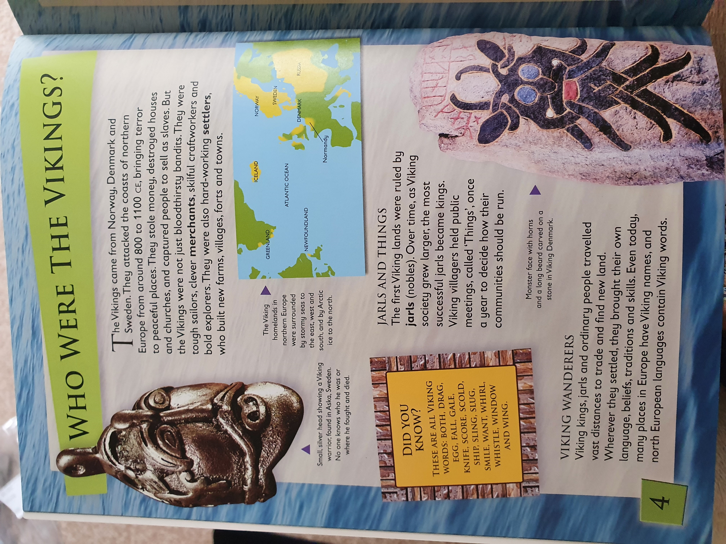
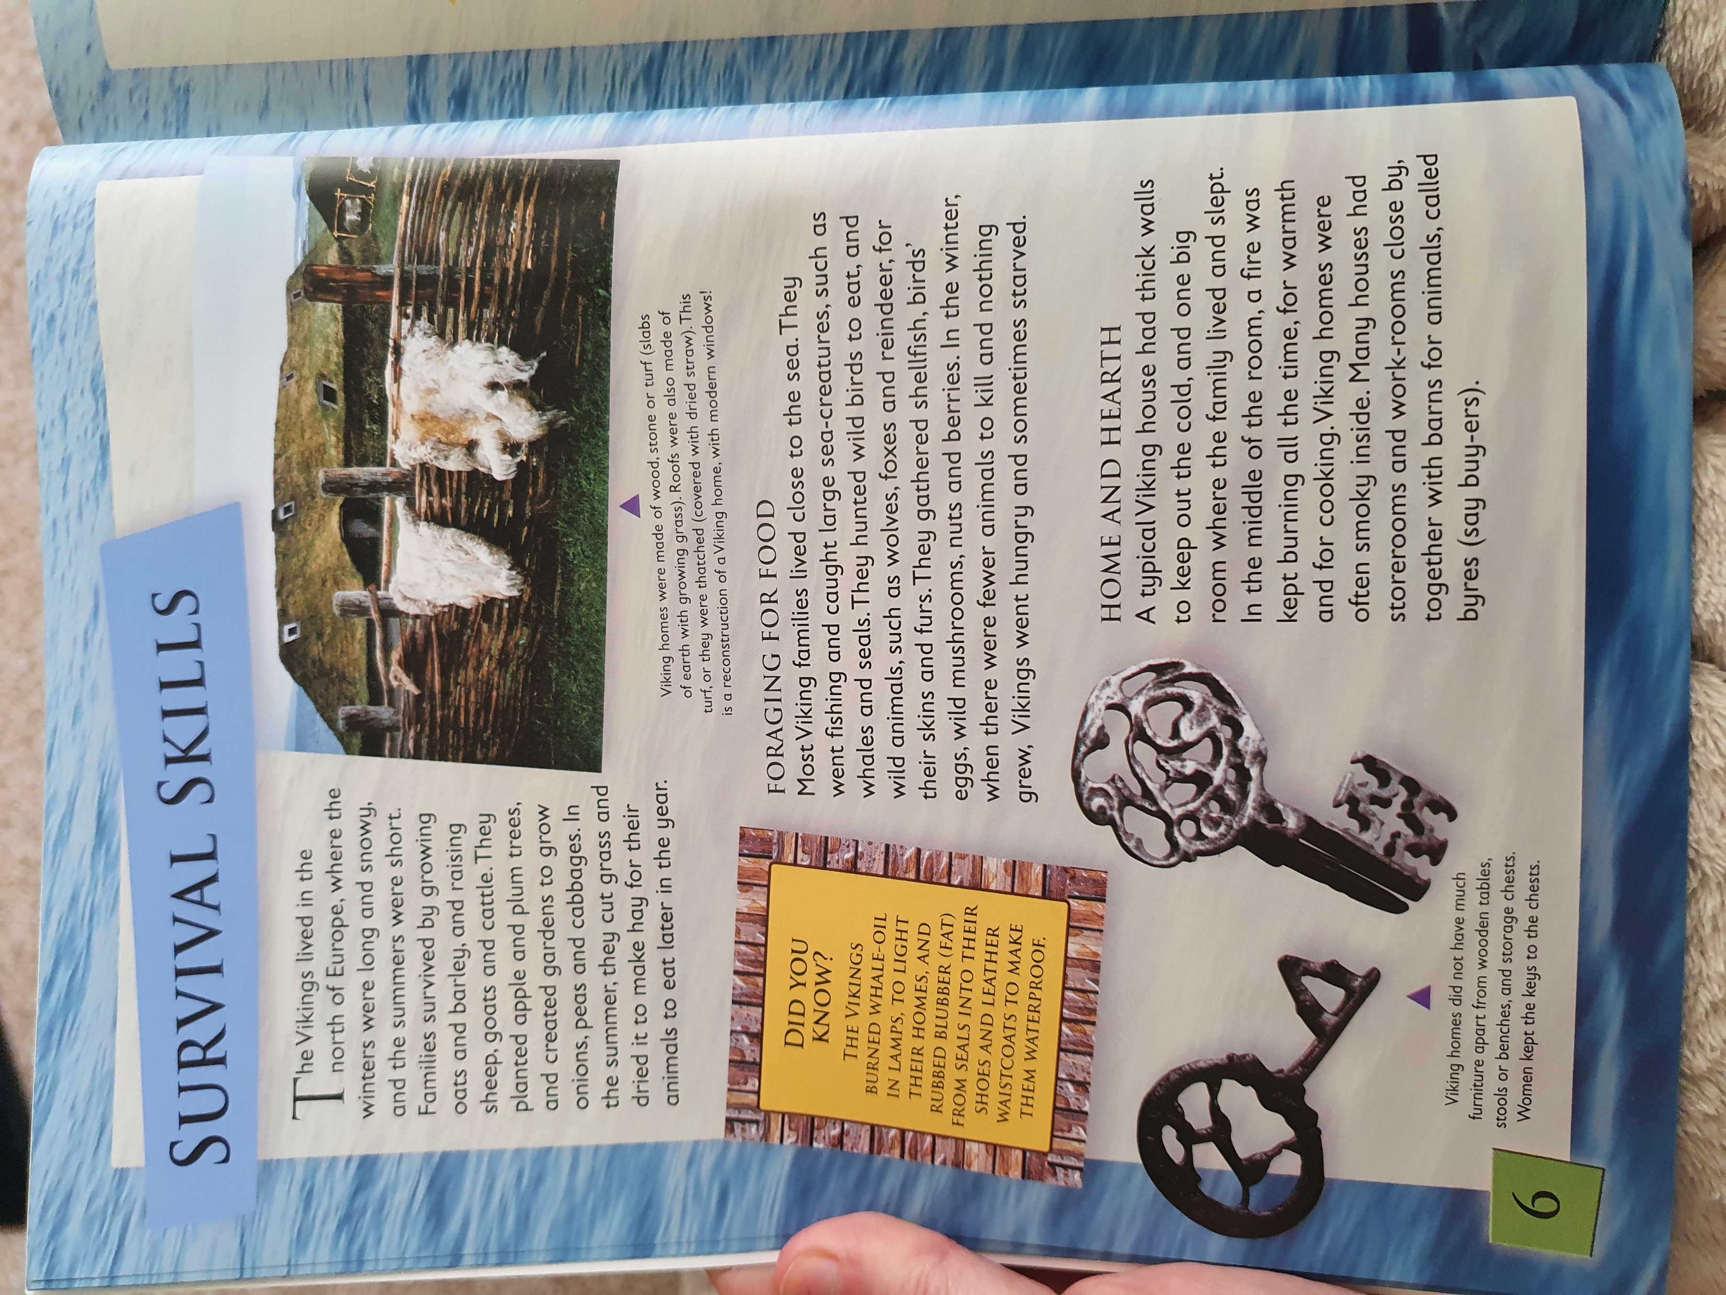

Slide 13
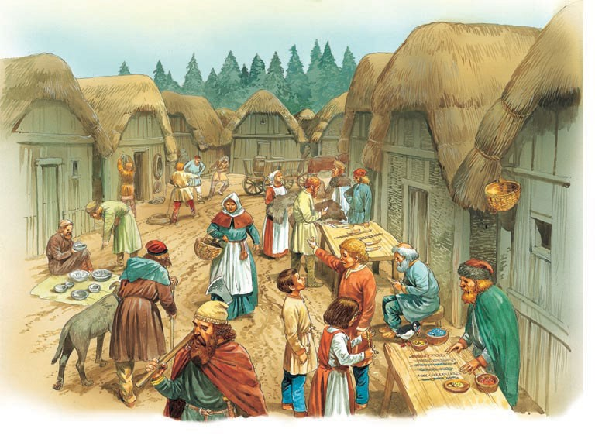
Other: Topic
Objective: To create a poster about Viking Life.
Useful Links…
https://www.bbc.co.uk/bitesize/topics/ztyr9j6/articles/ztqbr82
https://www.theschoolrun.com/homework-help/vikings

