Slide 1
Remote Learning Plan!
Hello Year 4!
During the next few weeks, we will be providing the children with remote learning on a daily basis. The work will be available on the website the day before e.g. Monday’s work will be online Sunday.
Everyday the remote learning will consist of:
English Lesson
Maths Lesson
Reading Lesson
One other curriculum lesson (PSHE, Art etc)
We will be available during the hours of 9am-4pm so please feel free to contact us on our new e-mail njs.year4@taw.org.uk
Some of the work provided will be split into the star levels that the children use everyday in class (1,2 3).
Stay safe everyone!
Miss Jones, Mrs Jukes, Mrs Kuczynska and Mrs Sisson.

Slide 2
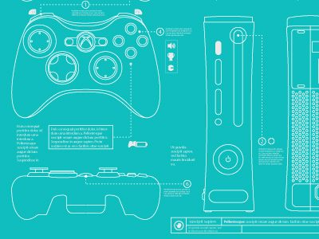
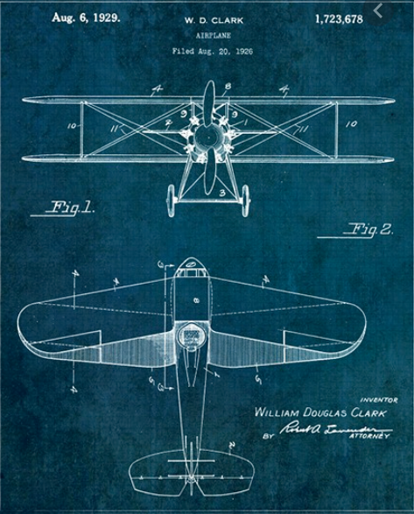
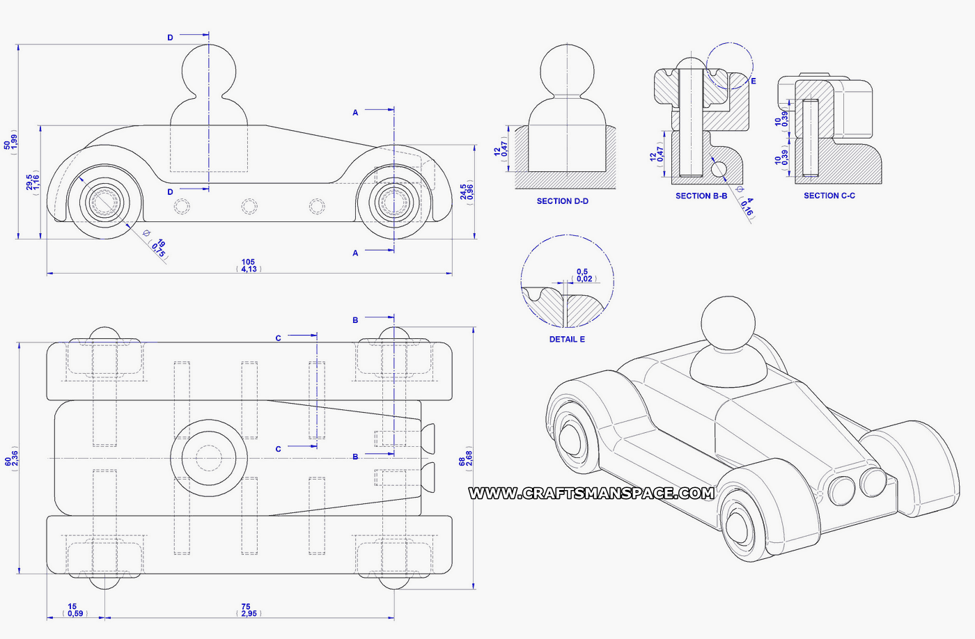
English:
Objective: To create a blue print of my own invention.
Last week, we started looking at explanation texts. On Thursday, you created a mind-map of your own invention ideas.
Today you are going to bring your idea to life!
Main task…
Create a blue print of your own invention (See next slide).
1* - Draw a picture of your invention.
2/3* - Draw a picture of your invention and label the parts.
Task 2…
Answer the following questions in as much detail as possible!
What is your invention for?
What does your invention do?

Slide 3
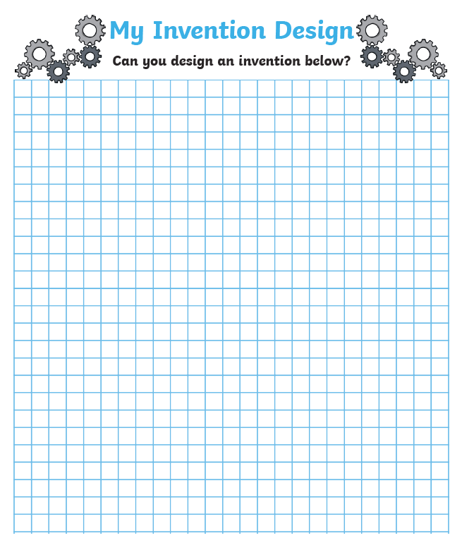

Slide 4
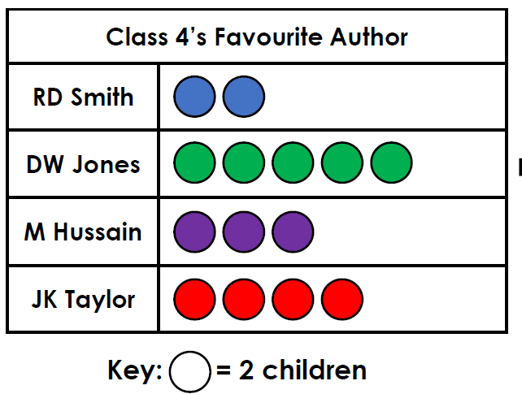
Maths: We will be focusing on Statistics.
Objective: To interpret various Tables.
Please choose a video from the link below and focus on the teaching strategies used to help you interpret Tables and retrieve data from them.
Interpreting Data, Graphs and Tables
How many children have voted for M
Hussain?
Who is class 4’s least favourite author?
https://newportjuniorschool.org.uk/wp-content/uploads/2019/10/Calculation-Policy.pdf
As we are beginning a new topic, please read the calculation policy which will offer guidance on how to set calculations out.
1* - Today you will be focusing on reading tables, charts and pictograms and you will need to answer the questions focusing on the data.
2*/3* - Today you will be looking at tables and you will need to look at the data carefully and answer the questions accordingly.
Extension: Today you will be focusing on the pictogram and table.
Answer the true or false statement focusing on the number of children in each table. Do they match?

Slide 5
1 STAR TASK!

Slide 8
2/3 STAR TASK!

Slide 9
2/3 STAR TASK!

Slide 10
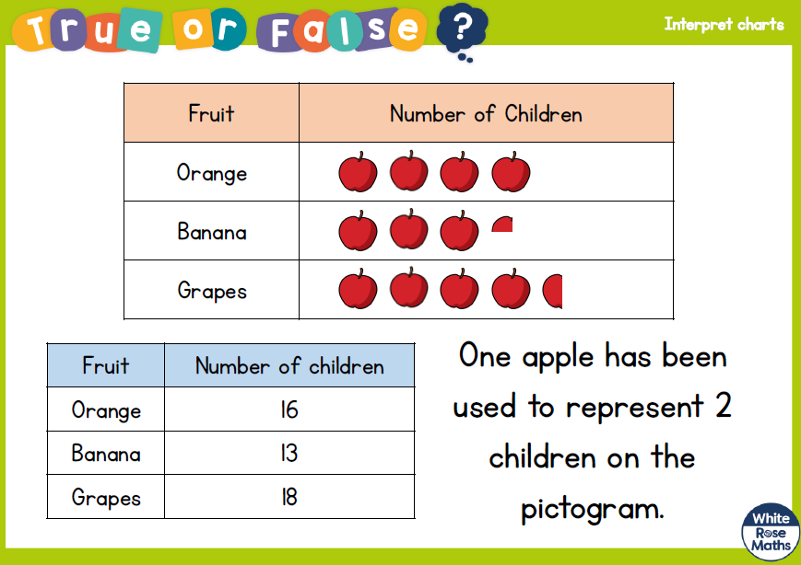
Extension Task!
Please explore this statement by focusing on the pictogram.
Does the number of children match in each table?
Is the statement true or false?

Slide 11
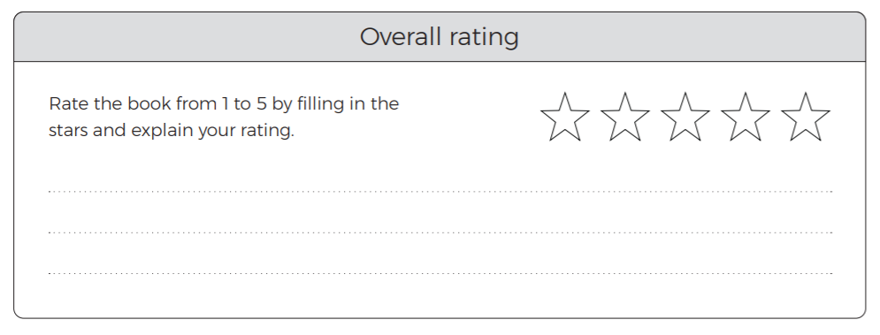
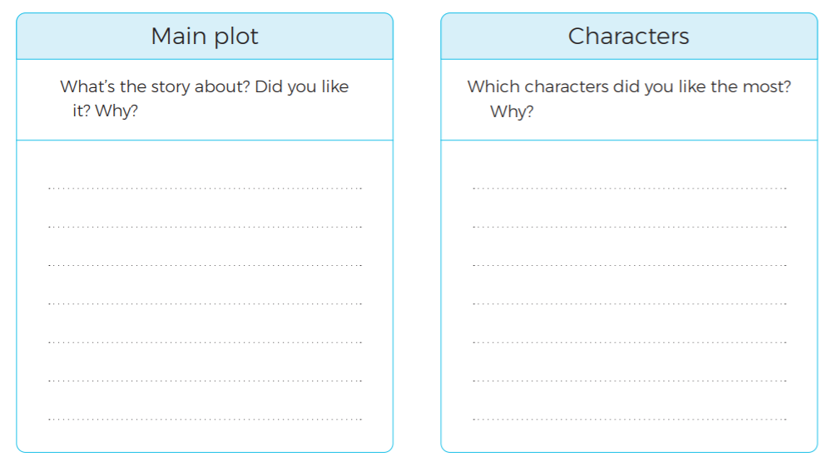
Reading:
Objective: To write a book review.
Read the chapter ‘Friends for Life’.
All Children – Complete the book review!

Slide 15
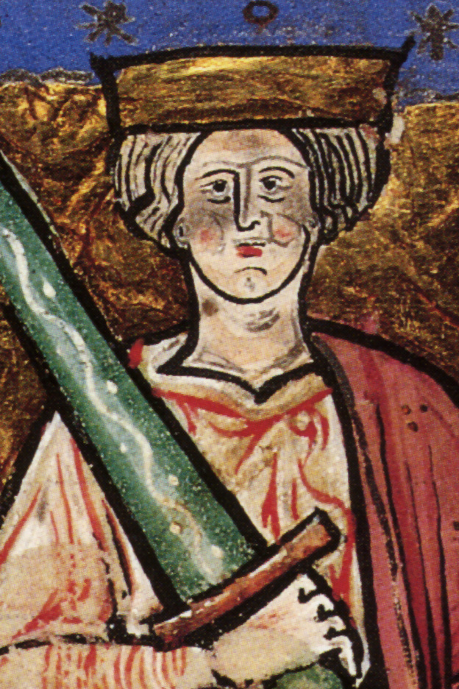
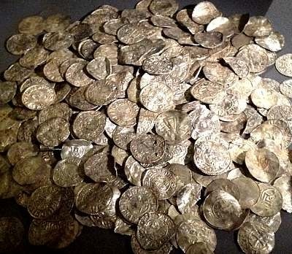
Other: Topic
Objective: To explain who King Ethelred II was and understand why Danegeld was introduced.
Task…
Some of these links might be useful…
Using the information about King Ethelred II and Danegeld, write an information text about what you discover.
Use the iPad to research any extra information.
You must have information on the following:
The Second Viking Age
King Ethelred II
Danegeld
Paying the Dane
Add some pictures to support your information!
https://kids.kiddle.co/Ethelred_the_Unready
https://wiki.kidzsearch.com/wiki/Ethelred_the_Unready
https://kids.kiddle.co/Danegeld#:~:text=The%20Danegeld%20(%22Danish%20tax%22,until%20the%20early%2012th%20century.
https://wiki.kidzsearch.com/wiki/Danegeld

Slide 16
