Slide 1
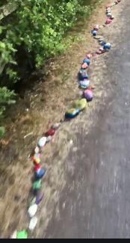
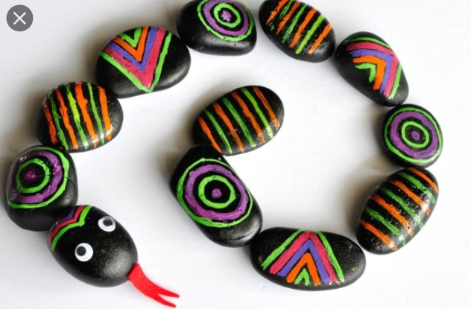
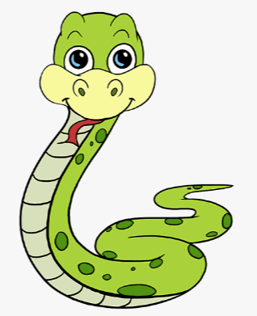
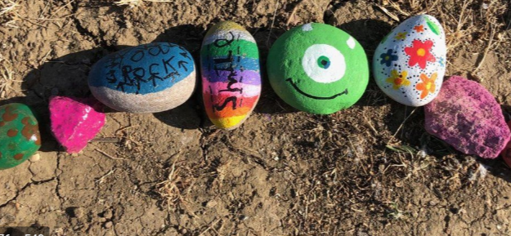
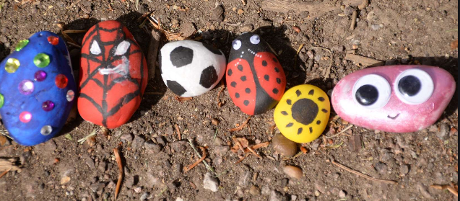
NJS Art Challenge:
Norman the NJS Snake
Calling all children, Staff and parents at NJS. We would like you all to find a rock which can be any size and paint (decorate) it with either a pattern or design of your choice. We would like to make a special Lockdown snake which we can place at the entrance of our school. We would like all members of the community to get involved.

