Slide 1
Remote Learning Plan!
Hello Year 4!
During the next few weeks, we will be providing the children with remote learning on a daily basis. The work will be available on the website the day before e.g. Monday’s work will be online Sunday.
Everyday the remote learning will consist of:
English Lesson
Maths Lesson
Reading Lesson
One other curriculum lesson (PSHE, Art etc)
We will be available during the hours of 9am-4pm so please feel free to contact us on our new e-mail njs.year4@taw.org.uk
Some of the work provided will be split into the star levels that the children use everyday in class (1,2 3).
Stay safe everyone!
Miss Jones, Mrs Jukes, Mrs Kuczynska and Mrs Sisson.

Slide 2
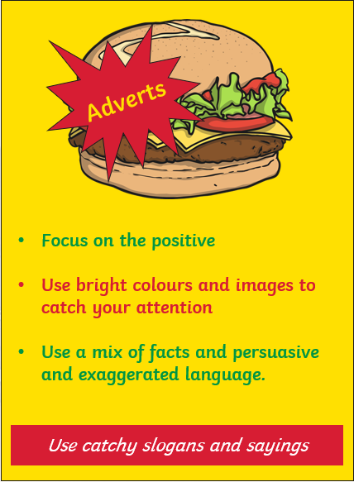
English:
Objective: To create an advert for my invention.
Have a look at the poster about making an advert!
Imagine that you have made your invention and now you want to sell it… create an advertisement for your invention!
Remember to use the tips on the poster opposite!
On the next slide are some examples for existing products that may inspire your own poster.

Slide 3
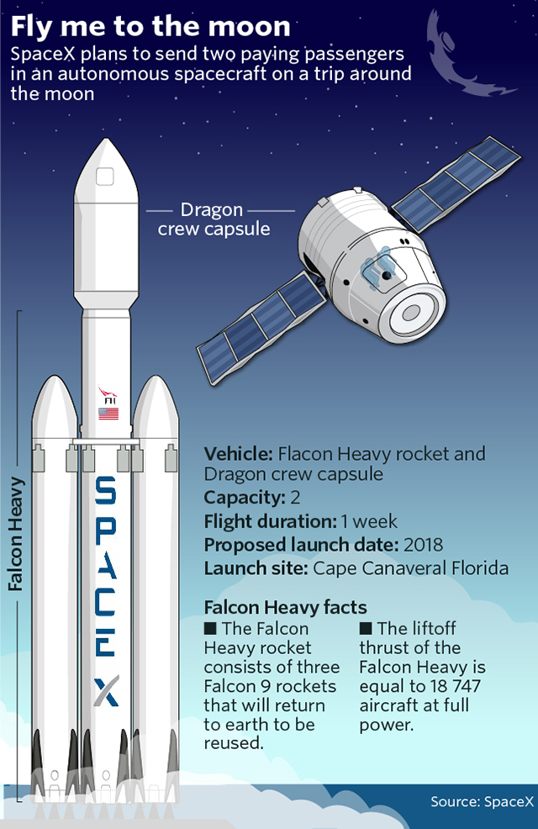

Slide 4
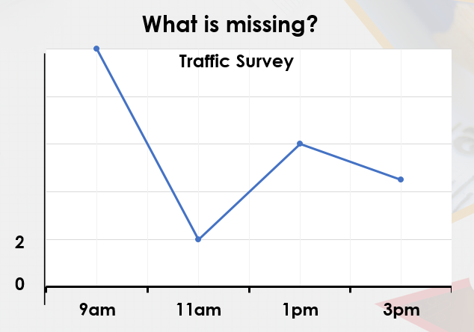
Maths: We will be focusing on Statistics.
Objective: To interpret line graphs.
Can you use the checklist to see what is
missing from the graph?
Please choose a video from the link below and focus on the teaching strategies used to help you interpret Tables and retrieve data from them.
Interpreting Data, Graphs and Tables
https://newportjuniorschool.org.uk/wp-content/uploads/2019/10/Calculation-Policy.pdf
As we are beginning a new topic, please read the calculation policy which will offer guidance on how to set calculations out.
1* - Today you will be focusing on line graphs and you will need to interpret the data to answer the questions and solve the problems.
2*/3* - Today you will be focusing on line graphs and you will need to interpret the data to answer the questions and solve the problems.
Extension: Today you will be focusing on the line graph.
Answer the true or false statement focusing on the graph.

Slide 5
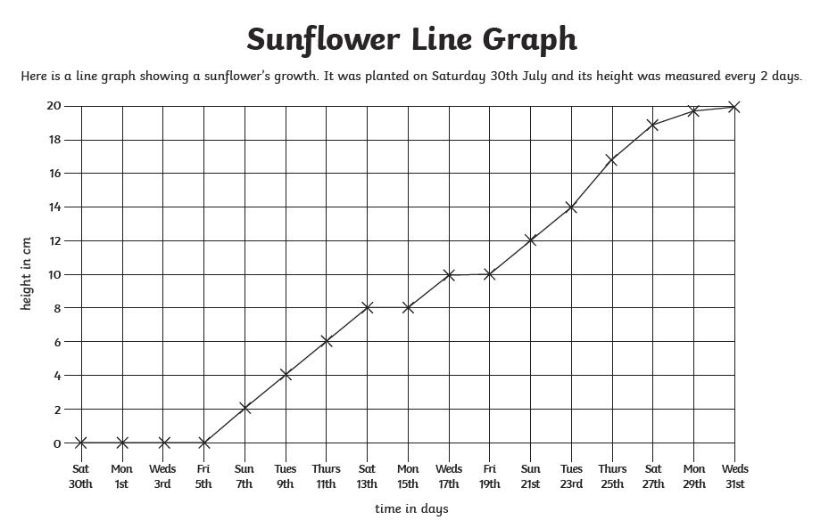
1 STAR TASK!

Slide 6
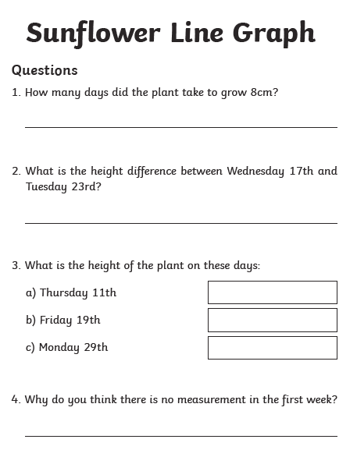

Slide 7
2/3 STAR TASK!

Slide 8
2/3 STAR TASK!

Slide 9
Extension Task!
Please explore this statement by focusing on the line graph.
Is the statement true or false?

Slide 10
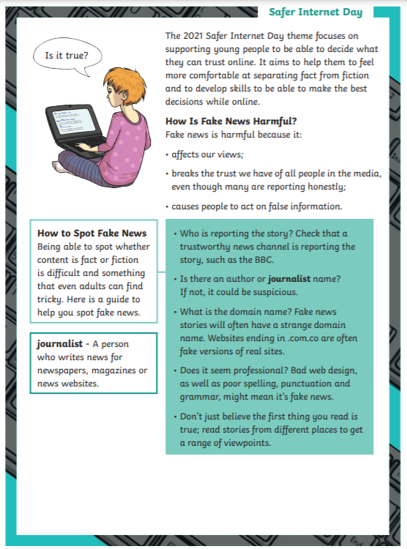
Reading:
Objective: To develop reading comprehension skills.
As this week in internet safety week, we have decided to develop our reading comprehension skills. George spends a lot of time online and we need to understand how to do this safely. For reading today, there is a separate document on the website. Below I have added the page numbers for each star level.
Pages 1-4 → 1 Star (Text and Questions)
Page 5 → 1 Star Answers
Page 6-10 → 2 Star (Text and Questions)
Page 11-12 → 2 Star Answers
Page 13-17 → 3 Star (Text and Questions)
Page 18-19 → 3 Star Answers

Slide 11
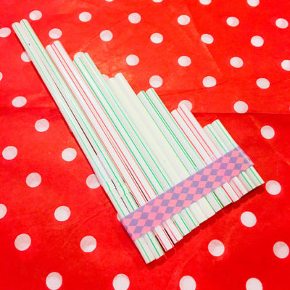
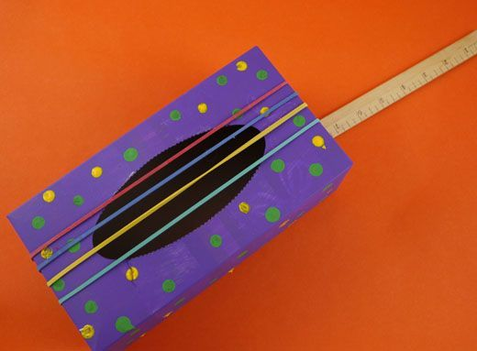
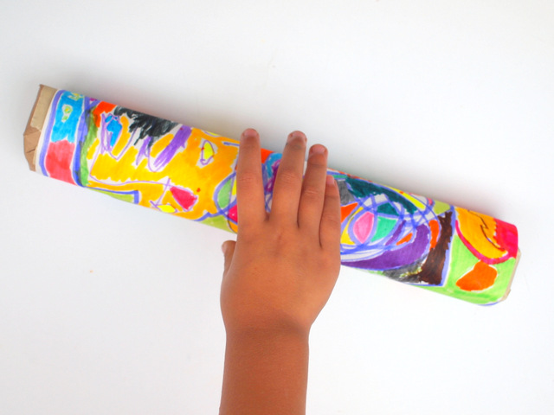
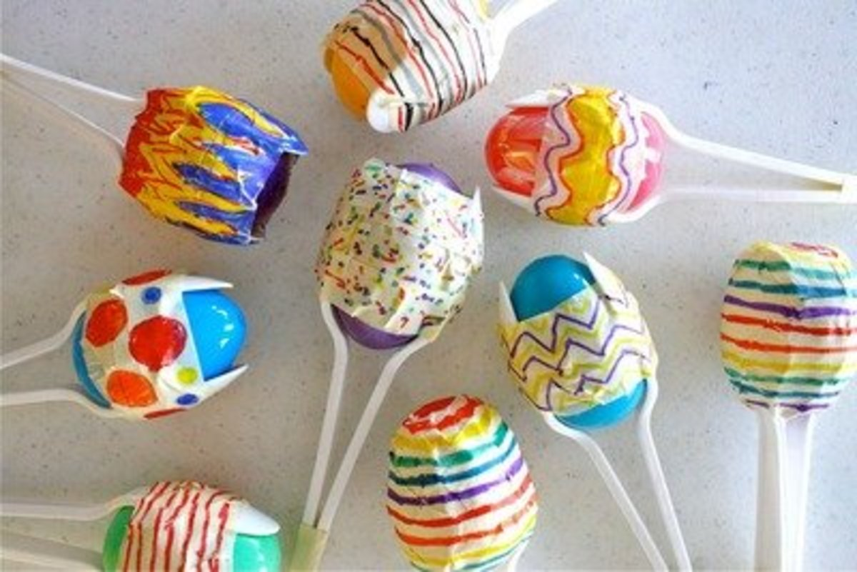
Other: Science
Objective: To make a musical instrument.
Alternatively you could try and create your own.
Happy making.
We hope you have fun – let us know how you get on.
Last term our topic for Science was sound.
With lockdown and everything else getting in the way we did not get to the fun part –
Making musical instruments!
Have a look at these ideas and see if you too could make a musical instrument…
https://www.youtube.com/watch?v=4nKxD_H_08Y
https://www.youtube.com/watch?v=UWA1NAaRxhw
https://www.youtube.com/watch?v=V3KGrxmic6k
https://www.youtube.com/watch?v=JvPF6yZFfJE

