Slide 1
Remote Learning Plan!
Hello Year 4!
During the next few weeks, we will be providing the children with remote learning on a daily basis. The work will be available on the website the day before e.g. Monday’s work will be online Sunday.
Everyday the remote learning will consist of:
English Lesson
Maths Lesson
Reading Lesson
One other curriculum lesson (PSHE, Art etc)
We will be available during the hours of 9am-4pm so please feel free to contact us on our new e-mail njs.year4@taw.org.uk
Some of the work provided will be split into the star levels that the children use everyday in class (1,2 3).
Stay safe everyone!
Miss Jones, Mrs Jukes, Mrs Kuczynska and Mrs Sisson.

Slide 2
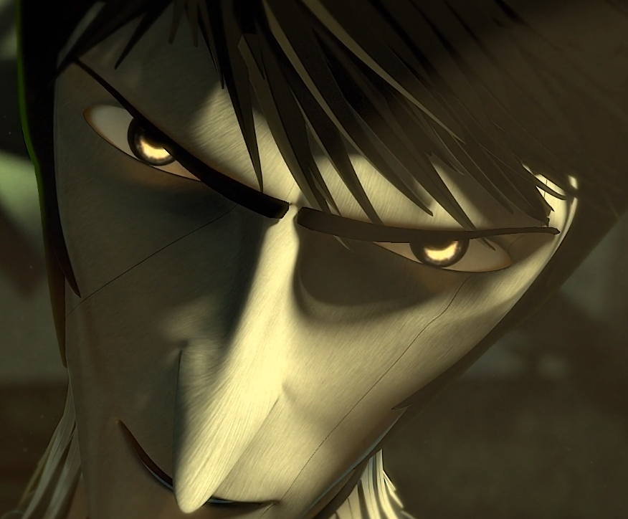
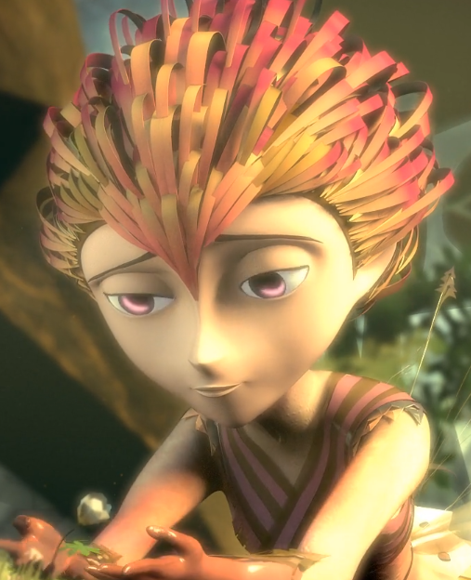
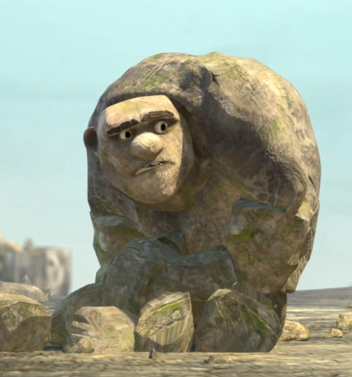
English:
Objective: To answer a set of questions in character.
Re-watch the video should you feel you need a reminder…
https://vimeo.com/91642206
Today, I would like you to be a journalist for a newspaper! Imagine that you are going to speak to Rock, Paper or Scissors following the events!
Task 1…
Think of 5-7 questions that you could ask your chosen character.
You are a journalist so you want as much information as possible!
Task 2…
1* - Choose 3 of your questions and become the person answering for example Paper.
2/3* - Answer all of your questions in character. Give as much detail as you can to help.
See the example on the next page!

Slide 3
Example: Journalist to Scissors.
Question: Scissors, you are considered a violent person from this event. What are your thoughts?
Answer: Well, I don’t know where to start. I know that people consider me as a bad person but it is the opposite. My story has not been told so people presume that I’m the bad guy. It makes me sad but I will tell my story one day.
Example: Journalist to Rock.
Question: Rock, why were you watching over paper?
Answer: Paper is so fragile and dainty. She is a giver and lots of people see what as a threat like scissors. I am in awe of what paper can do and how she makes the world a beautiful place. I consider myself to be a brotherly figure.
Example: Journalist to Paper.
Question: Paper, how did you feel as you saw scissors coming.
Answer: Oh, sorry, I try to block that image out of my mind. I was petrified, I could feel my whole body shaking but I knew it wasn’t because of the wind. I heard scissors before I could see him and the sound made me instantly freeze.

Slide 4
Maths: We will be focusing on Statistics.
Objective: I can convert pounds and pence.
Please solve the following by looking at
picture below:
What is the total value of the coins below?
How many pounds do you have?
How many pennies altogether?
Please choose a video from the link below and focus on the teaching strategies used to help you identify all the various types of money we use.
Coins that make 50p
https://newportjuniorschool.org.uk/wp-content/uploads/2019/10/Calculation-Policy.pdf
As we are beginning a new topic, please read the calculation policy which will offer guidance on how to set calculations out.
1* - Today you will counting money and various amounts. You will need to convert pence into pounds. Remember that 100 pennies make £1. Answer and complete the questions.
2*/3* - Today you will be converting pounds and pence. Answer the questions on the worksheet.
Extension: Is the statement true or false?
Please add the coins together using column addition to check the amount. Remember your decimal places.

Slide 5
1 STAR TASK!

Slide 6
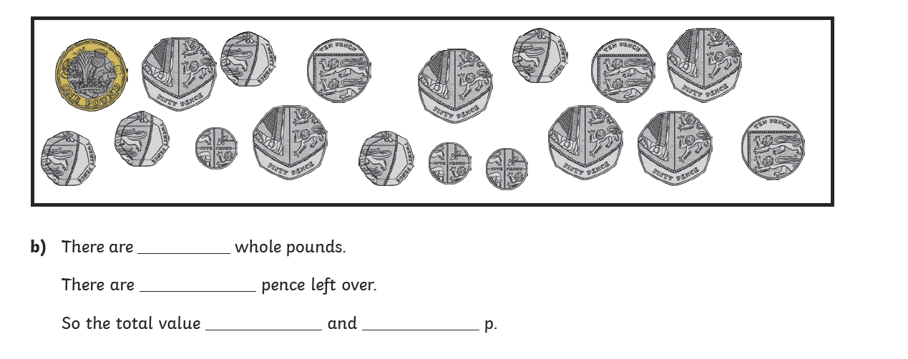
1 STAR TASK!

Slide 8
2/3 STAR TASK!

Slide 9
2/3 STAR TASK!

Slide 10
Extension Task!
Please explore this statement by adding up the pounds and pence.
Is the statement true or false?
How could you check you have the correct answer?

Slide 11
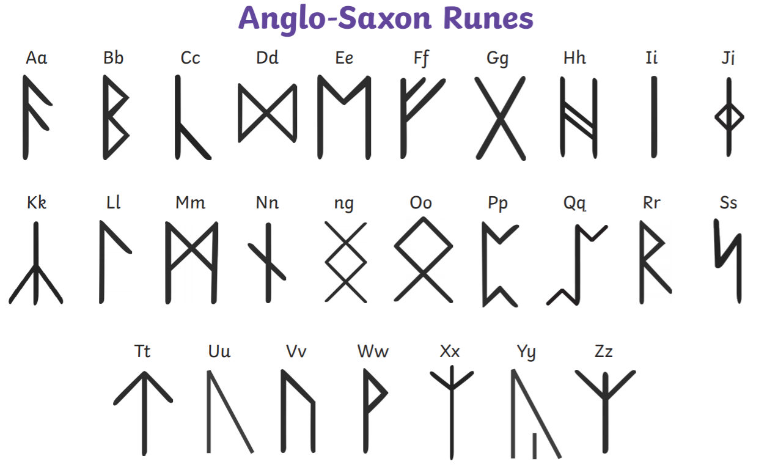
Reading: This week we will be focusing on a Non-fiction book about the Vikings.
Objective: To translate between English and ancient runes.
Read through the slide about Picture Stones and Runes! The complete the following task…
1* - Write down 3 simple sentences. For example: The cat sat on the mat.
Challenge… Can you translate your sentences using the ancient runes?
2/3* - Write down 5 sentences of your choice. Make sure they are short sentences or this task will take a long time!
Challenge… Can you translate your sentences using the ancient runes?
Extra challenge… What is your full name in ancient runes?

Slide 12
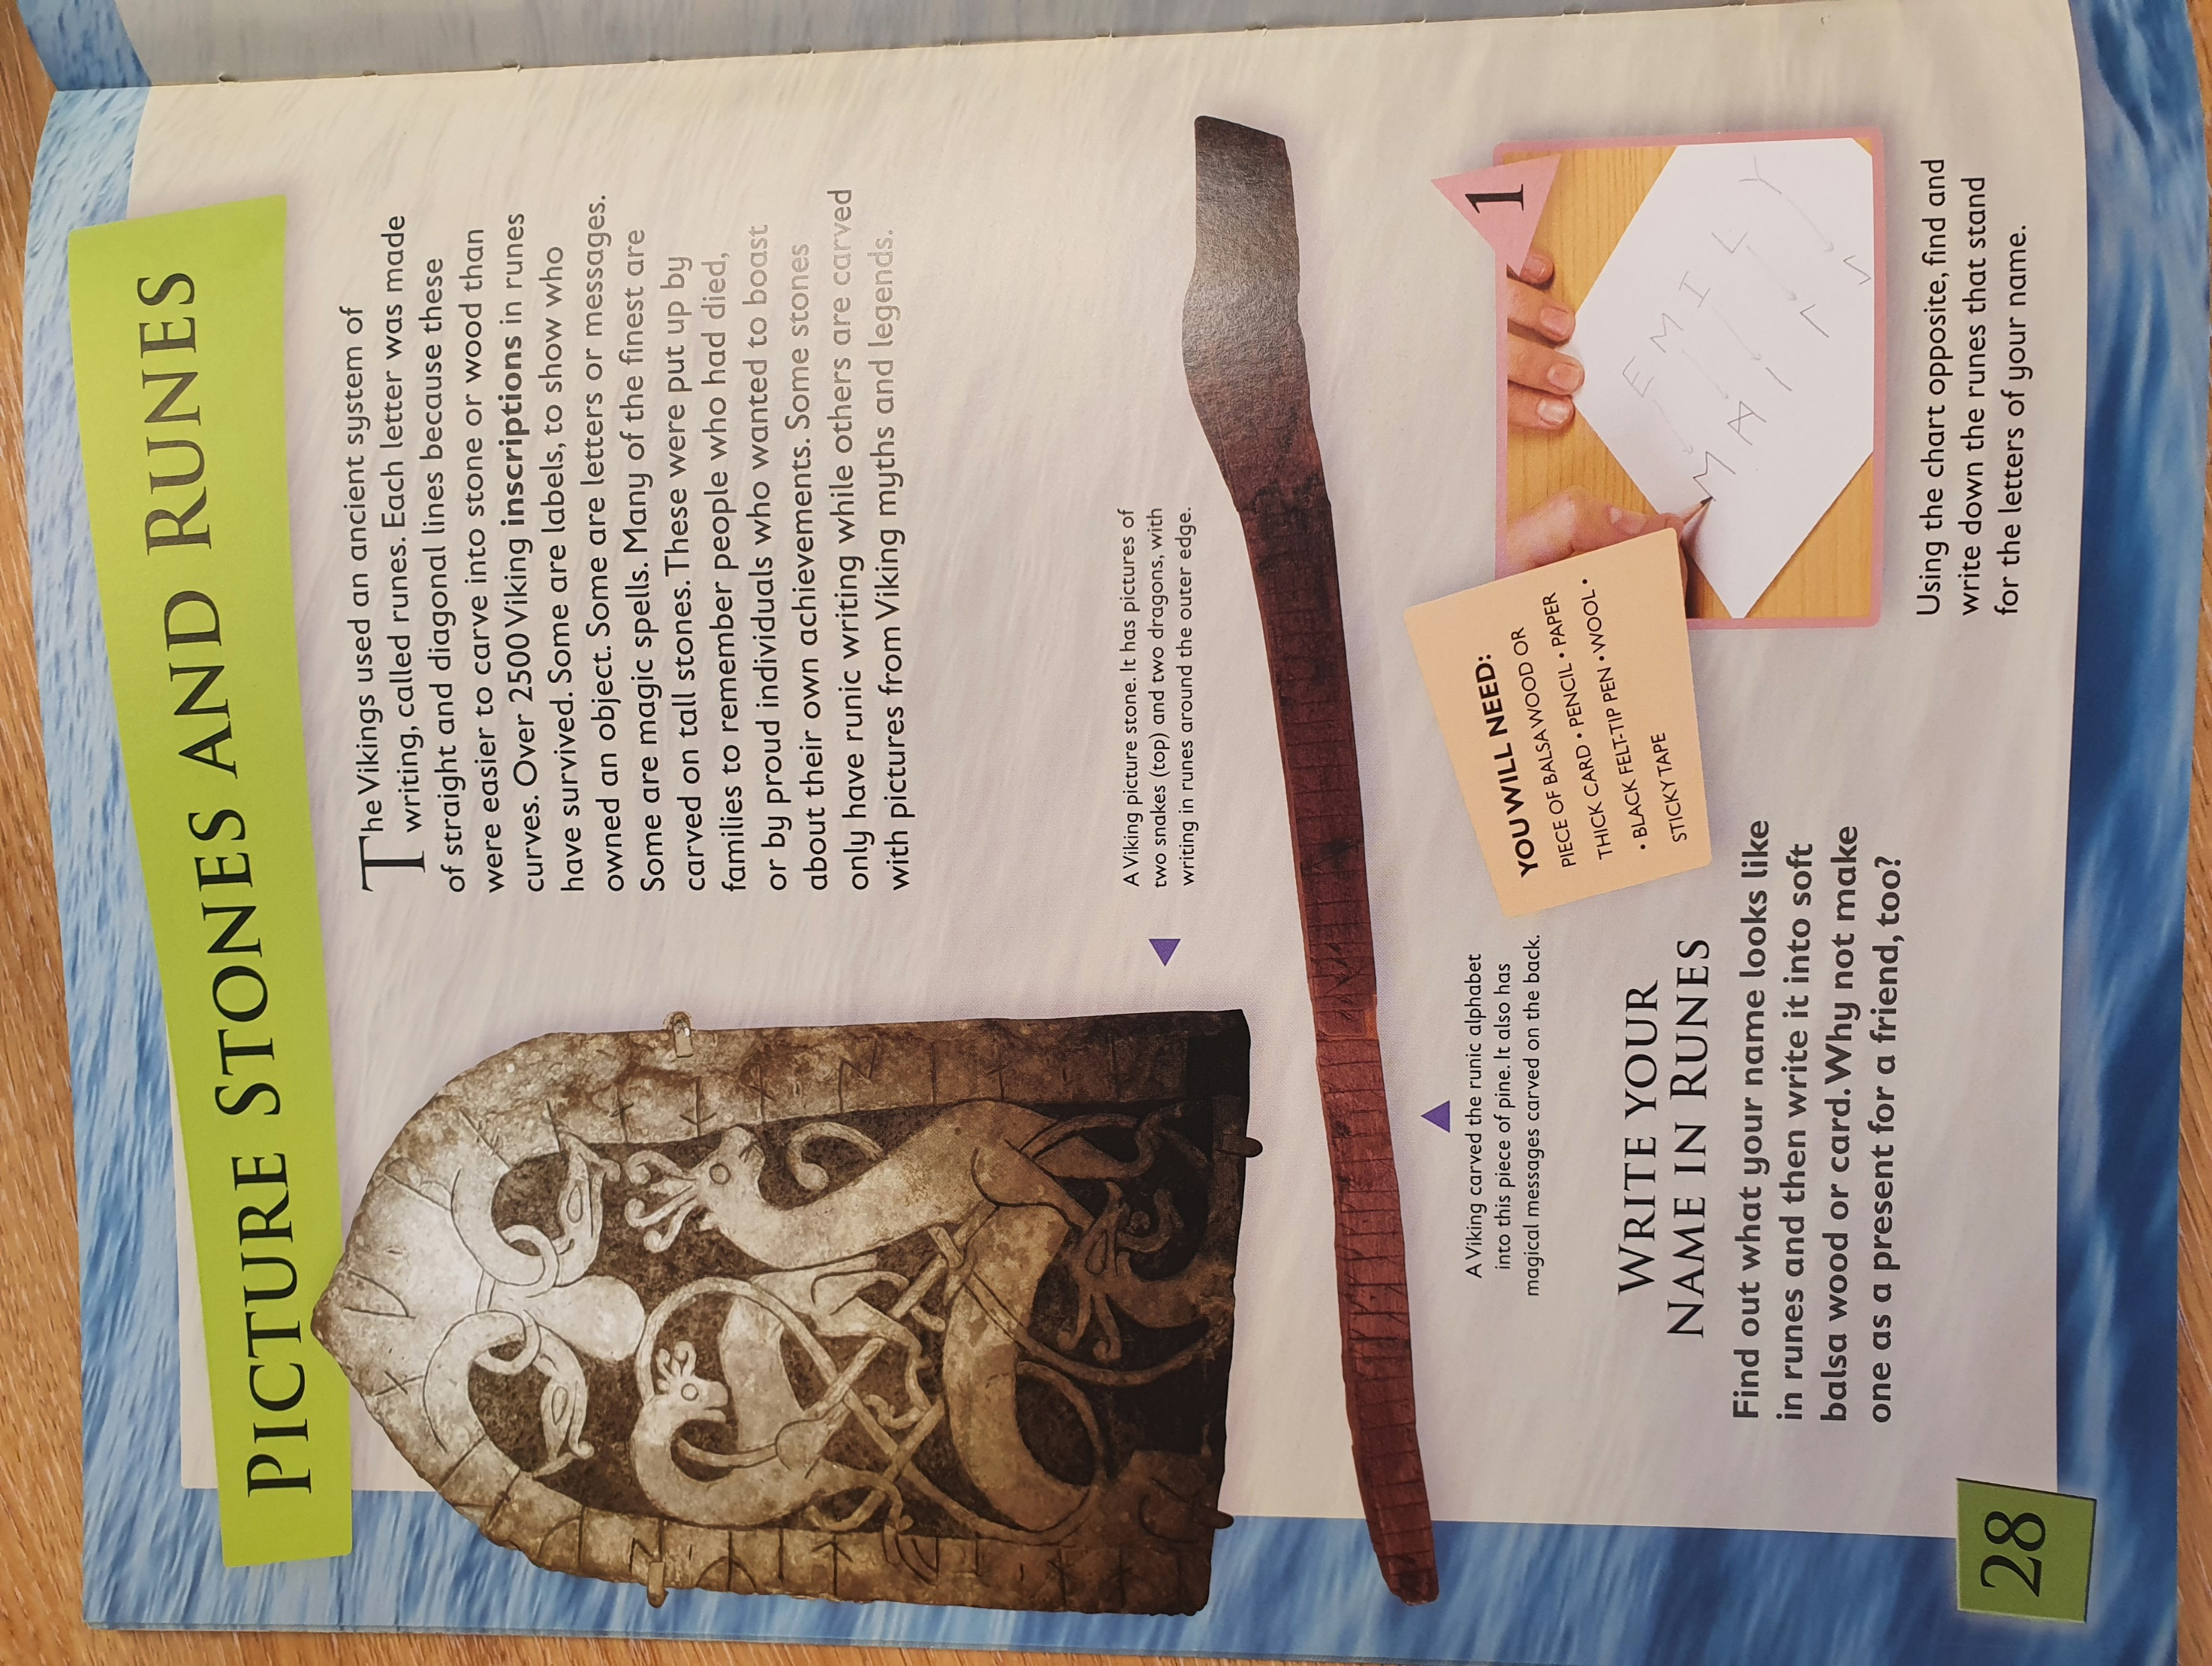
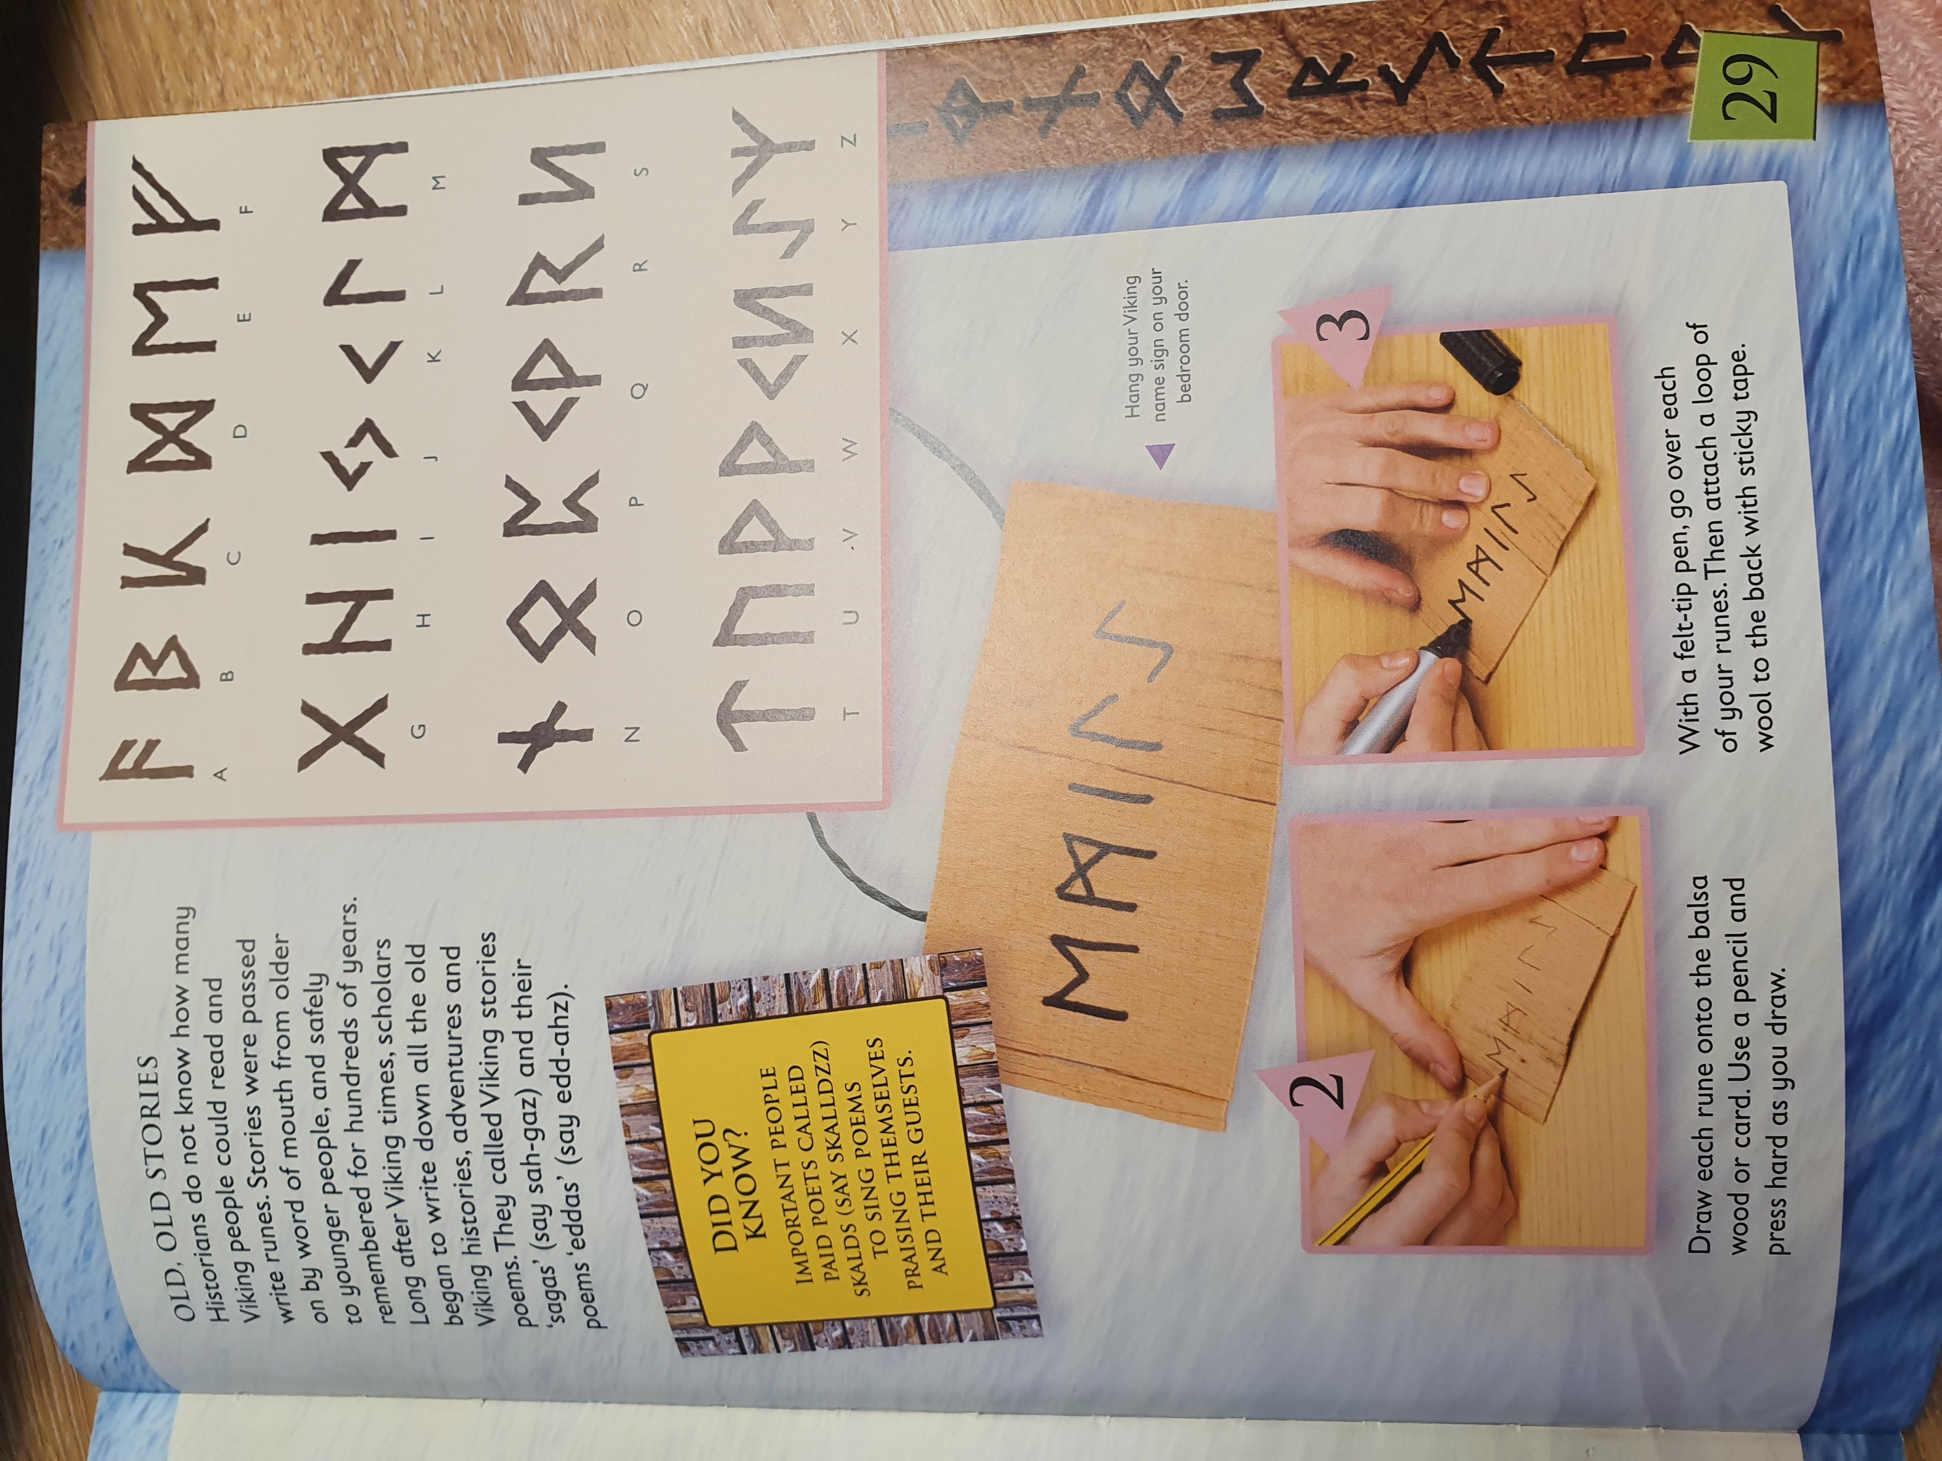

Slide 13
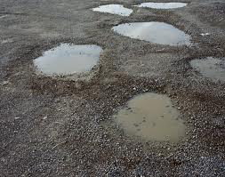
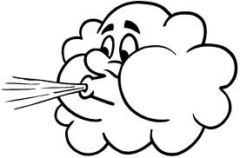
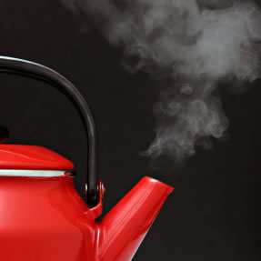
Other: Science
Objective: To understand what the water cycle is and why it is important.
Other examples of evaporation include warm-air hand driers, blowing on ink to dry it
and washing drying well on a sunny breezy day.
Evaporation.
Evaporation is the changing of a liquid into a gas.
Evaporation happens all around us without us
knowing it. A puddle on the road which begins to
‘disappear’ is evaporating.
Evaporation happens at a faster rate by the temperature being warmer and by the air moving more quickly in a breeze.
Read through this information before looking at your task on the next slide!
You can see evaporation taking place when a kettle boils, steam is the gas coming from the water. Sometimes you can see steam rising from the road or the playground after it has rained, this too is evaporation.

Slide 14
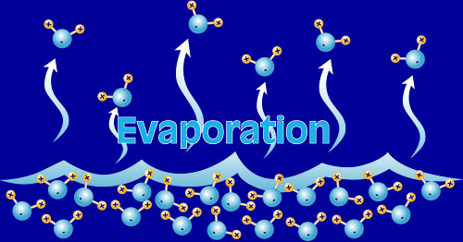
Evaporation is a very important process in the Water Cycle.
For your task today we would like you to research the water cycle-what is it, why is it important, what would happen to the world if there was no water cycle?
The links below may be useful!
When water heats up, it turns into water vapour. Once water becomes water vapour, it can easily move up to the Earth's atmosphere.
The water cycle for kids - What is the water cycle? - Why does it rain? - Science for children - YouTube
https://www.natgeokids.com/uk/discover/science/nature/water-cycle/
https://www.youtube.com/watch?v=ncORPosDrjI

