Slide 1
Remote Learning Plan!
Hello Year 4!
During the next few weeks, we will be providing the children with remote learning on a daily basis. The work will be available on the website the day before e.g. Monday’s work will be online Sunday.
Everyday the remote learning will consist of:
English Lesson
Maths Lesson
Reading Lesson
One other curriculum lesson (PSHE, Art etc)
We will be available during the hours of 9am-4pm so please feel free to contact us on our new e-mail njs.year4@taw.org.uk
Some of the work provided will be split into the star levels that the children use everyday in class (1,2 3).
Stay safe everyone!
Miss Jones, Mrs Jukes, Mrs Kuczynska and Mrs Sisson.

Slide 2
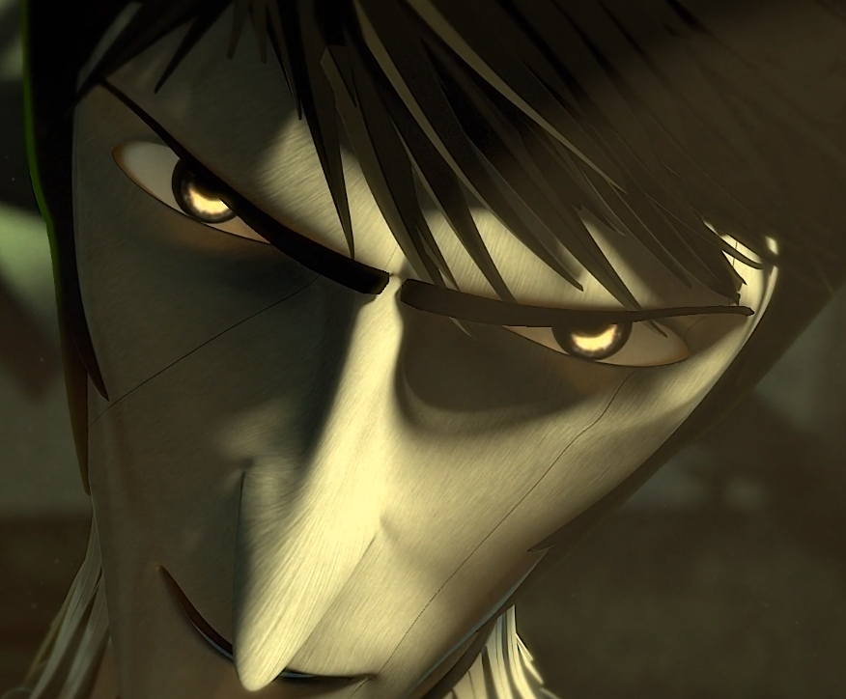
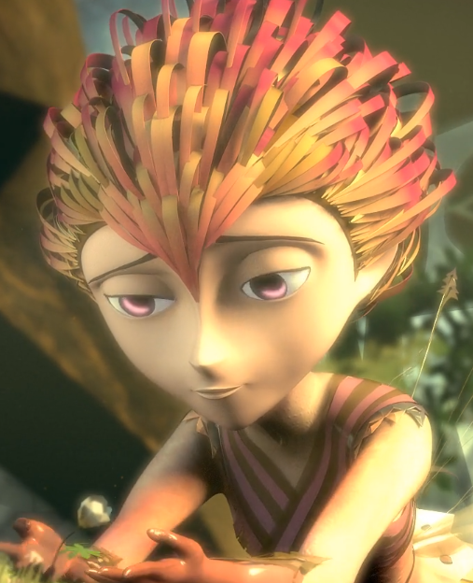
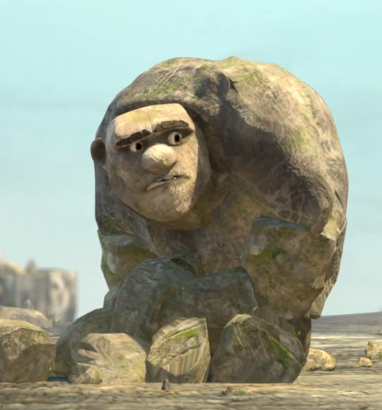
English:
Objective: To create a character profile.
Today… You are going to create one or two character profiles for the main characters! See the next two slides for your task ☺
Watch the following video from yesterday…
https://vimeo.com/91642206
Each of the characters in the story have their own personality and traits. Even though the film is silent, we can still make assumptions about the characters from the story itself.
Whilst you watch the story for a second time, do you think scissors is really a bad person? Why might be not be?
Why do you think he was trying to destroy paper?
Thinking about these questions can help build a back story to their lives – something we will look in detail at next week!

Slide 3
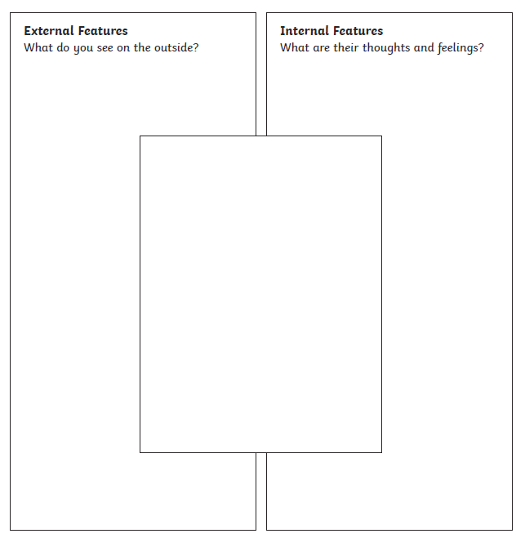
1*
1 Star Task…
Choose 1 of the main characters between Rock, Paper and Scissors. Complete a character profile for your choices.
Draw a picture of the character in the middle box. Then create a bullet point list in the external features – This means, what do you see on the outside? What does your character look like?
Finally, create a bullet point list in the internal features – This means, what are their thoughts? How does the character feel throughout the story?

Slide 4
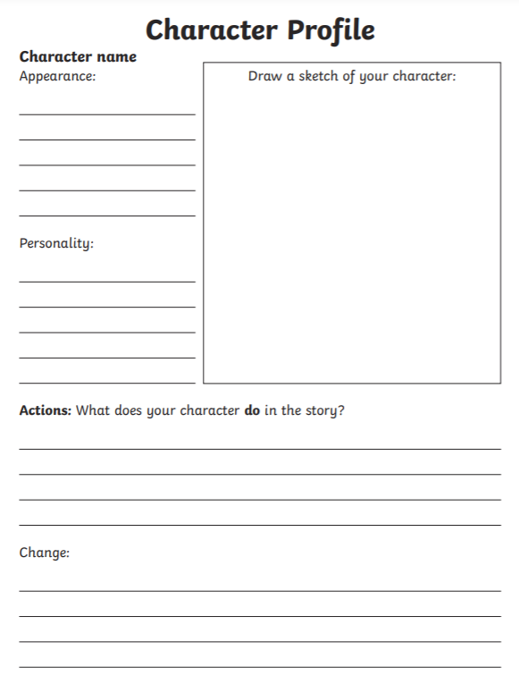
2/3*
2/3 Star Task…
Choose 2 of the main characters between Rock, Paper and Scissors. Complete a character profile for each of your choices.
Use the template provided to ensure your profile includes: Appearance, personality, Actions (What does your character do?) and changes they make in the story. You might also want to include a sketch of each character.
Please try to present your profiles in your own way! One for each character you choose!

Slide 5
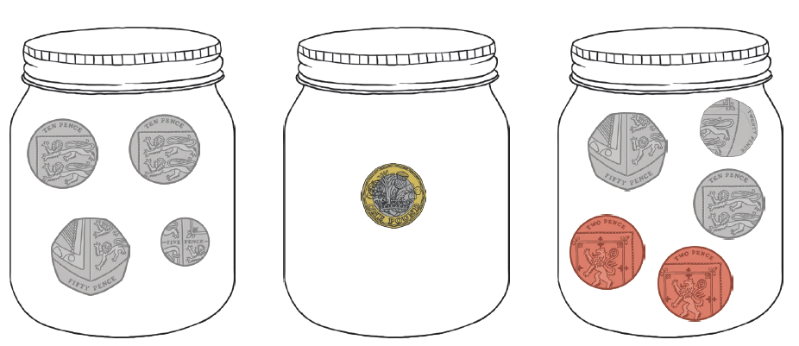
Maths: We will be focusing on Statistics.
Objective: I can order different amounts of money.
Please solve the following by looking at
picture below:
In each of the savings jars there are …
Which jar has the most amount of money?
Which jar has the least amount of money?
Please choose a video from the link below and focus on the teaching strategies used to help you identify all the various types of money we use.
Adding and Subtracting Coins
https://newportjuniorschool.org.uk/wp-content/uploads/2019/10/Calculation-Policy.pdf
As we are beginning a new topic, please read the calculation policy which will offer guidance on how to set calculations out.
1* - Today you will be comparing amounts of money by looking at how much each of the toys cost. Use the < > = symbols to help you compare amounts. Extension Task is to find out how much money there is in each jar.
2*/3* - Today you will be focusing on ordering money. Answer the questions on the worksheet.
Extension: Is the statement true or false?
Remember to check how many pennies are in a pound. Is £4.35 less than £4.50? Can you explain why?
Remember there are 100p in every pound £.

Slide 6
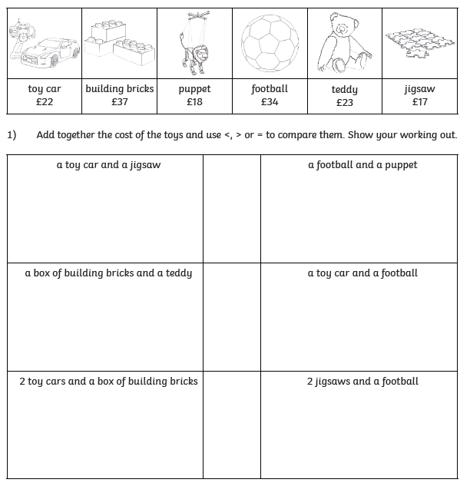
1 STAR TASK!
Comparing Money
Amounts:
Objective:
I can compare the
value of groups of
items.
Remember
< means less than
> means more than
= means equal to.

Slide 7
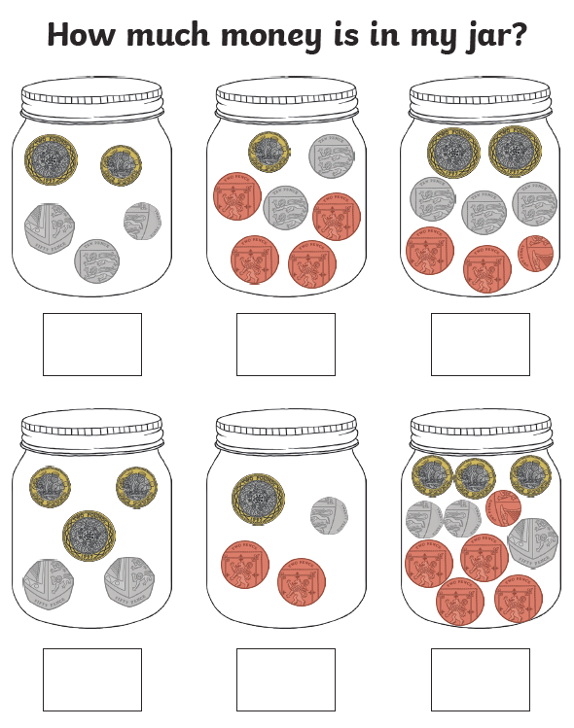
1 STAR TASK! Extension Task
Which jar has the most
amount of money?
Which jar has the least
amount of money?
How much is there
altogether?

Slide 8
2/3 STAR TASK!

Slide 9
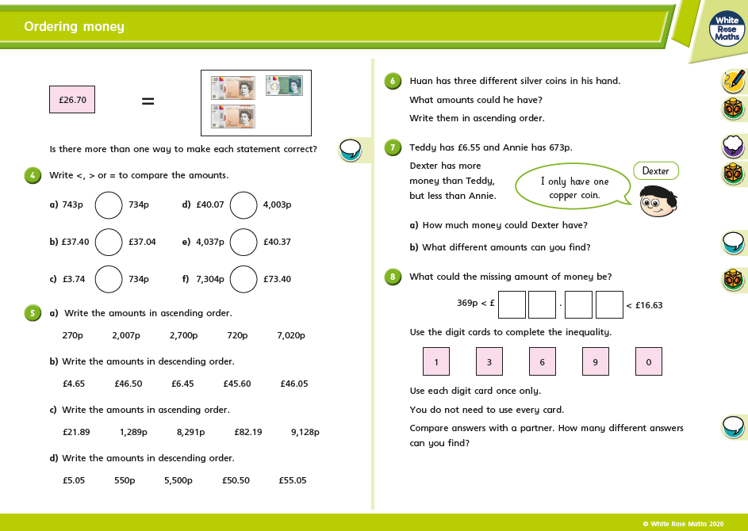
2/3 STAR TASK!

Slide 10
Extension Task!
Please explore this statement by focusing on the pounds and pence.
Is the statement true or false?
Remember how many pennies make four pounds?
Is 35p less than 50p?

Slide 11
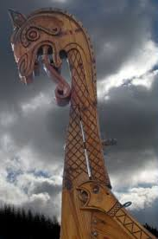
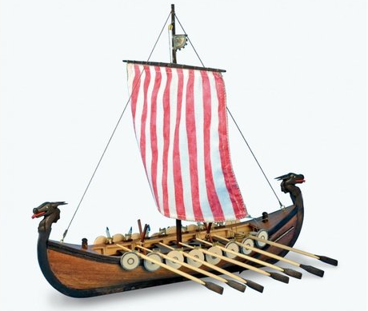
Reading: This week we will be focusing on a Non-fiction book about the Vikings.
Objective: To draw a diagram and label it using the text for information.
Read through the next slide about Dragon Ships! The complete the following task…
Extra challenge… Can you design your own dragon head for a Viking Ship?

Slide 12
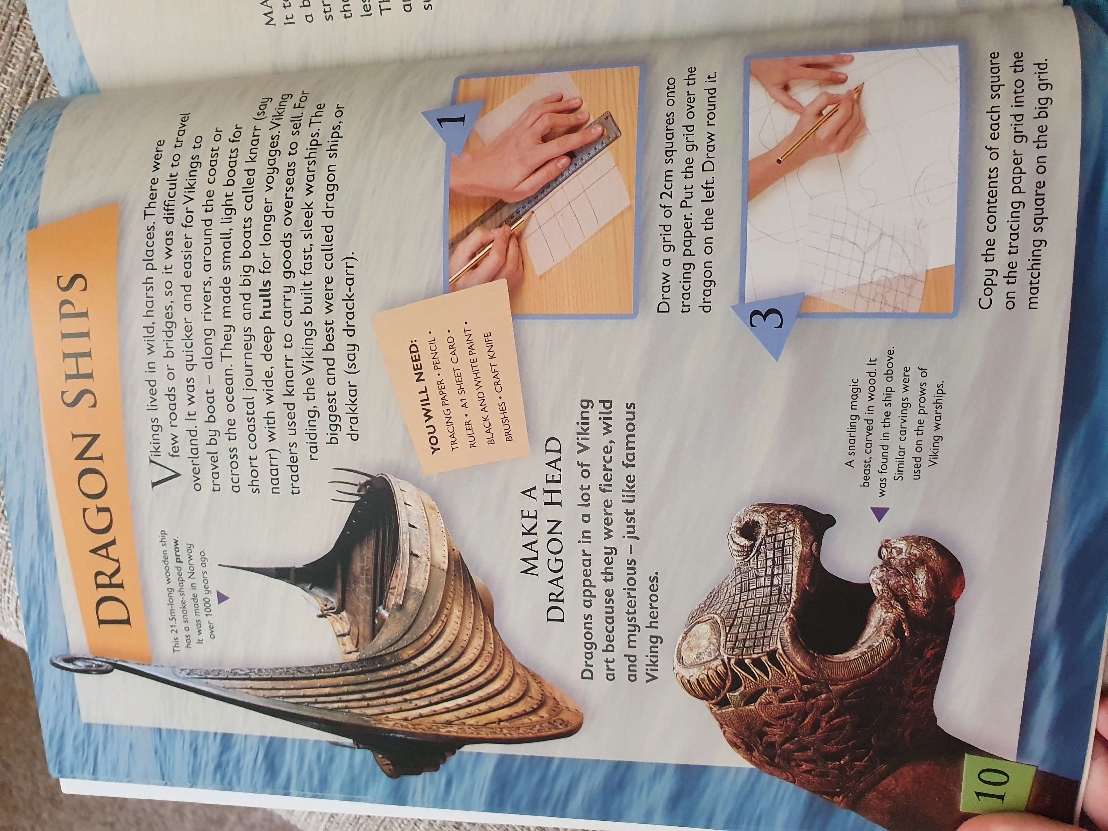
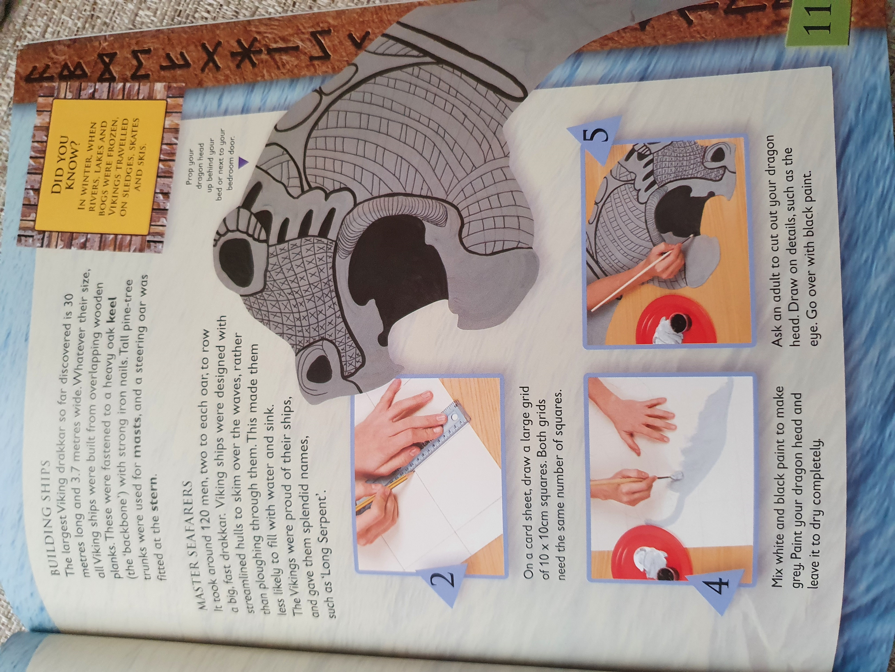

Slide 13
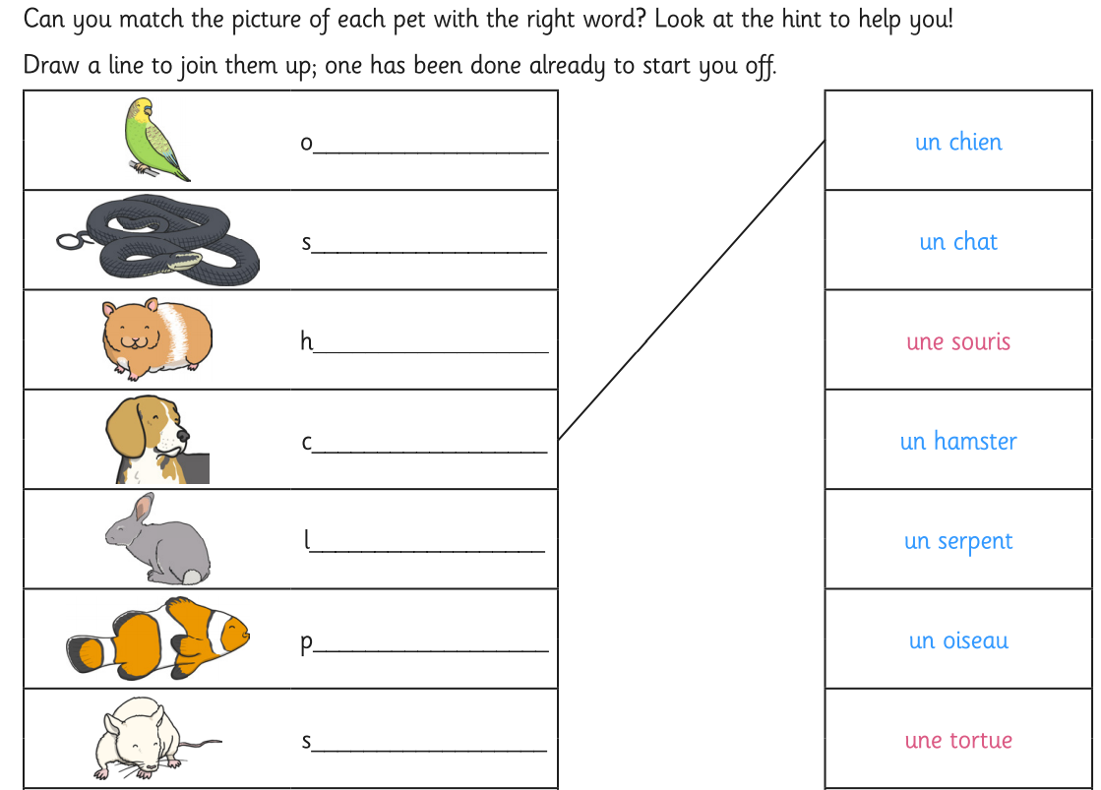
Other: French
Objective: To recognise the names of animals in French.
Watch the clip below to find ways of describing animals.
https://pln.myvle.co.uk/files/sc3490/websites/lspace_47/resources/__79d51d8095572226b9e7f4b7e79263bb.mp4
Read through the next slides full of French Animals! Then complete the following task… Can you match the picture of each pet, with the correct French spelling?
You can either… write the missing word on the line and join up the options.
OR
Draw a picture of the animal and in French, write the correct description.
E.G - Un chien

Slide 14
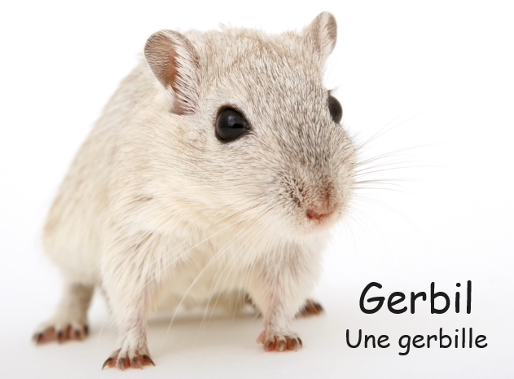
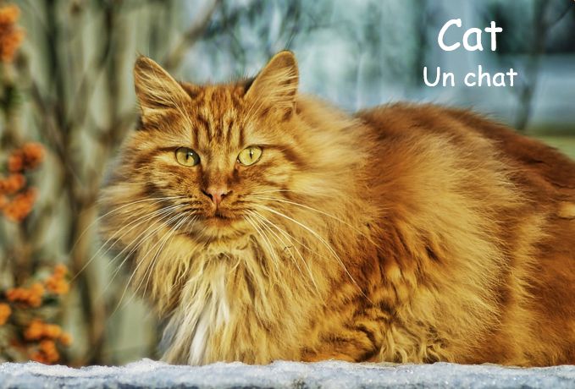
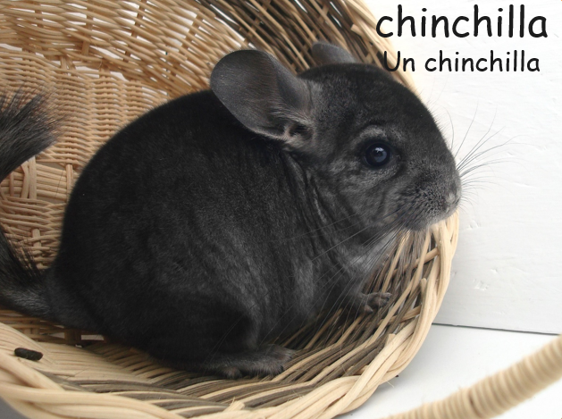
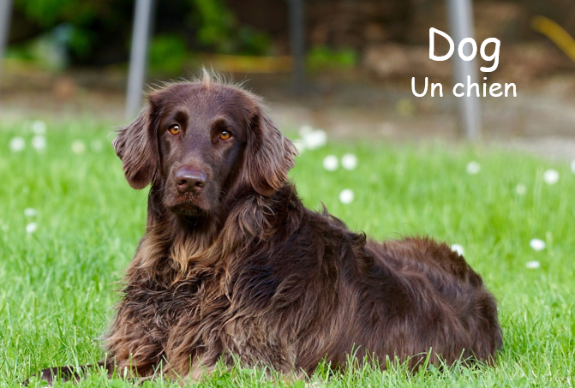

Slide 15
