Slide 1
Remote Learning Plan!
Hello Year 4!
During the next few weeks, we will be providing the children with remote learning on a daily basis. The work will be available on the website the day before e.g. Monday’s work will be online Sunday.
Everyday the remote learning will consist of:
English Lesson
Maths Lesson
Reading Lesson
One other curriculum lesson (PSHE, Art etc)
We will be available during the hours of 9am-4pm so please feel free to contact us on our new e-mail njs.year4@taw.org.uk
Some of the work provided will be split into the star levels that the children use everyday in class (1,2 3).
Stay safe everyone!
Miss Jones, Mrs Jukes, Mrs Kuczynska and Mrs Sisson.

Slide 2
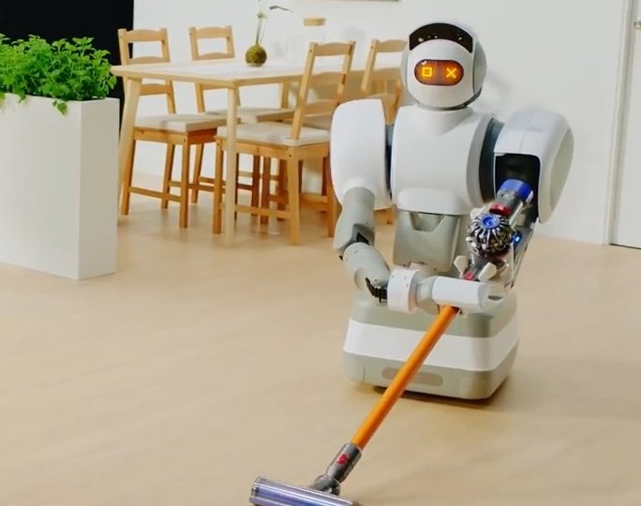
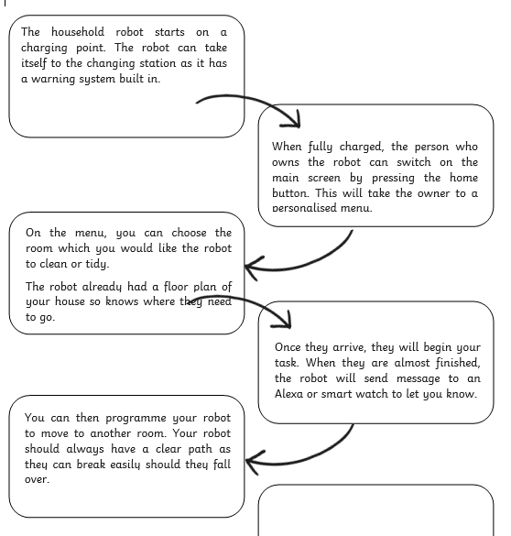
English:
Objective: To create a flow chart.
Now you have designed your invention, you need to explain how it works in steps.
A flow chart can help you separate each function, which will help with your explanation text.
Main Task…
1* - Use the slide to create a simple flow chart. Start with how your invention turns on. Then the steps you take for it to work.
2/3* - Use the slide to create a detailed flow chart. Think about how your invention starts (turns on) and what happens when you press buttons for example.
BOTH – Please the see the example I have created!

Slide 3
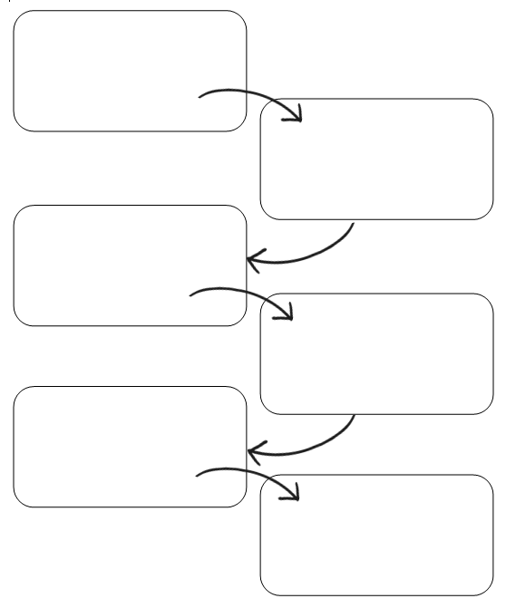
1 Star Template

Slide 4
Following that …………………………………………………….………………………………………………………………………………………………………………………………………………………………………………………………………………………………………………………………………………………………………………………………………………………………
First……………………………………………………………………………………………………………………………………………………………………………………………………………………………………………………………………………………………………………………………………………………………………………………………………………………………………………………………………………
Then……………………………………………………………………………………………………………………………………………………………………………………………………………………………………………………………………………………………………………………………………………………………………………………………………………………………………………………………………………
Finally…………………………………………………………………………………………………………………………………………………………………………………………………………………………………………………………………………………………………………………………………………………………………………………………………………………………………………………………………………
Word Bank – Try to use these conjunctions or openers if you can! Therefore, Consequently, Because, As a result of this, Following, So, If
2/3* Template

Slide 5
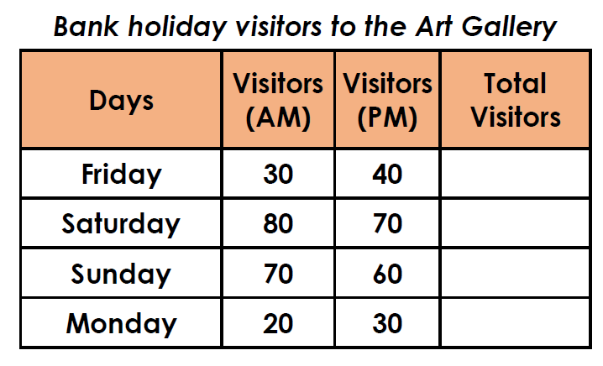
Maths: We will be focusing on Statistics.
Objective: To interpret various Tables.
Please choose a video from the link below and focus on the teaching strategies used to help you interpret Tables and retrieve data from them.
Interpreting Data, Graphs and Tables
Can you calculate the total number of
visitors for each of the days and fill in
the missing Total column?
https://newportjuniorschool.org.uk/wp-content/uploads/2019/10/Calculation-Policy.pdf
As we are beginning a new topic, please read the calculation policy which will offer guidance on how to set calculations out.
1* - Today you will be focusing on comparison, sum and difference and you will need to answer the questions by completing totals columns and finding differences.
2*/3* - Today you will be looking at comparison, sum and differences between various tables. You will need to answer the following questions.
Extension: Today you will be focusing on the pictogram.
Answer the true or false statement focusing on the differences between the orange and banana?

Slide 6
1 STAR TASK!

Slide 7
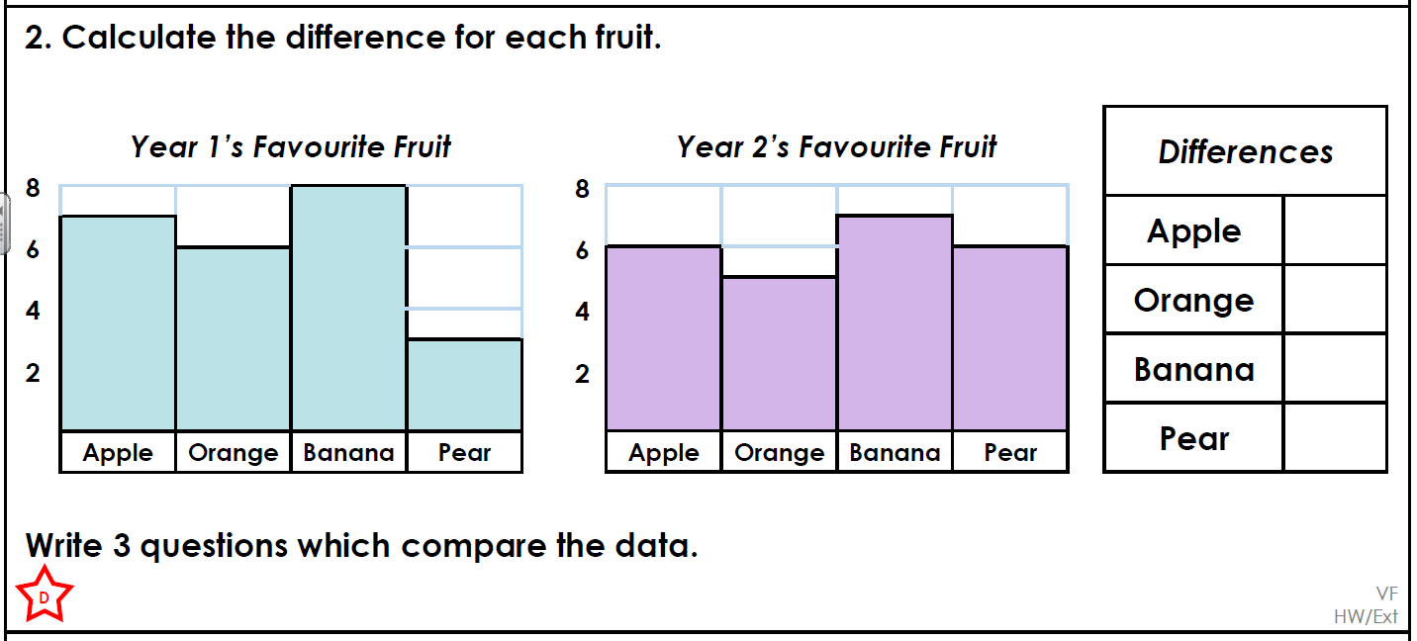

Slide 9
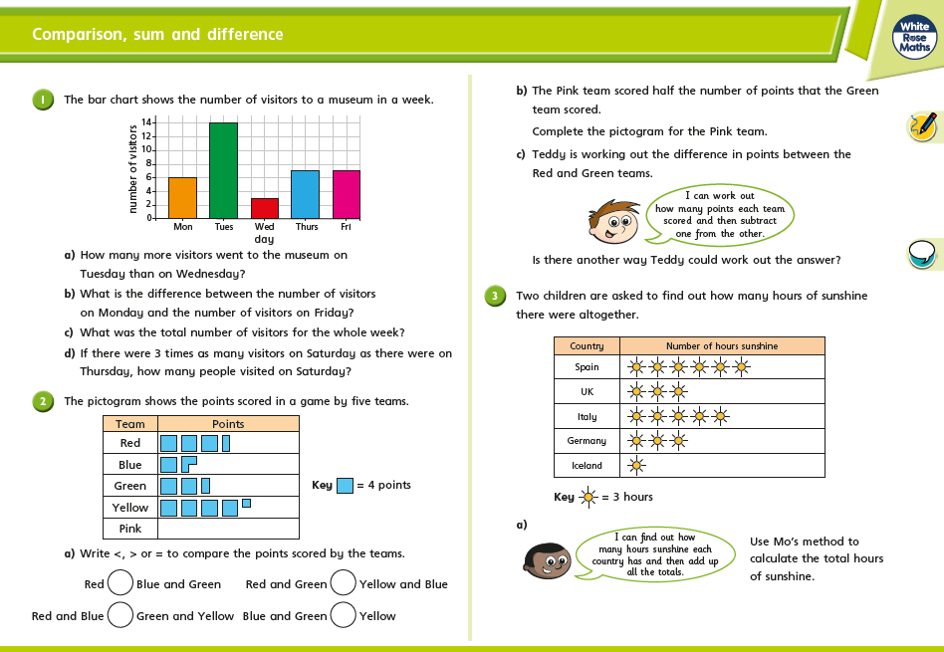
2/3 STAR TASK!

Slide 10
2/3 STAR TASK!

Slide 11
Extension Task!
Please explore this statement by focusing on the pictogram.
Work out the difference between the orange and banana totals.
Is the statement true or false?

Slide 12
Reading:
Objective: To design a front cover.
This afternoon, we would like you to aim for a screen free afternoon. Once you have seen your task, try to complete it without the use of a screen.
We have now read the full story of ‘The Dragon Inside Me’ by Adam Bushnell. During the first few lessons, we looked at the front cover and how it would link to the story.
For your screen free task, we would like you to design a new front cover for the book. What would you include?
Do you think the original matches the story?
Make sure your design shows the reader what they might see in the story but don’t give too much away – otherwise, they might not want to read it!

Slide 13
Other: Art
Objective: To create a picture in the style of
Jackson Pollock.
This afternoon, we would like you to aim for a screen free afternoon. Once you have seen your task, try to complete it without the use of a screen. You will see Jackson’s paintings show his feelings so you can do the same.
Today we are going to look at a different artist called Jackson Pollack. Have a look at the fact sheet to understand more life and about his style of art.
We would then like you to create a picture in the style of Jackson Pollack – either by creating a collage, painting, drawing, using chalk or in any way that interests you.
Please email in your finished artwork so we can create a gallery for the website.
At the end of the slides is an outline that might give you inspiration.

Slide 14
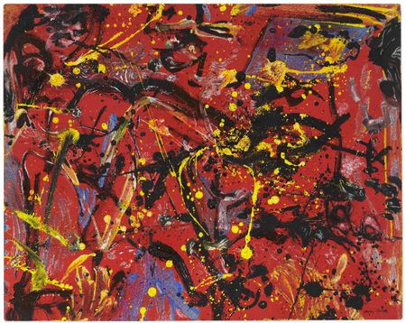
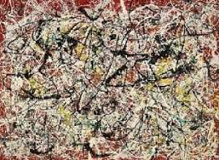
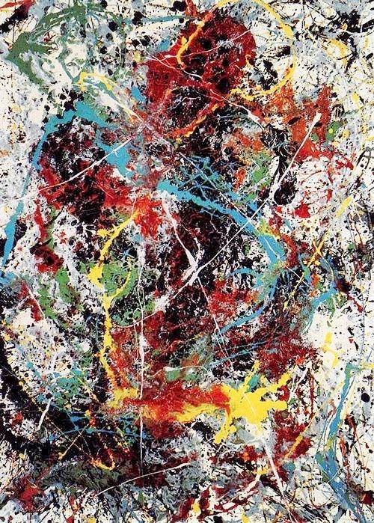
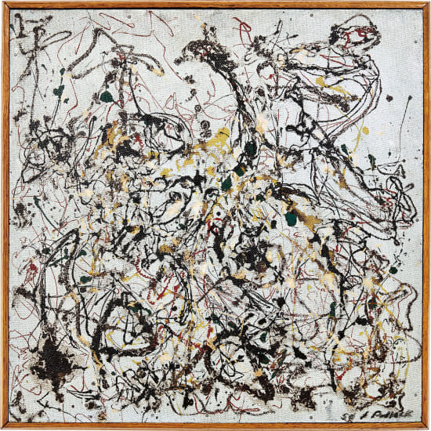
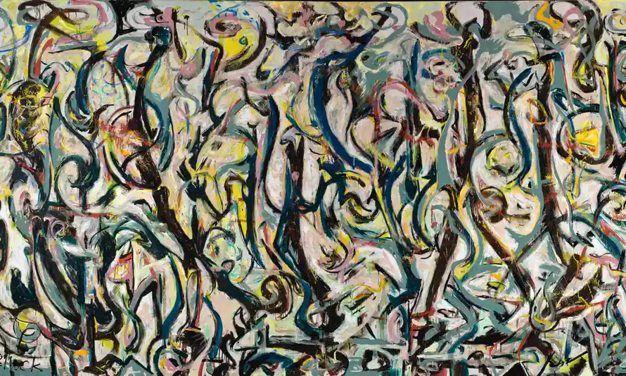
Jackson
Pollock
Examples

