Slide 1
Remote Learning Plan!
Hello Year 4!
During the next few weeks, we will be providing the children with remote learning on a daily basis. The work will be available on the website the day before e.g. Monday’s work will be online Sunday.
Everyday the remote learning will consist of:
English Lesson
Maths Lesson
Reading Lesson
One other curriculum lesson (PSHE, Art etc)
We will be available during the hours of 9am-4pm so please feel free to contact us on our new e-mail njs.year4@taw.org.uk
Some of the work provided will be split into the star levels that the children use everyday in class (1,2 3).
Stay safe everyone!
Miss Jones, Mrs Jukes, Mrs Kuczynska and Mrs Sisson.

Slide 2
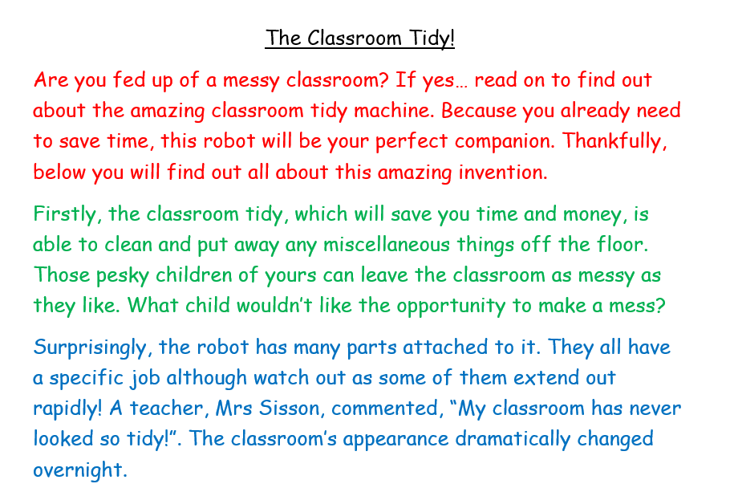
English:
Objective: To write an explanation text.
Main Task…
Today you are going to write an explanation text for your invention.
An example ‘The Classroom Tidy!’ can be found on this slide.
You need to have the following:
A Title
An introduction
An explanation of how your invention works.
A diagram with labels
A conclusion.
Remember to use your blue prints and flow chart to help with the explanation!

Slide 3
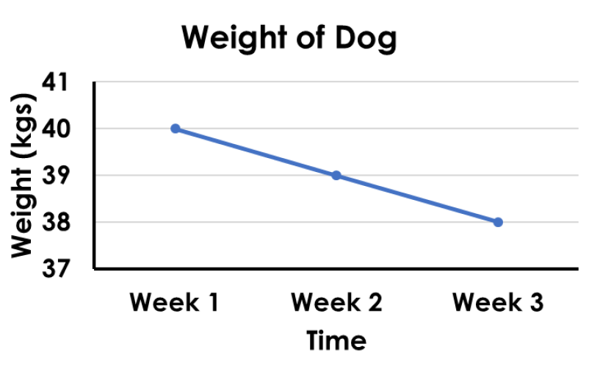
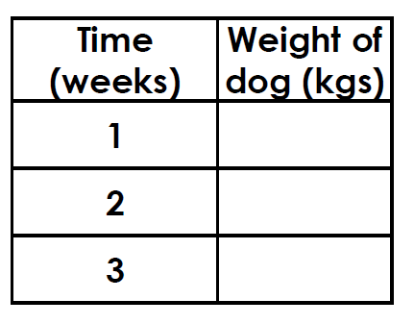
Maths: We will be focusing on Statistics.
Objective: To interpret various Tables.
Can you use the information and data
from the line graph to complete the table
below?
Please choose a video from the link below and focus on the teaching strategies used to help you interpret Tables and retrieve data from them.
Interpreting Data, Graphs and Tables
https://newportjuniorschool.org.uk/wp-content/uploads/2019/10/Calculation-Policy.pdf
As we are beginning a new topic, please read the calculation policy which will offer guidance on how to set calculations out.
1* - Today you will be focusing on line graphs and you will need to interpret the data to answer the questions and solve the problems.
2*/3* - Today you will be focusing on line graphs and you will need to interpret the data to answer the questions and solve the problems.
Extension: Today you will be focusing on the line graph.
Answer the true or false statement focusing on the graph. How do we know a ten minute rest was taken?

Slide 4
1 STAR TASK!

Slide 7
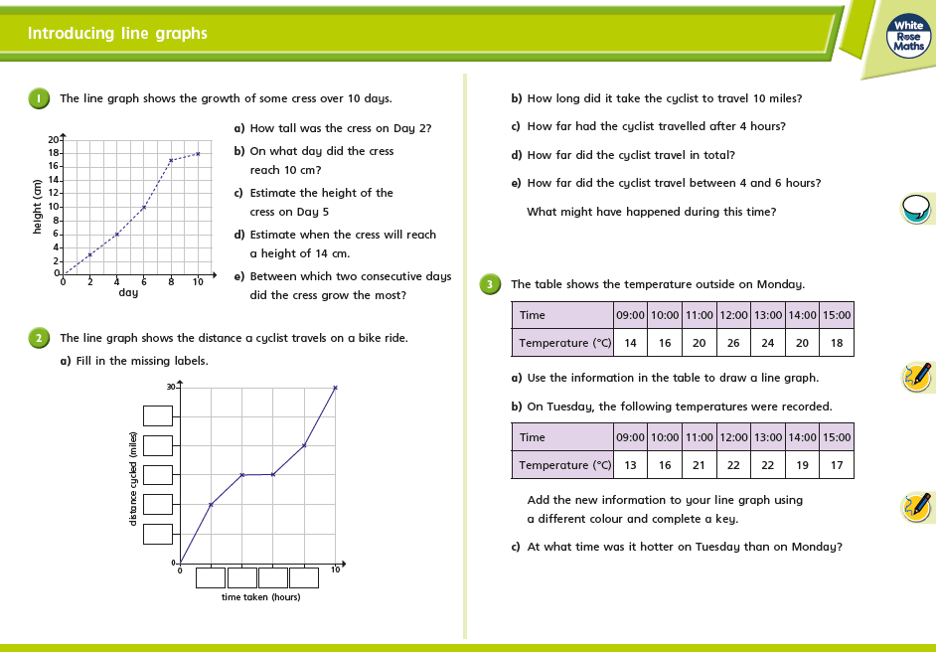
2/3 STAR TASK!

Slide 8
2/3 STAR TASK!

Slide 9
Extension Task!
Please explore this statement by focusing on the line graph.
Is the statement true or false?
How do we know they had a ten minute rest?

Slide 10
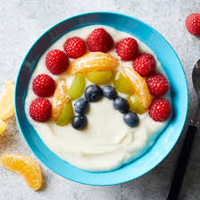
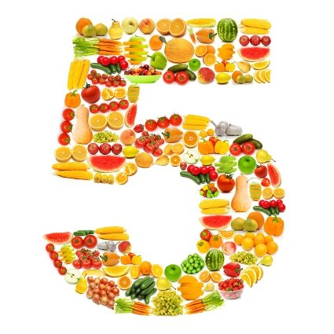
Reading:
Objective: To recognise ways to keep healthy.
Finally, at the end of the story, George starts to eat healthily and get some exercise. Think about one thing you could do to keep fit and well.
It could be a recipe for a healthy snack to swap for an unhealthy one.
It could be instructions for an exercise activity.
Task…
1* - Draw a picture of your healthy idea. Write a few sentences to explain why it is a good choice to make.
2/3* - Draw a picture of your healthy idea and write a set of instructions on how to make or do it.

Slide 11
Other: Beliefs and Values
Objective: To understand how Jesus treated
people who were poorly.
Mark 1:40-44
Jesus Heals a Man With Leprosy
40 A man with leprosy came to him and begged him on
his knees, “If you are willing, you can make me clean.”
41 Jesus was indignant. He reached out his hand and touched the man. “I am willing,” he said. “Be clean!”
42 Immediately the leprosy left him and he was cleansed.
Watch:
https://www.youtube.com/watch?v=Sdqt_0UXFPg
Think about the following questions…
Why don't we come to school when we are poorly?
What would we feel like if were sitting next to someone who is poorly?
How did Jesus treat people who were poorly?
Did he just walk away or did he help them?
Once you have watched the video, create a story board. A blank story board is on the next slide for you to use.

