Slide 1
Remote Learning Plan!
Hello Year 4!
During the next few weeks, we will be providing the children with remote learning on a daily basis. The work will be available on the website the day before e.g. Monday’s work will be online Sunday.
Everyday the remote learning will consist of:
English Lesson
Maths Lesson
Reading Lesson
One other curriculum lesson (PSHE, Art etc)
We will be available during the hours of 9am-4pm so please feel free to contact us on our new e-mail njs.year4@taw.org.uk
Some of the work provided will be split into the star levels that the children use everyday in class (1,2 3).
Stay safe everyone!
Miss Jones, Mrs Jukes, Mrs Kuczynska and Mrs Sisson.

Slide 2
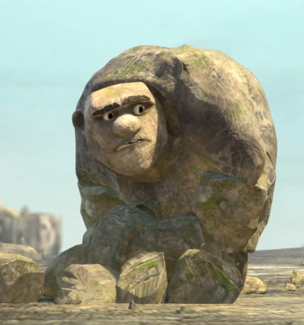
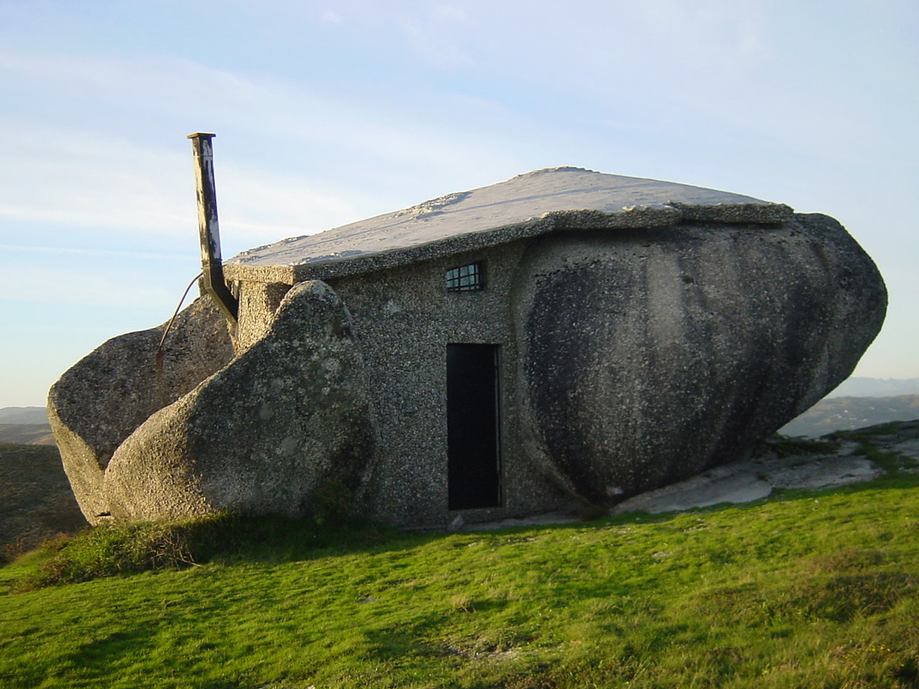
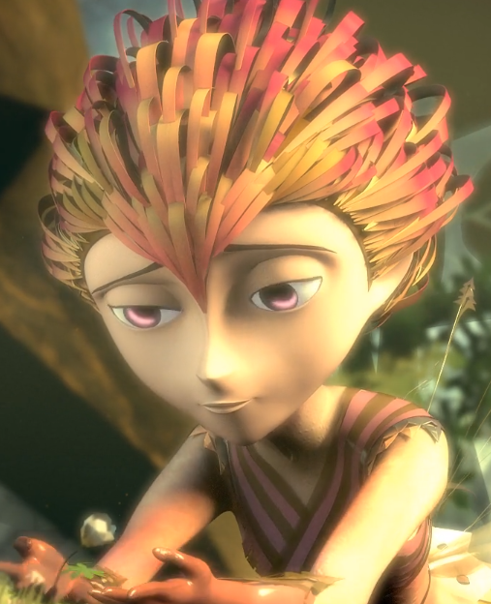
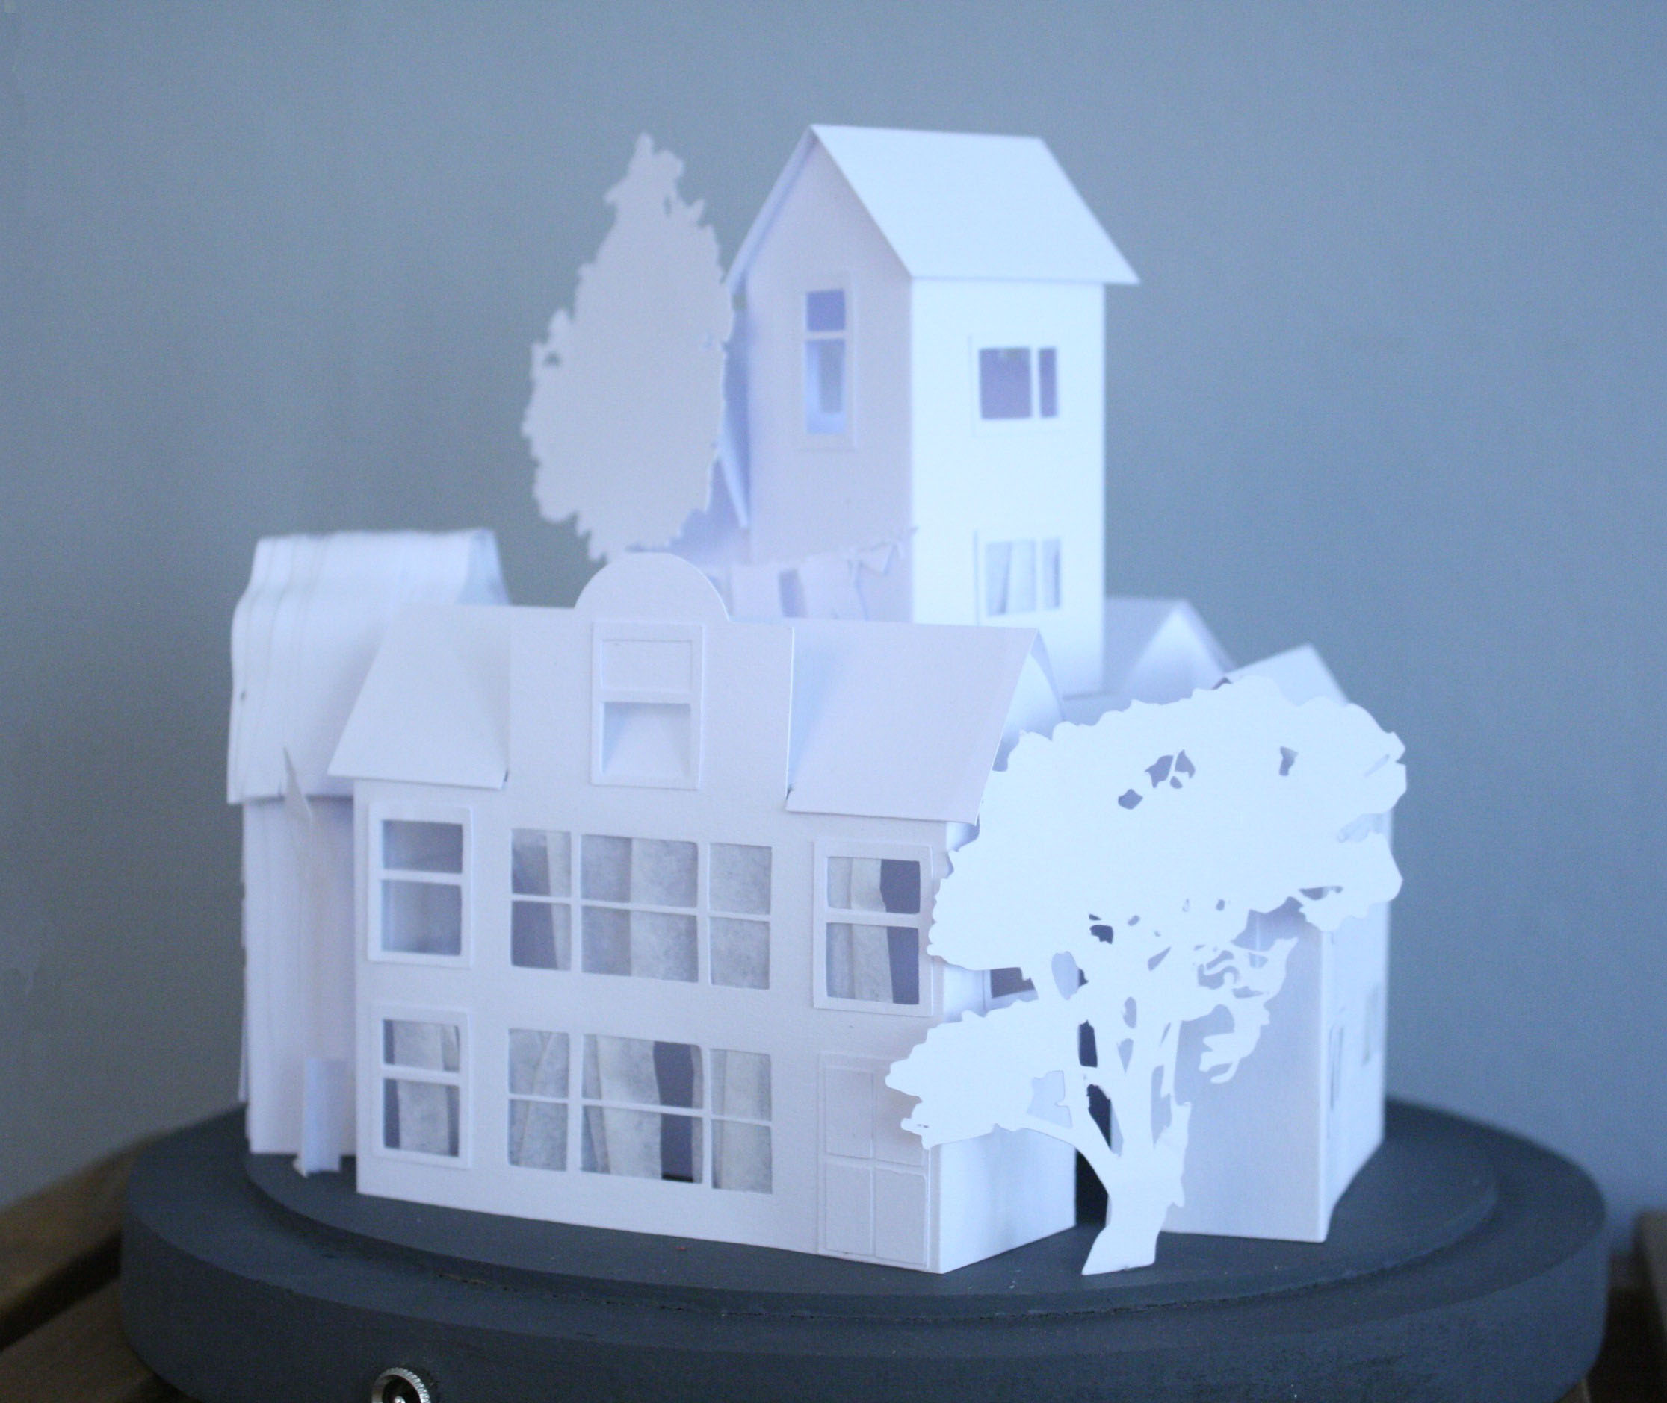
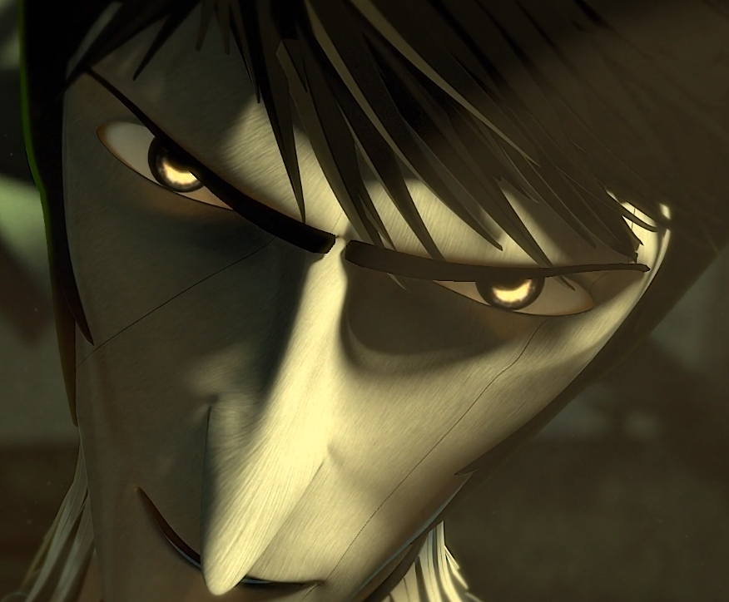
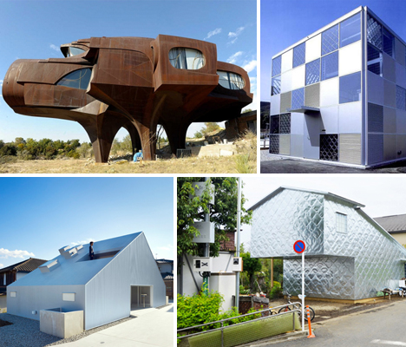
English:
Objective: To design and describe a setting for a character.
Re-watch the video should you feel you need a reminder…
https://vimeo.com/91642206
In the video, we are introduced to three main characters: Rock, Paper and Scissors. We know little about them and where they came from.
Today… we are going to imagine where they might live. Imagine what type of house Rock, Paper or Scissors would live in (See examples). What would it look like? What would it be made from? Where would it be? How safe is it?
1* - Design a home for either Rock, Paper or Scissors. Label your home to explain your choices.
2/3* - Design a home for either Rock, Paper or Scissors.
Write a setting description for your home (no less than 1 paragraph, roughly 7/8 lines). Use the word banks on the next slides to support your description.

Slide 6
Maths: We will be focusing on Statistics.
Objective: I can estimate how much money I need.
Please solve the following by looking at
picture below:
In each of the purses there are …
Estimate which purse contains the most?
Estimate which purse contains the least?
Please choose a video from the link below and focus on the teaching strategies used to help you identify all the various types of money we use.
Calculating Change From A £5 Note
https://newportjuniorschool.org.uk/wp-content/uploads/2019/10/Calculation-Policy.pdf
As we are beginning a new topic, please read the calculation policy which will offer guidance on how to set calculations out.
1* - Today you will be estimating amounts of money.
Place the amounts on a number line and round the amounts to the nearest pound.
2*/3* - Today you will be focusing on estimating money. Answer the questions on the worksheet.
Extension: Is the statement true or false?
How does the addition sum help you to estimate how much money you will need to buy both toys?
Remember there are 100p in every pound £.

Slide 7
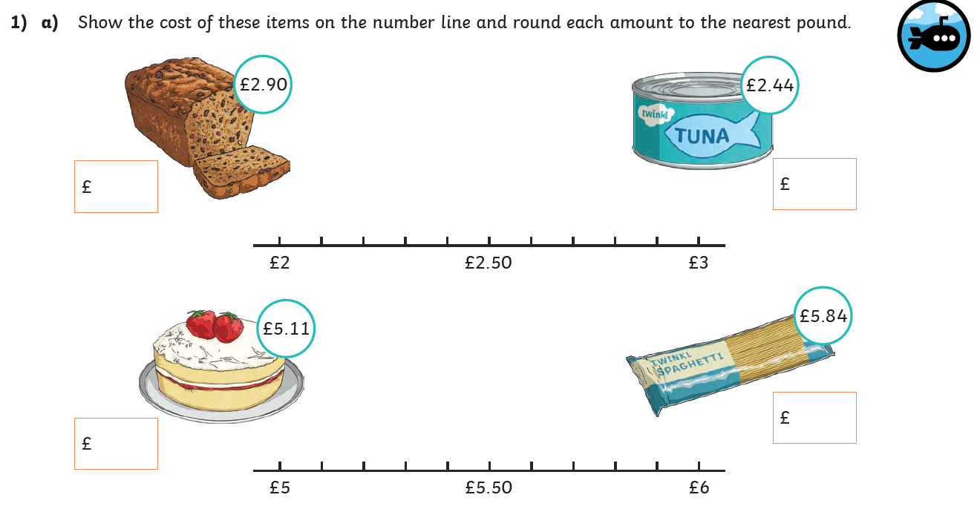
1 STAR TASK!
Estimating Money
Amounts:
Objective:
I can estimate how
much items cost.
Remember:
When rounding to
The nearest pound;
if it is 49p or less
round down.
If it is 50p or
more you will need
to round up..

Slide 8
1 STAR TASK! Extension Task
Look at the items of food below:
Estimate how much change you would receive if you paid
For each item with a £5 note?
Estimate how much change would you receive if you paid for
each item with a £10 note?

Slide 9
2/3 STAR TASK!

Slide 10
2/3 STAR TASK!

Slide 11
Extension Task!
Please explore this statement by focusing on a rough estimate of how much
Money you would need to buy both of these toys.
Is the statement true or false?
How does 5 + 15 help you make an estimate?

Slide 12
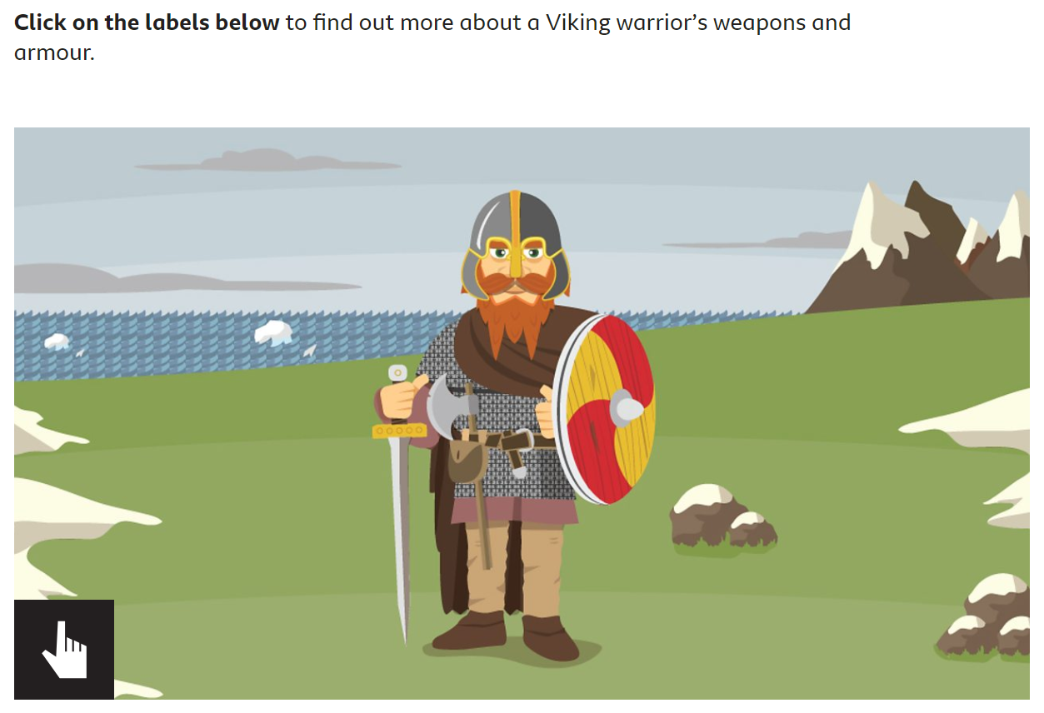
Reading: This week we will be focusing on a Non-fiction book about the Vikings.
Objective: To recall information about a Viking Warrior using an interactive and secondary source.
Read through the slide about Weapons and Armour! The complete the following task…
Look at this link to find out more about a Viking Warrior… https://www.bbc.co.uk/bitesize/topics/ztyr9j6/articles/zy9j2hv
Task… Draw a picture of a Viking Solider or print the one you can see on this slide.
Label your Viking Warrior to explain what each section is for.
2/3* - Use the Viking book information to add more detail to your mind-map.
Each section has its own information for you to recall from.
Click here to make the warrior interactive for your task.

Slide 13
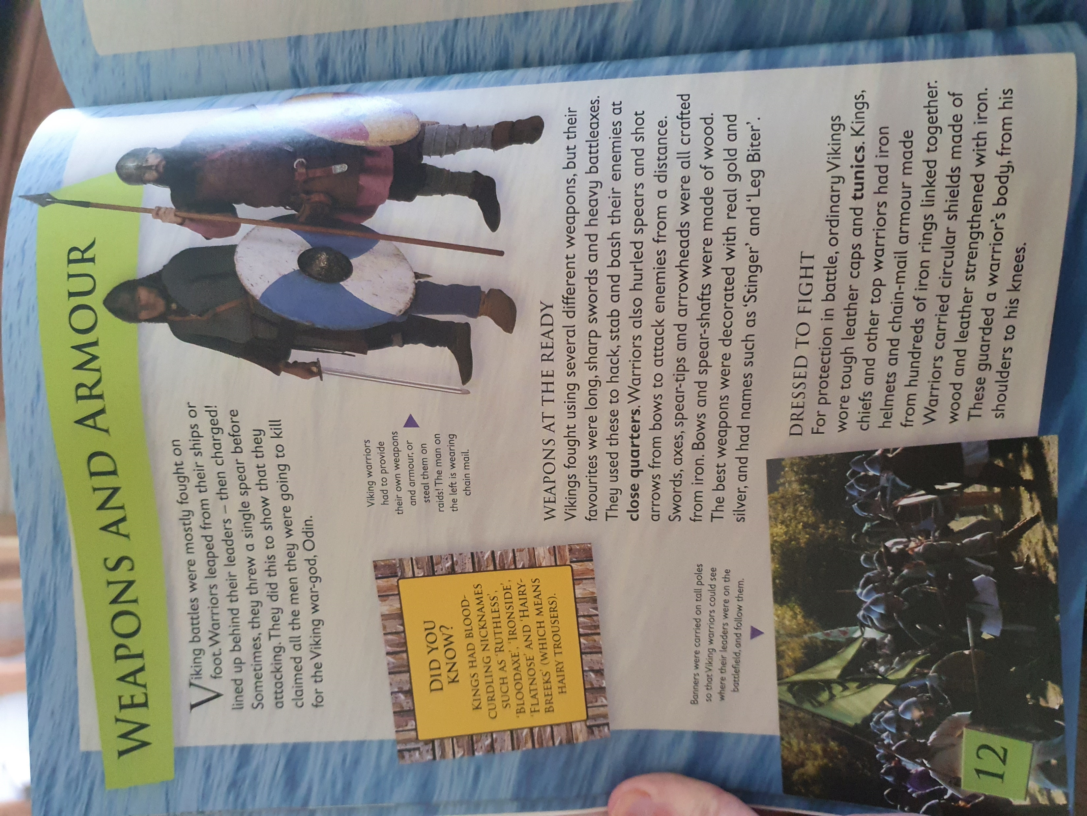
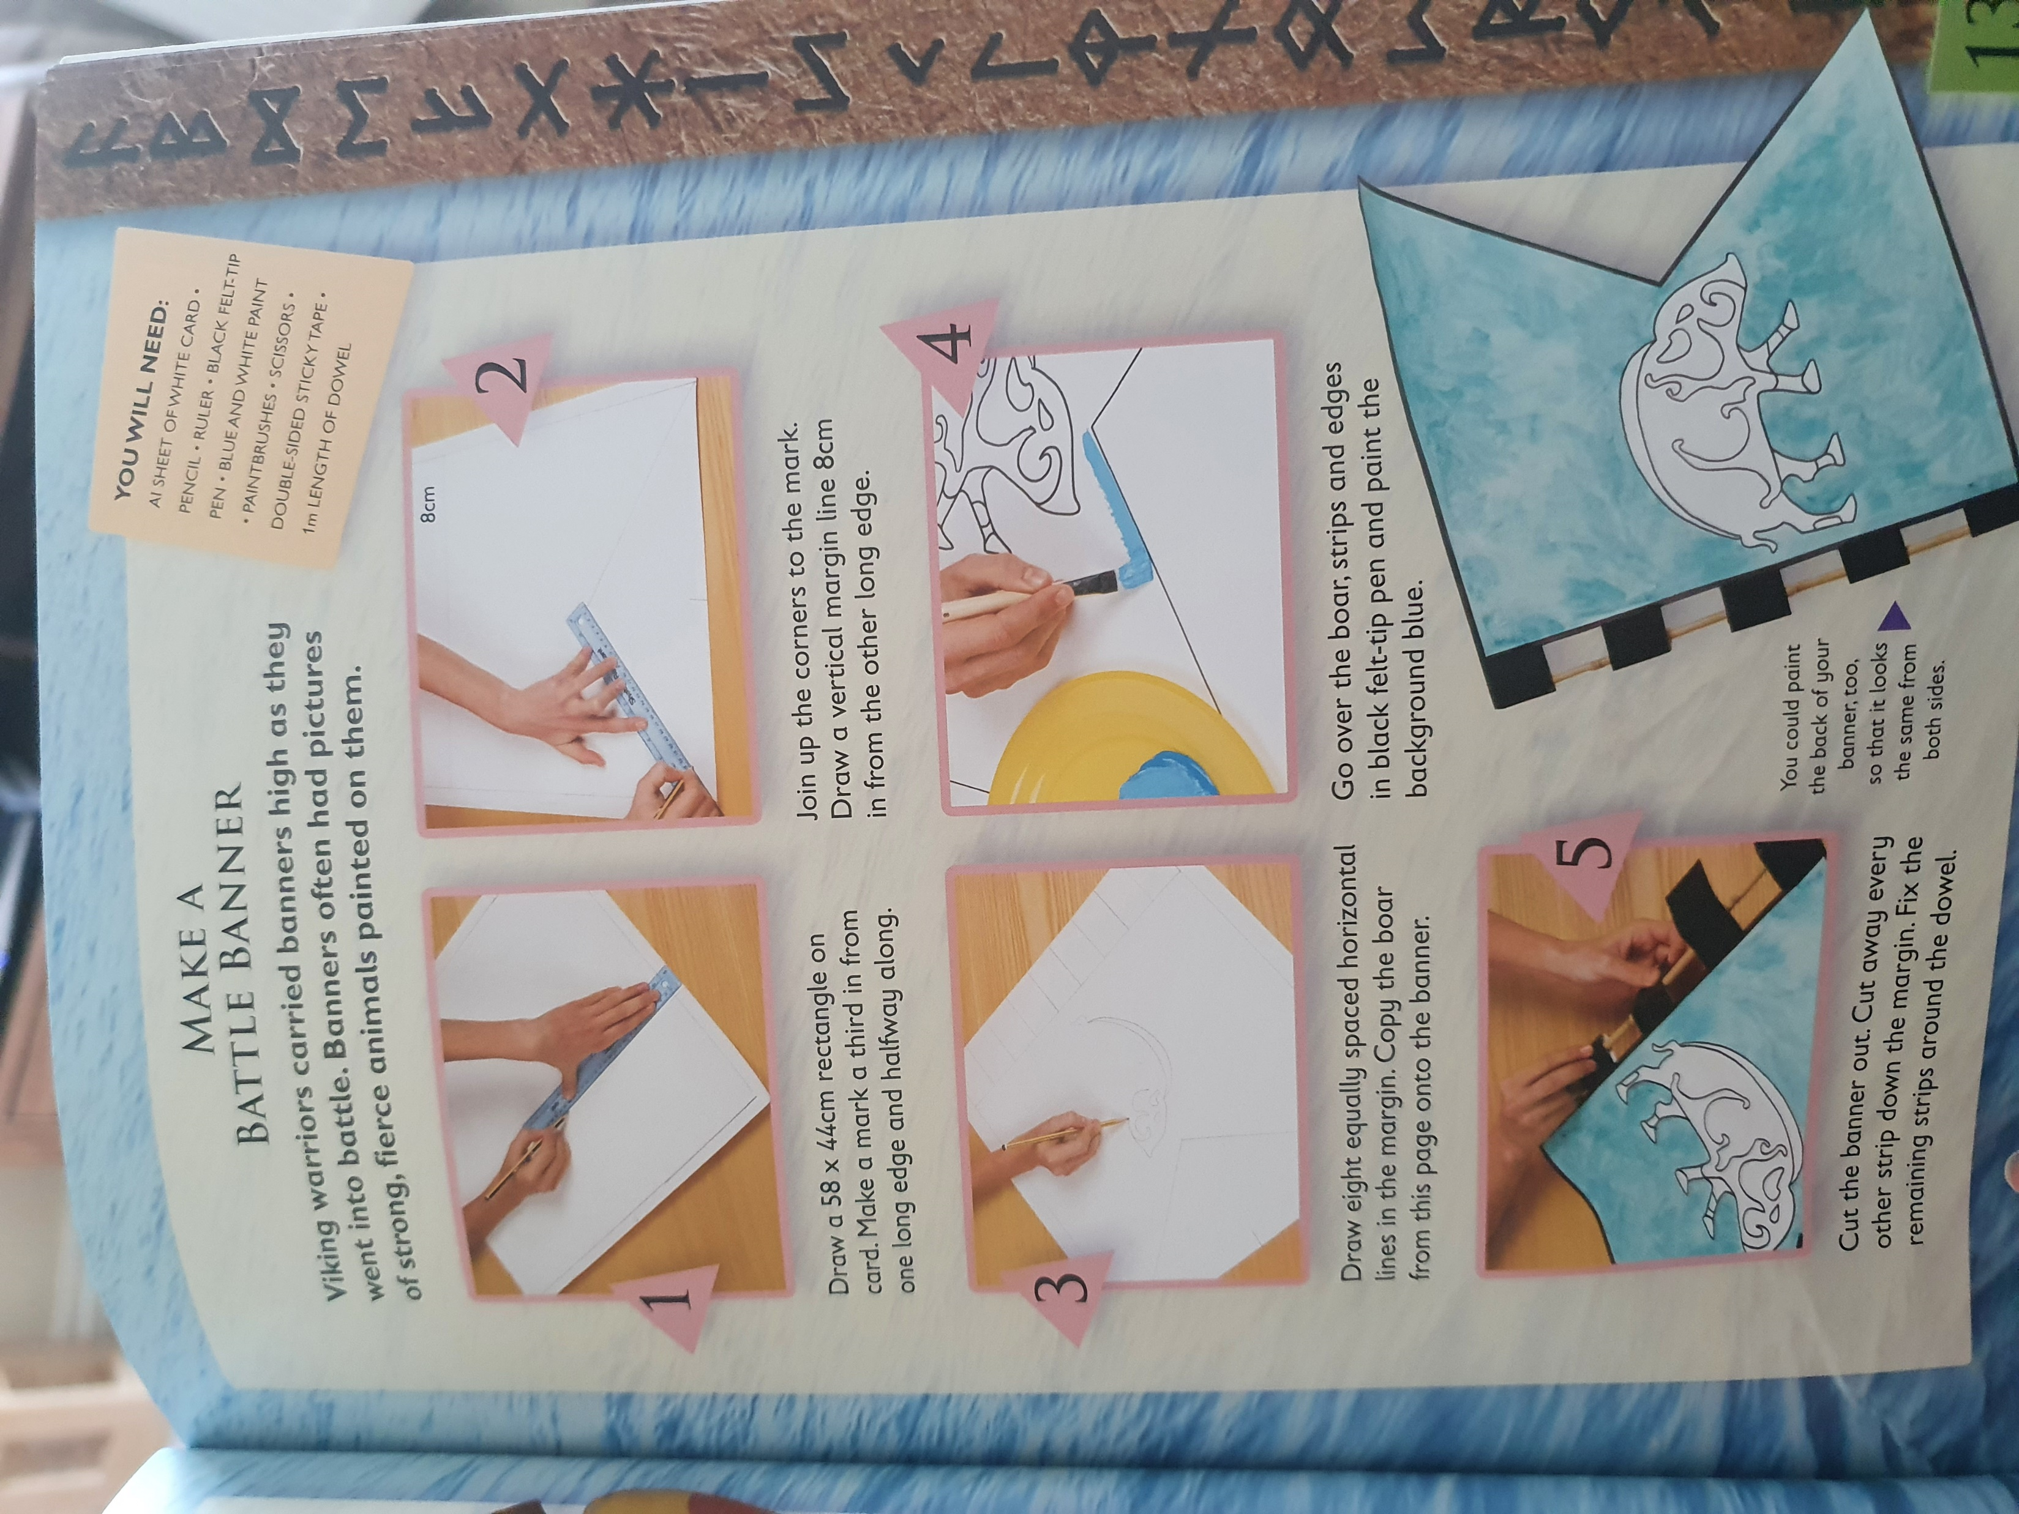

Slide 14
Other: E-Safety
Objective: To understand the importance of being safe and kind online.
When you watch the second video, think about the following questions:
Why when you write a post is it important to be kind?
How do you feel if someone says something unkind about you?
What sort of words would you use if you were being positive about someone?
Remind yourself of the video on the last e safety lesson: Block him right good, Alfie
https://www.thinkuknow.co.uk/8_10/watch/
Alfie made 4 big steps to stay safe online…
Profile picture is an avatar not an actual picture of himself.
Username does not feature his name.
Privacy set to friends only.
Clothes do not reveal which school he is from
Task…
Use the pictures of Sam, Alfie and Ellie on the next slide to think of positive words they could use to each other.
We need to be safe online but also need to understand… Being kind online
Watch the following clip…
https://www.youtube.com/watch?v=0u6-2aCea-M

Slide 15
