Slide 1
Remote Learning Plan!
Hello Year 4!
During the next few weeks, we will be providing the children with remote learning on a daily basis. The work will be available on the website the day before e.g. Monday’s work will be online Sunday.
Everyday the remote learning will consist of:
English Lesson
Maths Lesson
Reading Lesson
One other curriculum lesson (PSHE, Art etc)
We will be available during the hours of 9am-4pm so please feel free to contact us on our new e-mail njs.year4@taw.org.uk
Some of the work provided will be split into the star levels that the children use everyday in class (1,2 3).
Stay safe everyone!
Miss Jones, Mrs Jukes, Mrs Kuczynska and Mrs Sisson.

Slide 2
English:
Objective: To research an invention of my choice.
Over the years, new inventions are designed and created by various inventors. Some inventions, we don’t always realise were designed hundreds of years ago.
Many people see some inventions as ‘game changers’ meaning they help with our day to day lives. For example: the lightbulb or even a toilet.
Main task…
Have a look at the next slide for some classic ‘game changers’.
Research a game changer (invention) of your choice and complete the following:
Who is the inventor? What can you tell me about them?
What is the invention? How does it work?
Draw an image of the invention.
Fun facts about your chosen invention.
Use the templates on the website to present your research!

Slide 3
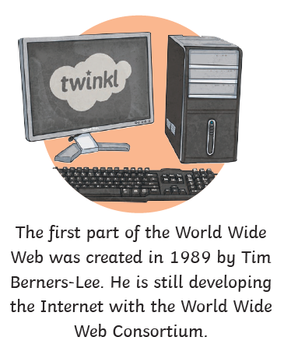
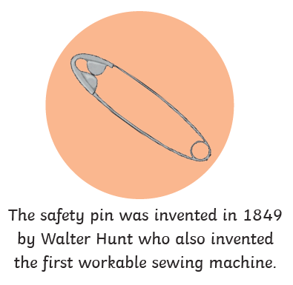

Slide 4
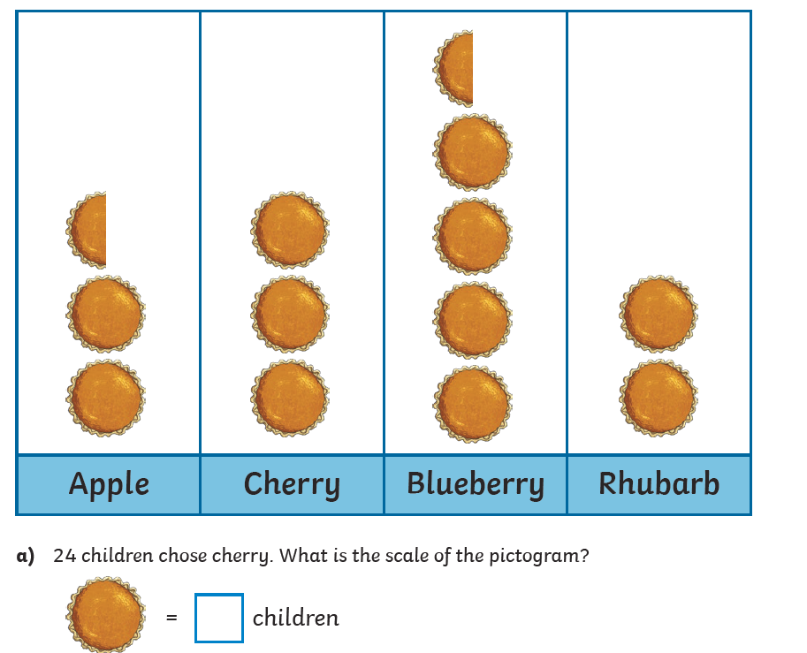
Maths: We will be focusing on Statistics.
Objective: To create Pictograms.
What title would you give this pictogram?
Can you solve the problem?
Please watch the video link below and focus on the teaching strategies used to help you interpret Pictograms and retrieve data from them.
Interpreting Pictograms
https://newportjuniorschool.org.uk/wp-content/uploads/2019/10/Calculation-Policy.pdf
As we are beginning a new topic, please read the calculation policy which will offer guidance on how to set calculations out.
1* - Today you will be focusing on pictograms and you will need to complete the pictogram and answer the questions.
2*/3* - Today you will be looking at pictograms and count in 2’s, 5’s and 10’s when focusing on symbols.
Extension: Today you will be focusing on the pictogram.
Each circle represents 2. Is the pictogram correct?
Please explain why in a full sentence.

Slide 5
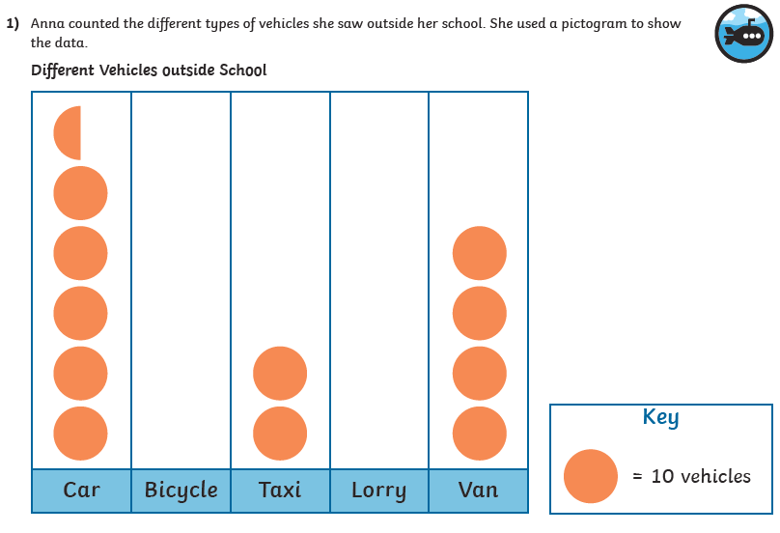
1 STAR TASK!

Slide 6
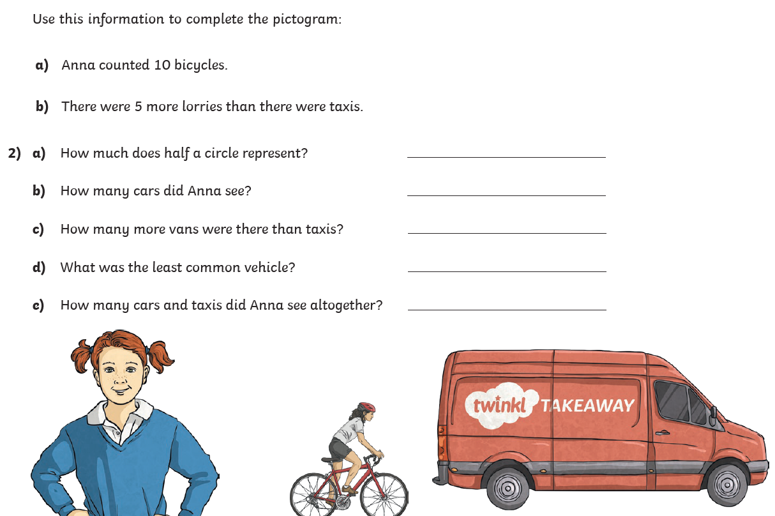
1 STAR TASK!

Slide 7
2/3 STAR TASK!

Slide 8
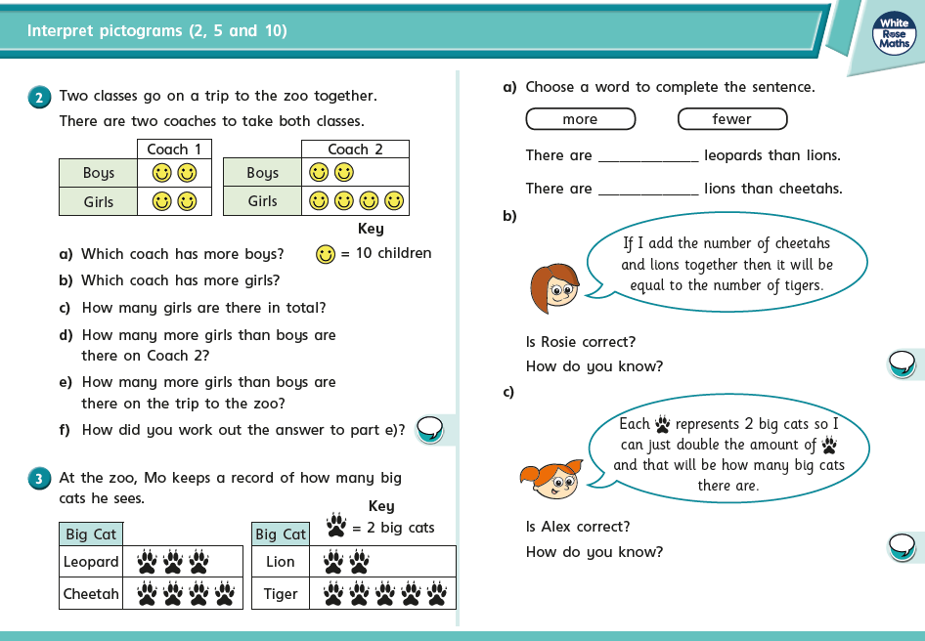
2/3 STAR TASK!

Slide 9
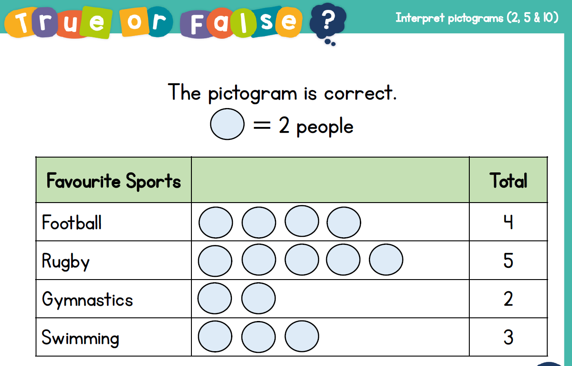
Extension Task!
Please explore this statement by focusing on the Pictogram.
Each circle represents 2 people.
Is the pictogram correct?
True or false; explain why.

Slide 10
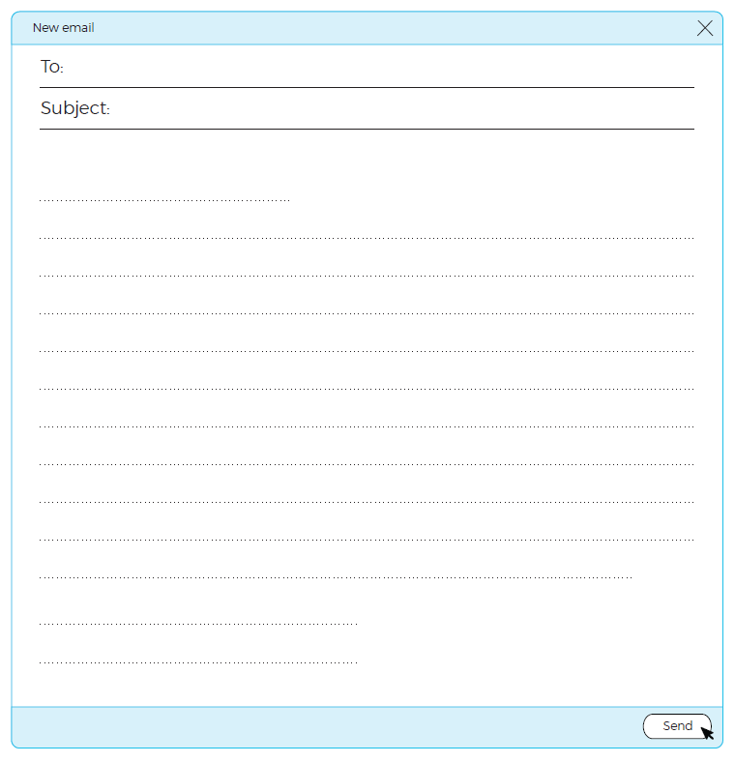
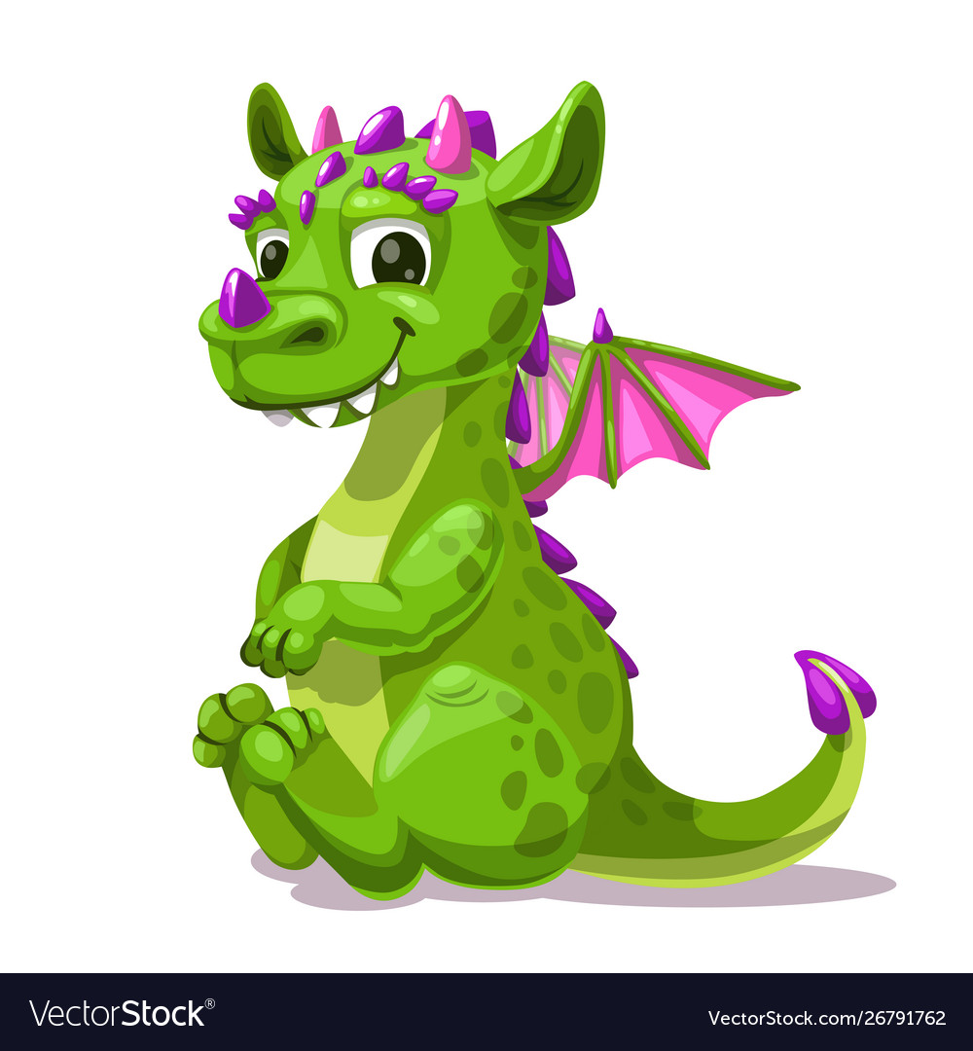
Reading:
Objective: To write an e-mail in character.
Ajay is clearly worried about his friend George.
1* - Pretend that you are Ajay and you are worried about him. Write an e-mail to one of your friends. In the e-mail, tell them why you are worried about George and some ideas you have to help him.
2/3* - Pretend that you are Ajay and write an e-mail to one of your other friends, describing the meeting with George. Say when it happened; where you were and why you are worried about him.
Try to include the following 4 words… confused, freaked out, hesitated and nervous.
Opposite you will find a template for writing an e-mail. You can use this one OR create your own.

Slide 11
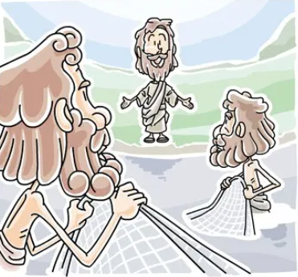
Other: Beliefs and Values
Objective: To understand why disciples are important to Jesus.
Read the passage above. Try and answer the following questions…
1. What did James and John leave behind?
2. What special new job did the disciples gain once they followed Jesus?
3. Can you explain what the passage above means?

Slide 12
Jesus asked his followers to be ‘fishers of people’.
Create a mind-map of jobs you think people might do if they were fishers of men.
They might have a job telling new followers where to go next.
Fishers of Men - Jobs

