Slide 1
Year 3 Home School Provision Daily Pack-03/02/21
The following slides will be split into 4 separate activities.
They will consist of Maths, English, Reading and one other subject.
Each slide will be daily activities for you and your child to do at home.
We as a Year 3 team, will update these slides daily to the website – please keep an eye out!
Please email NJS.Year3@taw.org.uk with any queries to share any work and one of the Year 3 teachers will get back to you as soon as possible!
Thank you for your understanding and on going support during these times.

Slide 3
Maths
To find simple fractions of amounts.
Introduction
Parent support
https://www.youtube.com/watch?v=TXJOIs7vXMs

Slide 4
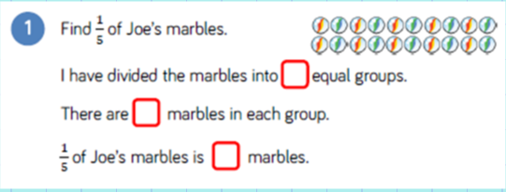
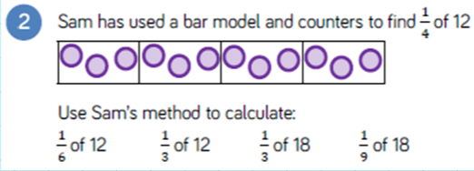

Slide 5
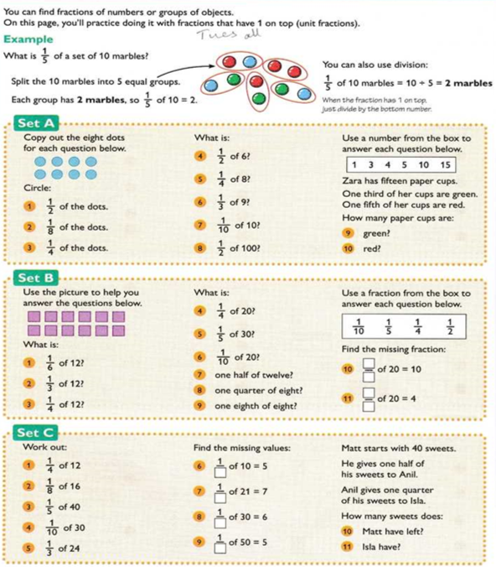
Set A – 1*
Set B – 2*
Set C – 3*

Slide 6
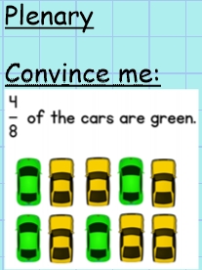
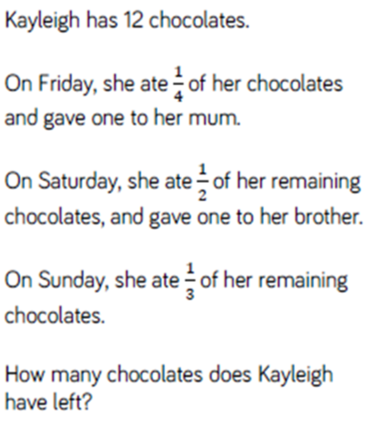
EXT:

Slide 7
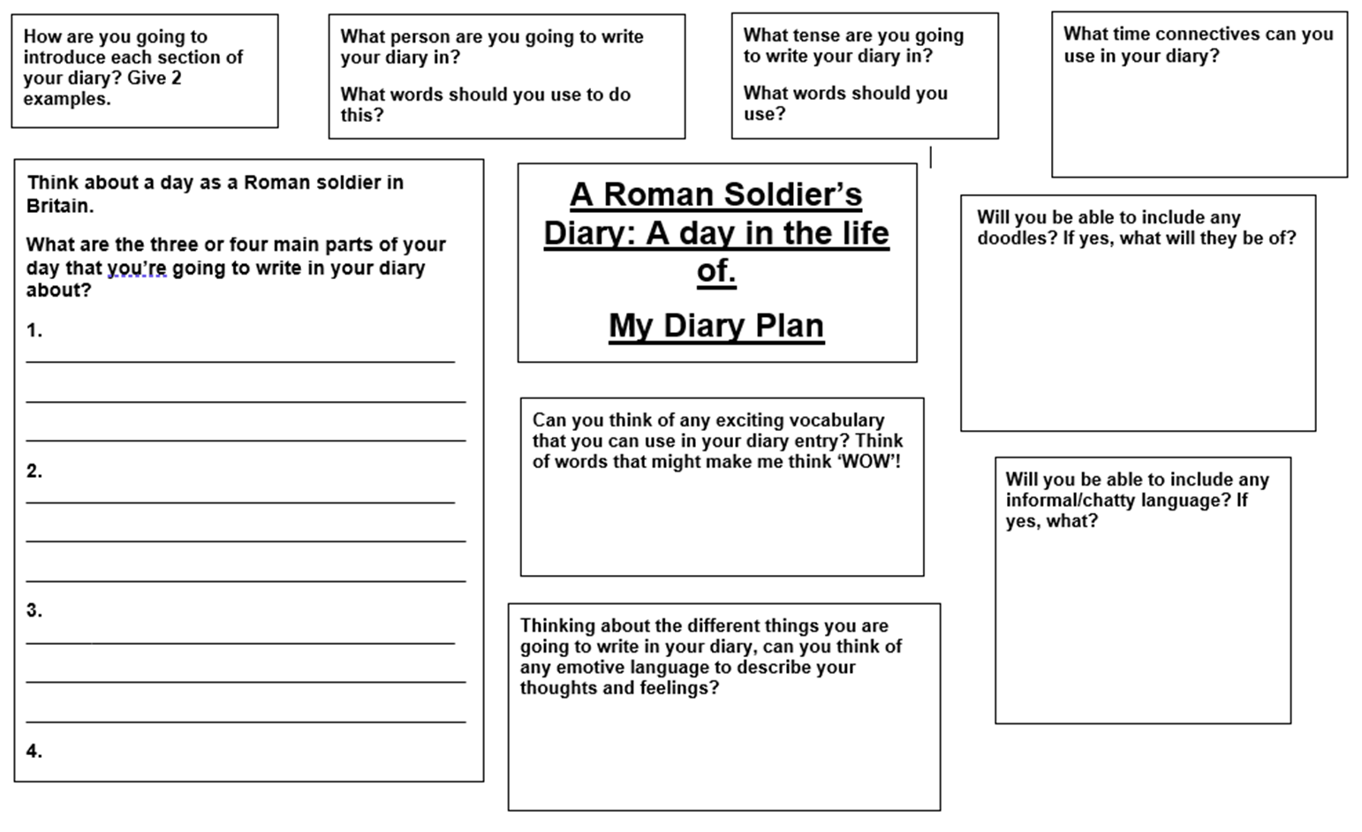
English -To use our plan and research to write the middle part of a diary extract. -To remember and use features of a diary.
Make sure that you have your plan from Friday.
Reread the start of the diary that you wrote on Monday.
What features did you use?

Slide 8
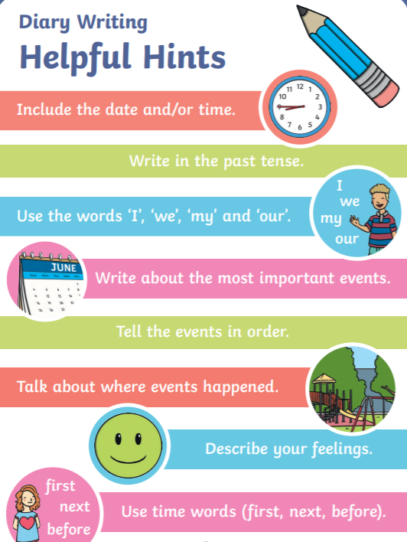
Did you get all of these?

Slide 9
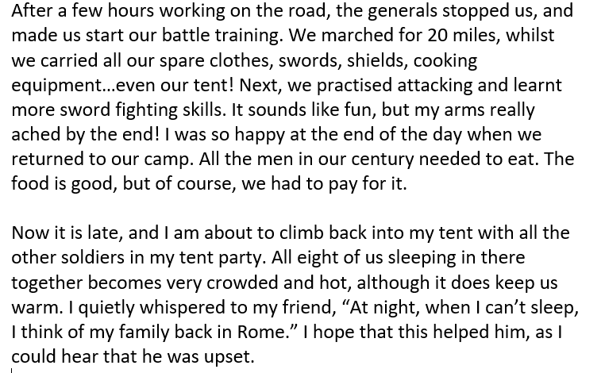
Now lets write the middle part of our diary…
Remember that YOU are the Roman soldier.
Write in time order- talk about the middle of your day.
Use time words.
Use ‘I’, ‘me’, ‘my’, ‘our’, ‘we’ etc.
Talk about your feelings.
Write about important events.
Include some direct speech that you wrote in your SPaG lessons.

Slide 10
Reading
Reading – Online lesson
To make a prediction, retrieve information, infer conclusions and explain my ideas.
Read Chapter 2 of ‘Takeover’. Then vote for the next chapter, make a prediction and do the online quiz. Complete the additional activities for further challenge.

Slide 11
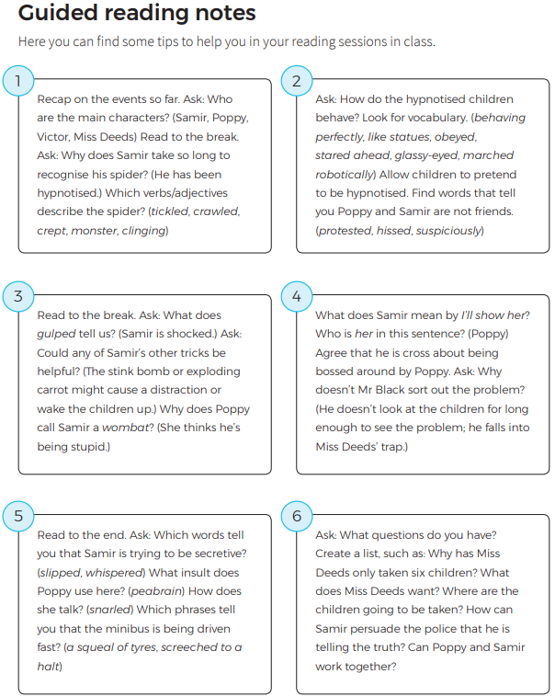
Parent / teacher Guided reading notes.
Use this selection of ideas as a reading prompt when reading the chapter with your child / class.
You don't have to ask every question, or get an answer – adjust as necessary.

Slide 18
Now it’s time to vote for the next chapter, but first, go to the next slide and make your prediction!...

Slide 19
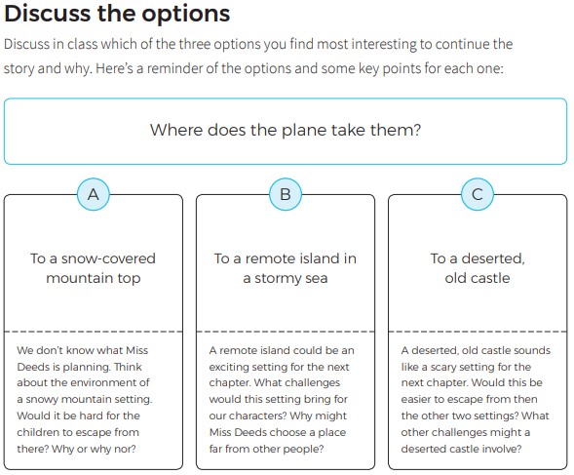
To make a prediction
First, discuss the questions presented here for each option. Then write a response to the question, ‘What happens next?’
E.g.:
I predict that Miss Deeds will take them to a remote island, because she wants to do whatever she wants, without being seen by other people. This setting is surrounded by sea, so harder to get to, for any potential rescuers. It would force the characters to be more resourceful, and there may be other dangers there, such as cliffs or animals.

Slide 20
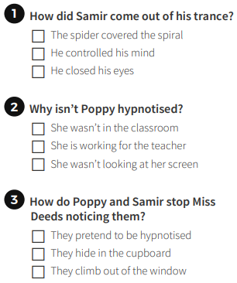
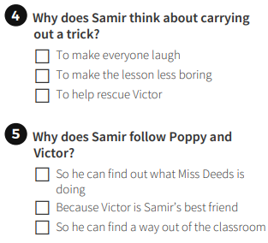
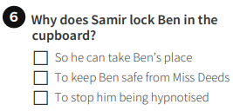
To retrieve and infer answers and draw conclusions.

Slide 21
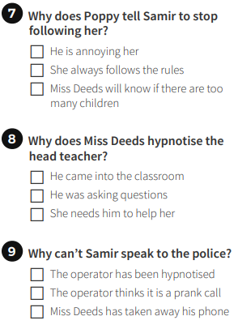
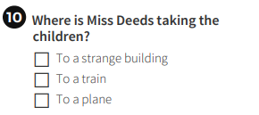
To retrieve and infer answers and draw conclusions.

Slide 22
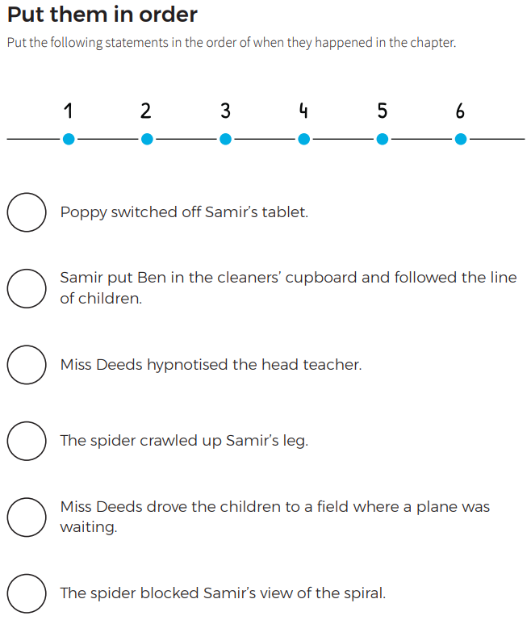
To summarise a text.
Number each statement, then copy out in the correct order in your books.
EXTENSION Activity:
Create a picture storyboard of what each event might look like. Use ideas from these statements and from the text in the chapter to create your storyboard, making sure you have them in the correct order.

Slide 23
PSHE:

