Slide 1
Year 3 Home School Provision Daily Pack- 05/02/21
The following slides will be split into 4 separate activities.
They will consist of Maths, English, Reading and one other subject.
Each slide will be daily activities for you and your child to do at home.
We as a Year 3 team, will update these slides daily to the website – please keep an eye out!
Please email NJS.Year3@taw.org.uk with any queries to share any work and one of the Year 3 teachers will get back to you as soon as possible!
Thank you for your understanding and on going support during these times.

Slide 2
TTRS Challenge!
Today I have started a Year 3 class challenge for TTRS. Please login and give your class the chance to win! It will run until next Friday.
Good luck!
Regards,
Mr B

Slide 4
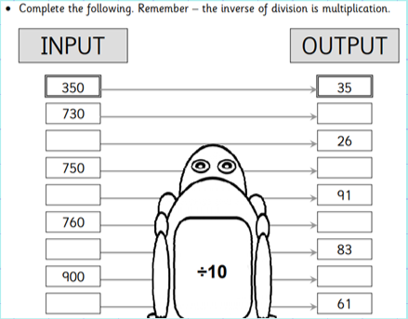
Maths
To solve problems involving fractions and explain my reasoning where necessary
Introduction

Slide 5
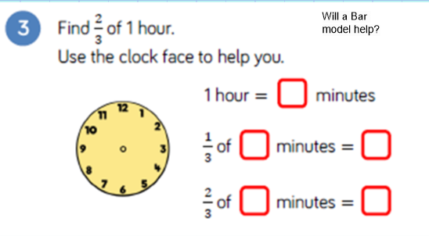

Slide 6
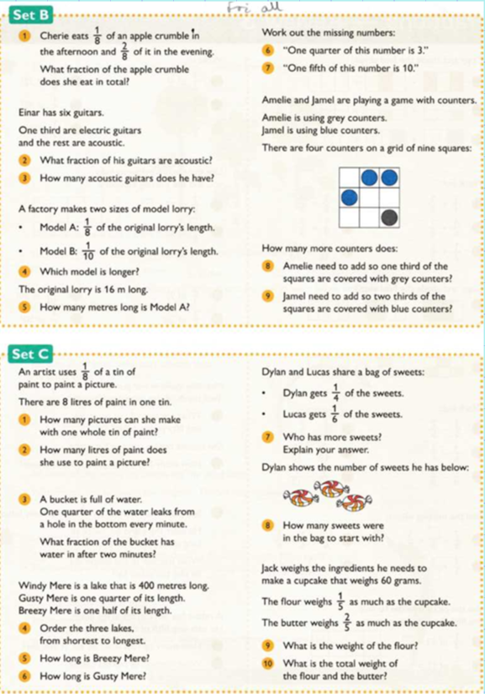

Slide 7
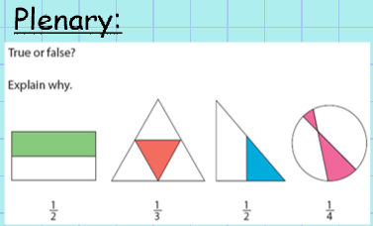
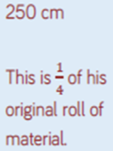

Slide 8
English - To edit your own work to improve it for the reader.

Slide 10
Could we use another exciting adjective to describe the car?

Slide 11
Today’s task:
Look at your diary writing from the three days this week.
Use a green pen (or any colour!) to edit your work and try to improve it.
Consider these things:
Spelling (use a dictionary to check)
Synonyms for words (thesaurus)
Was your writing correctly punctuated?
Check tense of writing
Did you include adjectives?
Did you include adverbs?
Did you use time openers?
Today you are going to be the teacher!

Slide 12
Reading
Reading
To make a prediction, retrieve information, infer conclusions and explain my ideas.
Reread Chapter 2 of ‘Takeover’. CHALLENGE:
Try to practice good use of expression when you say the dialogue of the characters. Give them different ‘voices’. Can you make Miss Deeds sound ‘evil’?

Slide 19
Now it’s time for some activities…

Slide 20
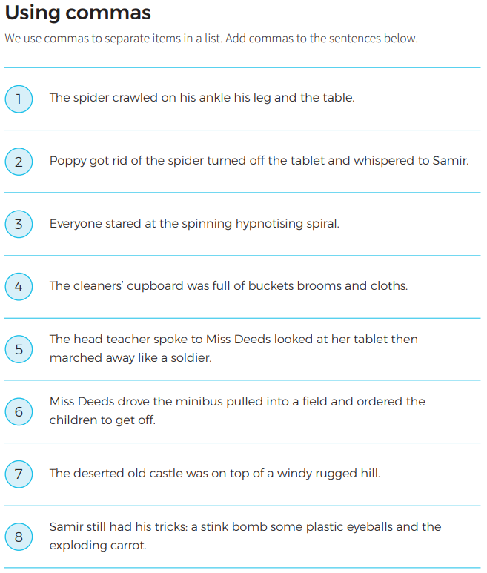
Copy the sentence out into your book and try to put the correct comma punctuation in.
Remember: items in a list are separated with a comma.
There is NO comma before the final item, which usually has the word ‘and’ before it.
E.G.:
Poppy wore her jeans, some socks, a jumper and her wellies.

Slide 21
EXTENSION: complete the challenges below.

Slide 22
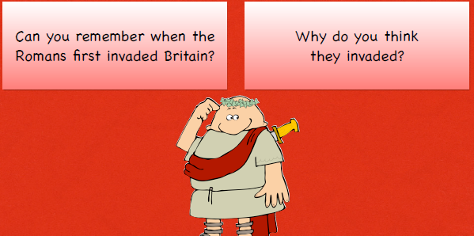
Topic: To find out how and why the Romans invaded Britain.

Slide 23
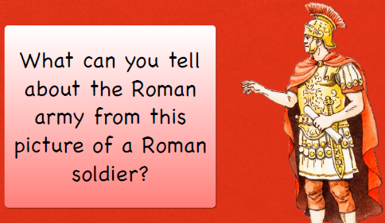
1
3
2
4

Slide 24
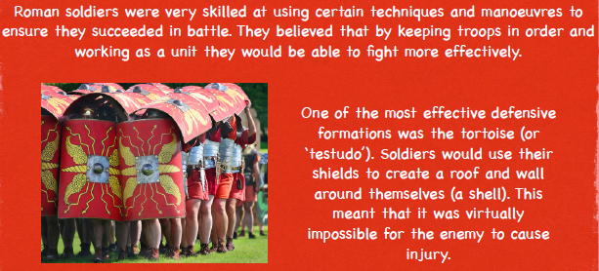

Slide 25
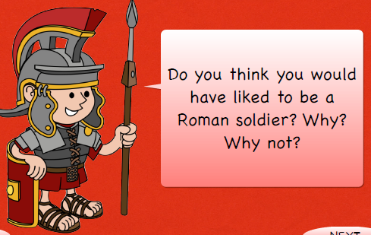
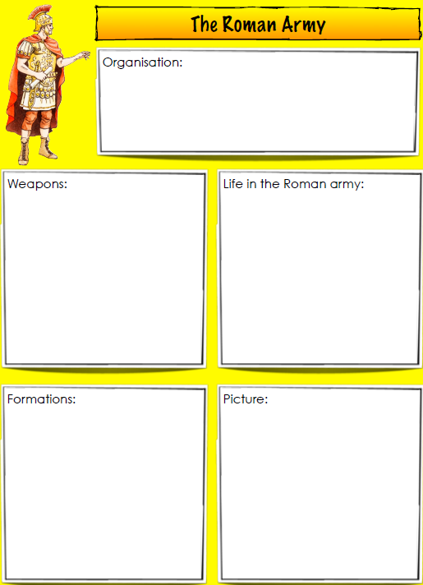
Task:
Complete the sheet to record all the information you have learnt today.

