Slide 1
Year 3 Home School Provision Daily Pack- 08/02/21
The following slides will be split into 4 separate activities.
They will consist of Maths, English, Reading and one other subject.
Each slide will be daily activities for you and your child to do at home.
We as a Year 3 team, will update these slides daily to the website – please keep an eye out!
Please email NJS.Year3@taw.org.uk with any queries to share any work and one of the Year 3 teachers will get back to you as soon as possible!
Thank you for your understanding and on going support during these times.

Slide 2
Maths
To subtract fractions with the same denominator within one whole.
Parent support:
https://www.youtube.com/watch?v=VTCOHFJOAA8

Slide 3
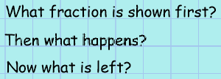
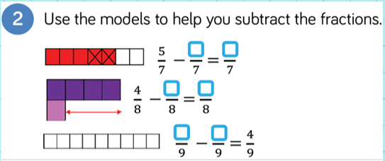
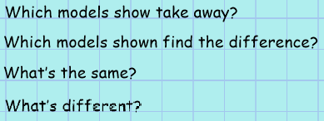

Slide 4
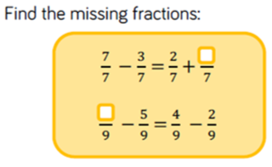
Look at the fraction sums in the red brackets. They are separated by an equals sign. That means that the red brackets on the left have to have the SAME answer as the right side. Work out the left side first and it will help you find the answer to the right.
Do the same for this question but work out the fraction sum on the right to help you work out the fraction sum on the left.

Slide 5
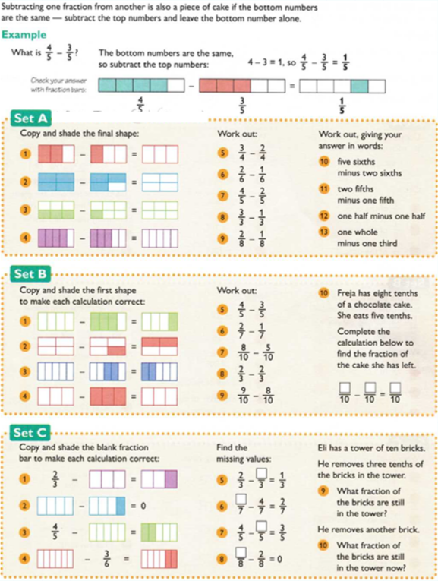
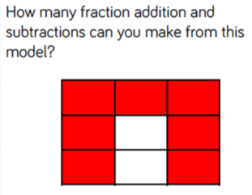
Set A – 1*
Set B – 2*
Set C – 3*
Plenary:

Slide 6
Don’t forget to log onto TTRS today!
Enjoy Rockstars!

Slide 7
English -SPaG lesson- To know when to use ‘a’ or ‘an’.

Slide 8
Did you get all of these?

Slide 9
Apple
Umbrella
Laptop
Egg
Jumper
Otter
Icicle
Teacher
Yoghurt
Book

Slide 14
There are some exceptions though…

Slide 15
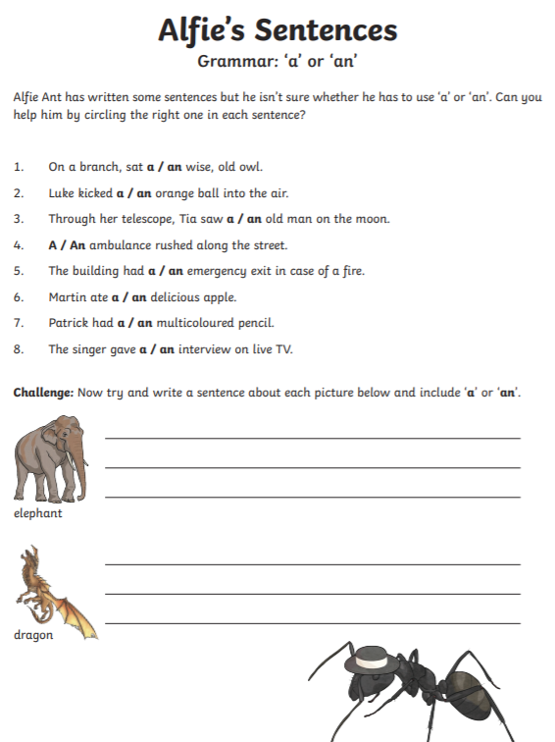
Task 1:

Slide 16
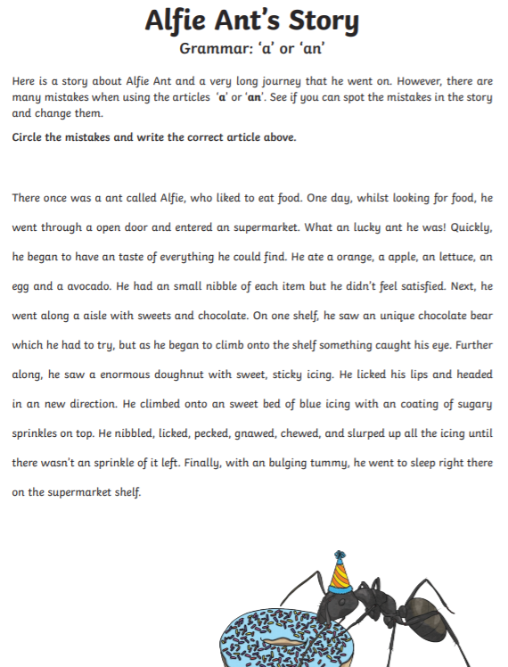
Task 2:

Slide 17
Reading –
To retrieve and explain information from a text.
To infer and predict and explain answers, using the text to support my ideas.
The short extracts on the following pages have several questions each, based on the Reading VIPERS topic areas (Vocabulary, Inference, Prediction, Explanation, Retrieval and Summarising).
Read the texts, taking no more than a minute or so to do this, and then answer the questions about the text, thinking about which type of reading VIPER you are answering.
The following page explains in some more detail what the reading VIPERS are about. Try to use these when reading with your child. These are suggestions, not requirements! Please use them as you see fit.
NB:- As with last week’s work, answers are provided, but no peeping until you have attempted the questions yourself!!
1* - two comprehensions 2** - any three comprehensions 3*** - all four comprehensions

Slide 18
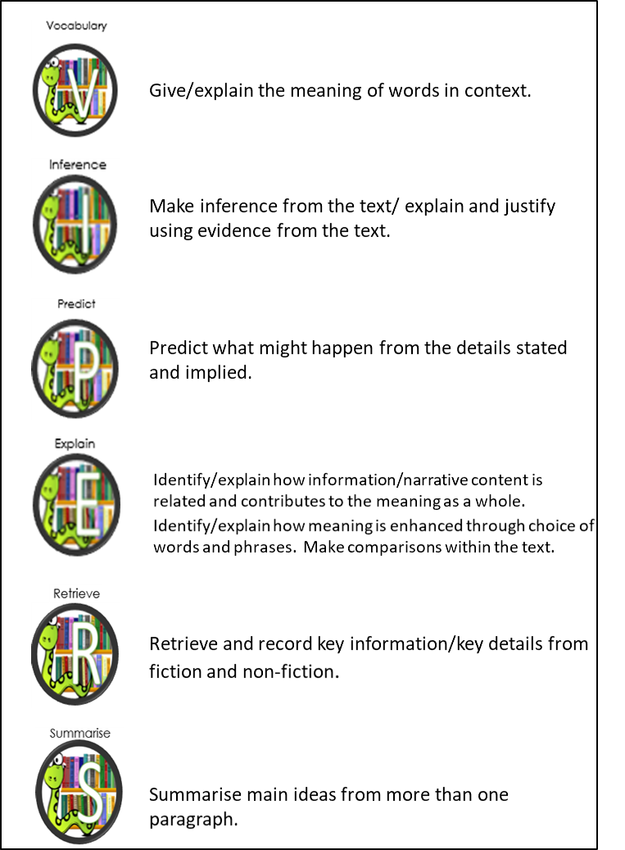
VIPERS
EXAMPLE QUESTIONS
Hunt for clues in the text, try missing the word out and then reading ‘around’ the word. What do words mean? What does this word tell you about the main character?
Working out what isn’t said directly in the text. E.g.: ‘He shivered and the hairs on his neck stood up.’ Is this person cold, or afraid? How do you know? What voice might these characters use? What did the author want us to feel like here?
Read the text and try to make an ‘educated’ guess about what will happen in the next chapter, paragraph, book etc.
What does this paragraph suggest will happen next? Where will the main character go? How do you know?
How does the author engage the reader? What is the purpose of this text feature? What is the author’s point of view? Why is the text organised in this way?
When was the story written? Who afre the main characters? What genre of writing is this? When did the main event happen? Find 2 facts about the main character.
Can you number these events in the order they happened? Summarise the beginning / middle / and end of the story. What would you call this chapter if you had to name it? Why?

Slide 23
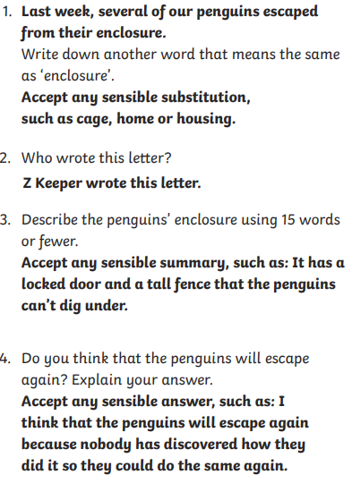
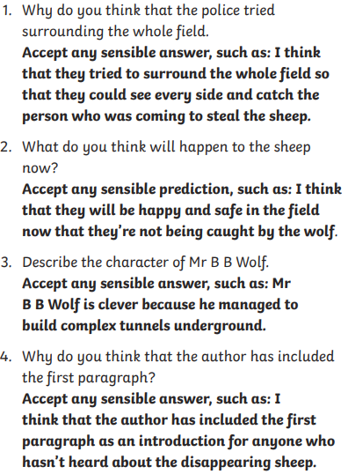
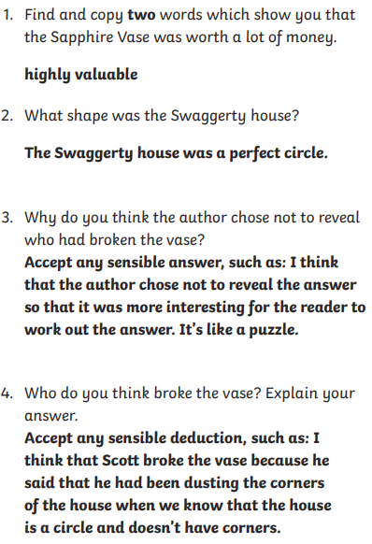
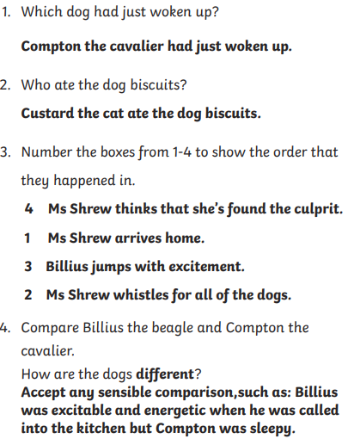

Slide 24
Topic: I can explain what Roman Baths were and know about the different amenities they contained.

Slide 28
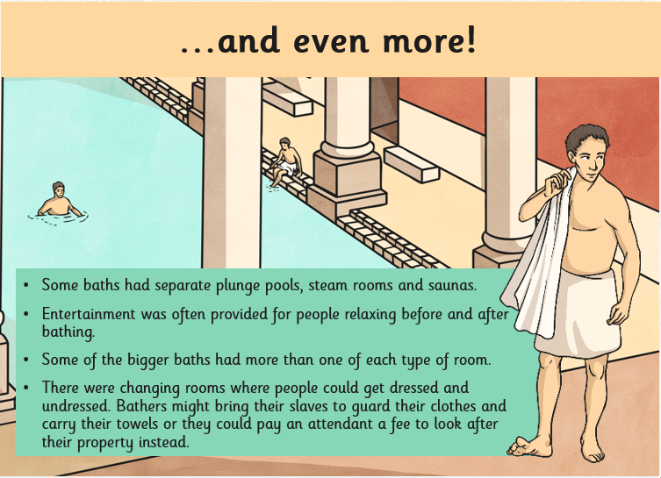

Slide 29
Answer the questions below. Don’t forget to use full sentences using some of the words from the question!

Slide 30
The next few pages give you templates and ideas to copy out, print out, or just for ideas for your own designs.

Slide 32
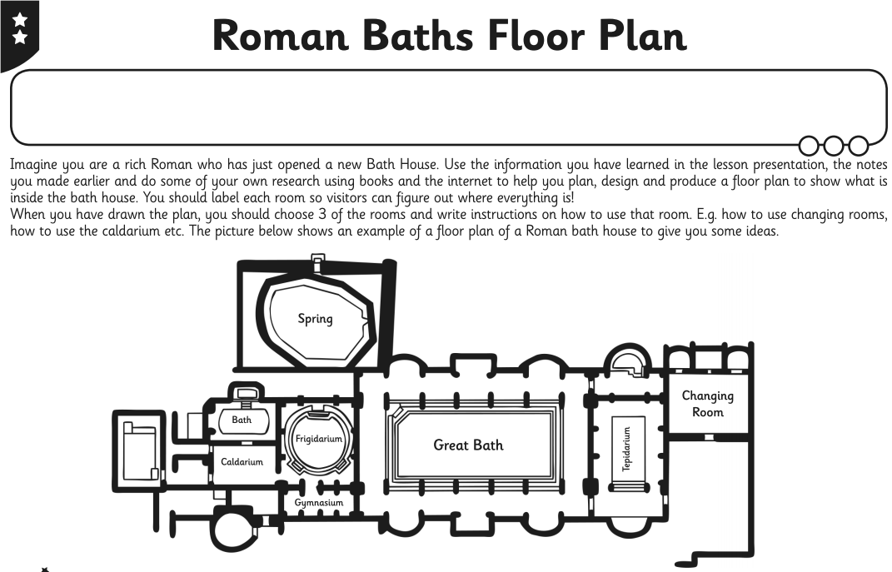

Slide 33
