Slide 1
Year 3 Home School Provision Daily Pack- 09/02/21
The following slides will be split into 4 separate activities.
They will consist of Maths, English, Reading and one other subject.
Each slide will be daily activities for you and your child to do at home.
We as a Year 3 team, will update these slides daily to the website – please keep an eye out!
Please email NJS.Year3@taw.org.uk with any queries to share any work and one of the Year 3 teachers will get back to you as soon as possible!
Thank you for your understanding and on going support during these times.

Slide 2
Safer Internet Day 2021
Today is Safer Internet Day 2021 (SID21). The theme this year is about trust, and whether you can trust everything you read on the Internet. You have a choice of 2 activities today. Complete one, or both activities.
Please see the slide presentation materials on a separate link to this PowerPoint, on the Year 3 News part of the school website. You can contact us on the NJS.Year3@taw.org.uk email, if you have not received the link to the resources along with your usual Home learning Pack email, or cannot find the link on the website.
On the following slides are several E-Safety SID21 activities relating to the theme of ‘Trust’. You can choose to complete these as well, or just do the ones mentioned above.
When you open the powerpoint, please run it in presentation mode (slideshow mode), so that the slide transitions, links and animations within it work effectively.

Slide 3
What websites/apps do you trust to give you accurate information? Why?
Have you ever seen anything online that was untrue?
How do you decide if something is untrue or fake online?
How do you decide if an online source of information or website is trustworthy or not?

Slide 4
Watch the video carefully. Then answer the questions on the next slide. Pause the video at 2 seconds. What do you notice about the first letters of each line?

Slide 5
Now discuss the meerkat facts – which do you believe are true and which do you believe are false? Can you explain how you know which facts are true or false?
Answers:
True
False
False
True

Slide 6
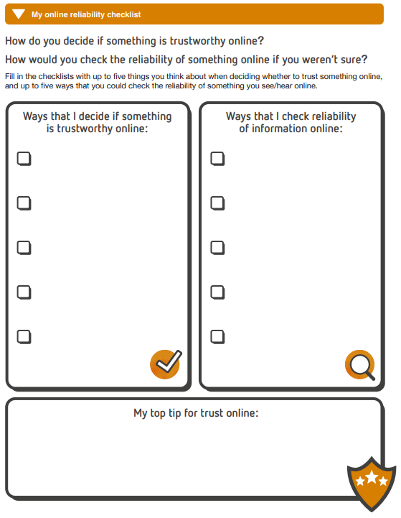
When evaluating information presented on a website, you might consider some or all of the following:
Who created the information.
The reputation of the creator (with regards to being trustworthy).
The quality of the information (with regards to spelling/grammar/overall presentation).
How up to date the information is.
Whether the information is based on fact or opinion.
The possible motives (reasons) behind the creation and sharing of this information (e.g. what does the creator want you to do as a result of learning this?).

Slide 7
(Larger - for printing out)
Complete the list for how you decide whether a website is trustworthy (all children) and reliable (2**/3*** only)

Slide 8
EXTENSION
work:
Discuss the scenarios above with a trusted adult in your household. What should you do in each scenario. Talk about how you feel about each scenario. Now write a short letter of advice to the person in each scenario, explaining what you would do.

Slide 9
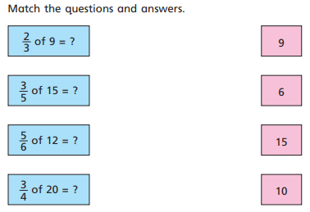
Maths
To find fractions of amounts.
Introduction
Parent Support:
https://www.youtube.com/watch?v=E2QvVicQcMo

Slide 10
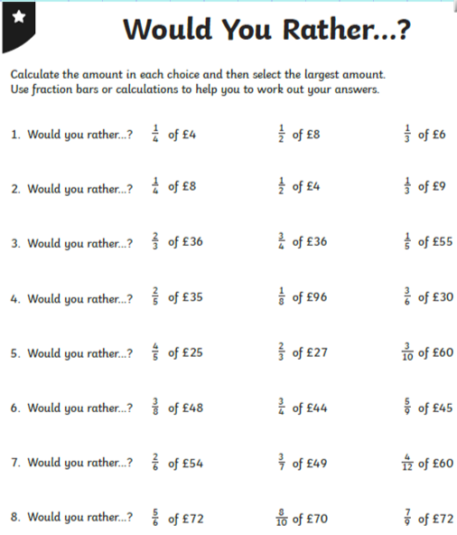
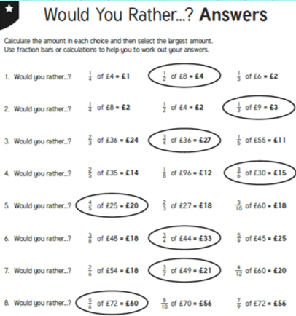
1*

Slide 11
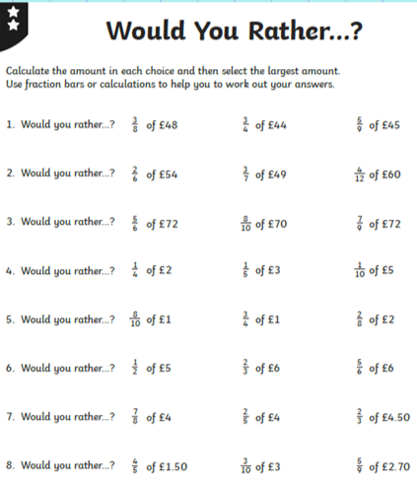
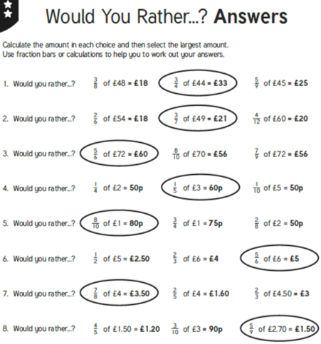
2*

Slide 12
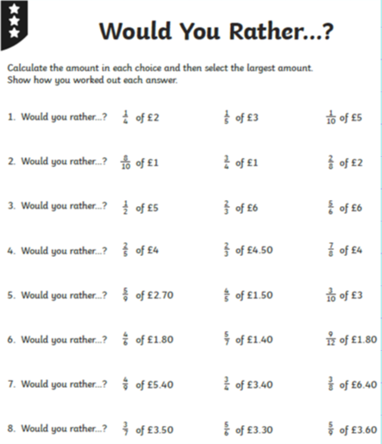
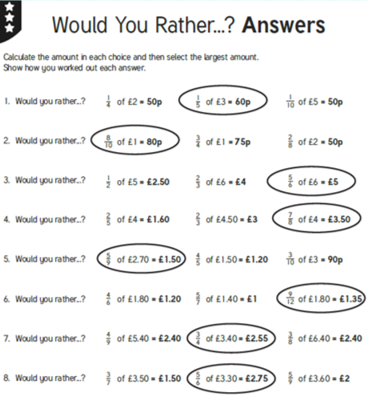
3*

Slide 13
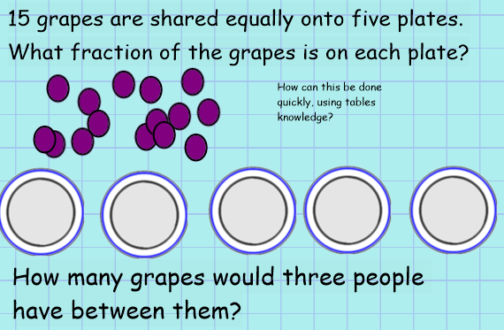
Plenary:

Slide 14
English -To create a ‘Safer Internet Day’ poster

Slide 15
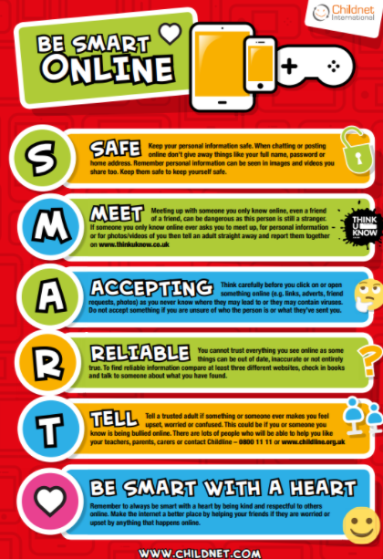
What things can you include in your poster to keep people safe online?
Pictures
Title
Subtitles
Rules

Slide 16
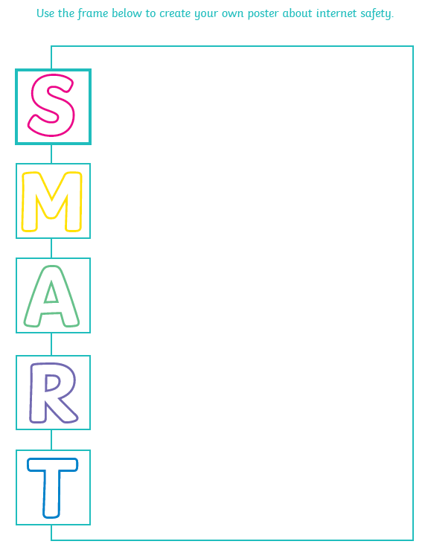
You can use these poster templates or create your own!

Slide 18
Reading
Today’s reading activity is somewhat shorter, to allow extra time to complete Safer Internet Day activities, and screen-free day activities.
Valentine’s Day is fast approaching, so what follows is a little history of the day, and a look at the traditions around the world associated with this day.
All children should try to complete all the reading comprehensions today.

Slide 19
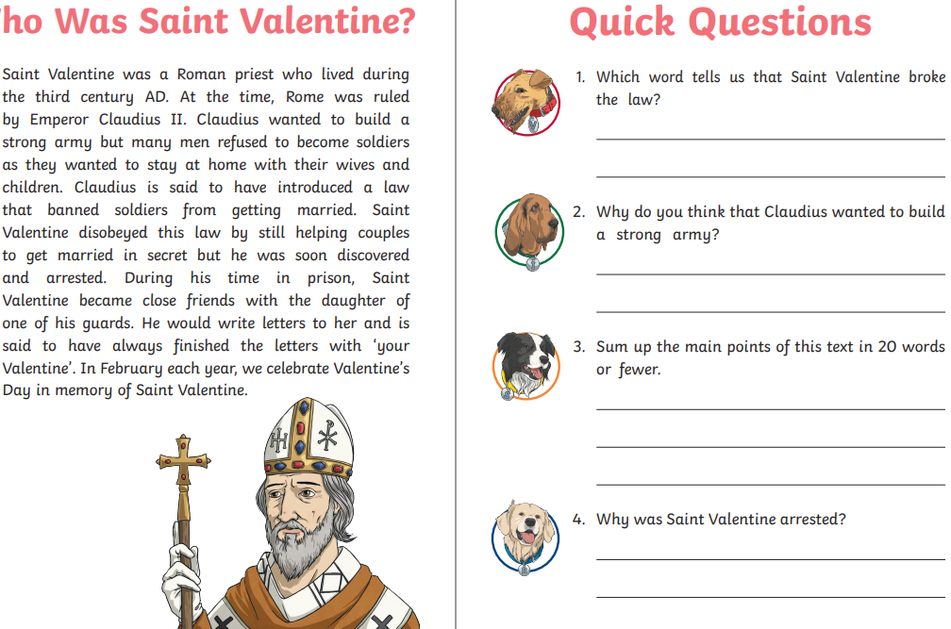
Reading – To infer, predict, summarise and explain ideas from a text.

Slide 21
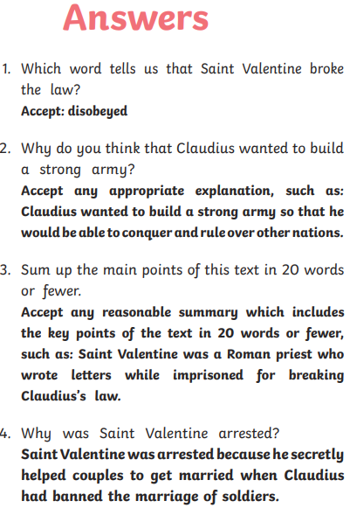
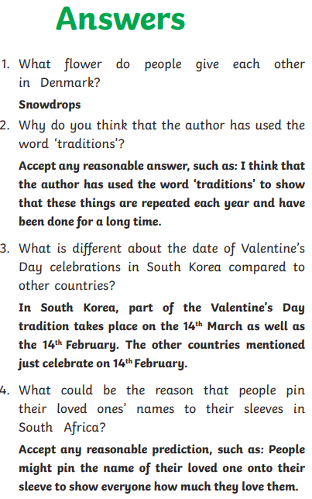

Slide 22
PSHE: (hopefully screen free!)

Slide 23
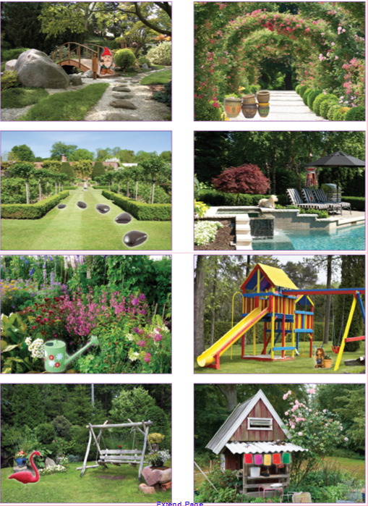
Look at the images of the gardens.
Write down as many items that are decorations for the garden. For example: lanterns, decorated pots, gnomes, painted stones, bug sticks.
How many can you find?

Slide 24
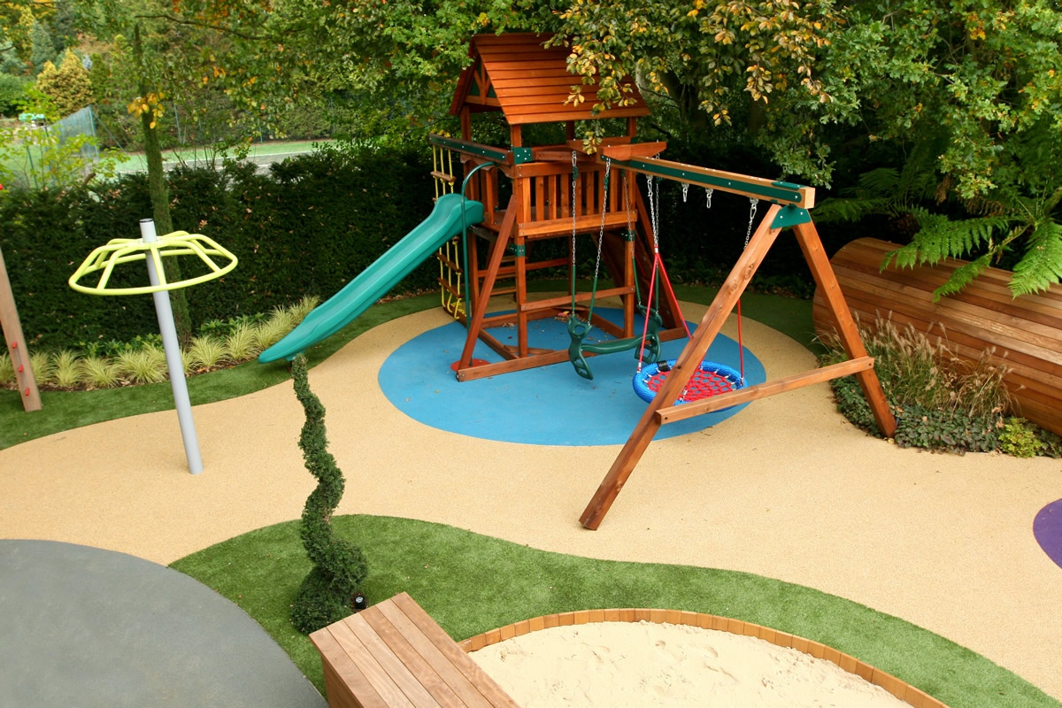
We are going to design a garden for people who face a particular challenge.
Can you think of some examples (eg. Someone who might be disabled, someone who might need a walking support, someone who is in hospital and need an outdoor space, children who live in a place without a safe, green space, elderly people, people who live in flats etc).
You will start your garden design
and come back to it next week.
You need to:
Choose who the garden is for
Design the garden and make a
poster showing the design
Plan an opening event for the
garden opening
You should be able to do this without the use of a
screen! Draw it in your book, colour it and have
some time without a computer or screen.

Slide 25
Screen free activities to try…
The following links should take you to some pages with ideas for screen free activities. Obviously, you have to actually look at a screen to find out what they are, but once done, put away the device and enjoy! Pictures of your screen-free activities are actively encouraged - please show us what you’ve been up to!
11 Screen free activities to do with the kids | Free Time with the Kids
Screen-free boredom busters | No screen activity ideas for kids | TheSchoolRun

Slide 26
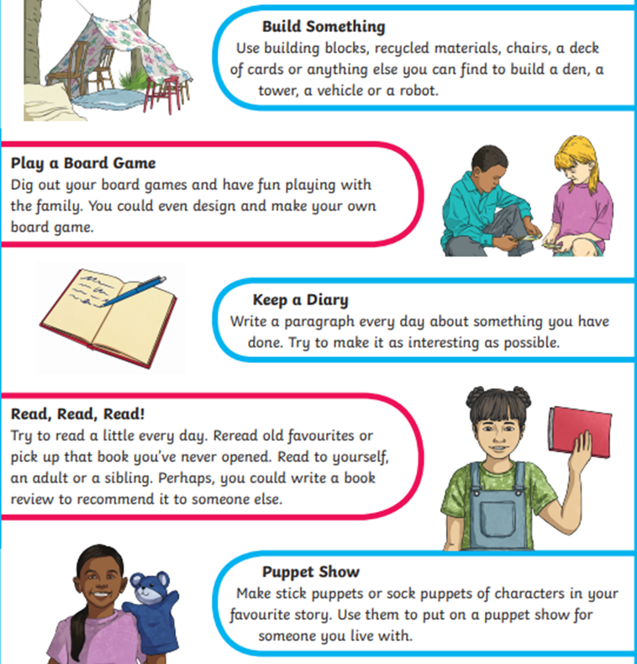
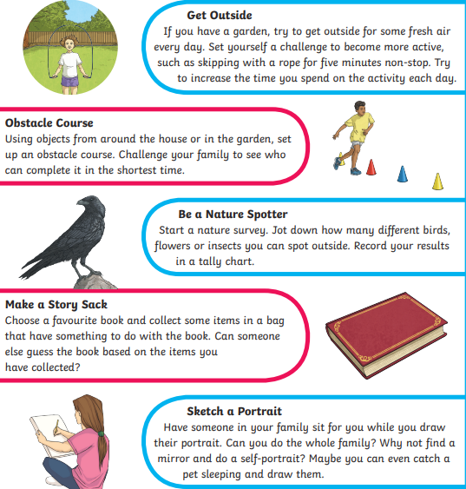

Slide 27
