Slide 1
Year 3 Home School Provision Daily Pack- 10/02/21
The following slides will be split into 4 separate activities.
They will consist of Maths, English, Reading and one other subject.
Each slide will be daily activities for you and your child to do at home.
We as a Year 3 team, will update these slides daily to the website – please keep an eye out!
Please email NJS.Year3@taw.org.uk with any queries to share any work and one of the Year 3 teachers will get back to you as soon as possible!
Thank you for your understanding and on going support during these times.

Slide 2
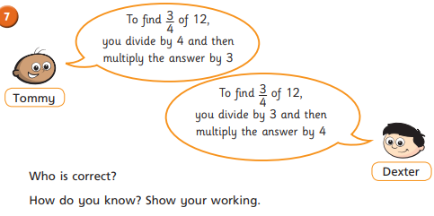
Maths
To solve multistep word problems involving fractions.
Introduction
What do you think?

Slide 3
Steps to solve a word problem:
Read the question
Re-read the question
Highlight/underline the important information
Decide what operation you will need
Solve the problem
Write a sentence to explain

Slide 4
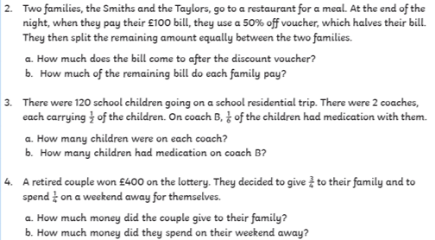
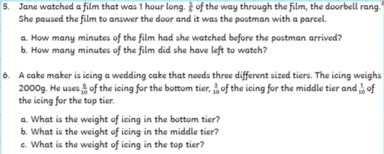
Steps to solve a word problem:
Read the question
Re-read the question
Highlight/underline the important information
Decide what operation you will need
Solve the problem
Write a sentence to explain

Slide 5
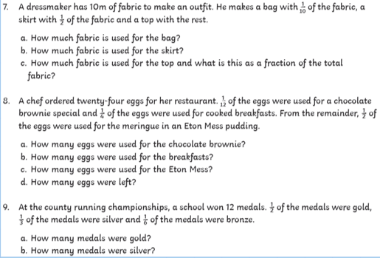
Steps to solve a word problem:
Read the question
Re-read the question
Highlight/underline the important information
Decide what operation you will need
Solve the problem
Write a sentence to explain

Slide 6
Plenary:
N2T:
One thing I have learnt this lesson is…
One thing I still find tricky is…

Slide 7
English- SPaG Lesson Subordinate Clauses

Slide 10
Answers!

Slide 12
Answers!

Slide 13
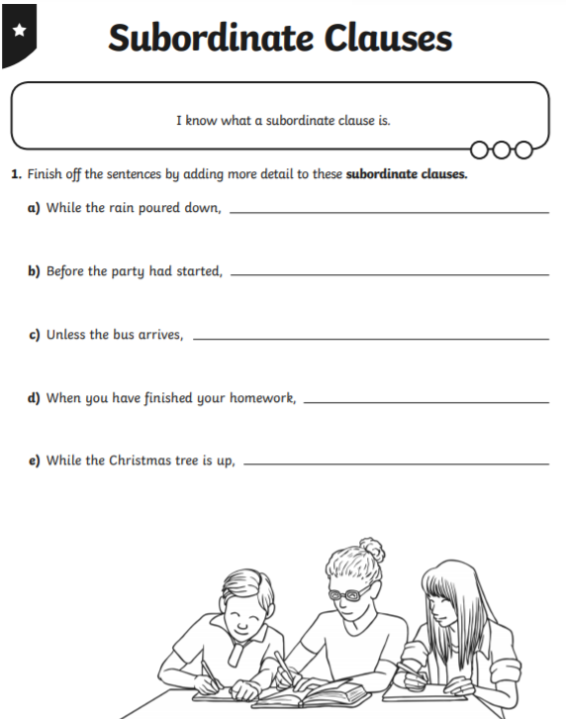
Task: Complete this 1*/2* worksheet on Subordinate Clauses.

Slide 14
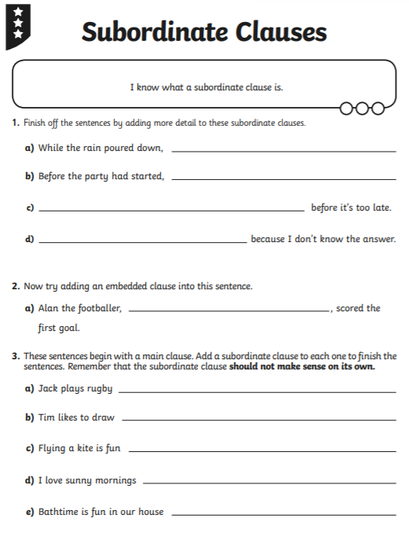
Try this 3* worksheet:

Slide 15
Reading – Online Lesson
To make a prediction, using the text to support my ideas.
To retrieve information, infer conclusions and explain, using the text to support my ideas.
Go to Fiction Express and read Chapter 3 of ‘Takeover’, or read it on the next few slides.

Slide 16
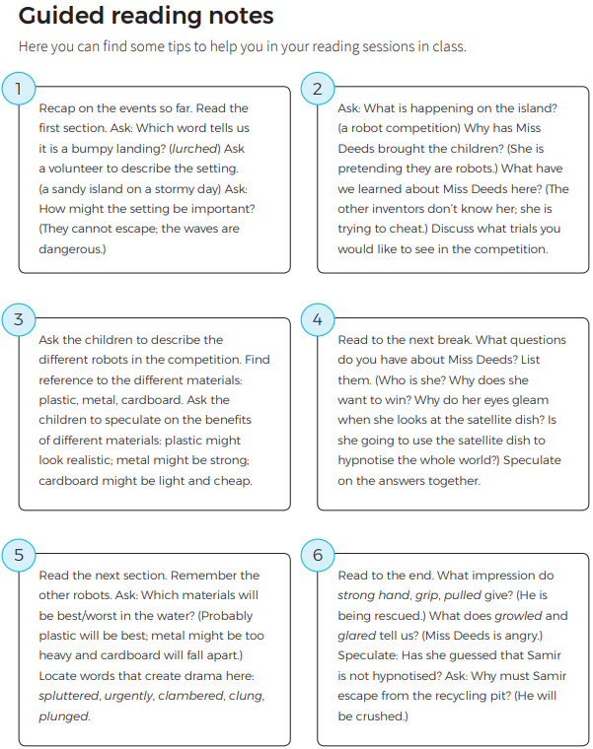
Parents / teachers – Use these to help you question the reader during your session.

Slide 22
Before you vote, make your prediction! See next slide for options.

Slide 23
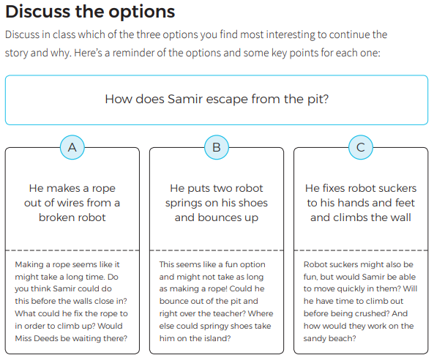
Begin your answer:
I predict that…
…followed by your explanation for you choice.
For example:
I predict option B, that Samir will put two robot springs on his shoes and bounce out of the pit. I think this will be the quickest option, especially as he doesn’t have much time. The only problem is that Miss Deeds might see Samir escape, and then send some other children or ‘robots’ after him. He might be able to get away on the springs, but not for long.

Slide 24
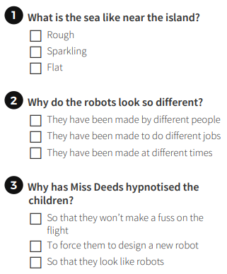
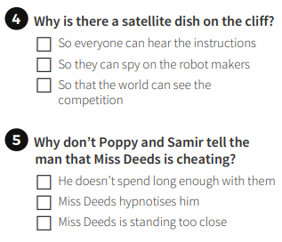
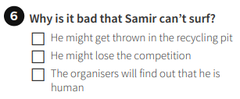
Now complete the online quiz. Remember to read the text to find the answers if you need to.

Slide 25
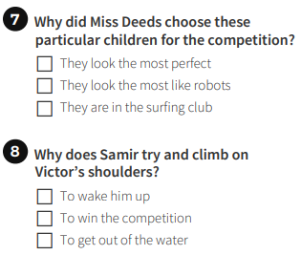
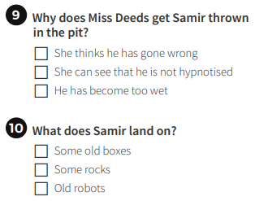
Please login to Fiction Express to find out the answers.

Slide 26
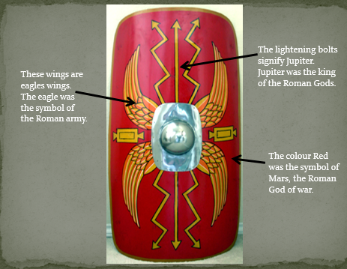
D&T: To research Roman shields and plan my own design.

Slide 29
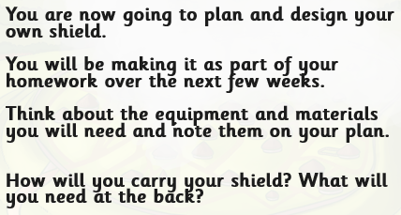

Slide 30
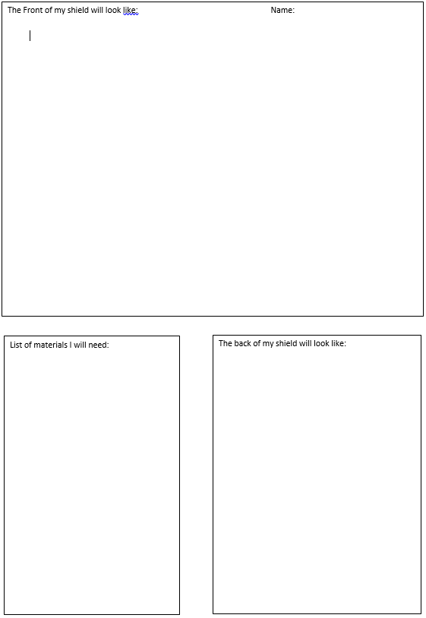
Copy this out into your book and complete your plan.
Don’t forget to label your diagram!

