Slide 1
Year 3 Home School Provision Daily Pack- 11/02/21
Today’s slides have 4 separate activities,
consisting of Maths, English, Reading and one other subject.
Each slide will be daily activities for you and your child to do at home.
We as a Year 3 team, will update these slides daily to the website – please keep an eye out!
Please email NJS.Year3@taw.org.uk with any queries to share any work and one of the Year 3 teachers will get back to you as soon as possible!
Thank you for your understanding and on going support during these times.

Slide 2
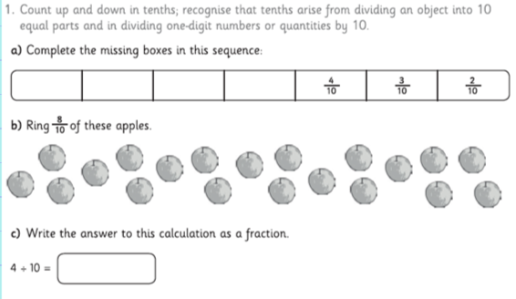
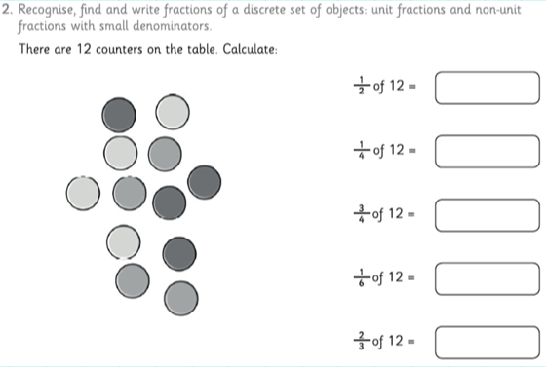
Maths
To solve problems involving fractions.

Slide 3
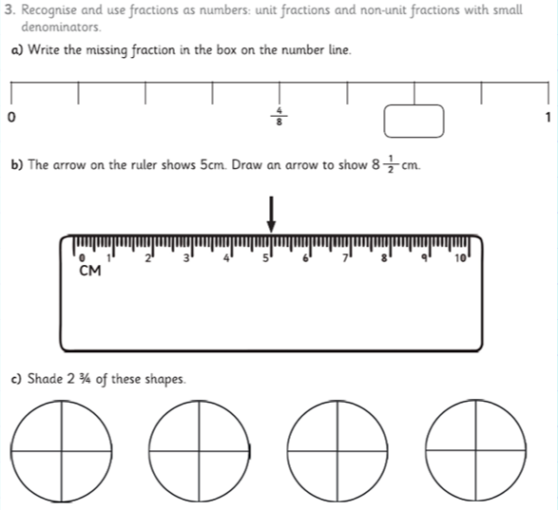
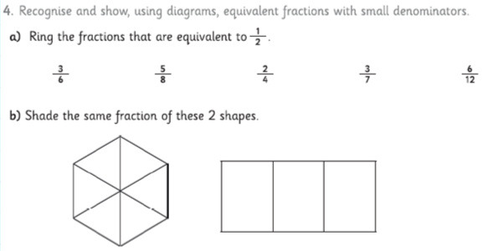

Slide 4
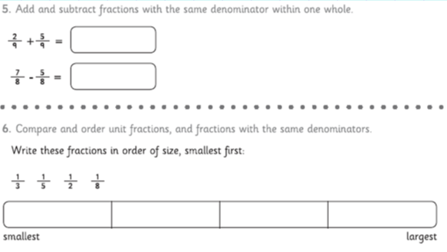
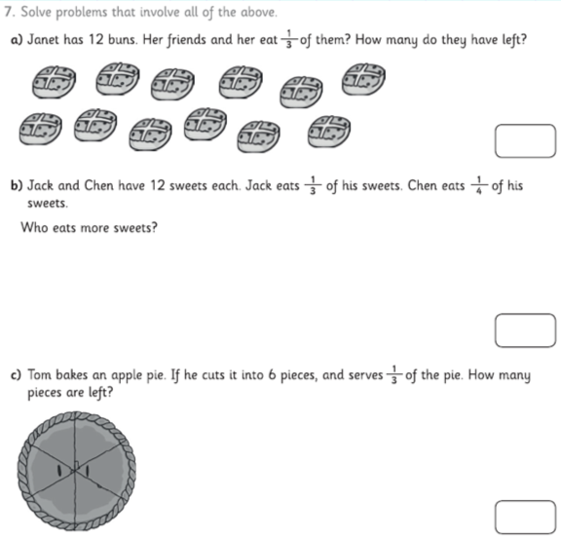

Slide 5
Answers

Slide 6
English

Slide 7
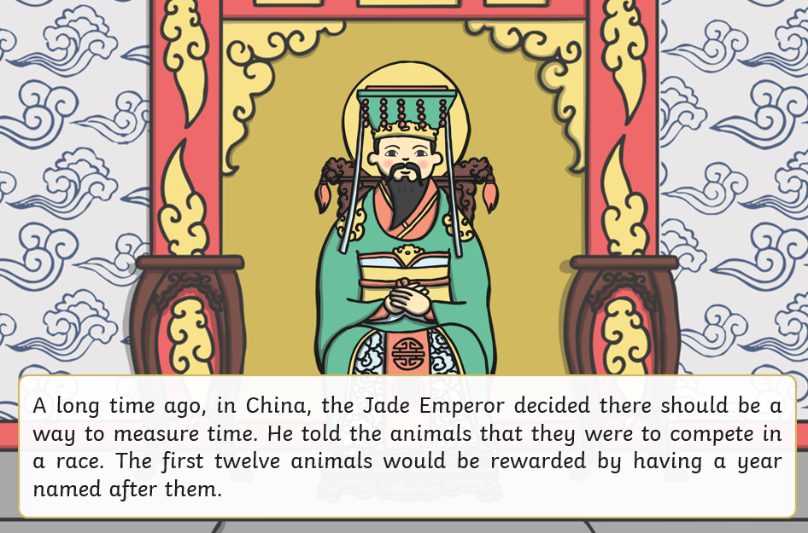
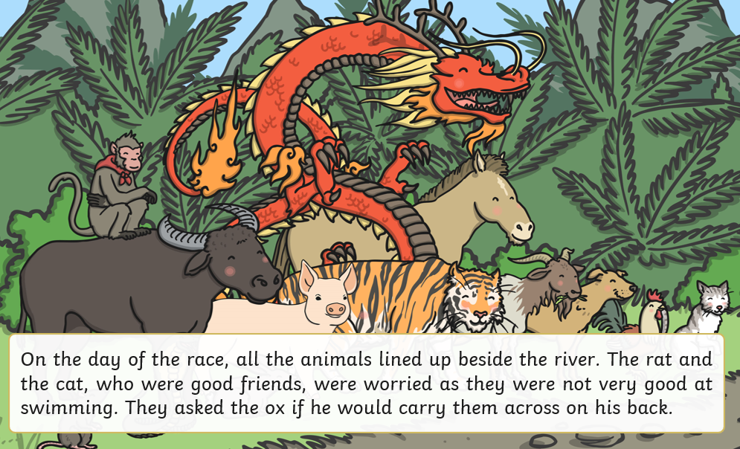
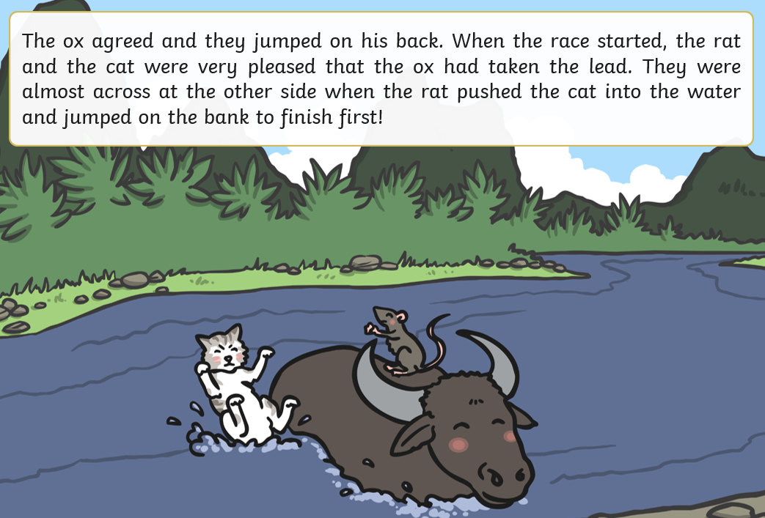
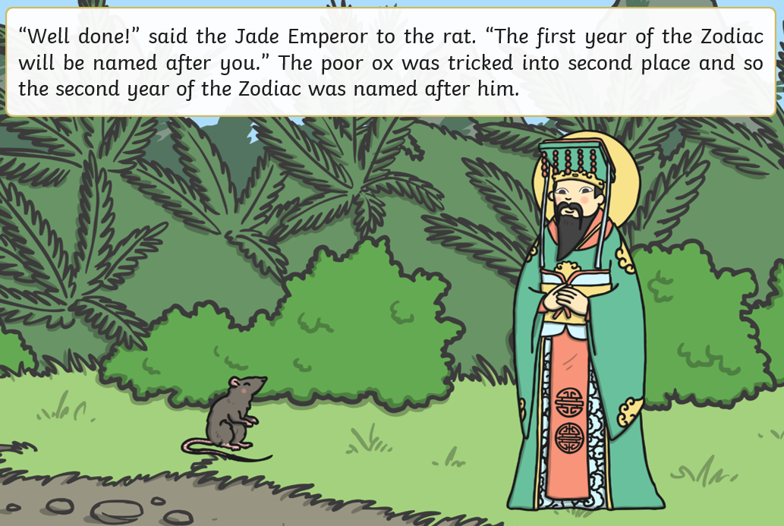

Slide 8
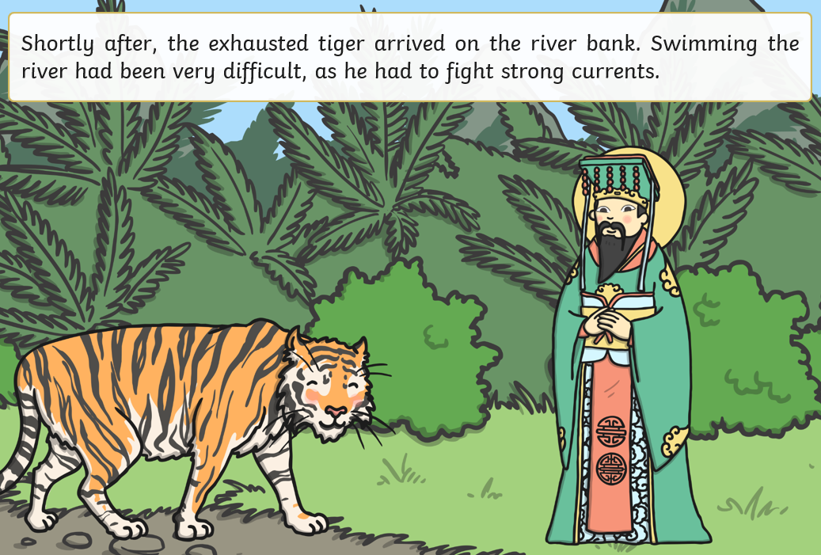
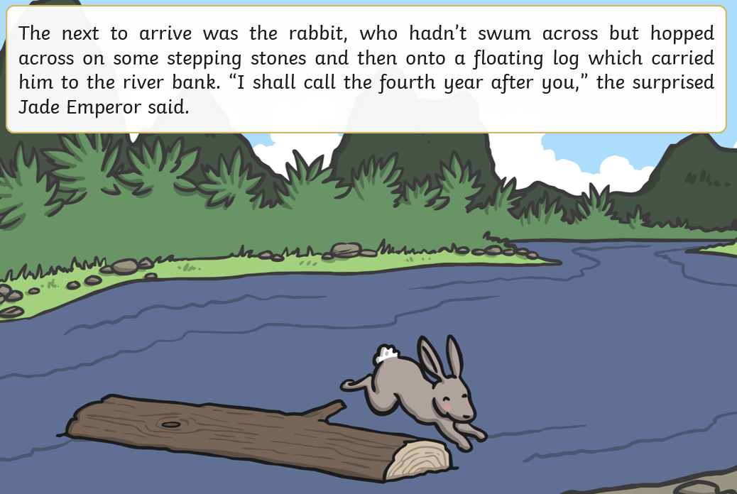
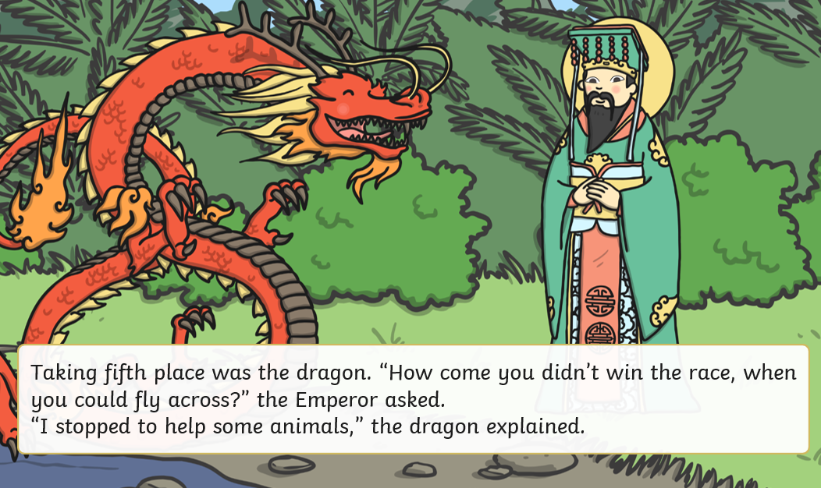
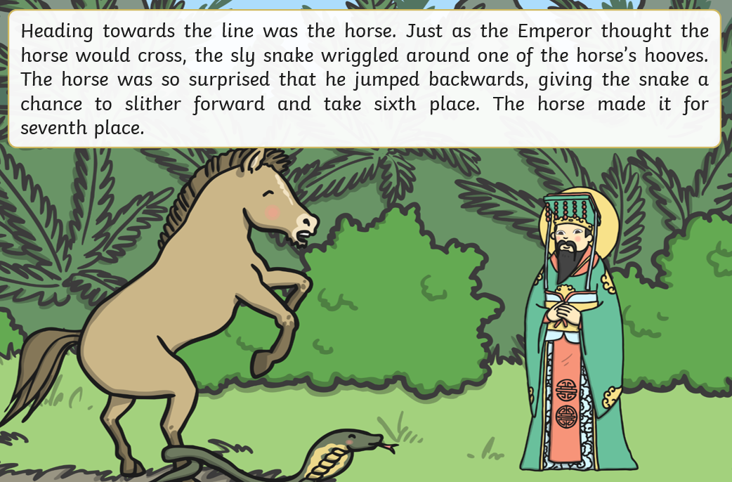

Slide 9
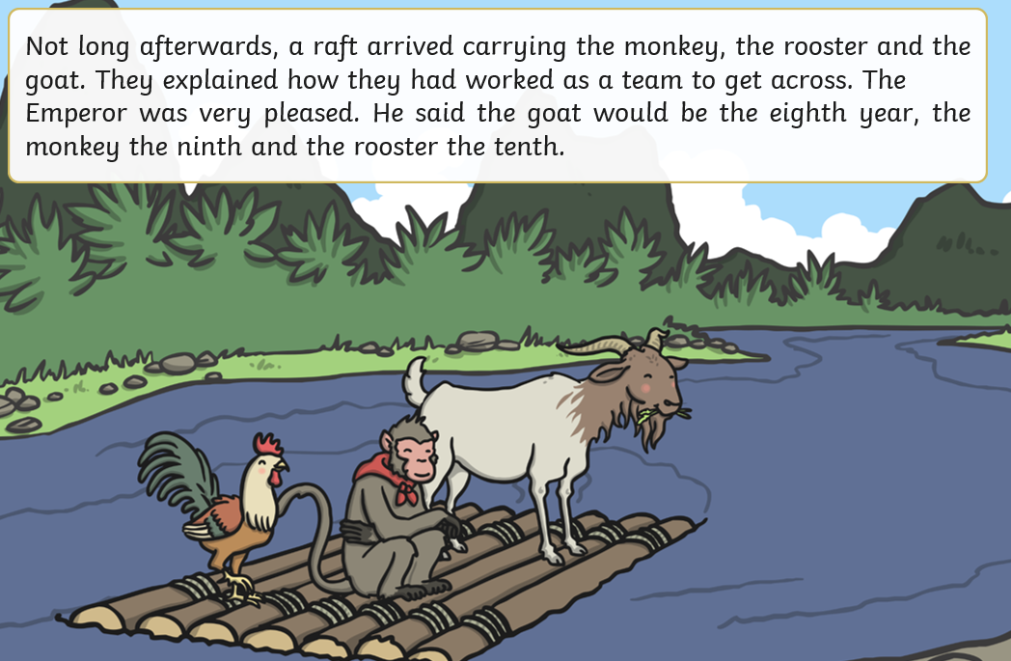
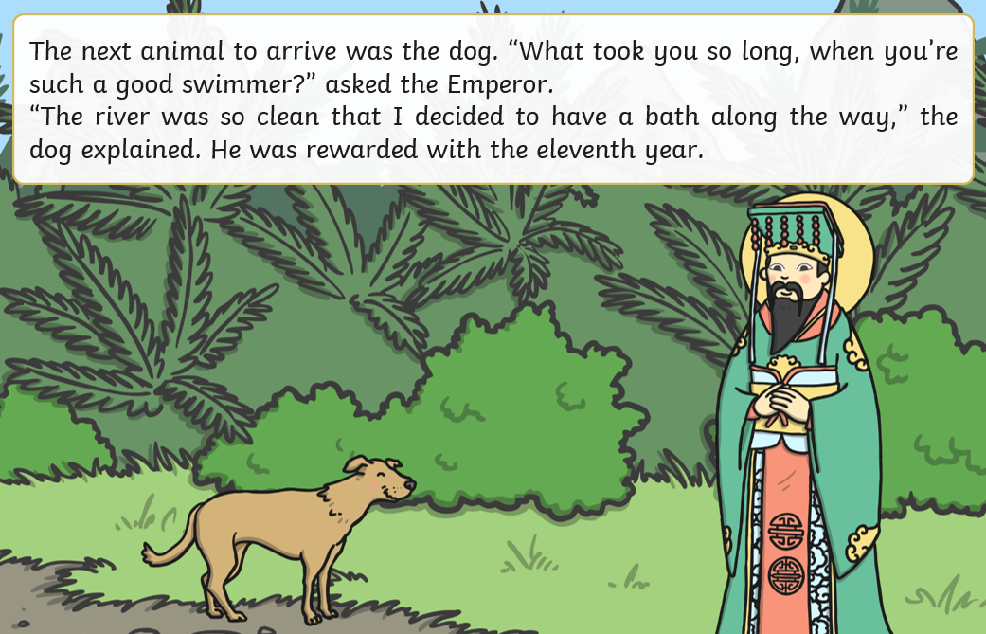
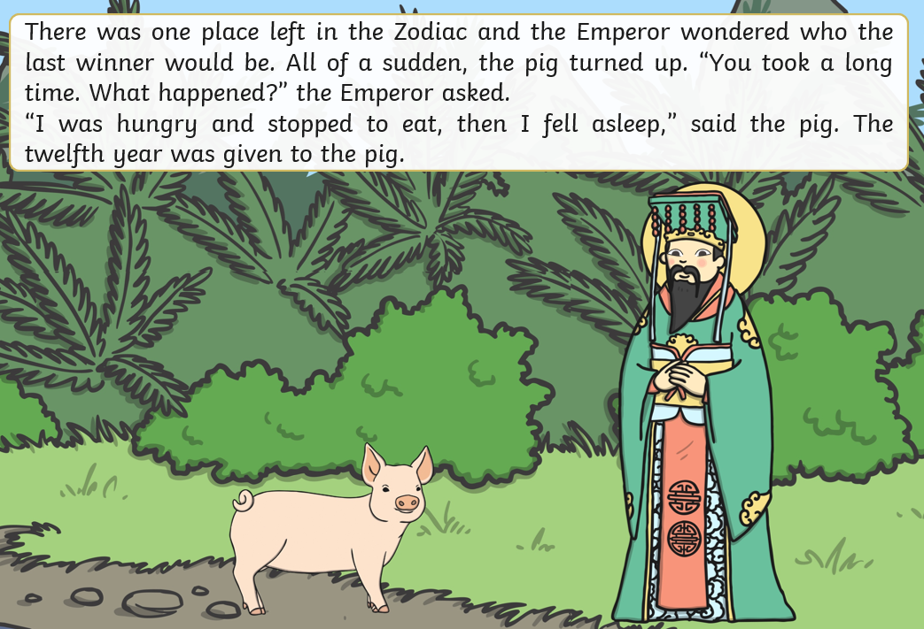
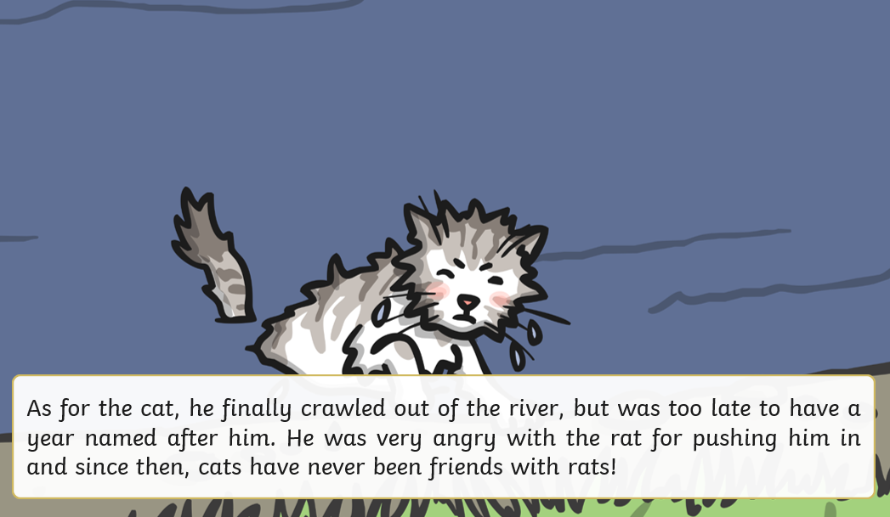

Slide 10
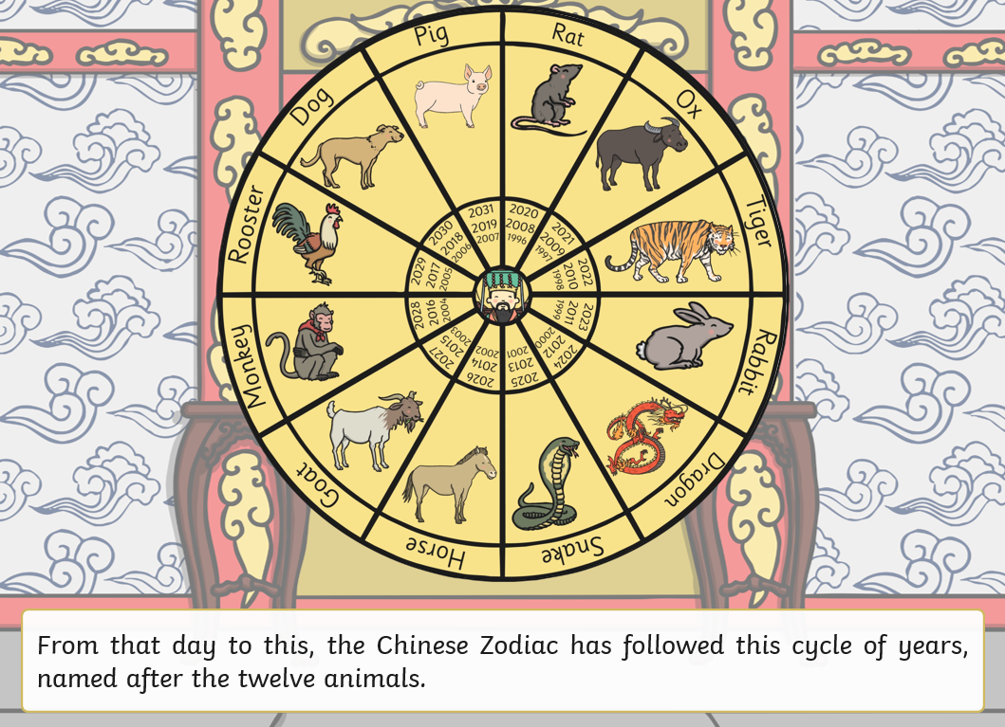

Slide 11
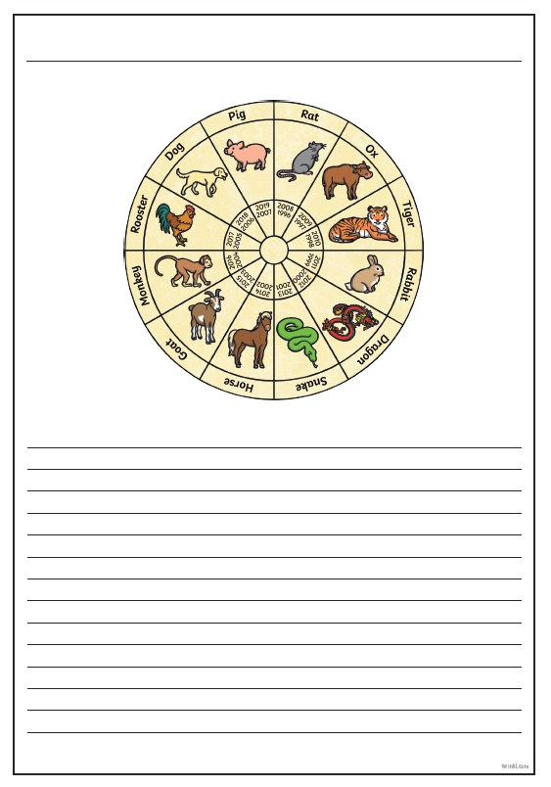
Task: Try to retell the story in your own words. Don’t forget: - Punctuation - Paragraphs - Adjectives - Adverbs

Slide 12
Reading:
To retrieve information, infer conclusions and explain, using the text to support my ideas.
Re-read Chapter 3 of ‘Takeover’, or read it on the next few slides.

Slide 19
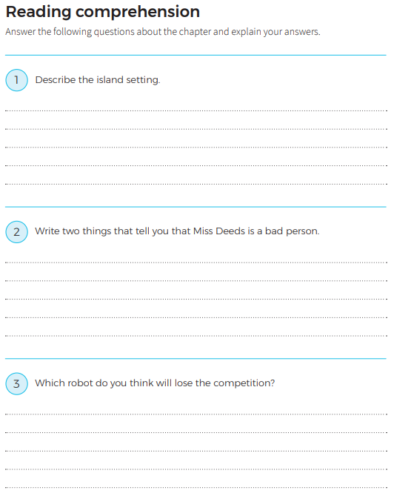
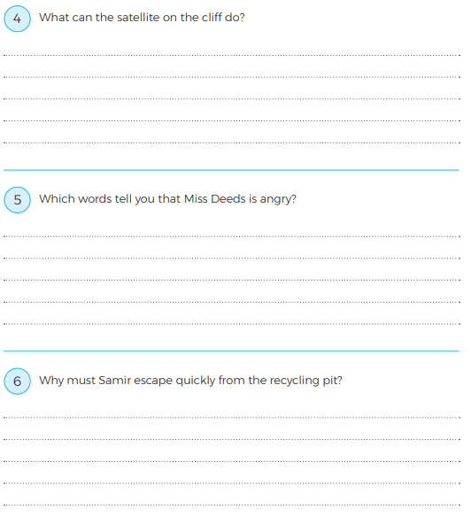

Slide 20
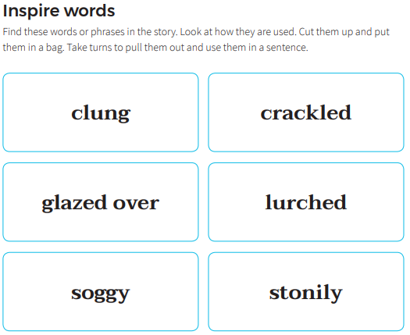
Extension:
Write the next part of the story, using these words in your new part. Look them up if you need to, to find their meanings.

Slide 21
E-Safety Lesson Spring 1st Half term
As well as Safer Internet Day, Children also complete an online safety lesson each half term. This term, we are looking at emails and how to send them safely / respectfully.
To safely send and receive emails.
Look at the following slides with your adult, to try and understand how to send emails safely, and try to understand when it is safe / not safe to open an email.

Slide 22
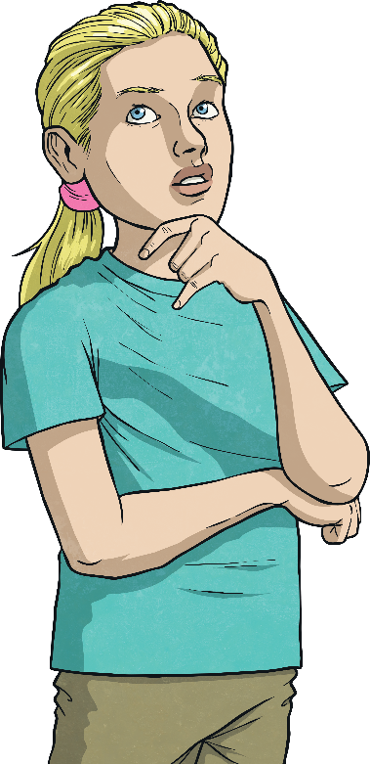
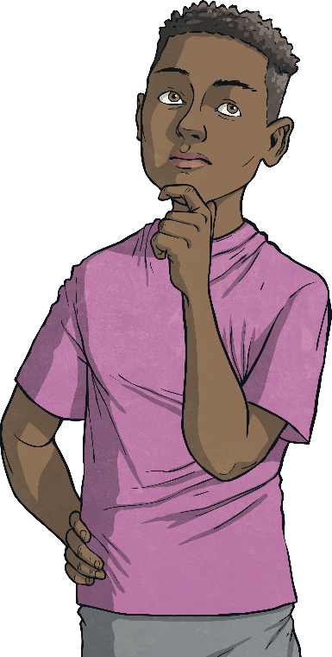
Who Uses Email?
?
Why do we use email?
What is it useful for?
?
?
Most adults now use emails every week or even every day, depending on their jobs.
Emails are quick and easy to write and send.
It is much quicker to communicate with email than with a letter.
With emails, you also have a record of what’s been said, unlike with a phone call.

Slide 23
Is It Safe?
Sit with your group. Discuss and try to answer this question:
Is emailing safe?
Is it always safe to open an email?
What could an email contain?
Is it safer than sending a letter?
Could other people see it?

Slide 24
Stop and Think
There are some basic rules to follow when deciding if an email is safe to open.
If you know the sender and the subject is something that seems normal, it will likely be safe to open.
If it is from a company that you know, the email address looks correct and the subject seems normal, it will likely be safe to open.
!
!
Warning Signs
One or more of these things might mean an email is unsafe to open:
an unknown or strange-looking email address
an email address pretending to be something else (e.g. instead of teacher@twinkl.co.uk, the address might say twin.kl.teacher@net.uk)
spelling mistakes in the subject or a strange subject title

Slide 25
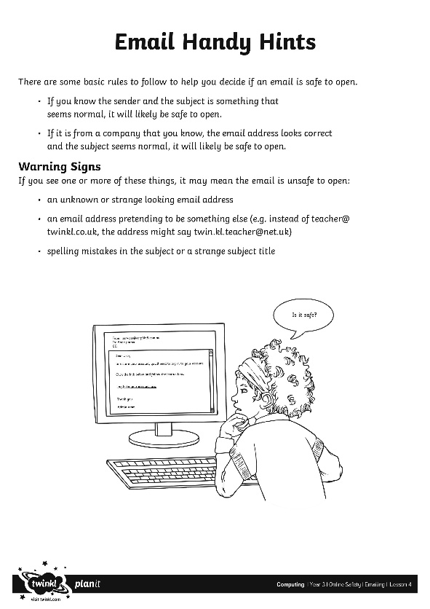
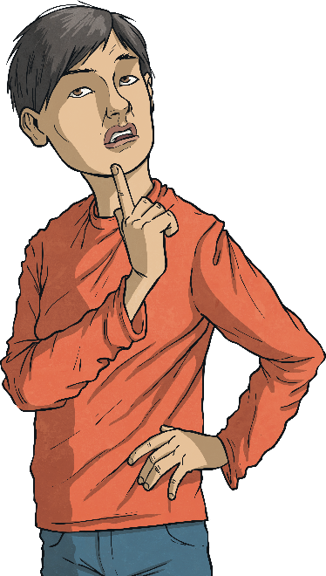
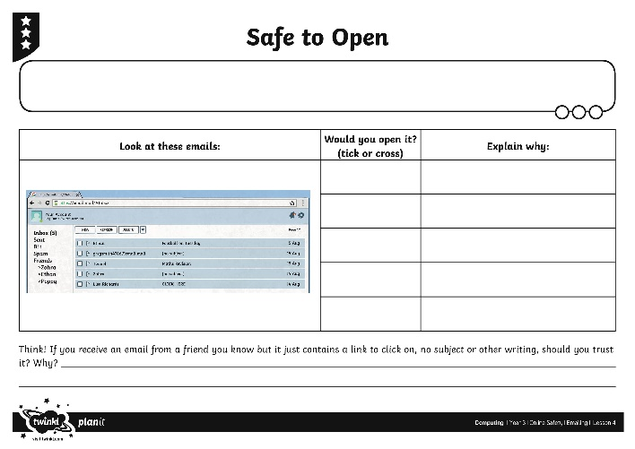
Stop and Think
Use the Safe to Open Activity Sheet and decide if you would open each email and explain why. Use the Email Handy Hints Sheet to help you remember the rules.

Slide 27
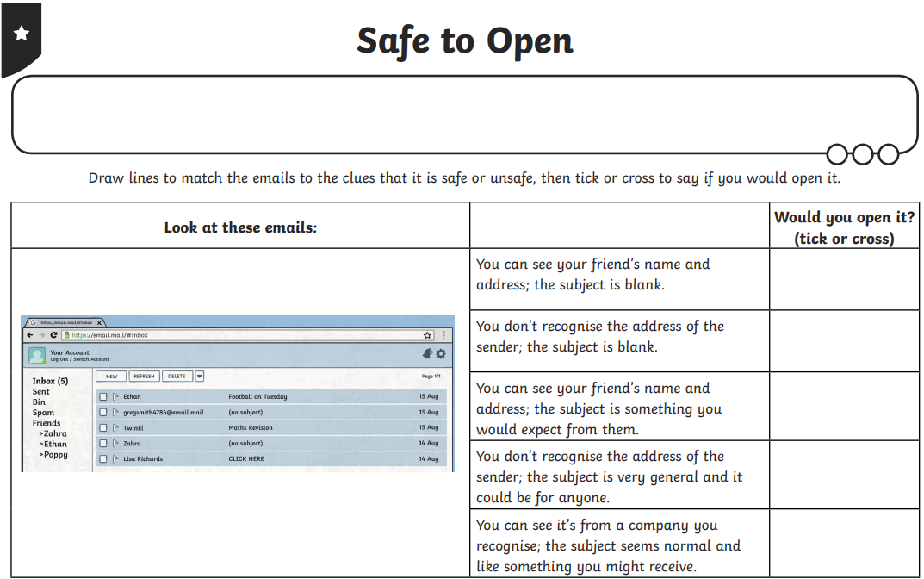
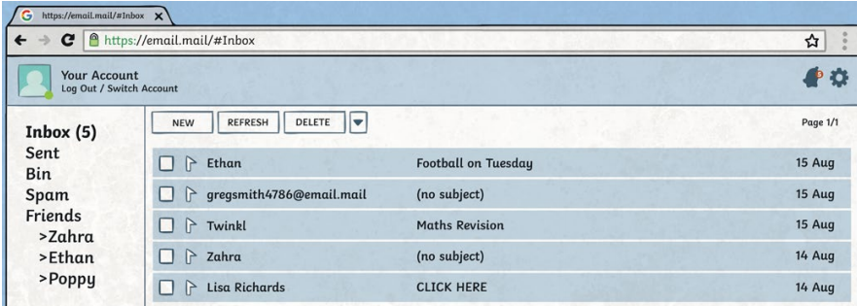

Slide 28
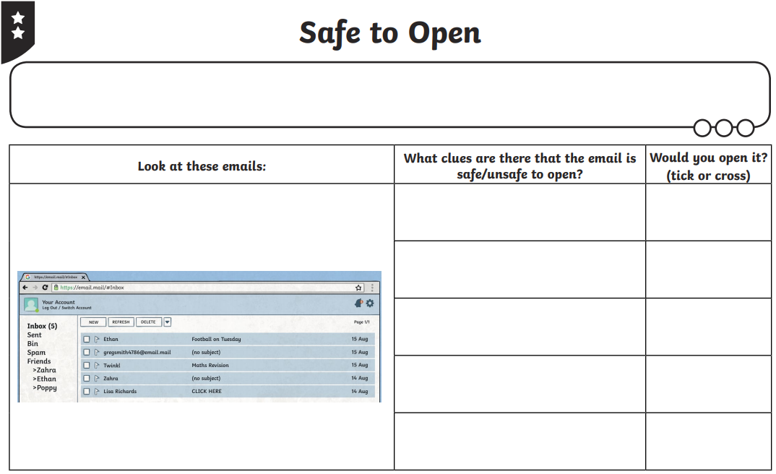
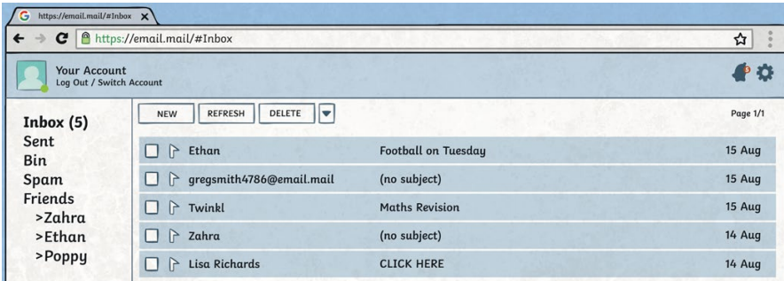

Slide 29
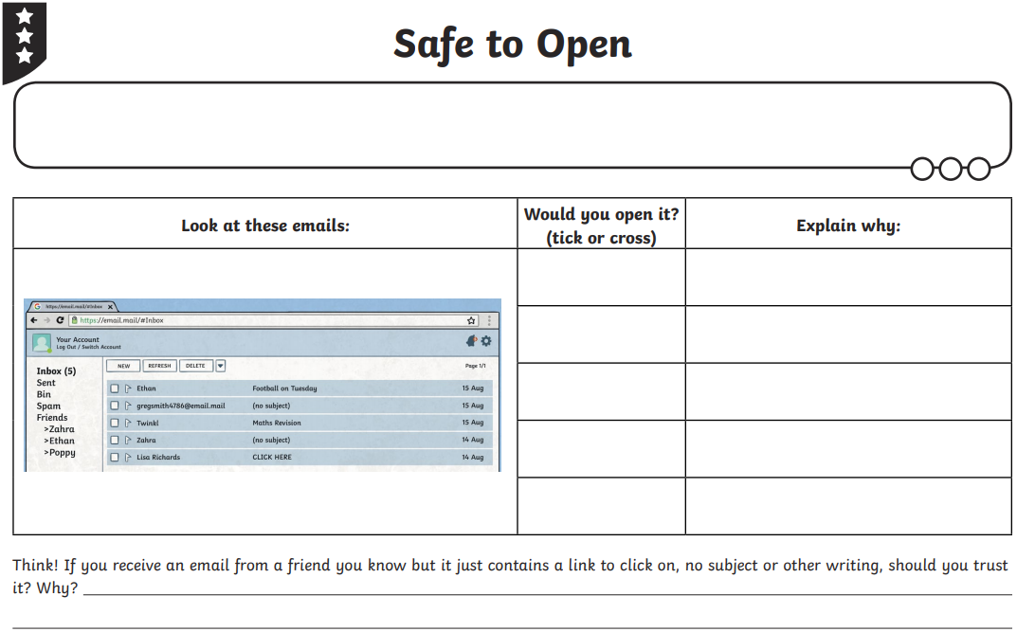
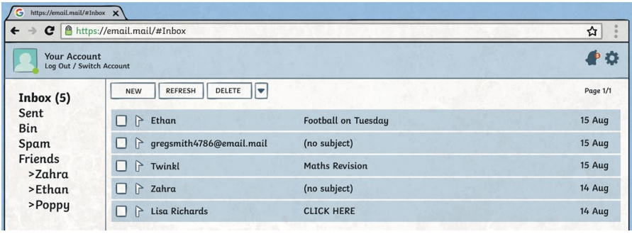

Slide 30
Snappy Senders
?
?
?
How do we write an email?
Write the email address (or addresses) you are sending it to in the ‘To’ bar.
Write a short title for the email in the ‘Subject’ bar that gives the recipient a clue as to what the message is about.
Think about who you are sending the email to. Just like a letter, you may need to be more formal depending on who you are writing to.

Slide 31
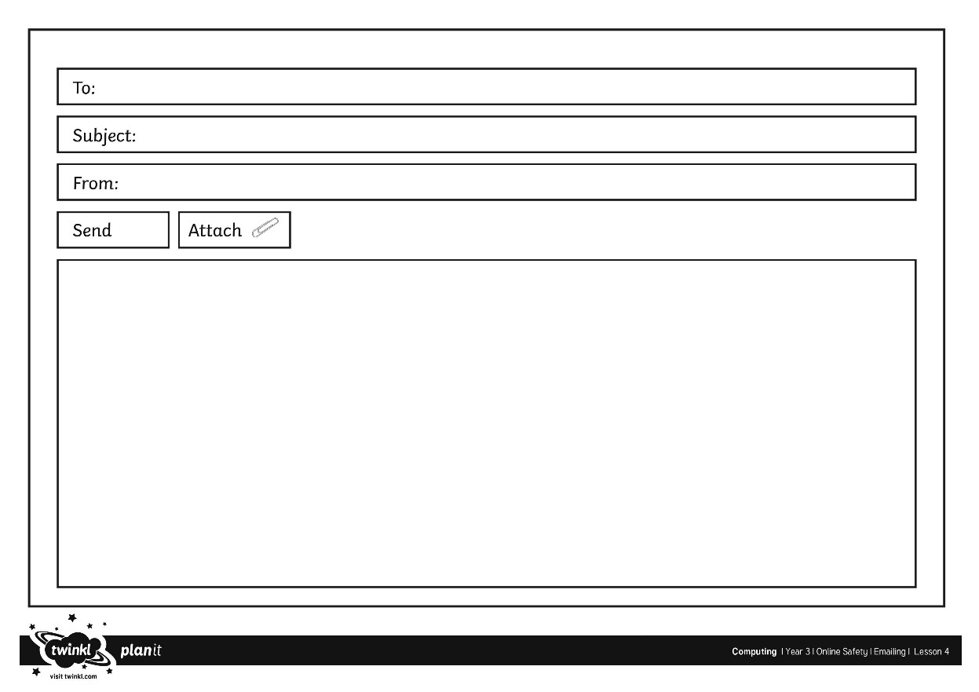
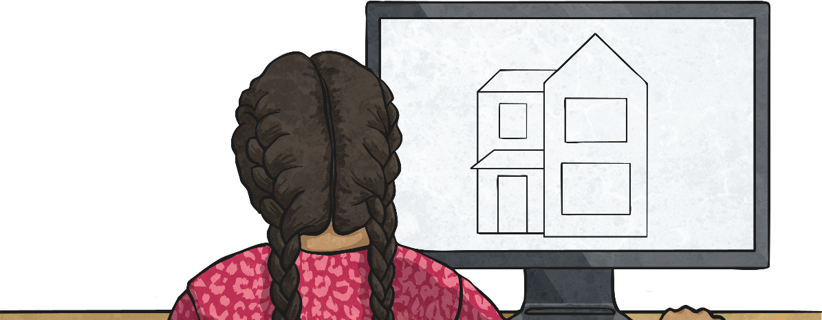
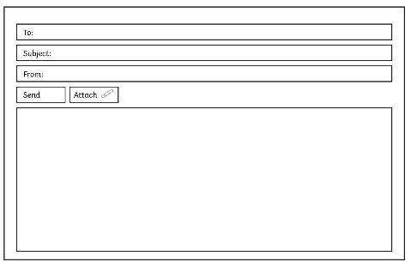
Email Me
Use your Blank Email Activity Sheet or a computer to demonstrate how to write an email. EXT: ask an adult to show you how to send a REAL email to the NJS.Year3@taw.org.uk email address!

Slide 32
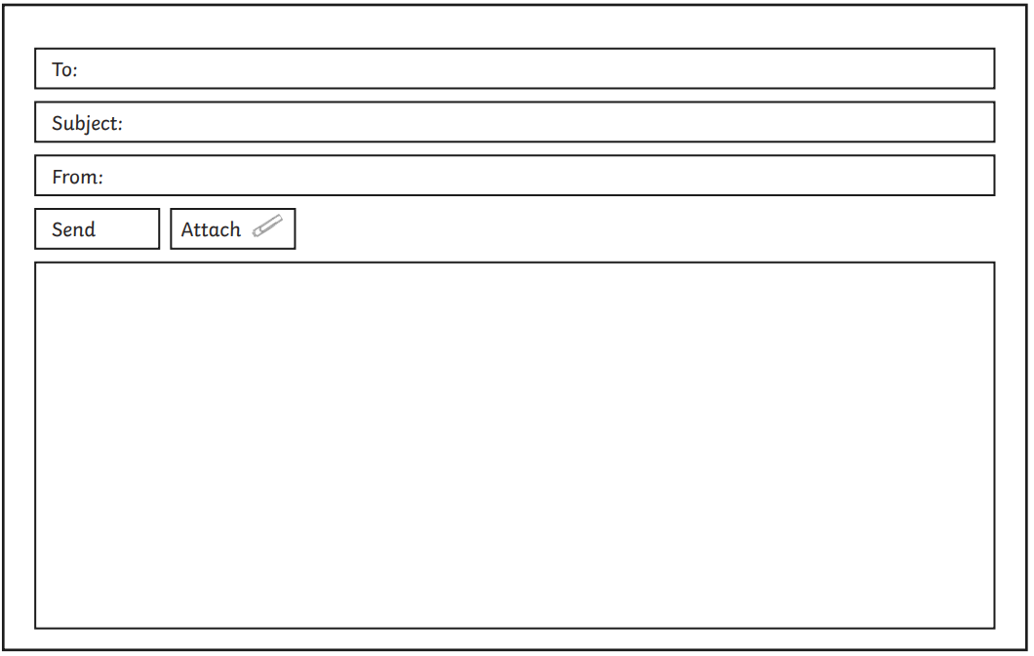
If you cannot write a real email, write an email using this template (copy it out), explaining what you have been up to in your spare time / afternoons. Remember to think if the email should be more formal/polite , or more friendly in tone.

Slide 33
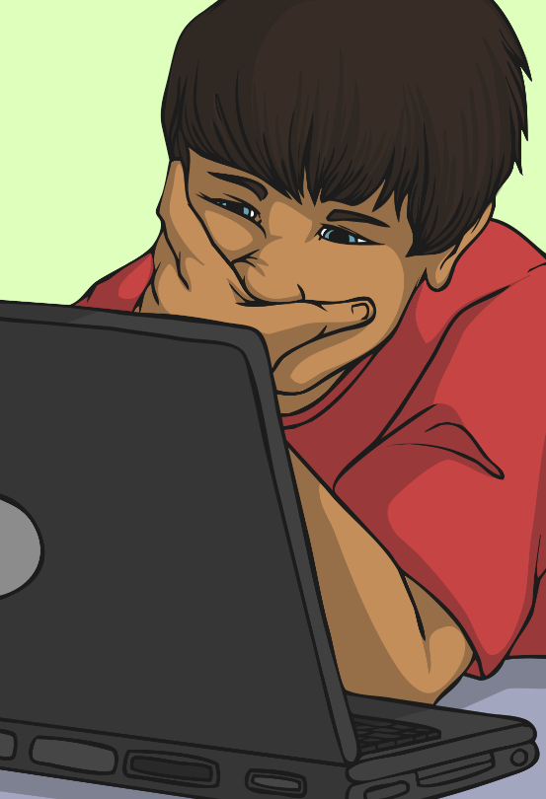
Should You Have an Email Address?
It is important to remember that most email providers have age restrictions. Usually, you cannot have your own email address until you are thirteen years old.
If you need to use an email address to contact someone, you could ask to do it with your parents’ email address.
You might also be able to have an email address on a closed network. Your school may set you up an email address which you can use to email other people in your school.
On a closed network, only authorised computers or email addresses would be able to connect. This means you would only be able to send or receive emails from the addresses that are part of the school network.

Slide 34
Music: To join the Big Sing workshop.
Youtube link: https://youtu.be/XRV7ceairTM

