Slide 1
Year 3 Home School Provision Daily Pack- 12/02/21
The following slides will be split into 4 separate activities.
They will consist of Maths, English, Reading and one other subject.
Each slide will be daily activities for you and your child to do at home.
We as a Year 3 team, will update these slides daily to the website – please keep an eye out!
Please email NJS.Year3@taw.org.uk with any queries to share any work and one of the Year 3 teachers will get back to you as soon as possible!
Thank you for your understanding and on going support during these times.

Slide 2
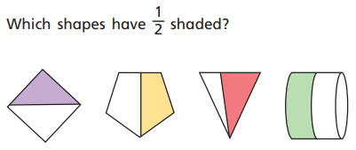
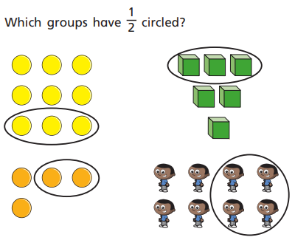
Maths
To understand the equivalence of a half and two quarters.

Slide 3
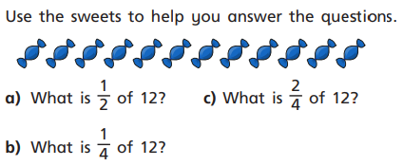
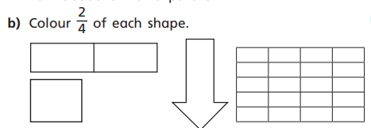

Slide 4
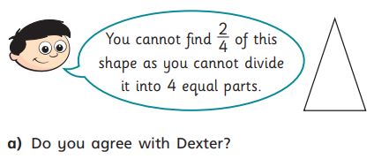
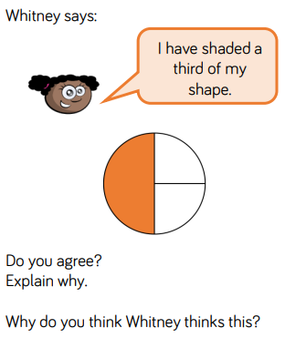
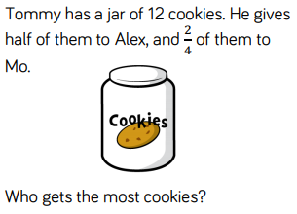
Can you write your own question using one half and two quarters?

Slide 5
Log onto TTRS and try and beat your top score!
Enjoy Rockstars!

Slide 6
English- Free write Friday Have a look at some of these ideas and choose one to write about.

Slide 7
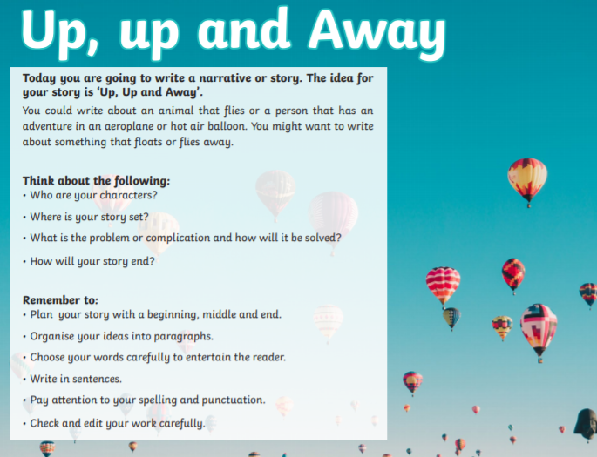

Slide 10
Reading –
To read aloud fluently and clearly, using correct intonation.
To develop knowledge of unfamiliar words when reading.
Go to Fiction Express and read aloud Chapter 3 of ‘Takeover’, or read it on the next few slides. Make sure you use good ‘voices’ for the characters, and take account of the punctuation. If you need a slightly easier version, go online and open up the Level 1 Lite version.

Slide 17
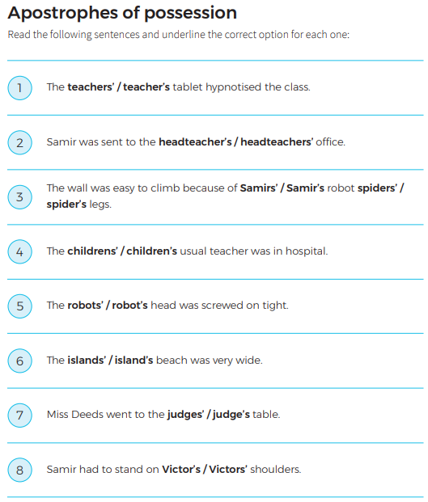
Watch the video on Apostrophes for possession and then try this activity.
Apostrophes for possession.

Slide 18
Try this crossword – you can find the clues by clicking on the correct words in the chapter online (the clues are word definitions).
EXT: Can you create your own crossword using some of the chapter words?

Slide 19
Art: To be able to use a variety of mediums to make a reproduction of an ancient Roman artefact.

Slide 21
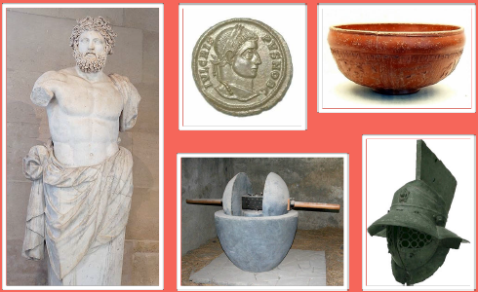
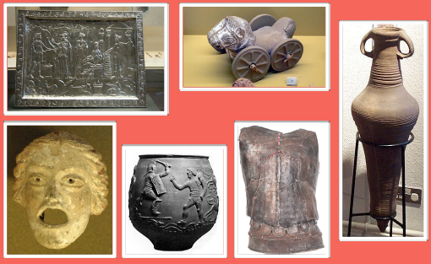

Slide 22
Please use any materials you have access to at home. You could use items from the recycling such as cardboard or paper for papier-mâché. You could (if you want to!) make salt dough or use plasticine (if available). You could also draw your artefact and colour in.
Send us any examples of the artefacts you have created. Remember, you can create an artefact with anything around your house!
Year.3NJS@taw.org.uk

