Slide 1
Year 3 Home School Provision Daily Pack- 22/02/21
The following slides will be split into 4 separate activities.
They will consist of Maths, English, Reading and one other subject.
Each slide will be daily activities for you and your child to do at home.
We as a Year 3 team, will update these slides daily to the website – please keep an eye out!
Please email NJS.Year3@taw.org.uk with any queries to share any work and one of the Year 3 teachers will get back to you as soon as possible!
Thank you for your understanding and on going support during these times.

Slide 2
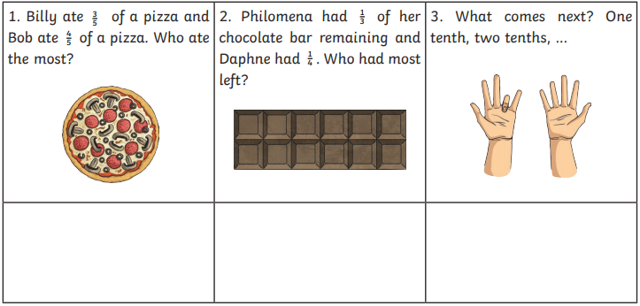
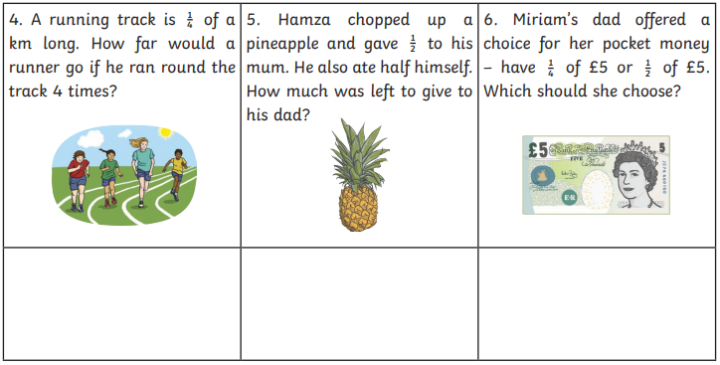
Maths
LO: To solve problems involving fractions and explain my reasoning where necessary
Introduction
Some of us have struggled with understanding word problems in the last couple of weeks. We will use this lesson to revisit word problems to make sure we fully understand.
1) Read the question
2) Re-read the question
3) Underline the important information
4) Work out the sum
5) Solve the problem
6) Write a sentence to explain

Slide 3
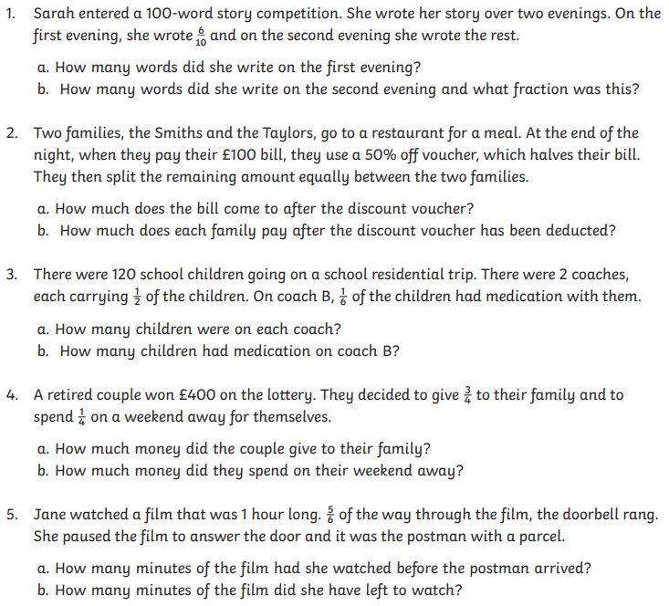
1) Read the question
2) Re-read the question
3) Underline the important information
4) Work out the sum
5) Solve the problem
6) Write a sentence to explain

Slide 4
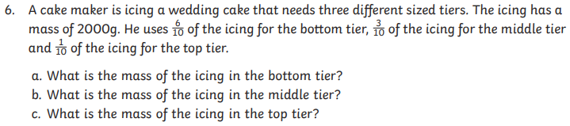
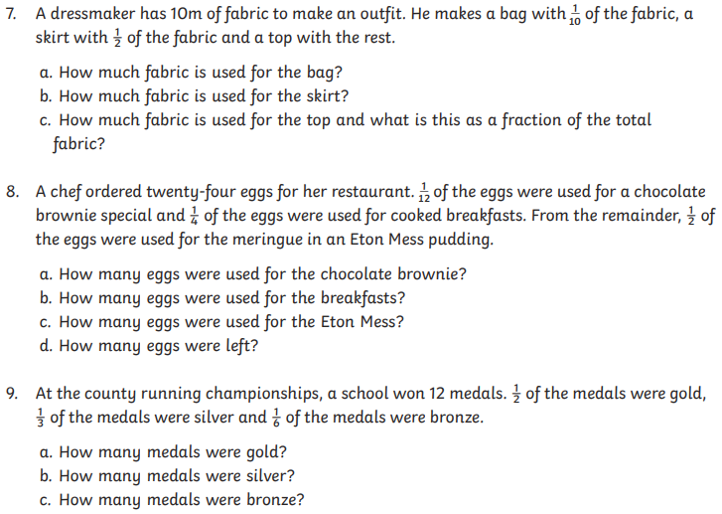
1) Read the question
2) Re-read the question
3) Underline the important information
4) Work out the sum
5) Solve the problem
6) Write a sentence to explain

Slide 5
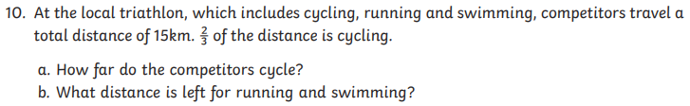
1) Read the question
2) Re-read the question
3) Underline the important information
4) Work out the sum
5) Solve the problem
6) Write a sentence to explain
Plenary:
N2T:
One thing I am more confident with is…..
One thing I would still like to work on is….

Slide 6
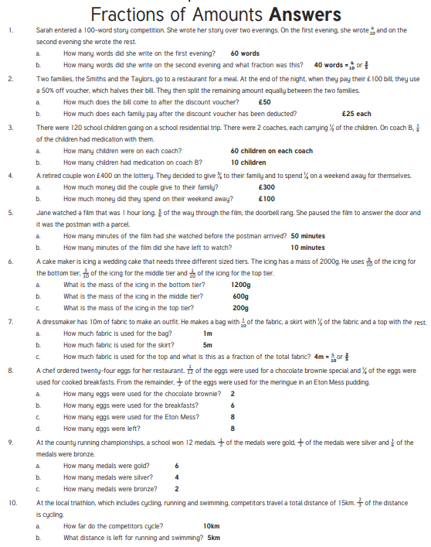

Slide 7

English- Today we are going to start our unit on Poetry.
What is a poem?
What do poems include?
What would you NOT see in a poem? Why?

Slide 8
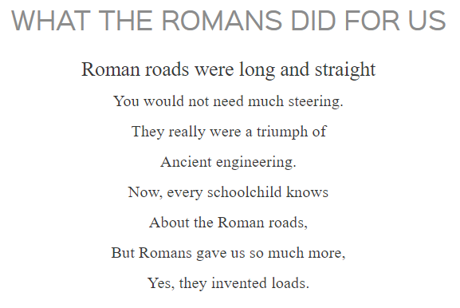
An example of a poem:
- What do you notice?
-What do you like?

Slide 9
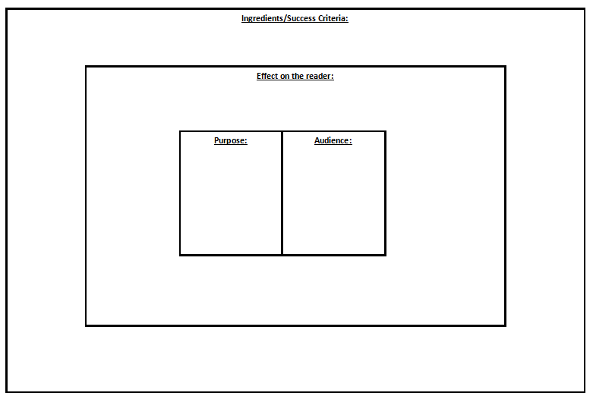
We have seen this ‘Big Picture’ before in English.
We use it at the start of a new unit
Spend some time looking at the ‘Big Picture’ and decide what you need to write in the boxes.
What things can you add in?
Have a try at coming up with your own ideas before clicking on to the next page!

Slide 10
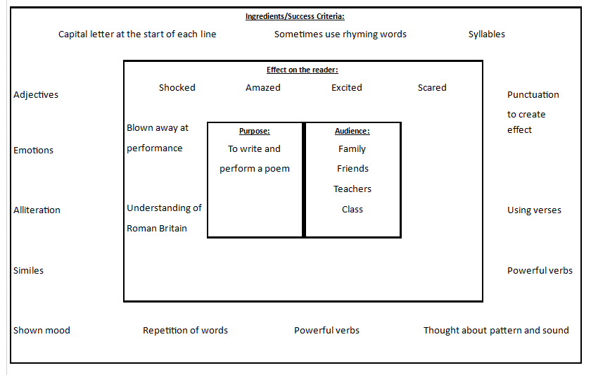
Take a look at this one for some ideas!
Feel free to add some more to yours…

Slide 11
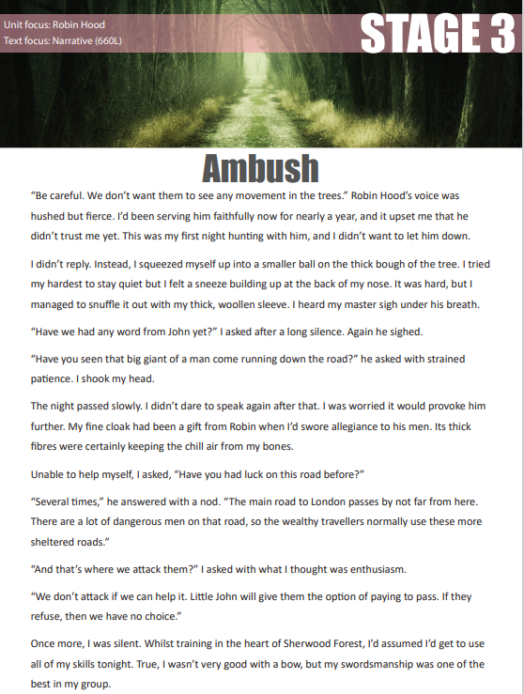

Reading – To answer questions about a text.
Mr B has learned a new skill! Listen to him read the extract by clicking the speaker icons, then answer the questions which follow. Enjoy!

Slide 12
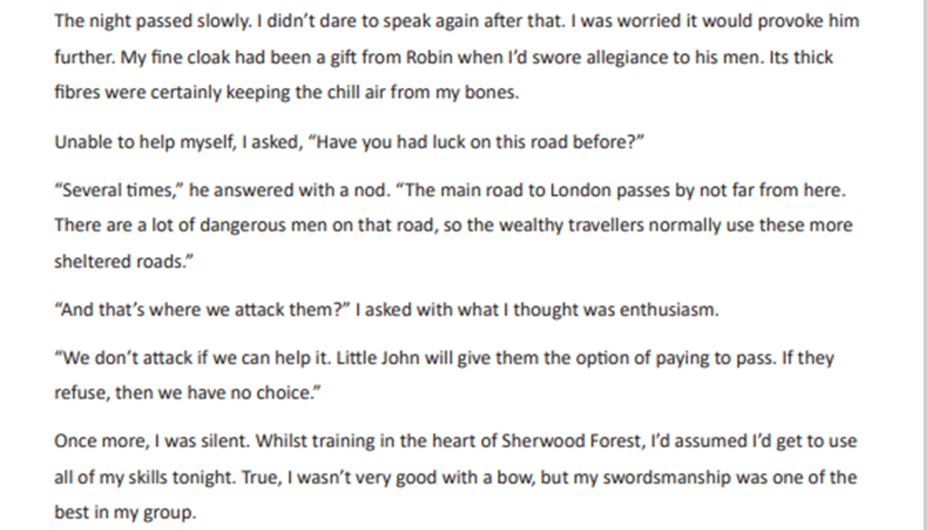

Slide 13
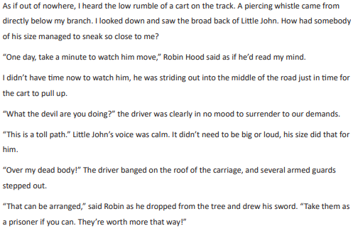

Slide 14
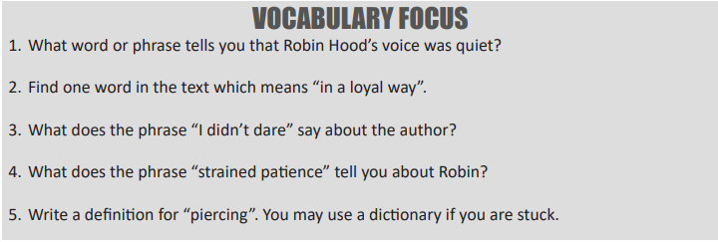
Read and answer the questions using complete sentences. Click on the speaker icons to have them read to you.

Slide 15
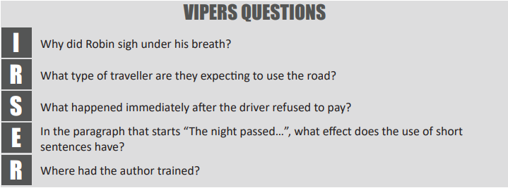
EXTENSION
What do you think will happen next? Either:
Write a detailed next paragraph to the story (eg: Without warning, the guards from inside the small cart sprang in to action. Whistling past my head, an arrow thudded into the tree I was in…) or;
Make a simple prediction to explain what you think (Eg: I think that…because…)

Slide 16
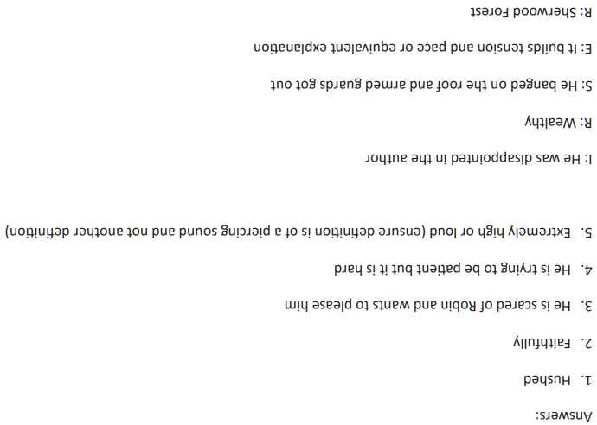
Answers
(yes, they are upside-down and small, to stop them being read onscreen at school– no cheating!)

Slide 17
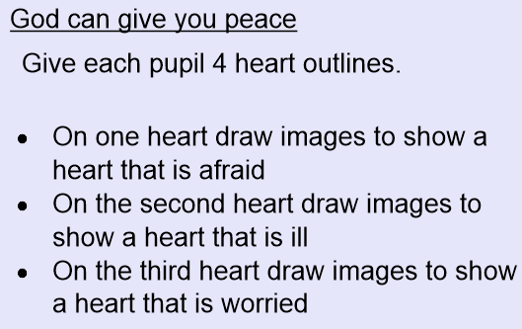
B&V:
How does it feel to be a disciple of Jesus?

Slide 18
