Slide 1
Year 3 Home School Provision Daily Pack- 23/02/21
The following slides will be split into 4 separate activities.
They will consist of Maths, English, Reading and one other subject.
Each slide will be daily activities for you and your child to do at home.
We as a Year 3 team, will update these slides daily to the website – please keep an eye out!
Please email NJS.Year3@taw.org.uk with any queries to share any work and one of the Year 3 teachers will get back to you as soon as possible!
Thank you for your understanding and on going support during these times.

Slide 2
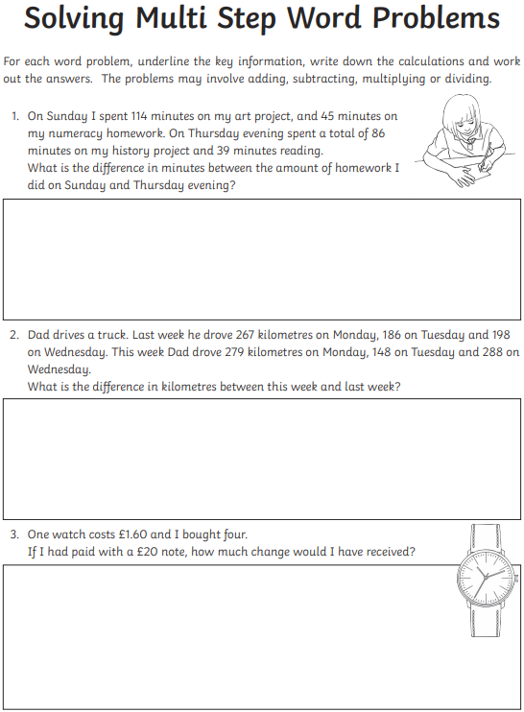
Maths
To solve multi step word problems explaining my reasoning where necessary.
1) Read the question
2) Re-read the question
3) Underline the important information
4) Work out the sum
5) Solve the problem
6) Write a sentence to explain

Slide 3
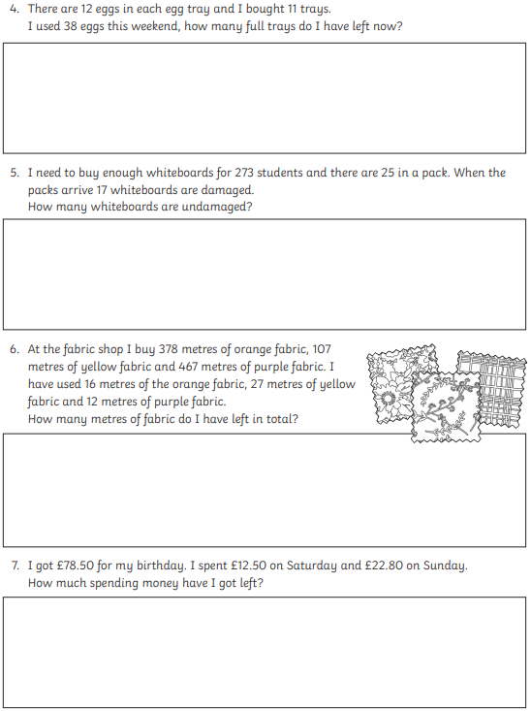
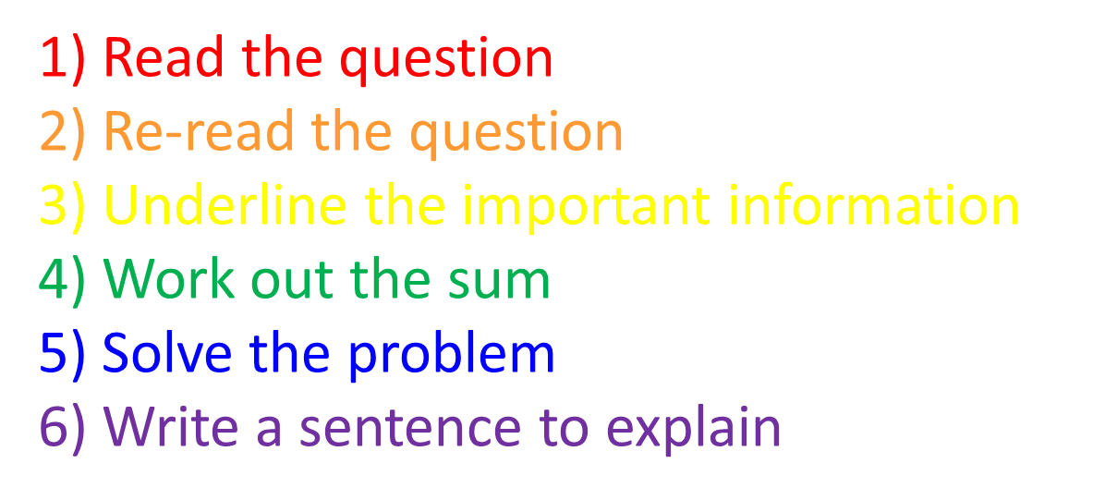

Slide 4
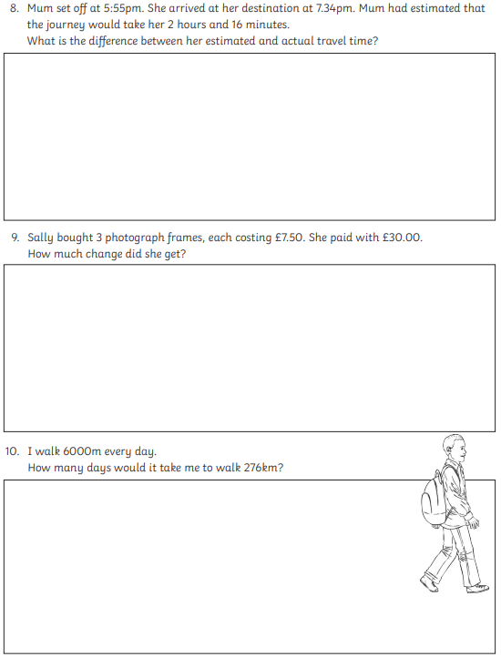
1) Read the question
2) Re-read the question
3) Underline the important information
4) Work out the sum
5) Solve the problem
6) Write a sentence to explain
Plenary:
To solve a word problem I must…

Slide 5
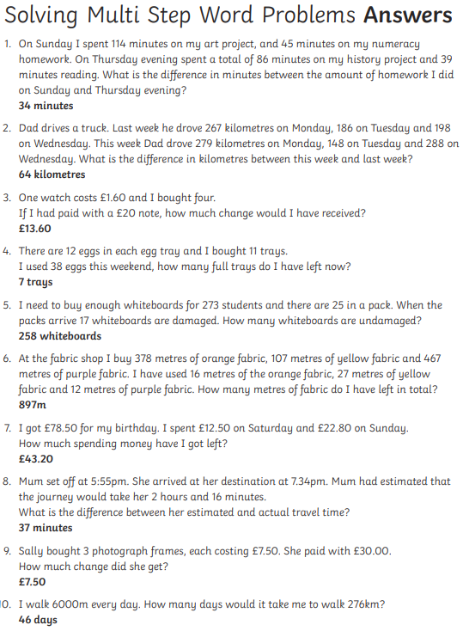
ANSWERS

Slide 6
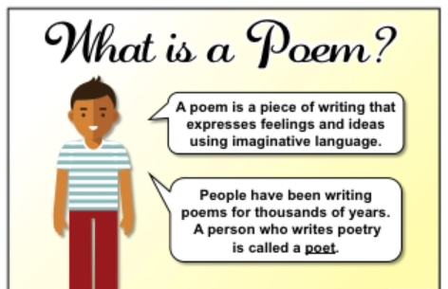
English:
- To look at features of a poem.
- To look at a ‘WAGOLL’ (What A Good One Looks Like)

Slide 7
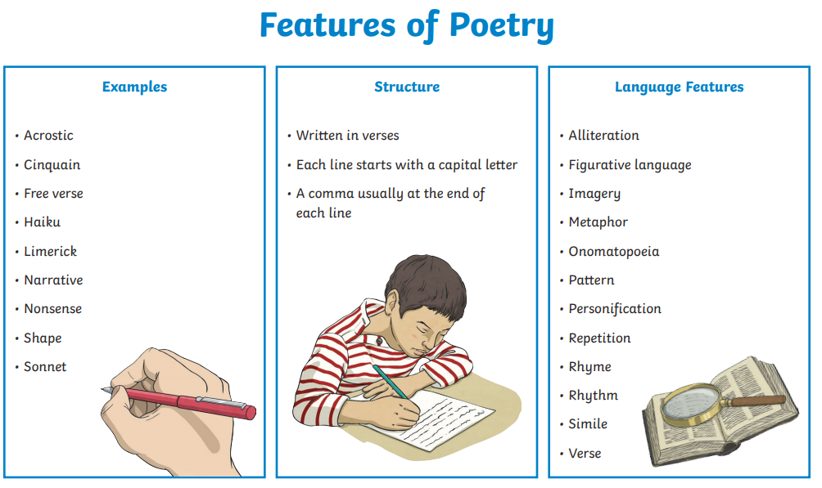
These things are really important when writing a poem…

Slide 8
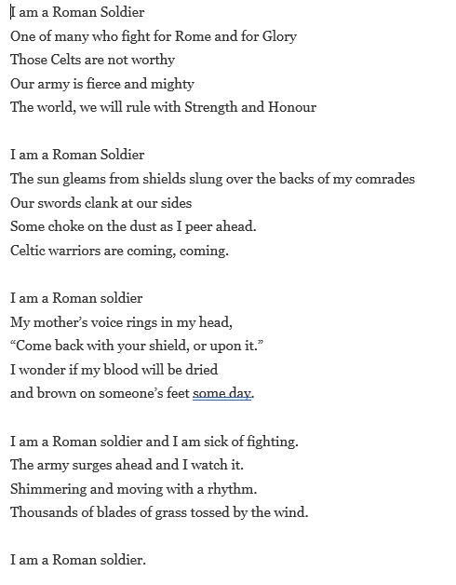
Now let's take a look at this ‘WAGOLL’:

Slide 9
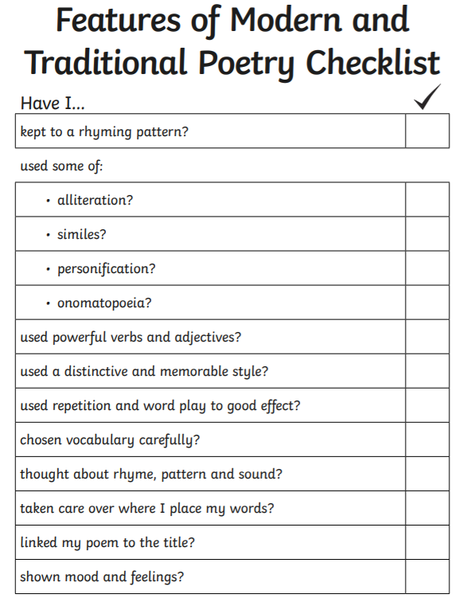
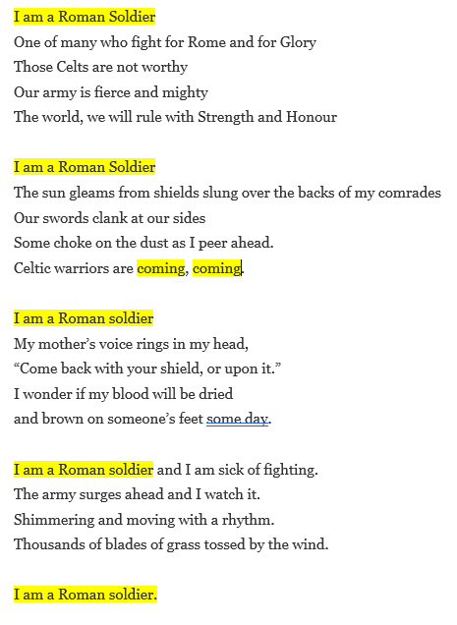

Task: Using different coloured pens or crayons, highlight features of a poem in our ‘WAGOLL’.

Slide 10

Reading –
To identify features of different text types and use text features to find information and explain ideas.
Today we are going to read a different type of text – non-fiction.
What is non-fiction?
How can you tell this text is not fiction?
How is the text organised?
What features does it have that make it different to fiction?
Now read on and answer VIPERS questions at the end.

Slide 11
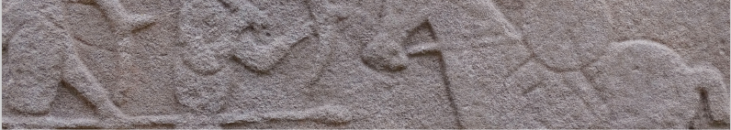
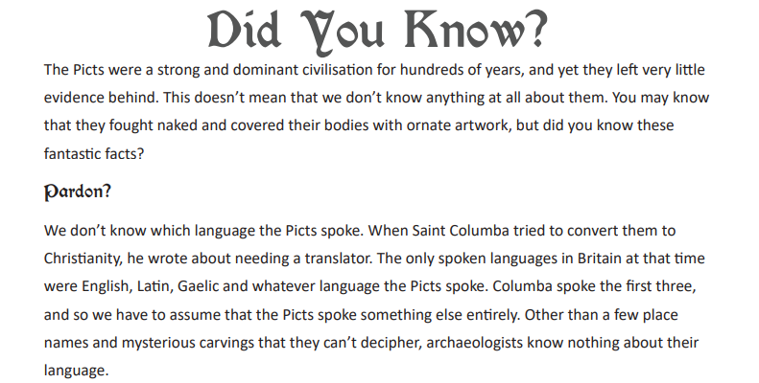

Slide 12
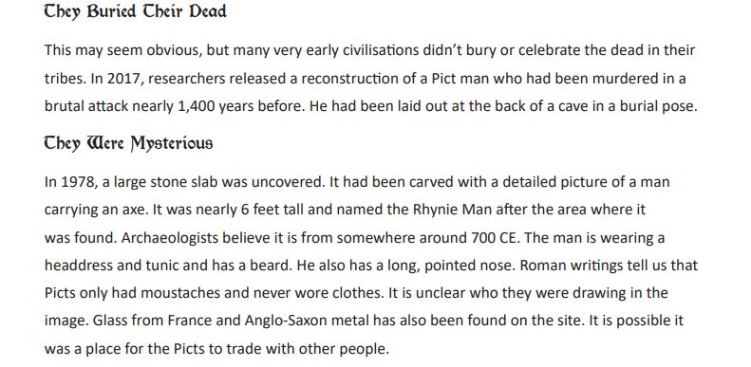

Slide 13
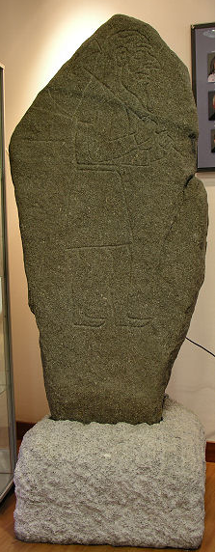

The Rhynie Man is a cartoon-like depiction, over a metre high, of a man carrying an axe, beautifully carved on a gabbro slab. The slab, itself 1.78m high, was uncovered during ploughing at Barflat, just to the south of Rhynie in Aberdeenshire, in 1978.
Today you find the Rhynie Man standing in the reception area of Woodhill House, the headquarters of Aberdeenshire Council, on the edge of Aberdeen.

Slide 14
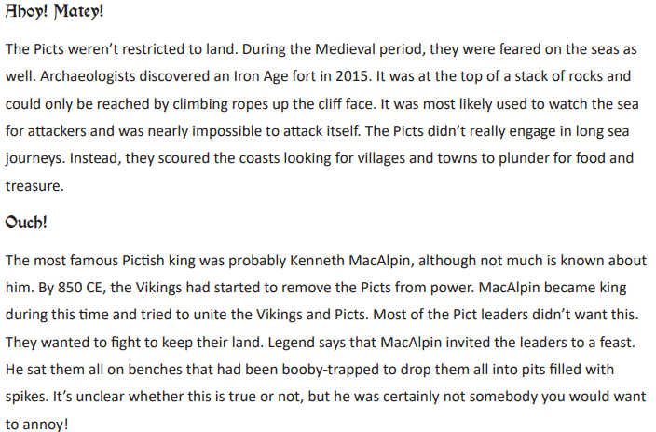
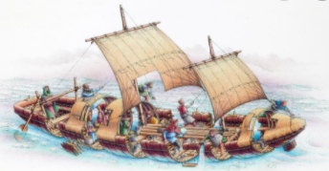

Slide 15
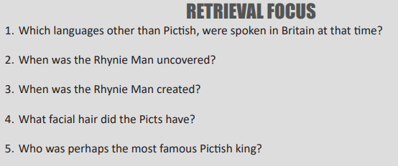
Question Time!
Now its time to answer the questions, using complete sentence where you can.

Slide 16
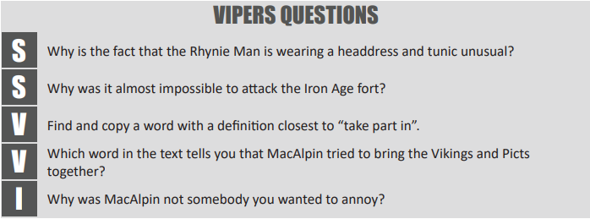

Slide 17
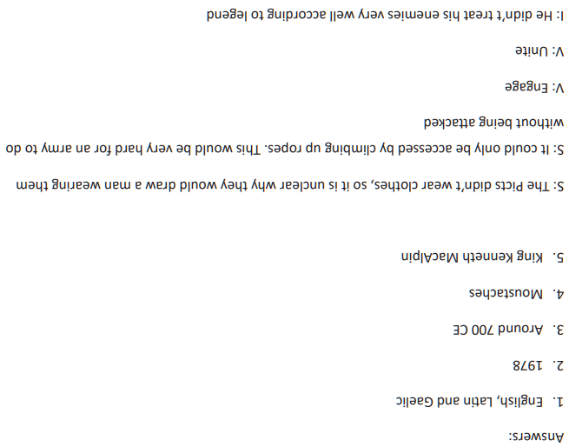
Answers
(Intentionally upside-down!)

Slide 18
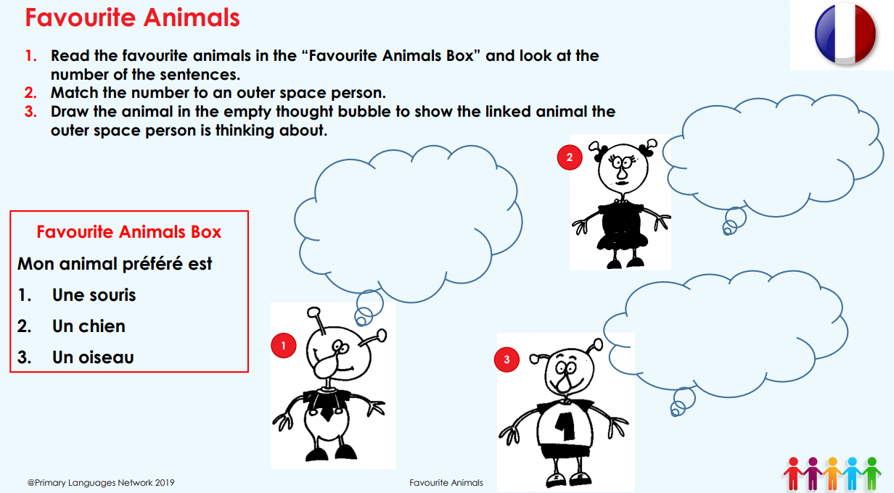

Slide 19
