Slide 1
Year 3 Home School Provision Daily Pack- 25/02/21
The following slides will be split into 4 separate activities.
They will consist of Maths, English, Reading and one other subject.
Each slide will be daily activities for you and your child to do at home.
We as a Year 3 team, will update these slides daily to the website – please keep an eye out!
Please email NJS.Year3@taw.org.uk with any queries to share any work and one of the Year 3 teachers will get back to you as soon as possible!
Thank you for your understanding and on going support during these times.

Slide 2
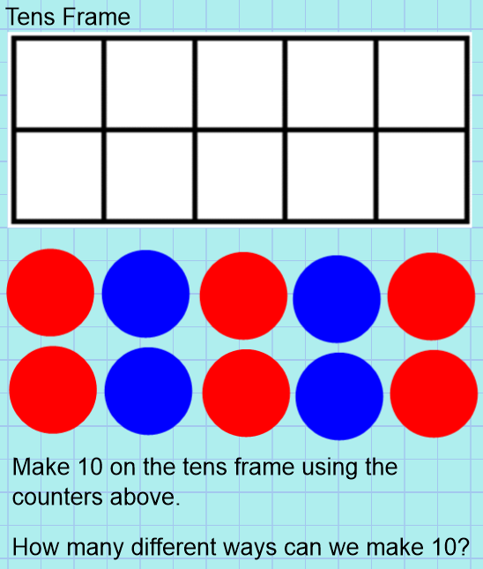
Maths
To be able to see relationships/bonds between numbers
You can easily draw the tens frame in your book if you do not have access to a printer.
You could use pencil dots, pieces of Lego or cut outs to make your own counters. Try and have them 3 of one colour and 2 in another colour.

Slide 3
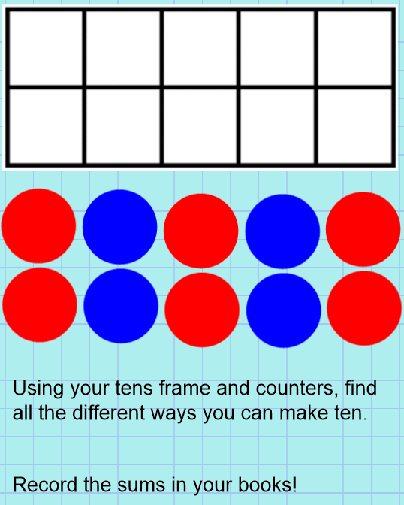
Record everything in your book!
This is a sequence of lessons so you might need to look back at what you have already done!

Slide 4
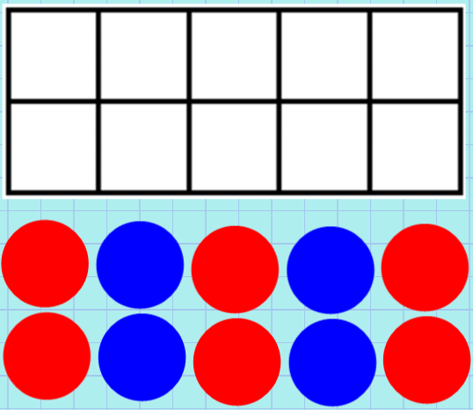
Remember there could be more than one answer to the question!

Slide 5
Plenary:
One thing I have learnt this lesson is…
Please email any work from of this lesson to chloe.watson@taw.org.uk or njs.year3@taw.org.uk

Slide 6
This lesson should take a while because of all the possibilities and reasoning.
However, should you finish early you can log onto TTRS and try and beat your best time!
Good luck Rockstars!

Slide 7
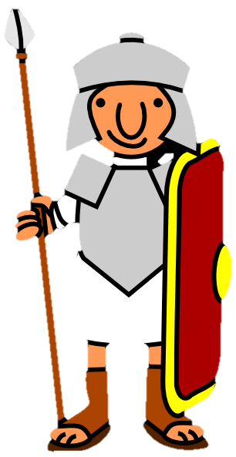
English: To identify features of chants and cadence calls

Slide 8
Think/Pair/Share
Look at the cadence call ‘Off to fight the heathen’
Can you identify any features?

Slide 10
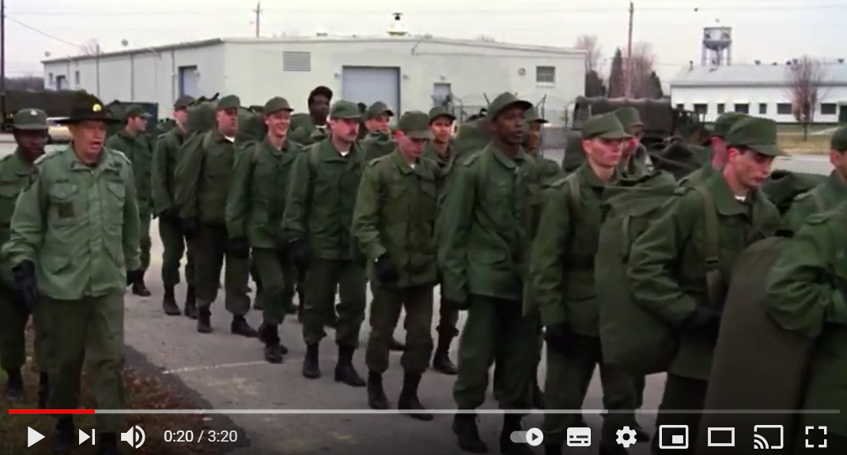
Look at the clip of a cadence below. Not a Roman army…obviously!
https://www.youtube.com/watch?v=DMzFK6kWmcU&t=5s

Slide 11
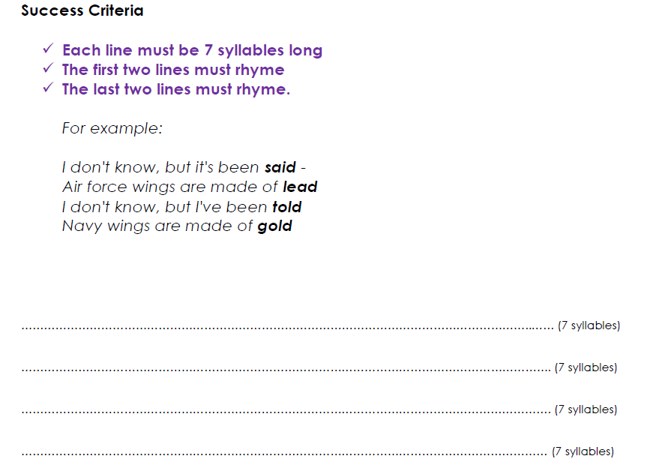
Task: To write a cadence poem.
1*/2*- Use this template to help you.
2*/3*- Write your cadence poem, without a writing frame.

Slide 12
Reading - Chapter 5 – Takeover
The final chapter! Read it on the next slides…

Slide 13
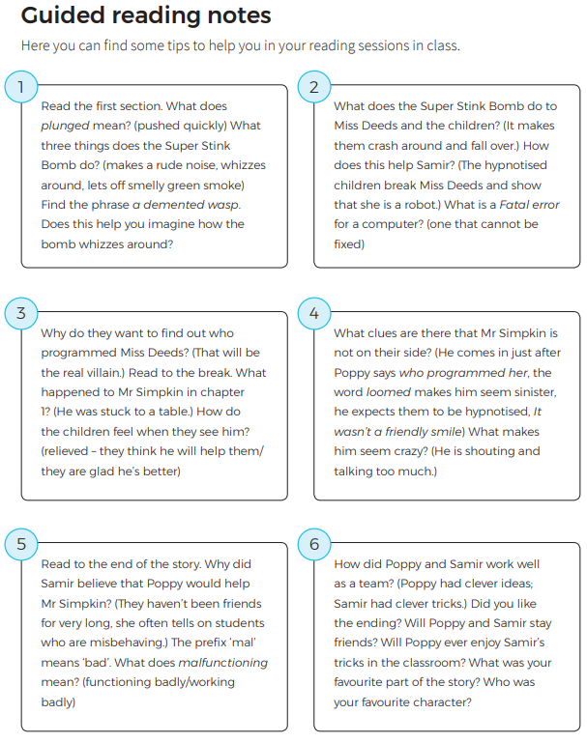

Slide 20
Phew! So it was Mr Simpkin after all that! Did you manage to predict this? Go online and complete the online quiz, or try the next pages for the written comprehension.

Slide 21
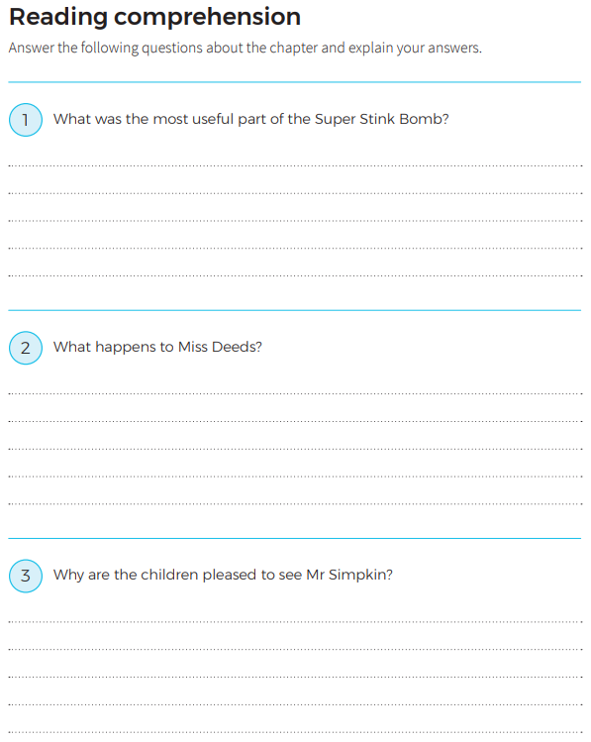
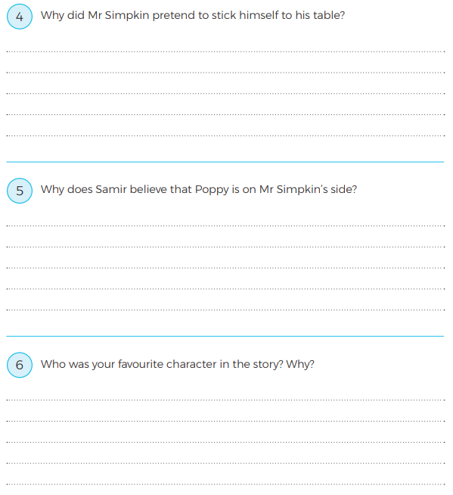

Slide 22
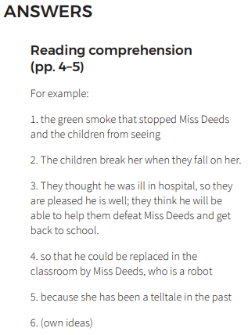

Slide 23
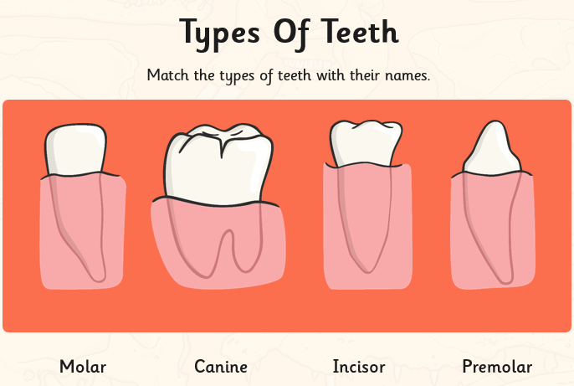
Science: To be able to identify the different types and functions of teeth and be able to identify similarities and differences

Slide 24
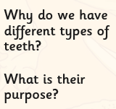

Slide 25
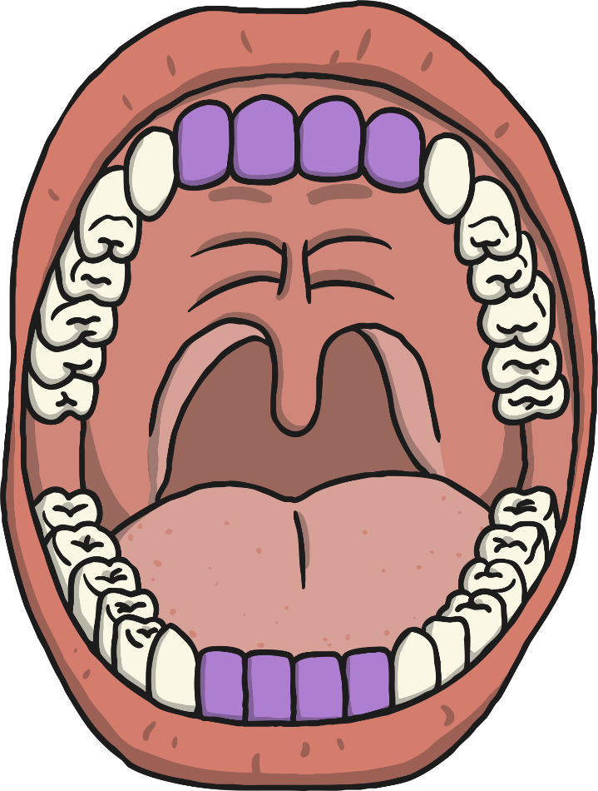
Incisors
How many?
Humans have 8 incisors altogether; 4 in the upper jaw and 4 in the lower jaw.
Shape
Incisors are shovel-shaped.
Function:
Used for biting and cutting food.

Slide 26
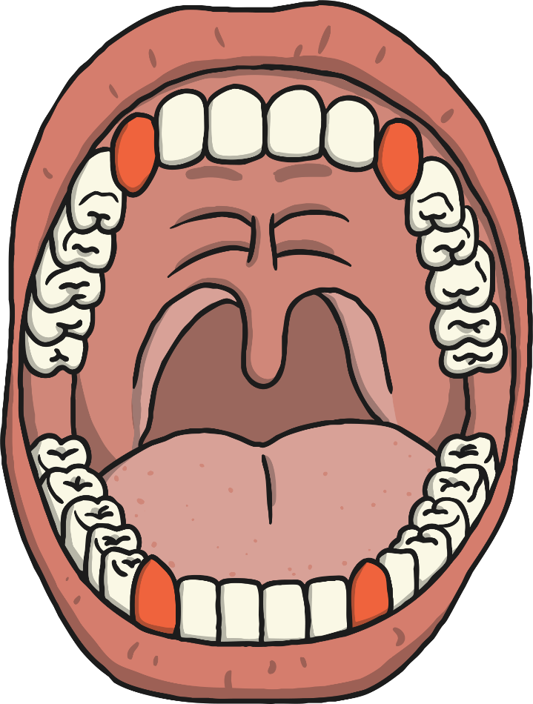
Canines
How many?
Humans have 4 canine teeth, one in each quarter of the mouth, on either side of the incisors.
Shape
Canines are pointy.
Function:
Used for tearing and ripping food.

Slide 27
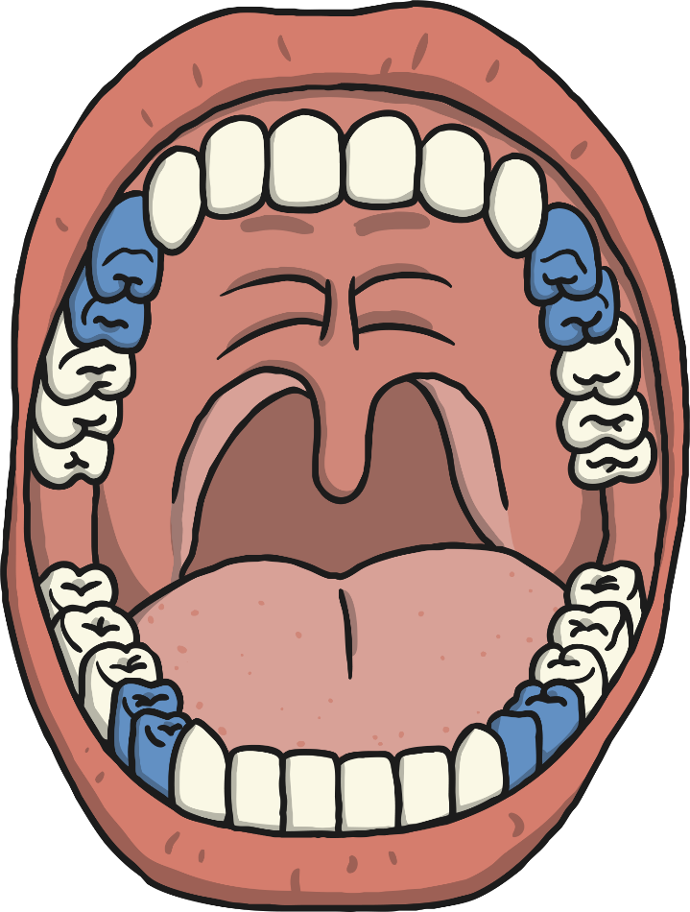
Premolars
How many?
Humans have 8 premolars, two in each quarter of the mouth. They are between the canine tooth and the molars.
Shape
Small and flat
Function:
Holding and crushing food.

Slide 28
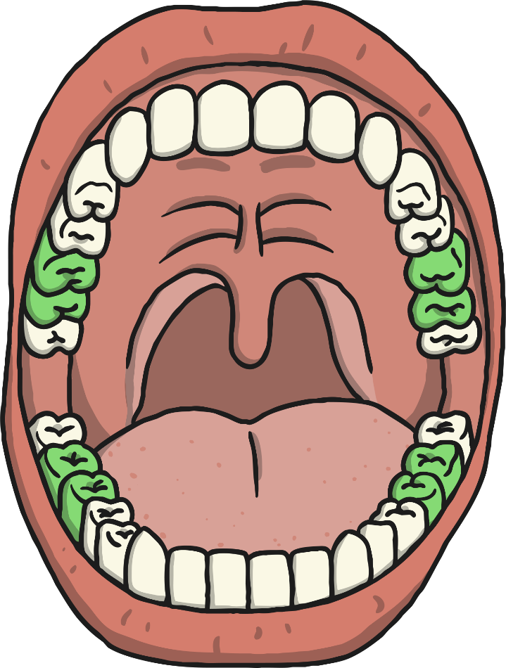
Molars
How many?
Humans have 8 molars, two in each quarter of the mouth. They are at the back of the mouth behind the premolars.
Shape
Large and flat
Function:
Grinding food

Slide 29
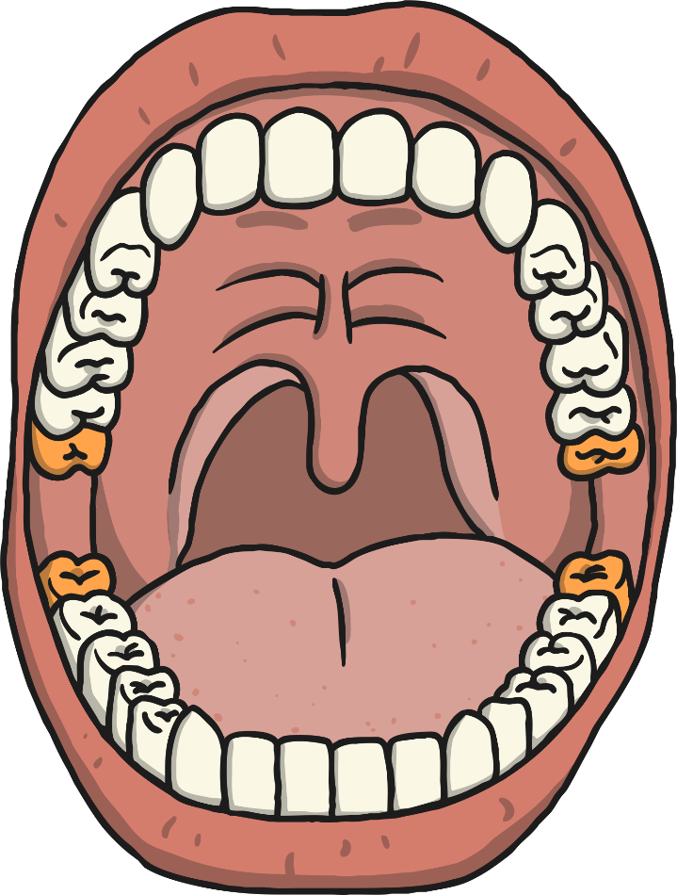
Wisdom Teeth
How many?
Humans can have up to 4 wisdom teeth, although not everyone has them. There is 1 in each quarter of the mouth behind the molars.
Shape
Large and flat (they are just a third molar)
Function:
Does not have one now! Some scientists think that human ancestors needed a third molar to help grind down plant tissue from thicker leaves when humans still ate them. Since the diet of humans has changed we don’t need them.
As the human diet changed our mouths have become smaller. This is the reason why many people have their wisdom teeth extracted – taken out – as there is no real room for a wisdom tooth so it tends to grow inward and can become a problem.

Slide 30
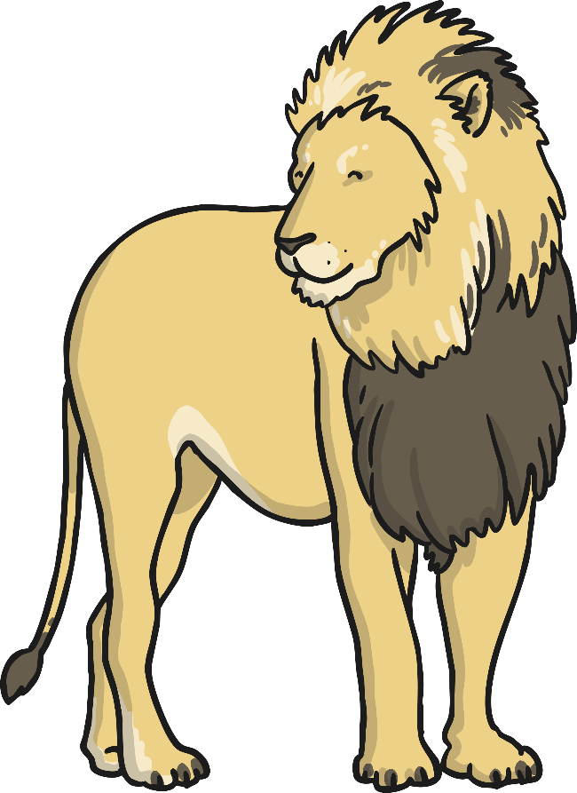
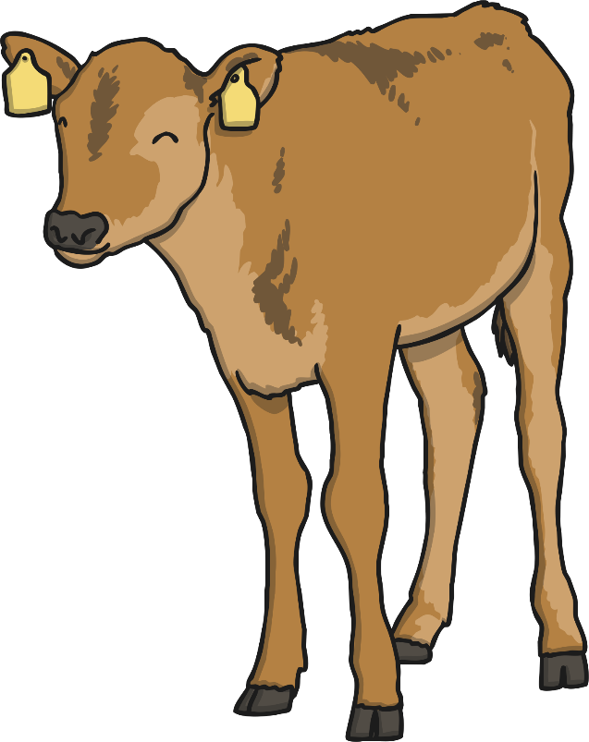
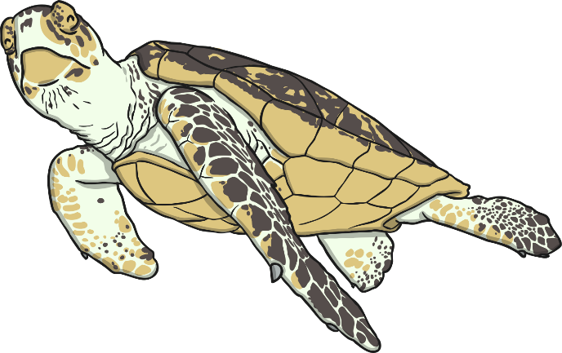
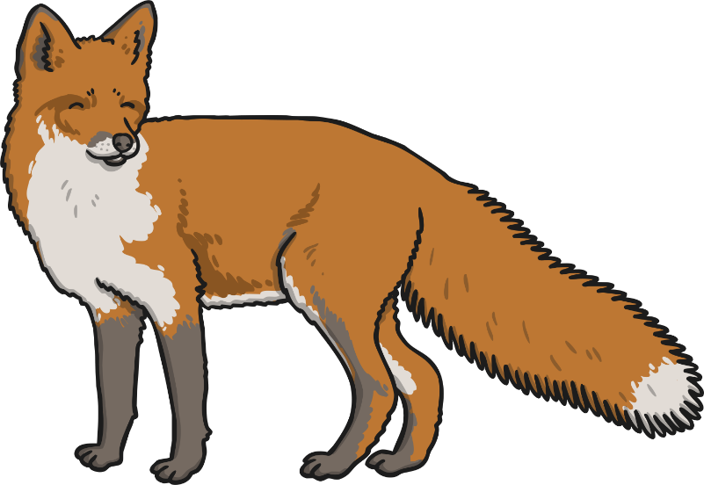
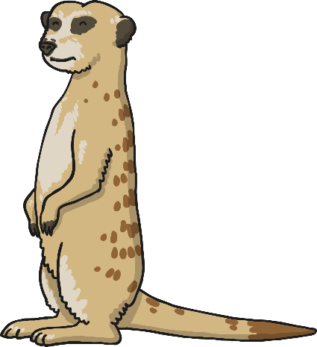
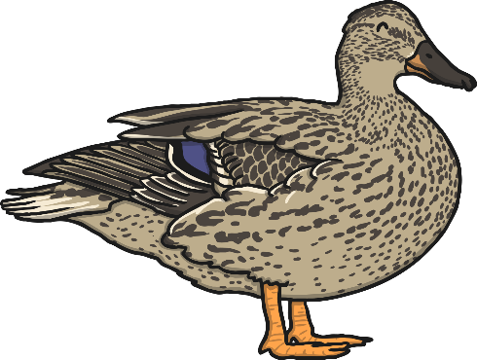
Animal Teeth
Do other animals have the same type of teeth as humans?
Why? Why not?

Slide 31
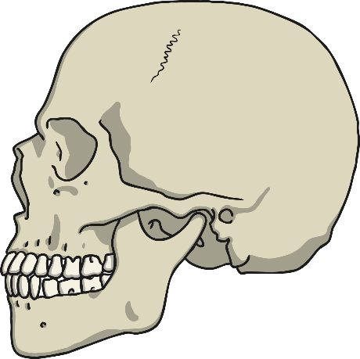
Comparing Teeth
You will now look at a range of different animals skulls which you will need to compare and contrast.
Why do you think they have different teeth?
Are there any similarities?
Are there any differences?
Does their diet impact their teeth?

Slide 32
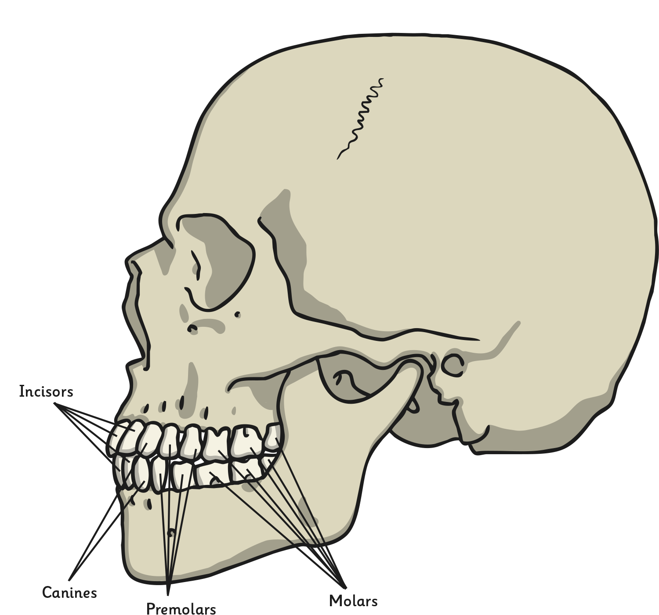
Human skull. Click again to go back.

Slide 33
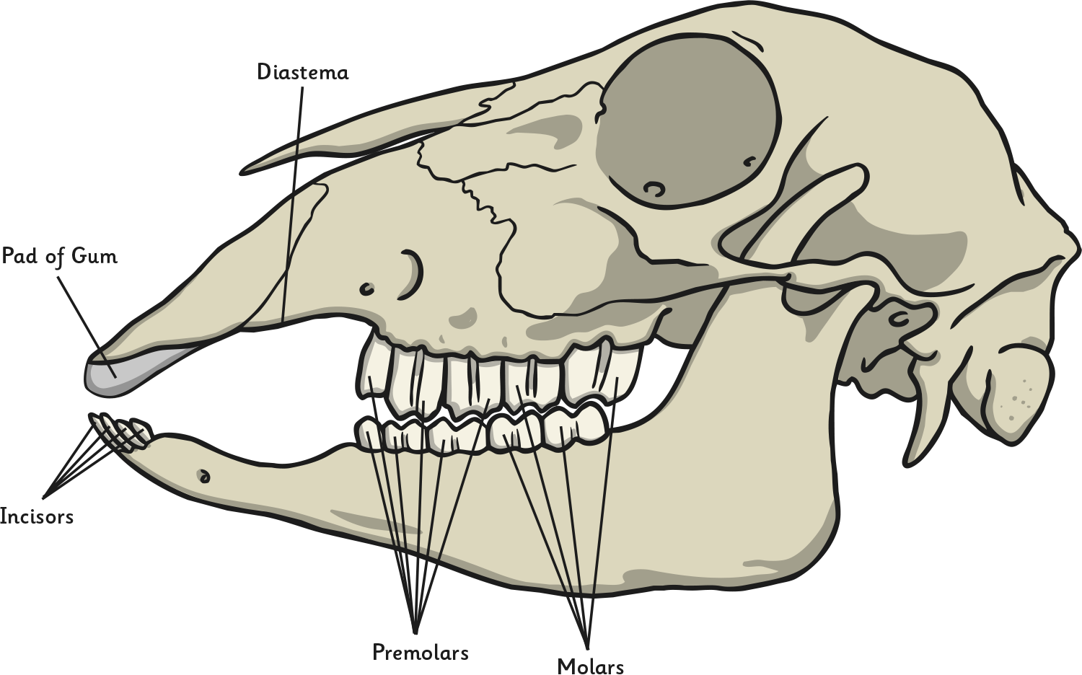
Sheep skull. Click again to go back.

Slide 34
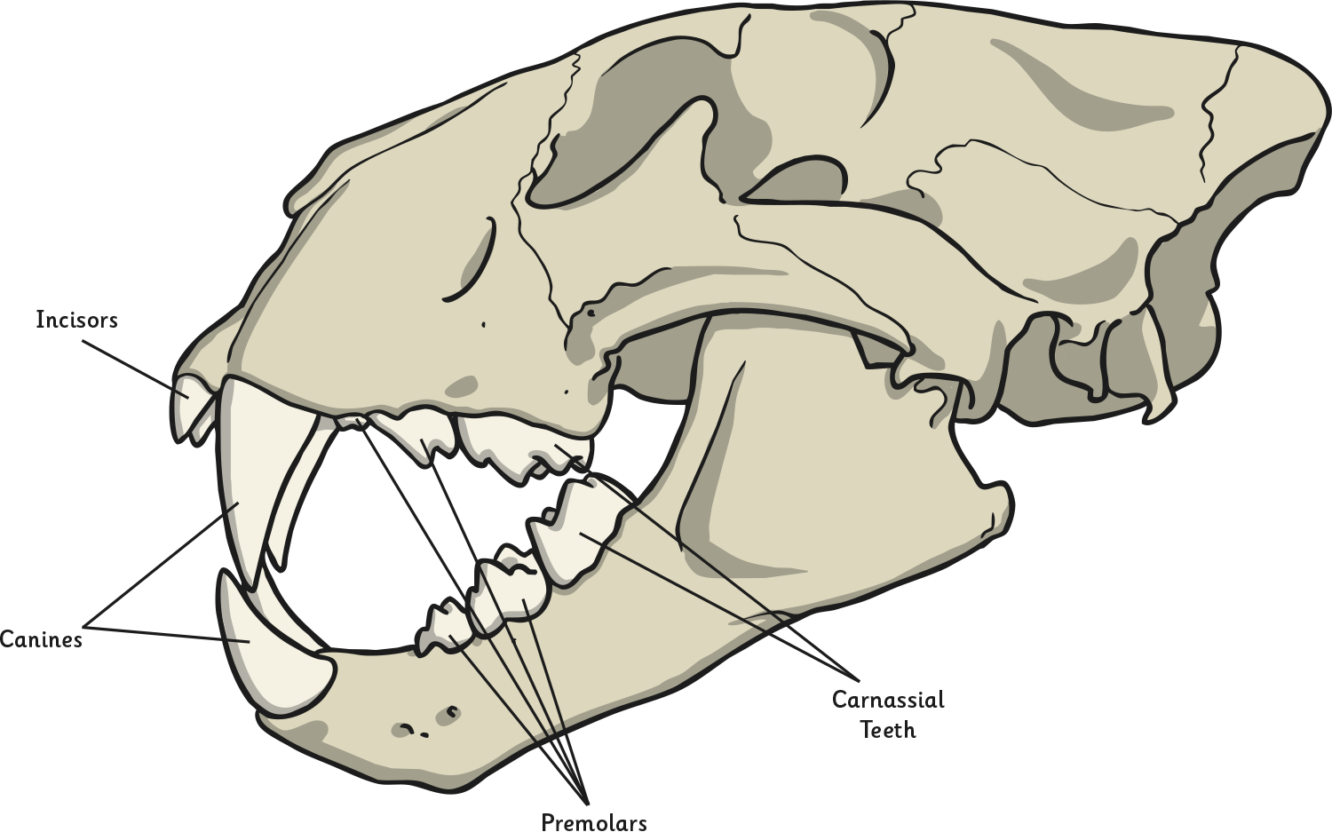
Lion skull. Click again to go back.

Slide 35
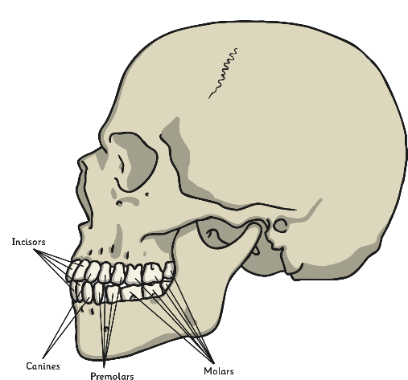
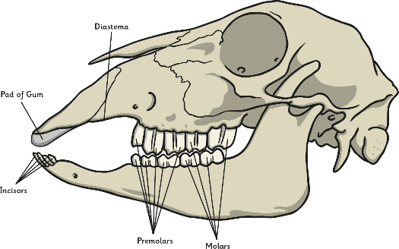
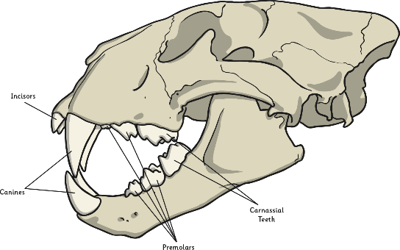
Food and Teeth
Herbivores eat plants
Carnivores eat only meat
Omnivores eat plants and meat
How does the food the animal eats affect the teeth it will have?
What similarities and differences do you notice?

Slide 36
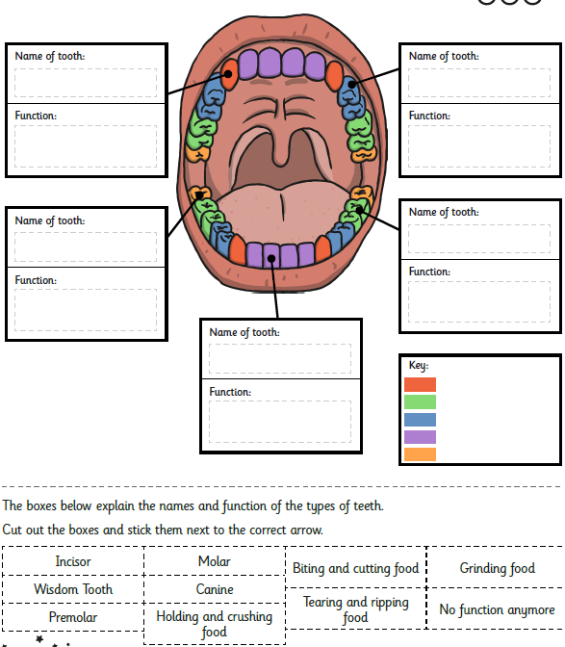
Activity:
Label the teeth and write out their functions.
How are our teeth similar to animal teeth?

