Slide 1
Year 3 Home School Provision Daily Pack- 26/02/21
The following slides will be split into 4 separate activities.
They will consist of Maths, English, Reading and one other subject.
Each slide will be daily activities for you and your child to do at home.
We as a Year 3 team, will update these slides daily to the website – please keep an eye out!
Please email NJS.Year3@taw.org.uk with any queries to share any work and one of the Year 3 teachers will get back to you as soon as possible!
Thank you for your understanding and on going support during these times.

Slide 2
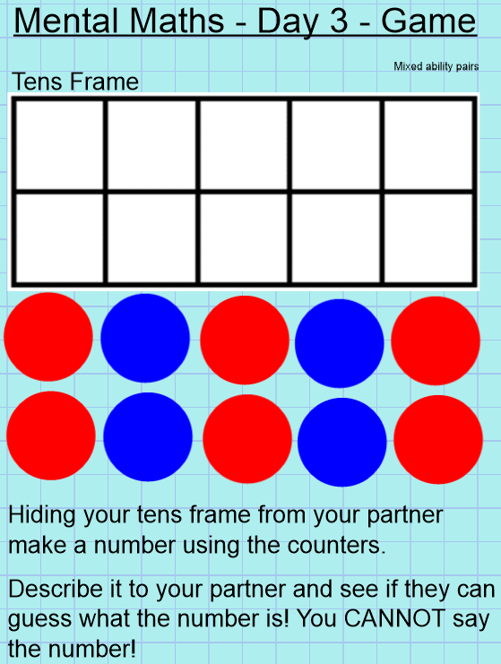
Maths
You will need to play with game with a sibling or an adult!
Think about what we learnt yesterday and the language we have been using.

Slide 3
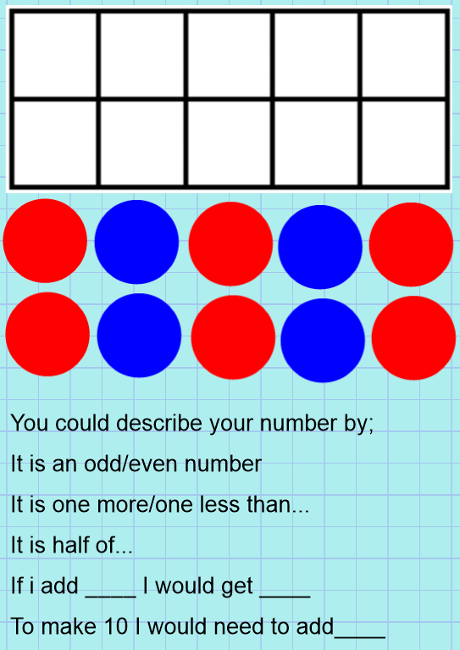
Record the numbers in your book and describe how you and your partner described them.
Is there anything you needed to work out? Or did you remember things from the previous lessons?

Slide 4
Plenary:
Four things I have learnt this week are…
1)
2)
3)
4)
Please email any work from of this lesson to chloe.watson@taw.org.uk or njs.year3@taw.org.uk

Slide 5
This lesson should take a while because of all the possibilities and reasoning.
However, should you finish early you can log onto TTRS and try and beat your best time!
Good luck Rockstars!

Slide 6
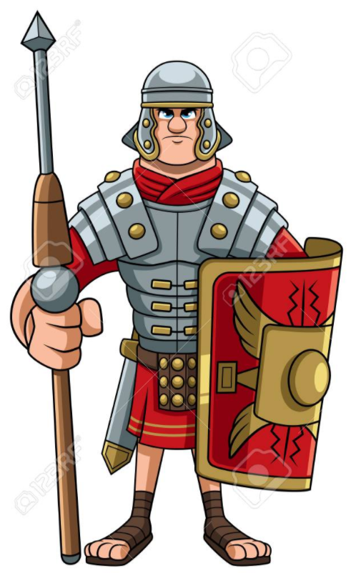
English- To perform a cadence to an audience.
Listen to this performance of a Roman marching song.
https://www.youtube.com/watch?v=Ry4Wv3wiLlo

Slide 7
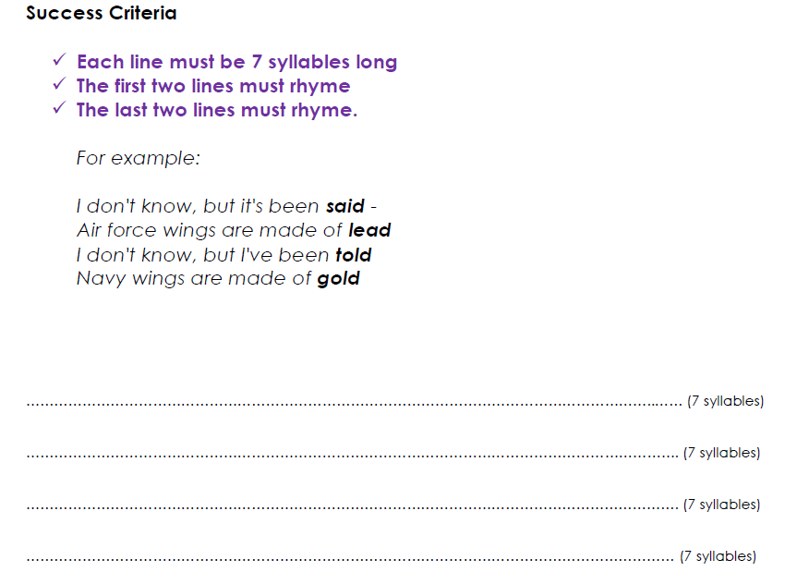
Look at your cadence that you wrote yesterday…
What do you like about it?
What would you change?
How could you perform it?

Slide 8
Task: To perform your cadence.
Perform your cadence to an audience.
Think about:
Pace
Expression
Gestures
Rhythm
Film yourself performing your cadence and send it to the year 3 email address.

Slide 9
Reading - Chapter 5 – Takeover
The final chapter! Read it again on the next slides…

Slide 16
You are now going to think about some questions to do with the story, in preparation to write an email to the author. This is good practice for when you read the live books and respond to forum questions.

Slide 17
If you are in class, interview a classmate about Takeover. If not, answer these questions yourself.
Try to get answers to these questions about the story:
What did you like best about the story?
What was the most exciting part?
Did you think any of the story was scary?
Who was your favourite character?
What do you think are the themes of the story?
Did the ending surprise you? Why/why not?
How would you change the story if you could?
Note down the answers you are given / you created.

Slide 18
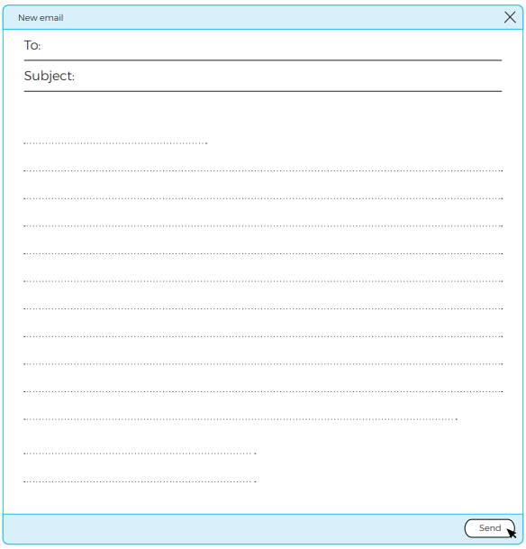
Email the authors
Now write an email to the authors, Jan Burchett and Sara Vogler.
Tell them how you felt about the story.
Try to include the answers to your questions on the last page to help you know what to write.

Slide 19
DESIGN A ROBOT!
Send your completed, labelled and coloured designs in to the Year 3 email.

Slide 20
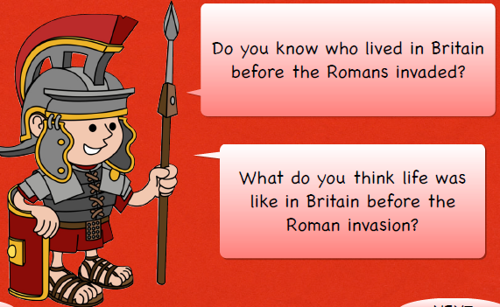
Topic: To find out who was in Britain when the Romans invaded and learn about their way of life.

Slide 24
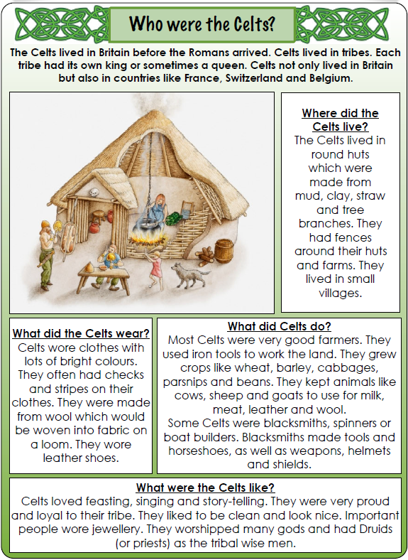
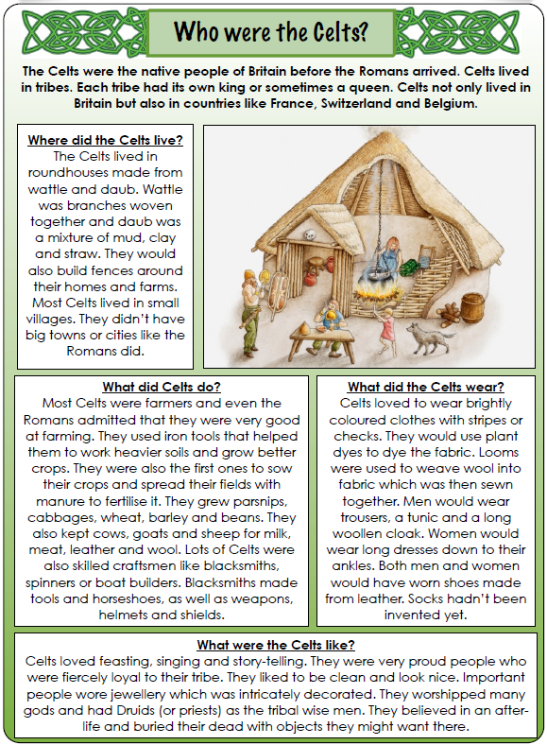
1*
2/3*

Slide 25
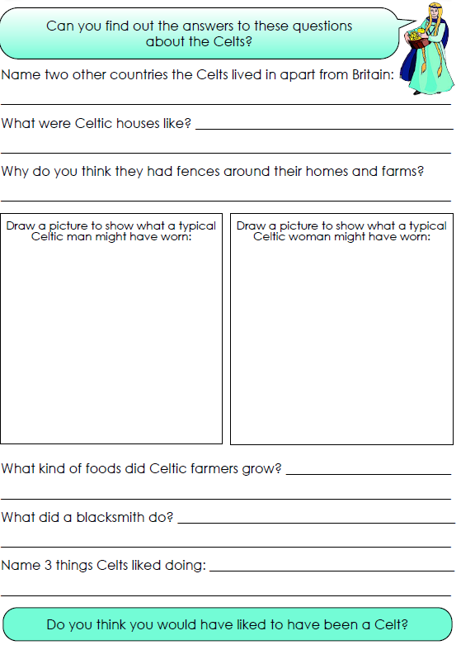
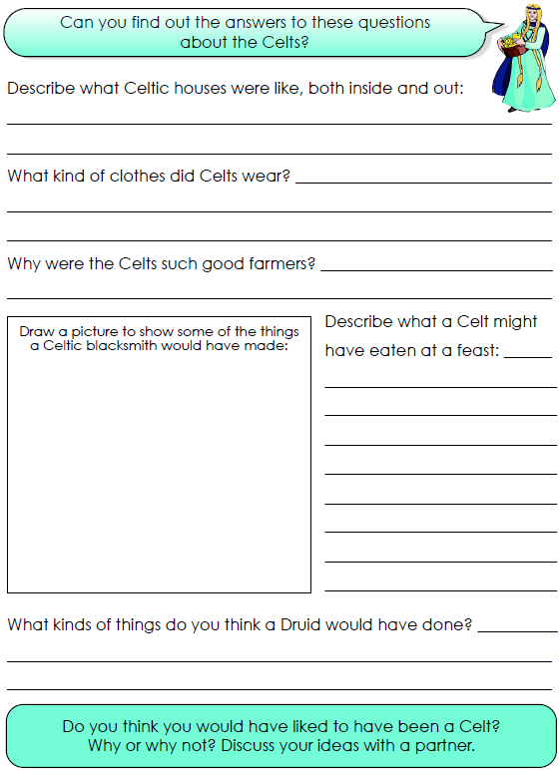
1*
2/3*

