Slide 1
TTRS Lifetime Coins Leader boards

Slide 2
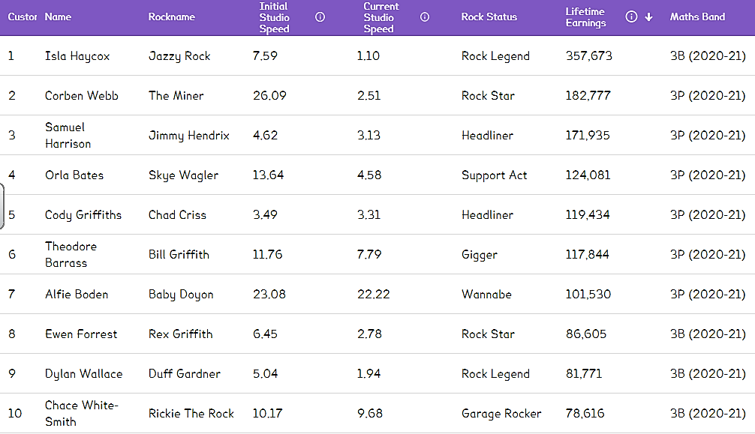

Slide 3
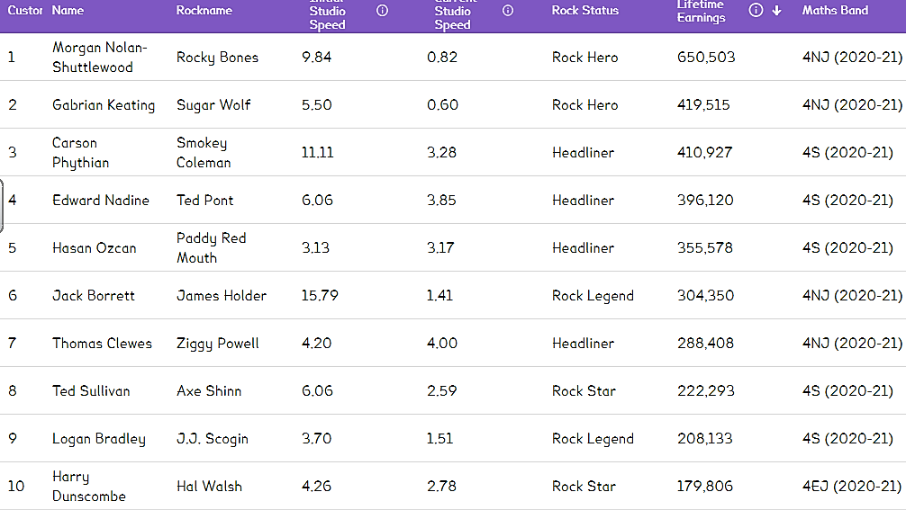

Slide 4
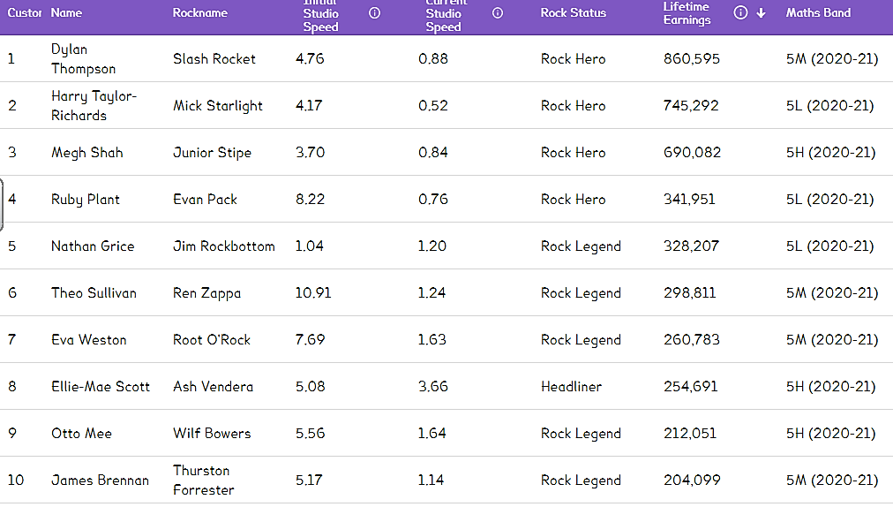

Slide 5
