Slide 1
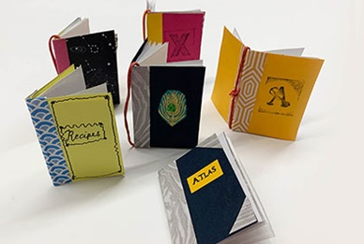
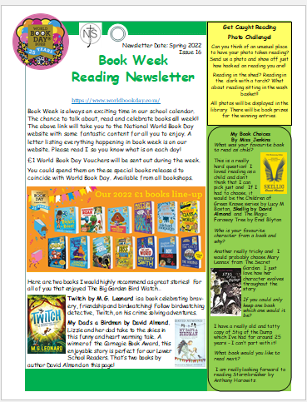
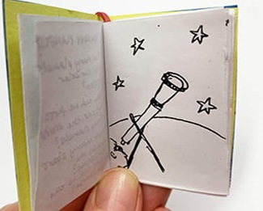
Story Time.
Make and write a miniature book!
Puzzles
Competitions
Can you find Wally? He has been hidden
By Mrs Breen somewhere in school!
Monday 27th February – Friday 3rd March
Family Book Quiz

