Slide 1
Guardians of Safety
Mental Health Awareness Week
15th – 21st May 2023

Slide 2
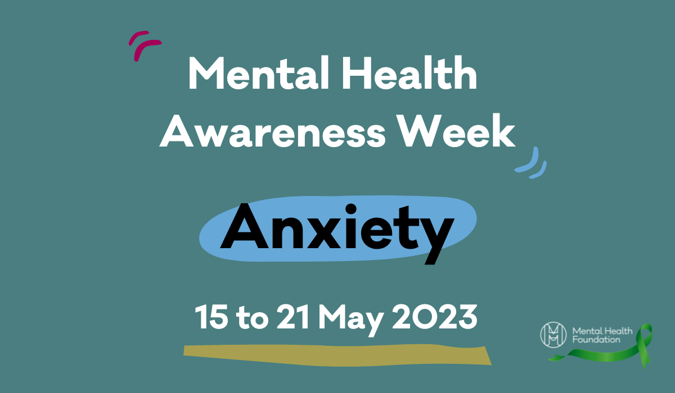
The theme of mental health week 2023 is ‘anxiety’ to help increase awareness and understanding of what ‘anxiety’ is. It is also a chance for us to think about things we can do to help us feel calmer and happier.

Slide 3
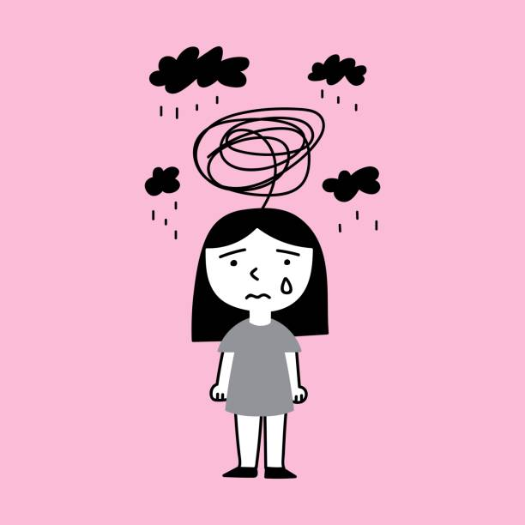
Having some anxiety – or worries – is totally normal! But sometimes our thoughts can get carried away and our worries get on top of us.
It happens to lots of people – adults included.

Slide 4
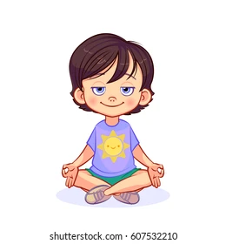
When our thoughts get too much it can start to impact our day to day lives. Some worries are normal such as: tests or starting a new school.
When something gets on top of us, we can do lots of things to help ease our feelings.

Slide 5
One way to feel less anxious is with kindness.

Slide 6
Kindness is a simple way to help everyone! When we are kind to each other, it helps us to feel connected, which means we can create new friendships or deepen existing ones.
Research has shown that when we’re kind or someone is kind to us, our bodies release ‘feel-good’ hormones which lift our mood.

Slide 7
Kindness isn’t just a ‘nice thing to do’, it can help us improve our own mental health and wellbeing whilst also helping others at the same time.
This week at NJS we are going to focus on kindness!

Slide 8
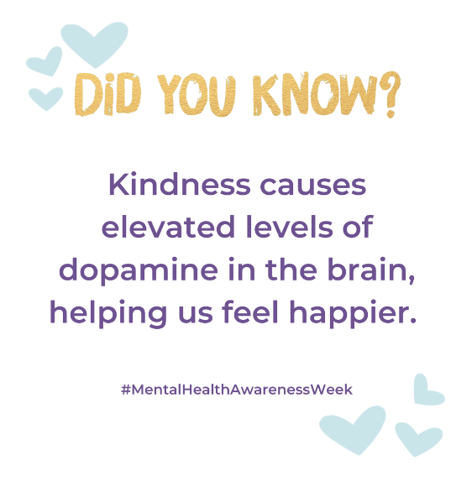

Slide 9
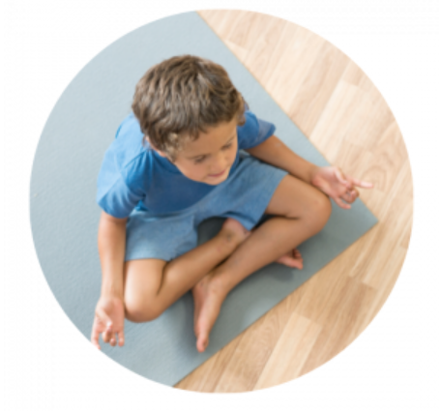
10 ways to be kinder to yourself!
Being kind is the best thing you can be. Sometimes we focus on doing things for others and forget to be kind to ourselves.
Just like cars need fuel to run, we need to fill ourselves with kindness in order to be the best we can be!
You could try…
Notes:
Getting a good night sleep
Meditation
Move your body and exercise
Think about what you are thankful for
Do something you love to do
Ask for help
Note down what you love about yourself
Believe in yourself
Use the power of yet ‘I cant do this… YET’
Practise speaking positively

Slide 10
This week at NJS…

Slide 11
WALK AND TALK
This week we are introducing a new concept at NJS…
WALK AND TALK.
Once a week, your teacher will pick a time (most likely after lunch) to go for a walk around the school field.
This is isn’t a time to run but a time to walk and talk. Spend the time wisely to talk to each other.
Notes:
You could talk about the following:
How your day is going?
What you did at the weekend?
Your favourite things to do?
Any worries you have?

Slide 12
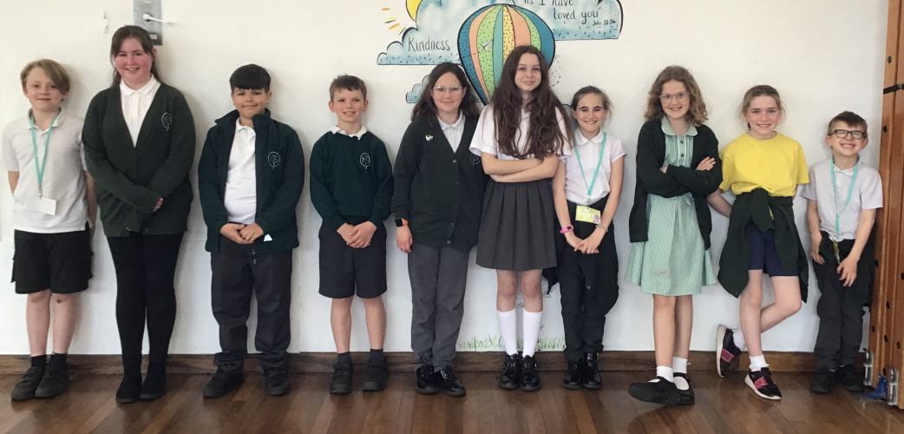
Health and Wellbeing Surgery!
On Wednesday we will be on the big yard with a special surgery. At our surgery we are able to help you with any worries you may have.
We will also have lots of ideas on how you can help your mental health.
Come and speak to us ☺

Slide 13
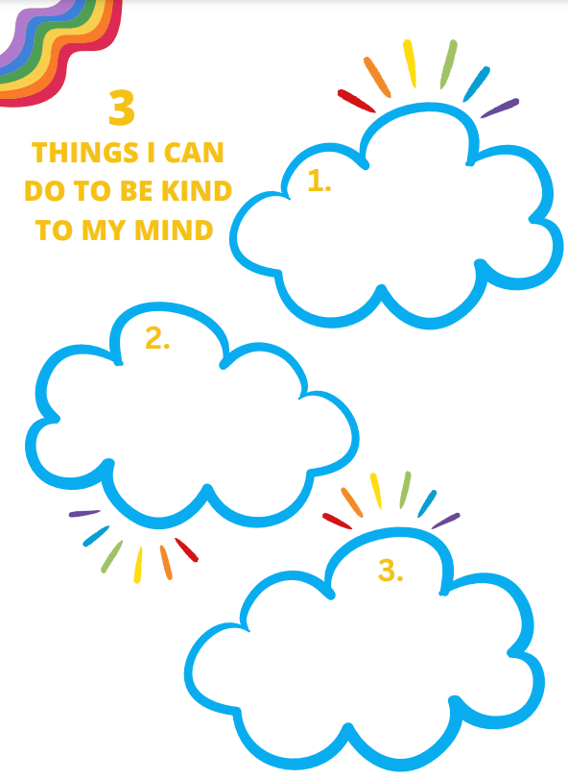
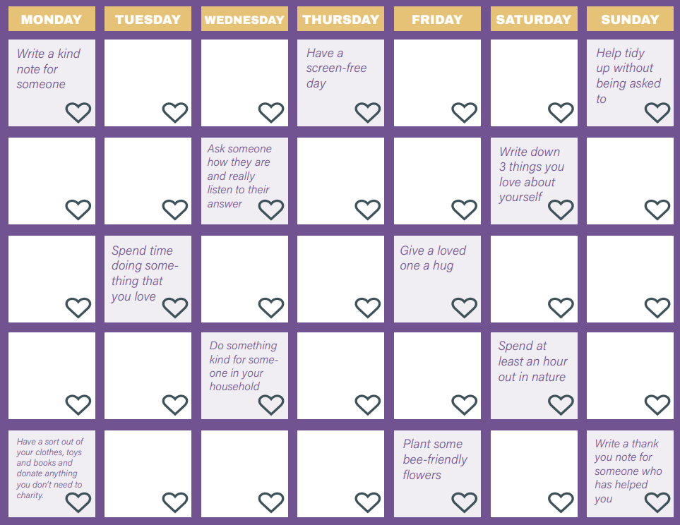
Classroom activities:
At some point this week, you will complete some activities in class about mental health week.

Slide 14
