Slide 1
ANTI-BULLYING WEEK 2023

Slide 2
Anti-Bullying Week 2023
Make A Noise About Bullying
Too often, we are silent when we see bullying take place, silent about the hurt bullying causes, and silent when we hear bullying dismissed as ‘just banter’.
Together, we can make a difference and take a stand against bullying.
From the playground to Parliament, and from our phones to our homes, let’s make a noise about bullying.
It doesn't have to be this way.
Of course, we won’t like everyone, and we don’t always agree, but we can choose respect and unity.
This Anti-Bullying Week let’s come together to have discussions about what bullying means to us, how banter can turn into something more hurtful, and what we can do to stop bullying.

Slide 3
https://youtu.be/VkU2xYJKQq4

Slide 4
What is bullying?
4

Slide 5
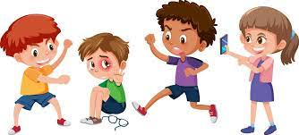
“
The repetitive, intentional hurting of one person or group by another person or group, where the relationship involves an imbalance of power. Bullying can be physical, verbal or psychological.
It can happen face to face or online.
“

Slide 6
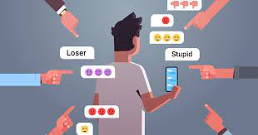
“
Cyberbullying
Cyberbullying is when someone is repetitively being mean to someone else on purpose but done online. This can be done through messaging apps , through the comments section on posts or through group chats
“

Slide 7
Difference between face-to-face bullying and cyberbullying:
In person you can usually tell by someone's facial expressions, whether they were being mean or meant what they said as a joke

Slide 8
What is Banter?
8

Slide 9
“
The playful and friendly exchange of teasing remarks.
“

Slide 10
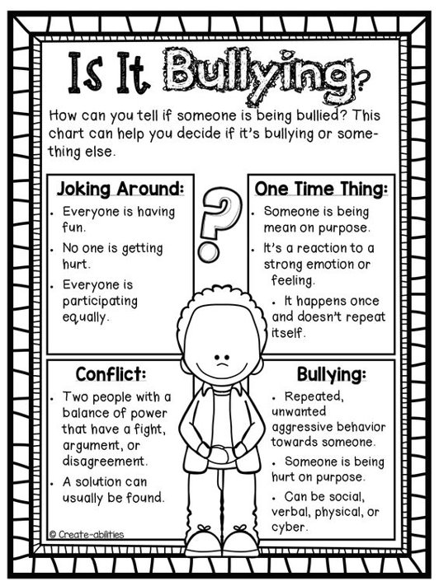

Slide 11
IT’S NOT BANTER IF…
You would be upset if someone said it to you
It's hurtful
You're not friends
Someone's asked you to stop
The target isn't laughing
It focuses on someone's insecurities

Slide 12
“
Who can you speak to here in school?
“

Slide 13
“
Any questions?
“

Slide 14
“
“
BULLYING ISN’T WELCOME HERE!

