Slide 1
Curriculum Subject: Music
Subject Leader: Eloise Ollerenshaw
Curriculum Overview and Statement of Intent, Implementation and Impact.
Intent This curriculum is designed to develop skills and knowledge in Music. It broadens the learning opportunities and experiences of our pupils and encourages them to reach their full potential. This curriculum is highly practical, creative and inclusive. It enables children to show courage in fulfilling their aspirations. | Implementation The breadth and depth of each of the four curriculum areas is mapped out to show the expected progression through the milestones (KS1, Lower KS2, Upper KS2). Lessons are planned with reference to the relevant threshold concepts and curriculum drivers. Threshold concepts will be repeated and revisited, applied to a variety of different musical situations when addressing the breadth of the curriculum, to develop greater depth of learning. | Impact Assessment for learning will be used throughout the teaching of this curriculum to ensure that progress in understanding is developed from basic, advancing to deep with reference to the threshold concepts in each subject area. Opportunities for the students to apply their knowledge and understanding to performance, composition and appraising activities will be provided throughout the year and successes celebrated and shared.

Slide 2
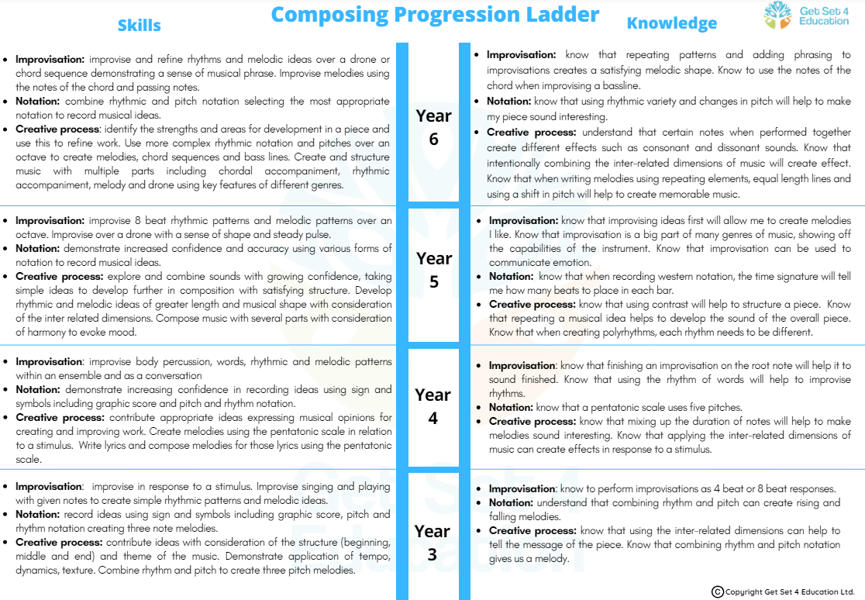

Slide 3
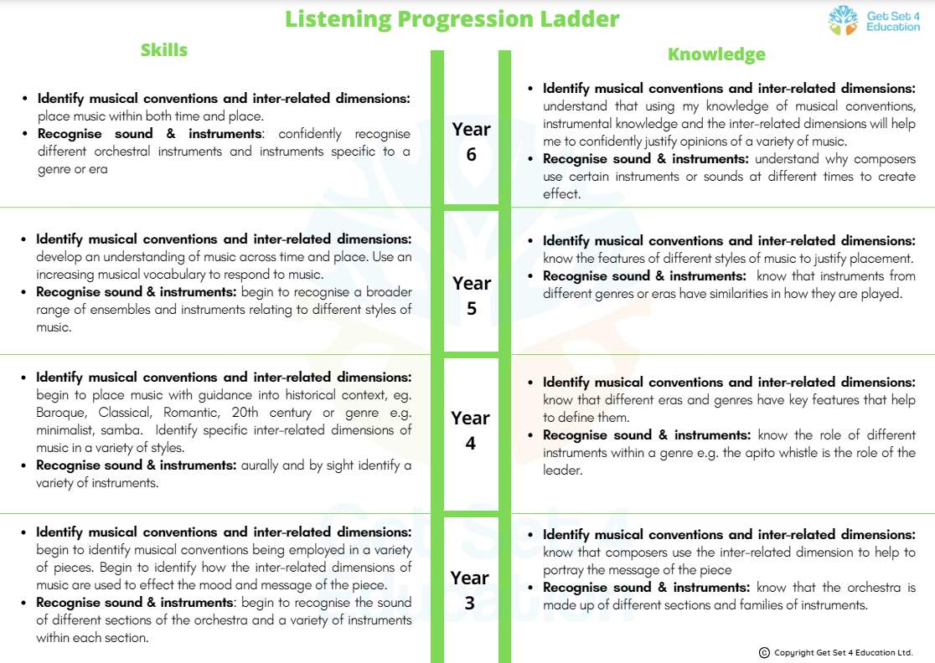

Slide 6
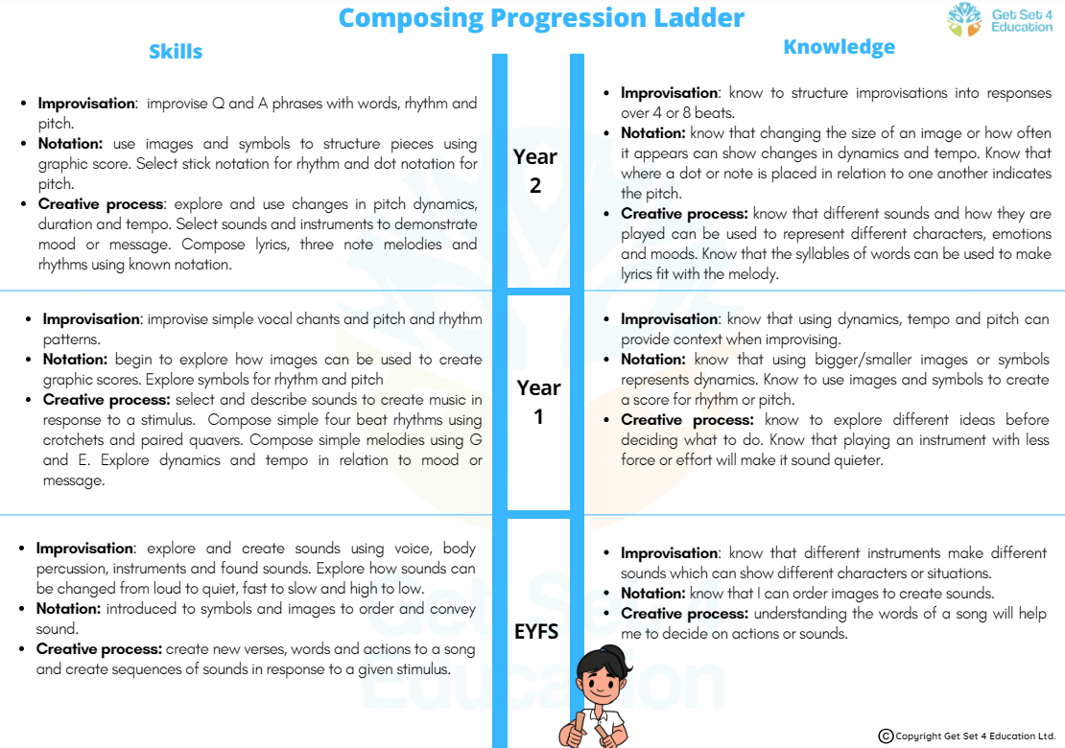
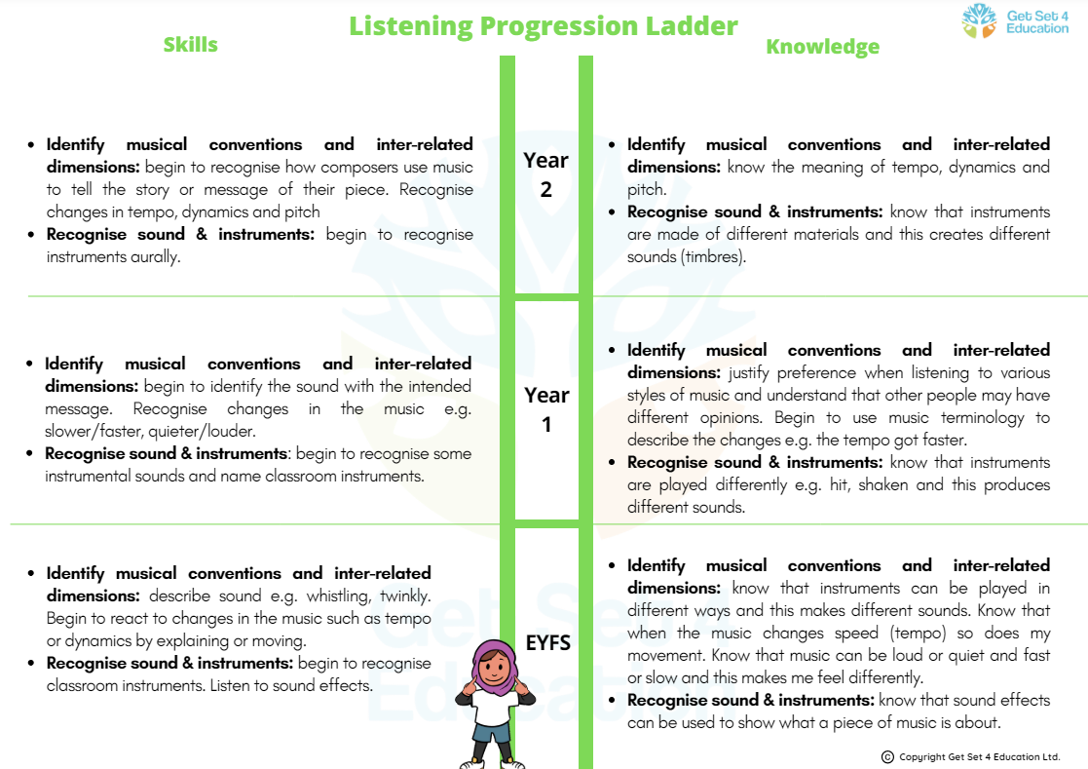
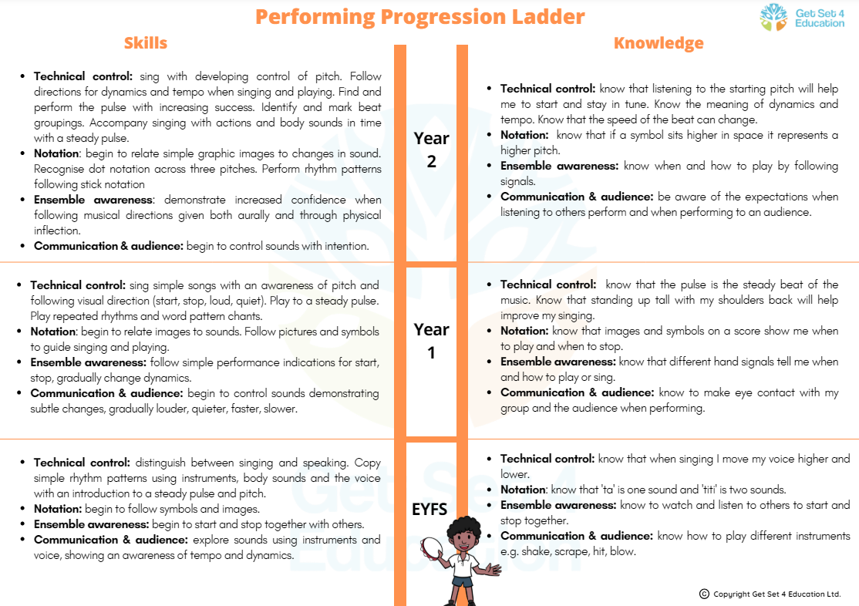
The progression ladders for EYFS and KS1 for the key skills:
Composing
Listening
Performing
Progression to KS3 – Taken from the National Curriculum.
Pupils should build on their previous knowledge and skills through performing, composing and listening. They should develop their vocal and/or instrumental fluency, accuracy and expressiveness, and understand musical structures, styles, genres and traditions, identifying the expressive use of musical dimensions.
Pupils should be taught to: Play and perform confidently in a range of solo and ensemble contexts. Improvise and compose. Use staff and other relevant notations appropriately and accurately in a range of musical styles, genres and traditions. Identify and use the interrelated dimensions of music expressively. Listen with increasing discrimination. Develop a deepening understand of the music they perform.
Notes:
KS1 and EYFS

