Slide 1
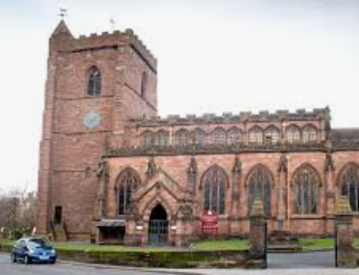
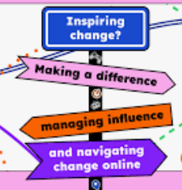
SMSC / Global Links
Safer Internet Day 11th Feb
Book week
World Book Day
Random Act of Kindness Day
Science Week
Shakespeare Week
Easter Service/Lunch
Senior Citizens Day
Mental Health Week
Valentines Lunch
Residential for Year 5
Class Assembly for 5K
English
Exploration narrative
Formal mission report
Setting narrative
Shakespeare unit on Macbeth
SPAG through out every unit.
Yr Group: 5
Term: Spring 2025
Art
“Mapping it Out”
Linked to History and Geography
To create a design for specific purposes and to create maps, charts and diagrams.
To understand how to use and develop imagination to create a detailed fantasy map and use methods to create maps that look old and traditional.
To know how to create a 3-D model of your local community.
“Graffiti Art”
Linked to Geography
To develop ideas and techniques for art work comprising stylised graffiti lettering.
To develop ideas for improving a public space with street art.
To express ideas through a satirical work of art designed for public spaces.
To develop techniques for creating street art using stencils.
To create street art using stencils.
PE
Swimming
Netball
Dodgeball
Dance
History
Children will be learning about local History.
“A Study of Newport”
The History of Newport
St. Nicholas’ Church
Newport’s Resources
The Canal
The Guildhall and
Butter-cross
The Great Fire of Newport.
For some of these lessons, children will be taken off the NJS site to visit key locations.
Guided Reading
Focussing upon key reading skills taken from VIPERS.
The Jamie Drake Equation.
Computing
Flat file databases
Programming
E-safety awareness.
Geography
Resources
Where does our power come from?
Where does our food come from?
Renewable energy
Music
Rock n Roll
The Planets
Beliefs & Values
Christianity
What would Jesus do?
Why do Christians call the day Jesus died “Good Friday?”
Mental Maths
TTRS
Test based skills
Maths
Area and Perimeter
Fractions, Decimals &Percentages.
Multiplication and division
D & T
Children to complete their DT day designing, building and evaluation a glider.
MFL- French
At the market
Clothes
Science
Earth, Space and Beyond; including a visit to the National Space Centre in Leicester where we will link Science with DT.
Properties of Change
Global Links
Interdependence
Diversity
Conflict resolution
PSHE
JIGSAW
Dreams and Goals!
Healthy Me!

